Slide 1

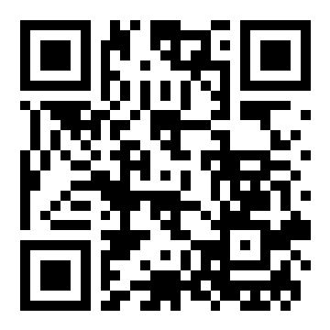
TEMPORAL VISUAL REUSE IN OPENVLA-OFT
A sequential negative study of caching across robot-control queries
RUTGERS
UNIVERSITY
Ved Dwivedi¹ | Cheng Yang² | Bo Yuan²
¹ John P. Stevens High School ² Department of Electrical and Computer Engineering, Rutgers University-New Brunswick
RESEARCH QUESTION
FIVE INCREASINGLY TARGETED TESTS
Can a frozen robot policy reuse visual computation across queries without losing task success?
Each redesign addressed the failure observed in the preceding stage.
SAVR
ACR
BRACE
PAIR
CAC
SHORT ANSWER
reuse both
cameras
keep wrist
current
reuse selected
K/V groups
predict reuse
risk
correct cached
actions
Not under the tested designs: savings and reliability did not coexist.
Test bed: OpenVLA-OFT on LIBERO | terminal task success + complete-query timing | frozen gates and independent semantic checks
RESULTS: COMPUTE SAVINGS APPEARED, BUT NO METHOD PASSED BOTH GATES
1 More reuse generally reduced success
2 Camera asymmetry preserved success - not speed
Terminal success (%)
SAVR1
SAVR2/3
ACR
100
98% reference
80
60
40
67/70 = 67/70
20
ACR success = batched full refresh
0
0
10
20
30
40
50
60
70
80
90
3 The final cache substrate failed closed-loop control
Online visual or scene reuse (%)
High-success safeguards worked only by suppressing reuse. The strongest SAVR redesign reached 69/70 success but reused just 0.95% of visual queries.
Dense: 68/120 successes | Cache: 0/120 | 22.60% gross timing headroom in systems qualification
CORE FINDING | Useful compute savings appeared, but no tested frozen-model method achieved both reliability and incremental speed.
WHY CLOSED-LOOP REUSE IS HARD
WHAT THE STUDY CONTRIBUTES
Recursive reuse combines internal states from different physical times. A changed action changes the next observation, so offline replay misses the feedback loop.
1
Optimize the fresh baseline first
Batching erased ACR's apparent speedup.
CURRENT
IMAGES
MIXED-AGE
K/V STATE
ACTION
DEVIATION
NEW ROBOT
STATE
NEXT CACHE
DECISION
2
Check model semantics independently
Shared helper code hid a one-token action-readout error.
feedback compounds across control queries
3
Test closed loop early
Offline similarity and risk signals did not guarantee control.
4
Next direction
Preserve current task-critical information or train the model under reuse.
SCOPE | One OpenVLA-OFT checkpoint, one simulator benchmark family, one GPU class. Cross-stage comparisons are descriptive, not randomized head-to-head estimates.
CODE + ARTIFACTS
github.com/vwdr/SAVR
Key references: OpenVLA (CoRL 2024); OpenVLA-OFT (RSS 2025); VLA-Cache (NeurIPS 2025); LIBERO (NeurIPS 2023).
Notes:
[Sources]
- Project results and wording: /Users/veddwivedi/Documents/VLA/SAVR/output/pdf/Temporal_Visual_Reuse_in_OpenVLA_OFT_A_Sequential_Negative_Study.pdf
- MIT URTC poster guidance: https://urtc.mit.edu/poster_presentation_2024.pdf
- Rutgers visual identity: https://communications.rutgers.edu/services-resources/logos-signatures-and-visual-identity
- Rutgers logo image: https://communications.rutgers.edu/sites/default/files/lg_rutgers_signature_samples2.png
- Repository QR target: https://github.com/vwdr/SAVR
[/Sources]

