Slide 1
APRIL 16, 2026
Before We Reproduce AI-Assisted Science, We Need to Make It Reproducible
6th Chameleon User Meeting | Applying AI to Accelerate Computational R&R
Victor Weeks
Software Engineer, NSF NCAR | 2026 BSSw Fellow
This material is based upon work supported by the NSF National Center for Atmospheric Research, a major facility sponsored by the U.S. National Science Foundation and managed by the University Corporation for Atmospheric Research. This work is also supported by the Better Scientific Software Fellowship Program, funded by the U.S. Department of Energy and National Science Foundation.
Notes:
TALKING POINTS (~1 min):
- Introduce yourself: Victor Weeks, software engineer at NCAR, 2026 BSSw Fellow.
- Frame the talk: We've been discussing how AI can help with computational reproducibility. I want to raise a complementary question — what happens when AI is building the computational artifacts we're trying to reproduce?
- Transition: Let me set the stage.

Slide 2
AI to Reproduce Computational Artifacts
Reconstruct software environments
Resolve dependency conflicts
Navigate platform-specific quirks
Automate artifact evaluation
AI to Build Computational Artifacts
Write scientific software
Configure computational experiments
Make architectural decisions
Generate analysis pipelines
 | Two Sides of the Same Coin
Notes:
TALKING POINTS (~1.5 min):
- This symposium is exploring the left side — how can AI help us reproduce computational artifacts? That's a great direction.
- But there's a parallel trend: AI is increasingly being used on the build side too.
- These are two sides of the same coin. If we don't get the build side right, we're producing artifacts that are harder to describe, evaluate, and reproduce — making the AD/AE process even more challenging.
- Transition: What does 'not getting it right' look like?

Slide 3
"Vibe Coding"
Conversational AI assists with code generation and refactoring
MCP & Tools
Agents access external tools, APIs, and platform infrastructure
Autonomous Agents
AI makes multi-step decisions, configures systems, and executes workflows
 | The AI-Assisted Development Spectrum
Notes:
TALKING POINTS (~1 min):
- Quick tour of where AI-assisted dev is today.
- 'Vibe coding' — conversational, developer in the loop.
- MCP and tool use — agents interacting with external systems. Chameleon already has an MCP server — a great example of this pattern.
- Autonomous agents — multi-step decisions with less human oversight.
- Each step increases potential for undetected errors in artifacts.
- Transition: What kinds of errors?

Slide 4
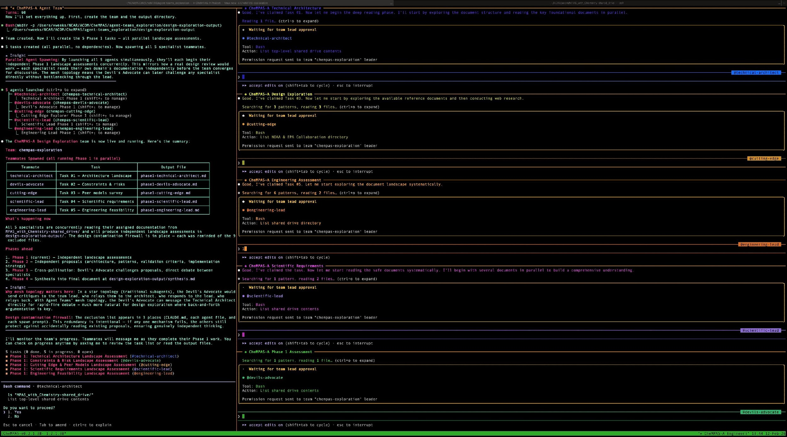
Failure modes distinct from standard software bugs:
Numerical Precision Errors
AI agents may introduce floating-point assumptions that silently degrade accuracy in physical simulations
Subtle Physics Violations
Generated code can violate conservation laws or domain constraints not captured by standard test suites
Opaque Decision Histories
When an agent makes architectural choices, the rationale may not be recorded — making the artifact harder to describe and evaluate
 | When AI Builds Scientific Software
Notes:
TALKING POINTS (~1.5 min):
- These aren't hypothetical — they're things I've encountered at NCAR.
- Precision: float32 vs float64, rounding that accumulates over simulations.
- Physics: code that doesn't conserve mass/energy/momentum and passes tests.
- Opaque decisions: commit history and PR reviews capture 'why' for human code; agent decisions can evaporate.
- Key: These pass CI/CD but corrupt the science — and complicate artifact evaluation.
- Transition: What do we do about it?

Slide 5
Validation Loops
Domain-specific checks integrated into agent workflows — not just at the end, but at each decision point
Human Oversight
Defined points where humans review agent decisions, especially for choices with scientific implications
Standardized Tooling
Reusable MCP server templates, scientific skills, and agent configurations that encode domain knowledge
 | Scientific Agentic Engineering (SAE)
Notes:
TALKING POINTS (~1.5 min):
- My BSSw Fellowship is developing a methodology I'm calling Scientific Agentic Engineering, or SAE.
- Three pillars: validation loops, human oversight, standardized tooling.
- SAE is tool-agnostic — about principles, not any specific AI product.
- Fellowship just started — framework design phase. Deliverables over the next 12 months.
- Transition: Why does this matter for this audience?

Slide 6
If AI agents build computational artifacts without guardrails, those artifacts become harder to describe in an Artifact Description and harder to validate in an Artifact Evaluation.
On the reproduce side, AI agents reconstructing environments and running evaluations also need the same kinds of guardrails — validation that the reconstructed environment actually matches, domain-aware checks on whether the reproduction is scientifically valid.
The same structural patterns that SAE defines — validation loops, domain-specific safeguards, and standardized tooling — serve both sides of this coin.
Build-time discipline is upstream of reproduce-time reliability.
 | Why Build-Time Discipline Matters for R&R
Notes:
TALKING POINTS (~1 min):
- Connection to today's discussions.
- Undisciplined build-side produces artifacts harder for AD/AE.
- Reproduce-side AI agents also need guardrails.
- Same structural patterns serve both sides.
- Build-time discipline is upstream of reproduce-time reliability.
- Transition: Closing.

Slide 7

Follow the Project
Scientific Agentic Engineering (SAE)
Framework & methodology
Community repository of scientific MCP templates
Reference workflow & tutorials
Workshops
All coming over the next 12 months.
vweeks.github.io/scientific-agentic-engineering
Notes:
TALKING POINTS (~30 sec):
- Fellowship just kicked off. All deliverables coming over the next 12 months.
- If interested — especially from R&R/AE perspective — project site will have resources.
- Interested in feedback on what guardrails would be most valuable for AD/AE.
- Thank you. Happy to take questions.

