Slide 1
The Reddit Trade
An analysis of social media’s impact on stock performance
Weirong Tian, Yuttakarn Limleartvate, Siegfried Vieluf, Victor Weinblatt

Slide 2
How has wallstreetbets impacted stock movements?
Fundamental setup: weak metrics for GME, a brick and mortar video game company during a global pandemic
Technical setup: hedge funds had accumulated a very large short position
Sentiment analysis: daily movements in stock prices impacted by WSB posts
Returns, Betas, and Sharpes
Who’s next?: Monte Carlo simulation of current hot WSB stocks

Slide 3
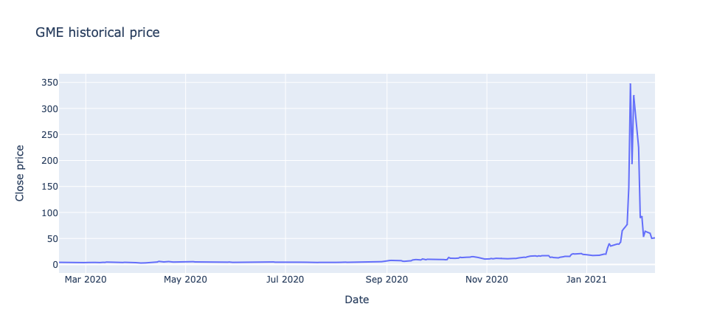
What’s going on with GameStop (GME)?
Source: Google Finance Data from 2/13/20 to 2/11/21

Slide 4
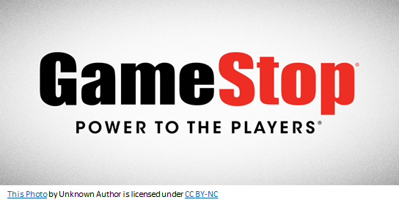
Fundamental Setup
Introduction
•GameStop sells video games, consumer electronics, and merchandise related to video games in the United States, Canada, & Europe
•5,000+ stores world wide
•Negative profits since 2017
•E-commerce sales reached 1.35b in 2020 ahead of expectations
•Vendor partnership with Microsoft
•Immersion to esports GameStop Performance Center
Sources: GameStop, Seeking Alpha, Bloomberg

Slide 5
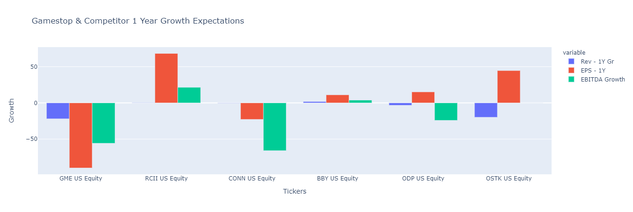
Source: Bloomberg

Slide 6
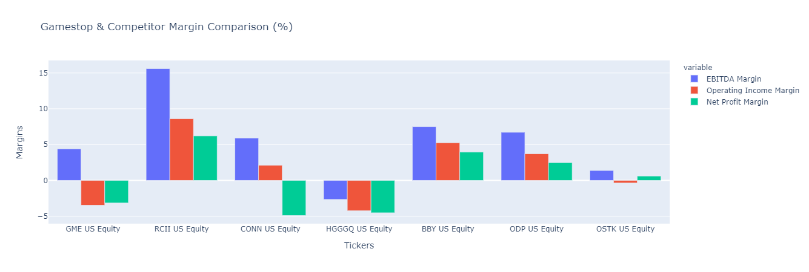
Source: Bloomberg

Slide 7
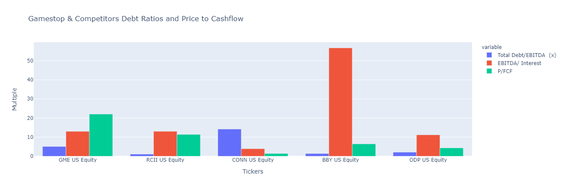
Source: Bloomberg

Slide 8
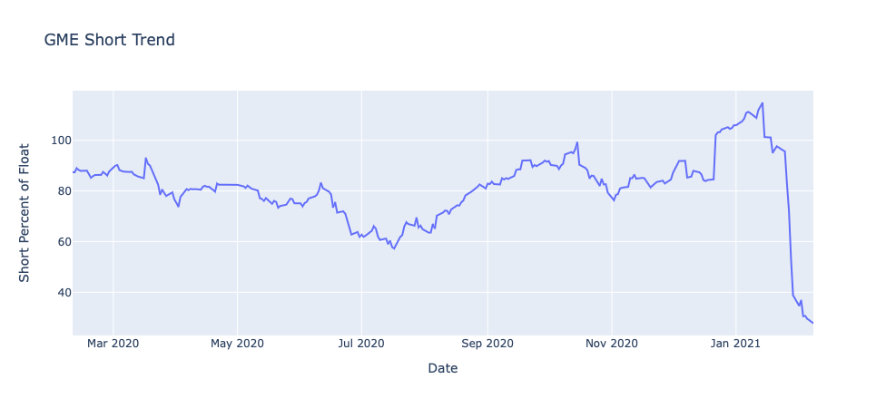
Technical Setup: large hedge fund short
Source: Bloomberg

Slide 9
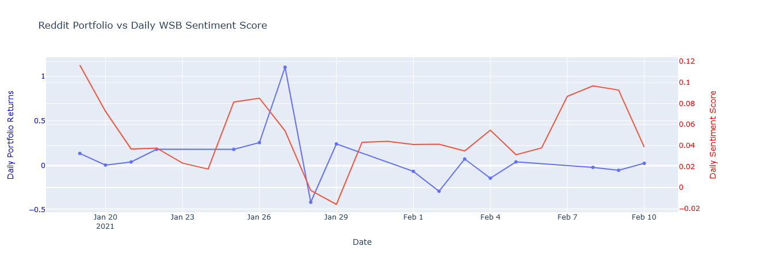
Sentiment Analysis
Sources: Reddit, Kaggle, Google Finance Python package: nltk Data from 1/15/21 to 2/10/21

Slide 10
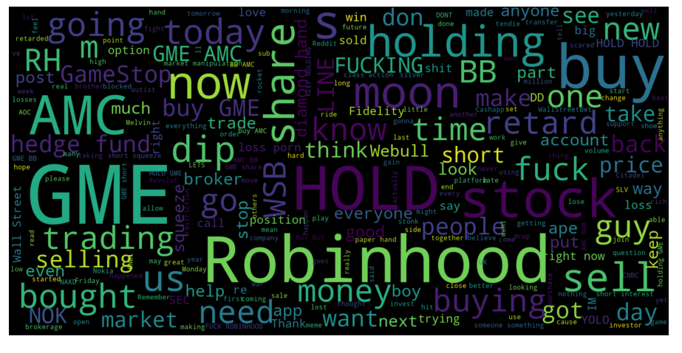
Analyzing Reddit’s wallstreetbets forum
Sources: Reddit, Kaggle Python packages: wordcloud, praw Data from 1/15/21 to 2/10/21

Slide 11
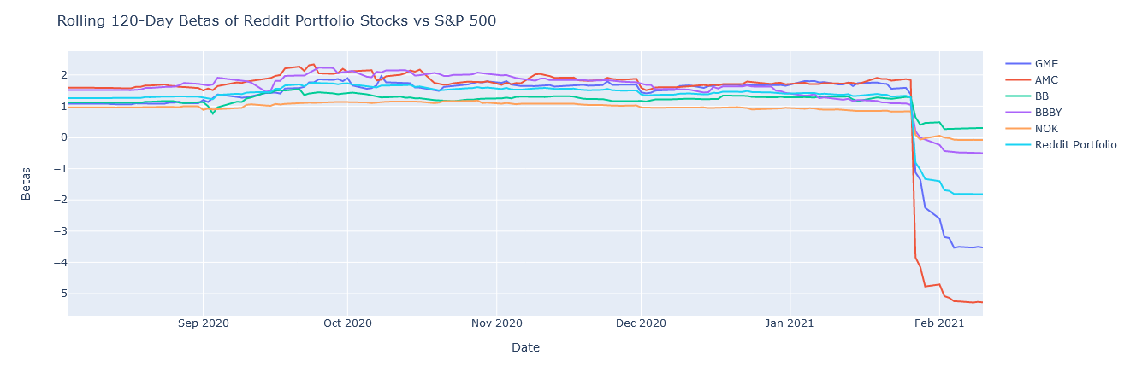
Source: Google Finance Data from 2/13/20 to 2/10/21

Slide 12
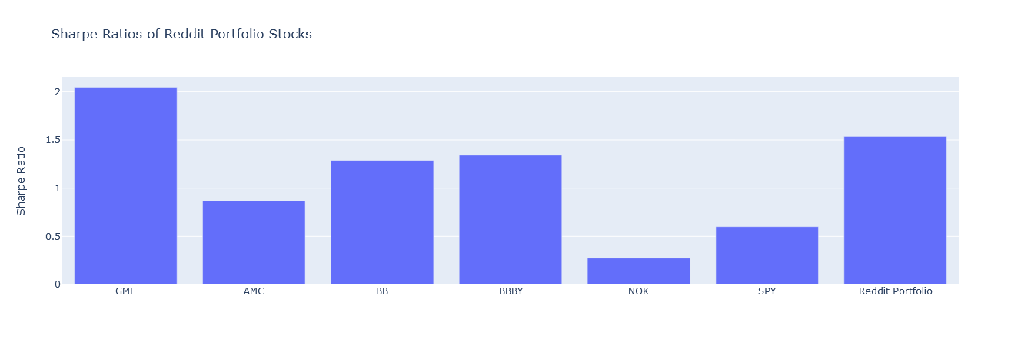
Source: Google Finance Data from 2/13/20 to 2/10/21

Slide 13
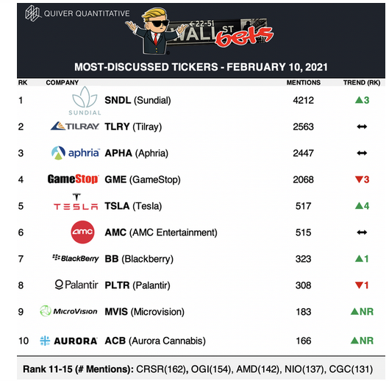
Who’s next??
Sources: Reddit, Quiver Quantitative

Slide 14
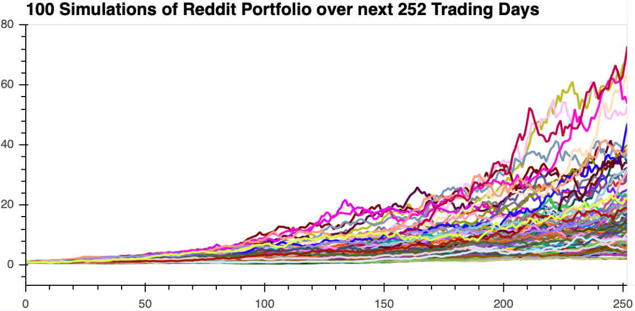
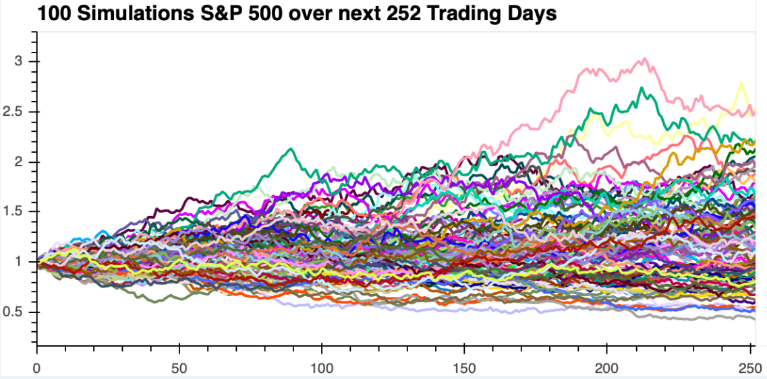
Monte Carlo Simulation
Source: Google Finance Python package: MCForecastTools Data from 2/13/20 to 2/11/21

Slide 15
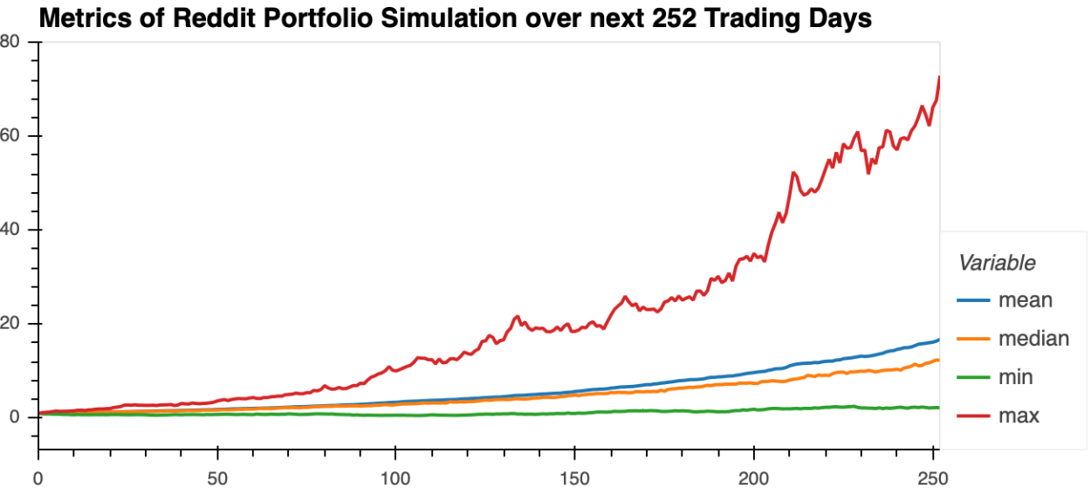
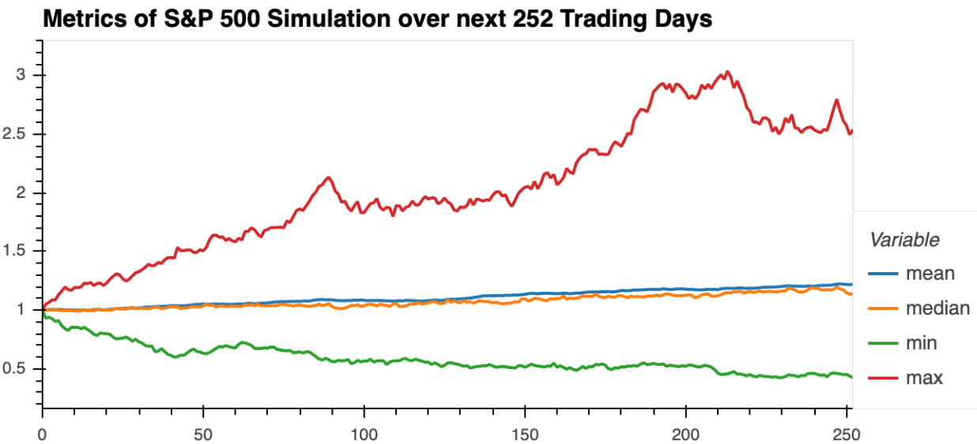
Monte Carlo Simulation
Source: Google Finance Python package: MCForecastTools Data from 2/13/20 to 2/11/21

Slide 16
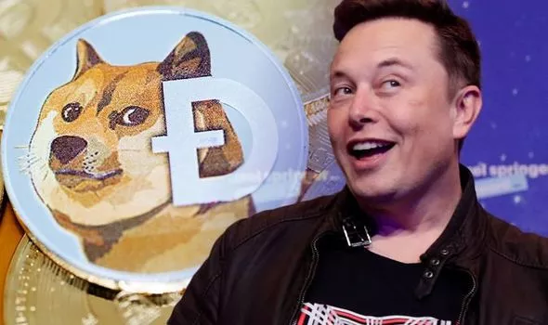
Next steps: Dogecoin to the moon!
Source: Getty

Slide 17
Q&A
Thank you!

