Slide 1
The Reddit Trade Visited
Backtesting a technical, macro, and sentiment based trading strategy on social media stocks
Weirong Tian, Yuttakarn Limleartvate, Katrina Tolentino, Victor Weinblatt

Slide 2
Trading WSB stocks using technical and macro indicators, and sentiment analysis
1. Technical indicators: William’s R%, RSI, on-balance volume, beta, and AR(1)
2. Macro indicators: 2s10s yield curve, VIX index, USDJPY
3. Sentiment analysis: NLTK Vader and custom RNN LSTM
4. GradientBoosting regression to forecast next minute returns
5. Trade sizing based on historical returns and standard deviation
6. Risk parity portfolio that weighs our trading strategy across stocks inversely proportional to risk

Slide 3
Data
Minute data from 1/28/21 to 3/31/21
Training set: 1/28/21 to 3/11/21
Test set: 3/12/21 to 3/31/21
Stocks: AMC, BB, BBBY, GME, NOK
Sources: Bloomberg, Kaggle, Reddit, Twitter

Slide 4
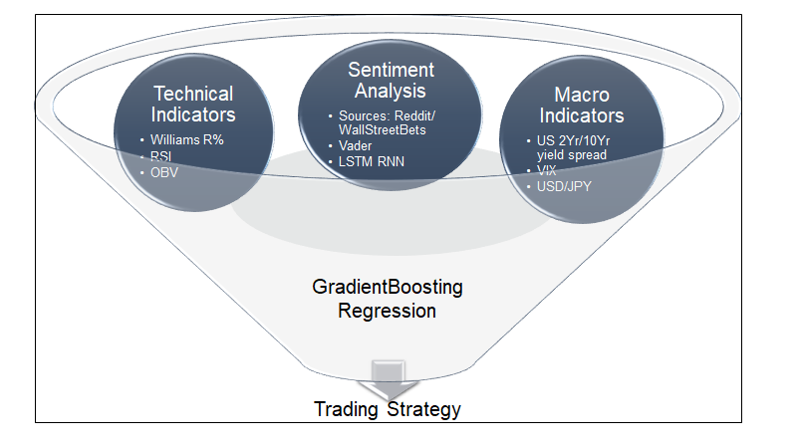

Slide 5

Technical Indicators
William %R: momentum indicator that moves between 0 and -100 and measure overbought and oversold levels.
Williams %R(n)i= ((closePricei-1 - highn)/( highn - lown ))×100
Relative Strength Index (RSI): momentum indicator that moves between 0 and 100 and measure overbought and oversold levels.
RSI(n)i=100 - 100×( 1/(1-RS(n)i)
RS(n)i indicates a ratio between the average of past n periods where the price increased and the average of n periods where the price decreased
On-Balance Value: momentum indicator that uses volume flow to predict changes in stock prices

Slide 6
Macro Indicators
US 2 year/10 year yield spread: general tendency to signal the market’s expectation of an upcoming recession or general downturn in growth
VIX: a measure of the stock market’s expectation of volatility based on S&P 500 index options
USD/JYP exchange rate: Japanese Yen is considered a safe currency

Slide 7
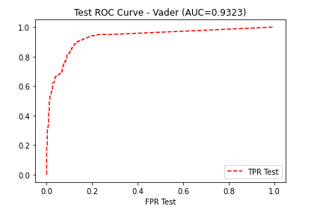
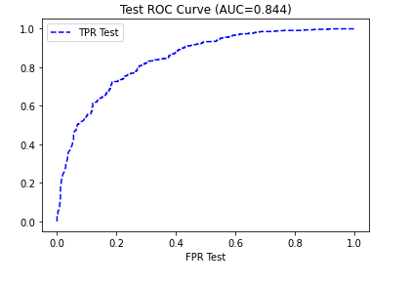
Sentiment Analysis
RNN LSTM trained on 4200 labeled tweets (same data used to build Vader)
Both models then classified WSB posts as positive or negative, grouped and averaged by minute
Vader Accuracy: 93.71% RNN LSTM Accuracy: 77.81%

Slide 8
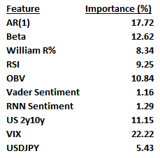
GradientBoosting Regression
n_estimators = 1000
learning_rate = 0.75
max_depth = 5
RandomSearch used for hyperparameter tuning
Other models tested: AdaBoost, Lasso regression, Ridge regression

Slide 9
Trading Strategy
Take long/shorts based on model’s prediction of next minute’s return
Trade weighting formula:
(( Predicted next minute return - average minute return ) / std dev of returns) * 2.0
Strategy employs margin on strong signal strength

Slide 10
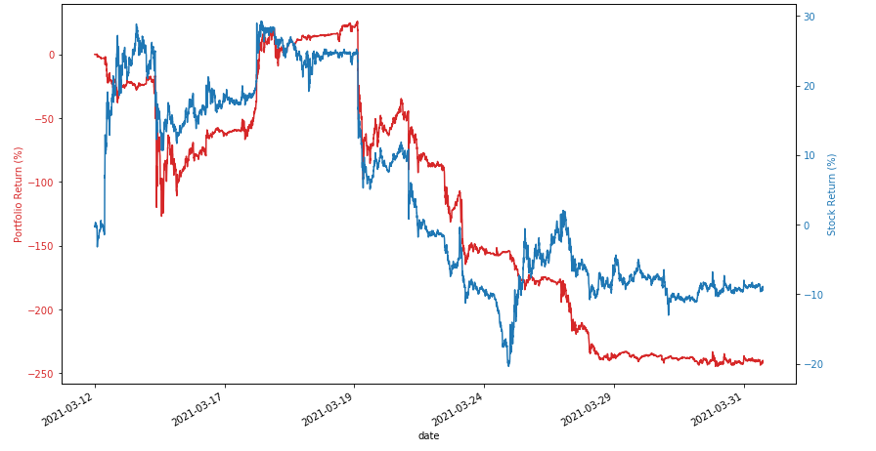
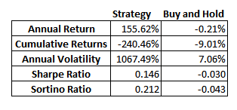
AMC

Slide 11
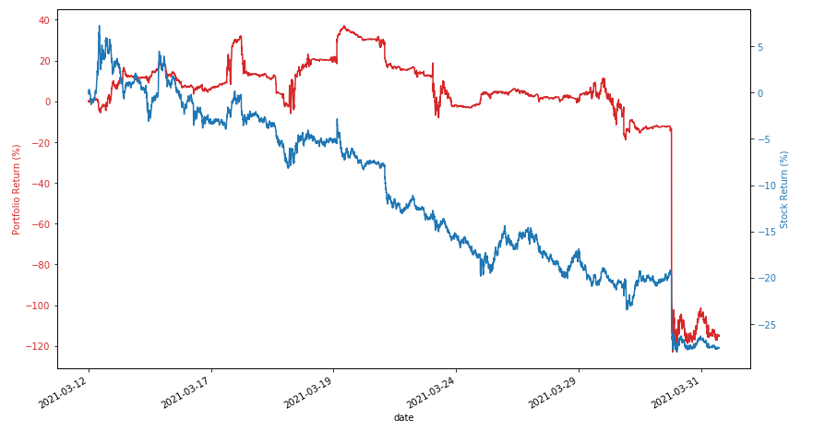
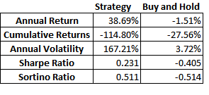
BB

Slide 12
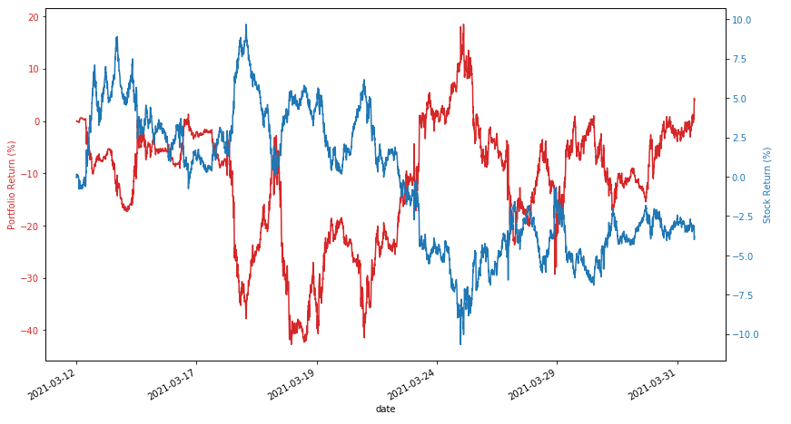
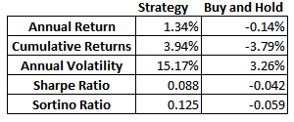
BBBY

Slide 13
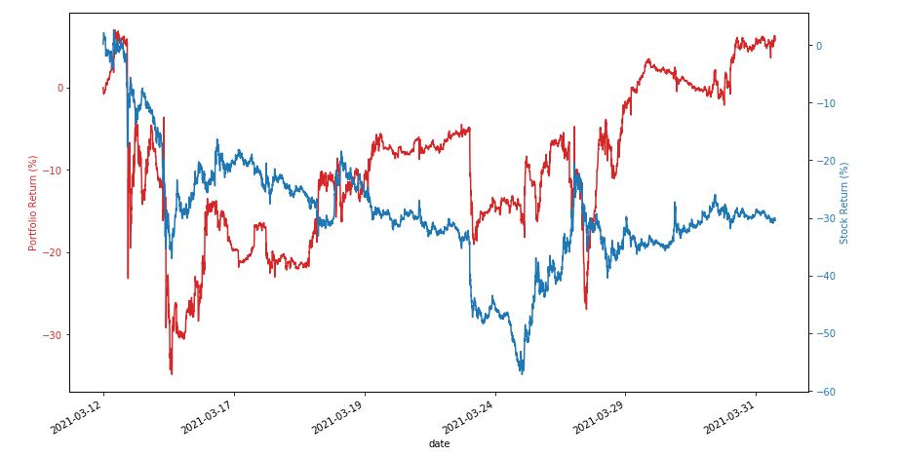
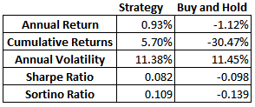
GME

Slide 14
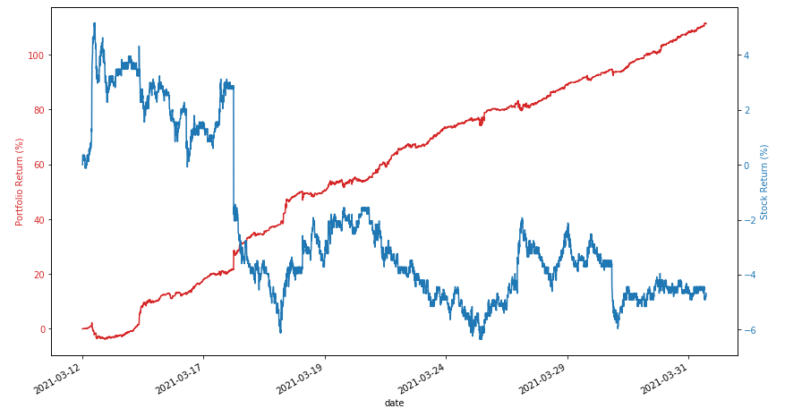
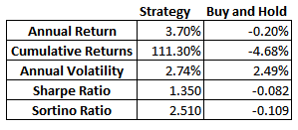
NOK

Slide 15
Caveats
No trading costs, taxes, fees on leverage, slippage
Significant portfolio turnover
Trading halts and overnight news

Slide 16
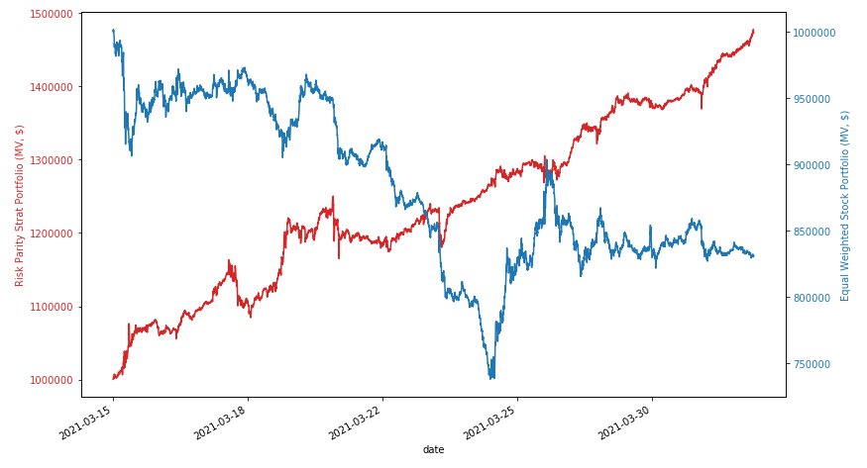
Risk Parity Strat Portfolio vs Equal Weighted Long Only

Slide 17
Q&A
Thank you!

