Slide 1
#Yolo Advisors, Inc
Your robo-advisor to avoid #FOMO
Weirong Tian, Katrina Tolentino, Hyuntae Kim, Vasili Nashvilli, Victor Weinblatt

Slide 2
Data
Daily price data from 8/1/2017 to 5/20/2021
10 of Reddit WSB most popular stocks
7 of the most liquid and popular cryptocurrencies
Sources: Yahoo! Finance, coinmarketcap.com
Python packages: PyPortfolioOpt, Streamlit

Slide 3
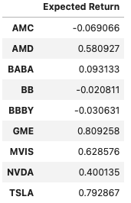
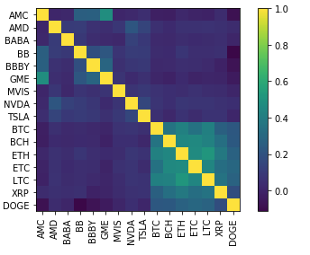
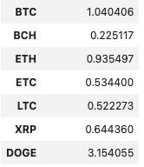
Markowitz Mean-Variance
A portfolio optimization model
Assumption: Investors make rational decisions
Two main components: Variance (ie, risk) and Expected Return Covariance Heat Map

Slide 4
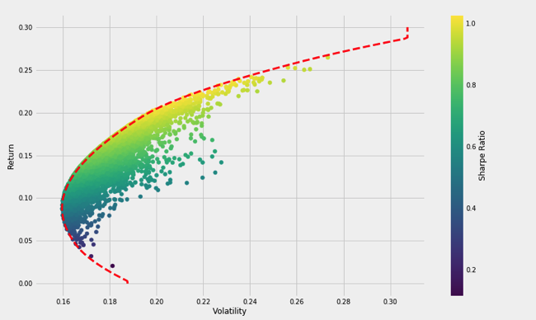
Efficient Frontier
The set of portfolios which satisfy the condition that no other portfolio exists with a higher expected return with the same risk.

Slide 5
Black-Litterman with Views
Assumes the market is efficient and at equilibrium (ie, supply = demand)
Should hold assets in proportion to market cap - this informs our ‘priors’
Incorporate investors ‘views’ (relative and absolute), and confidence levels, on different assets to produce ‘posterior’ expected returns
Bayesian weighting of priors and views (with confidence), taking into account covariances between assets, to arrive at posteriors
Input posterior estimates of returns and covariances into mean-variance optimizer to produce efficient frontier

Slide 6

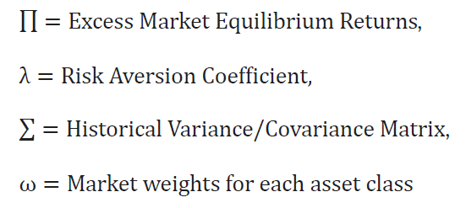
Black-Litterman - Reverse Optimization

Slide 7

Streamlit
Easy to use
Interactive
Allows deployment via Streamlit sharing platform
Supports backend and frontend development
Other dashboard packages considered: Viola, Panels, Dash

Slide 8
Demo
https://share.streamlit.io/vweinblatt123/cf-project3/main/Victor/main.py

