Slide 1
Void Bubble
CS 526
Software Design Project
Victor Reynolds

Slide 2
Overview
A 2D top-down shoot-em-up, similar to the highly popular twin stick shooter games “Geometry Wars” and “Shred Nebula.”
Controls with mouse and keyboard instead of game controller.
Uses the LWJGL library – The Lightweight Java Games Library. The same framework used by Minecraft.

Slide 3
Requirement Analysis
Use OpenGL to display text, load and display images with alpha channels, and primitive geometry. (Lines, triangles)
Has sound and music.
Move around large groups of objects, does collision detection between them and allows them to go about their own business.
Saves persistant data to the hard drive, where it can be loaded upon the next session.
Has a menu.

Slide 4
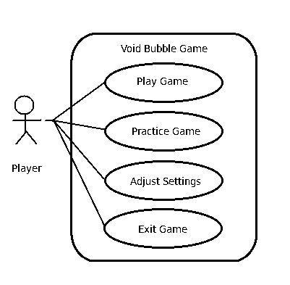
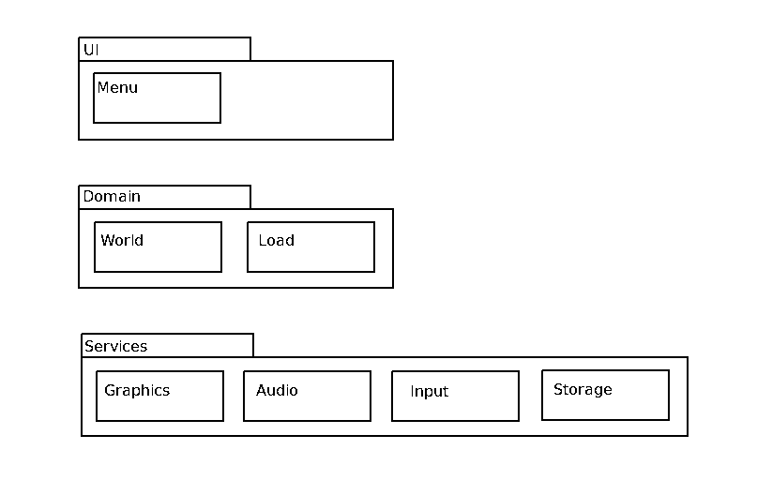
Design (Initial)

Slide 5
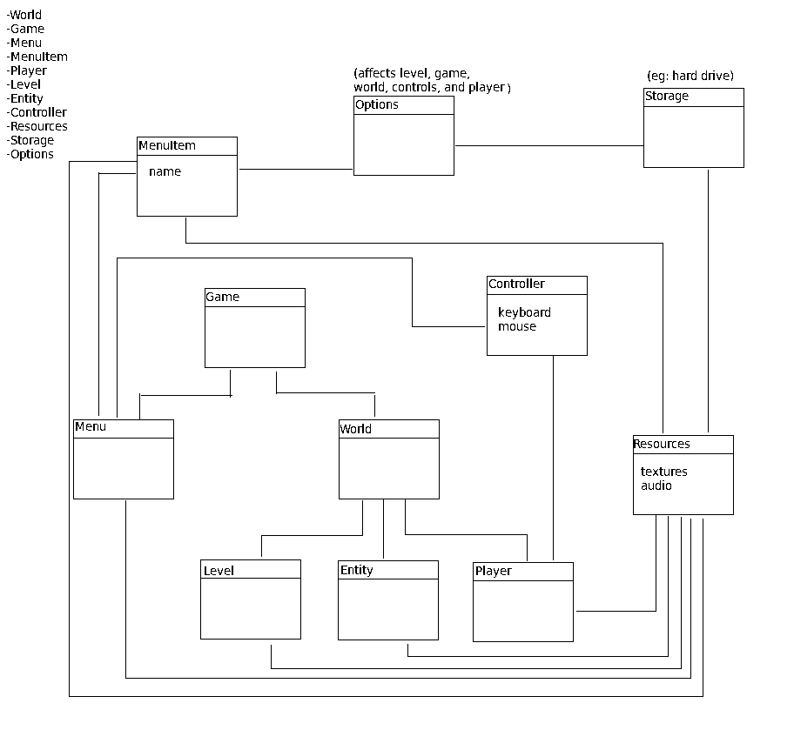
Figuring out Dependencies

Slide 6
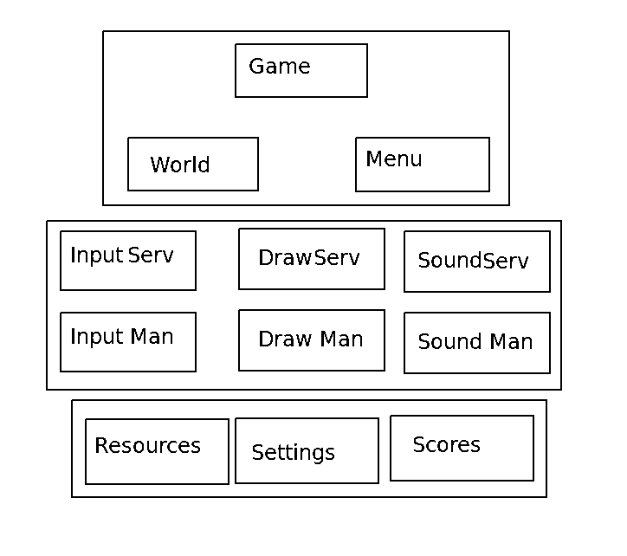
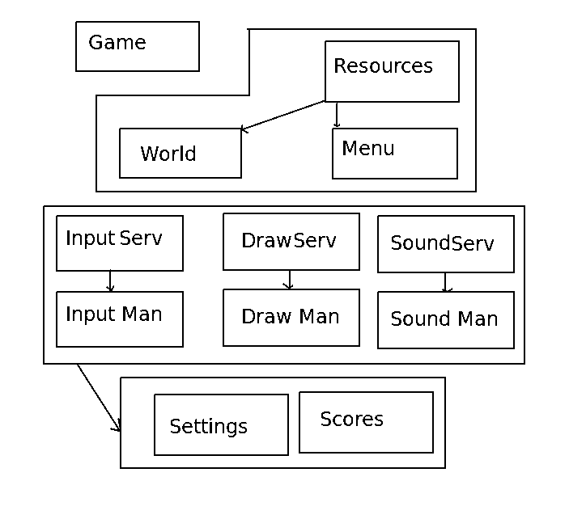
Managers

