Slide 1
Python for Beginners: Data Analysis and Visualization
Vincent Lum (vincentlum@cuhk.edu.hk)
Library

Slide 2
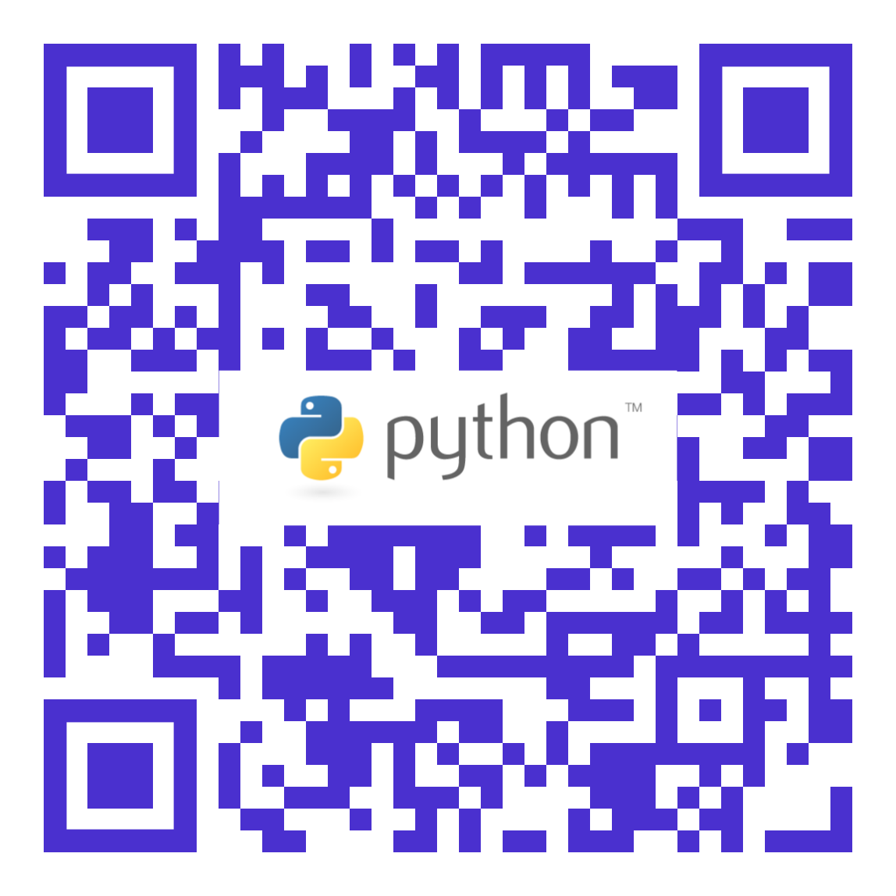
Working files
Github page:
https://github.com/vwylum/python-training

Slide 3

What we cover
Rough idea what Python can perform
Data Manipulation and Management
Concept of Data Visualisation and Analysis
Fundamentals of Python
Notes:
Manage expectation

Slide 4
Strength in Python
Code readability
Highly extensible programming language
Many pieces of functionality can be added
But the core language still remains small
Notes:
Extensible by 3rd party
Remain simple

Slide 5
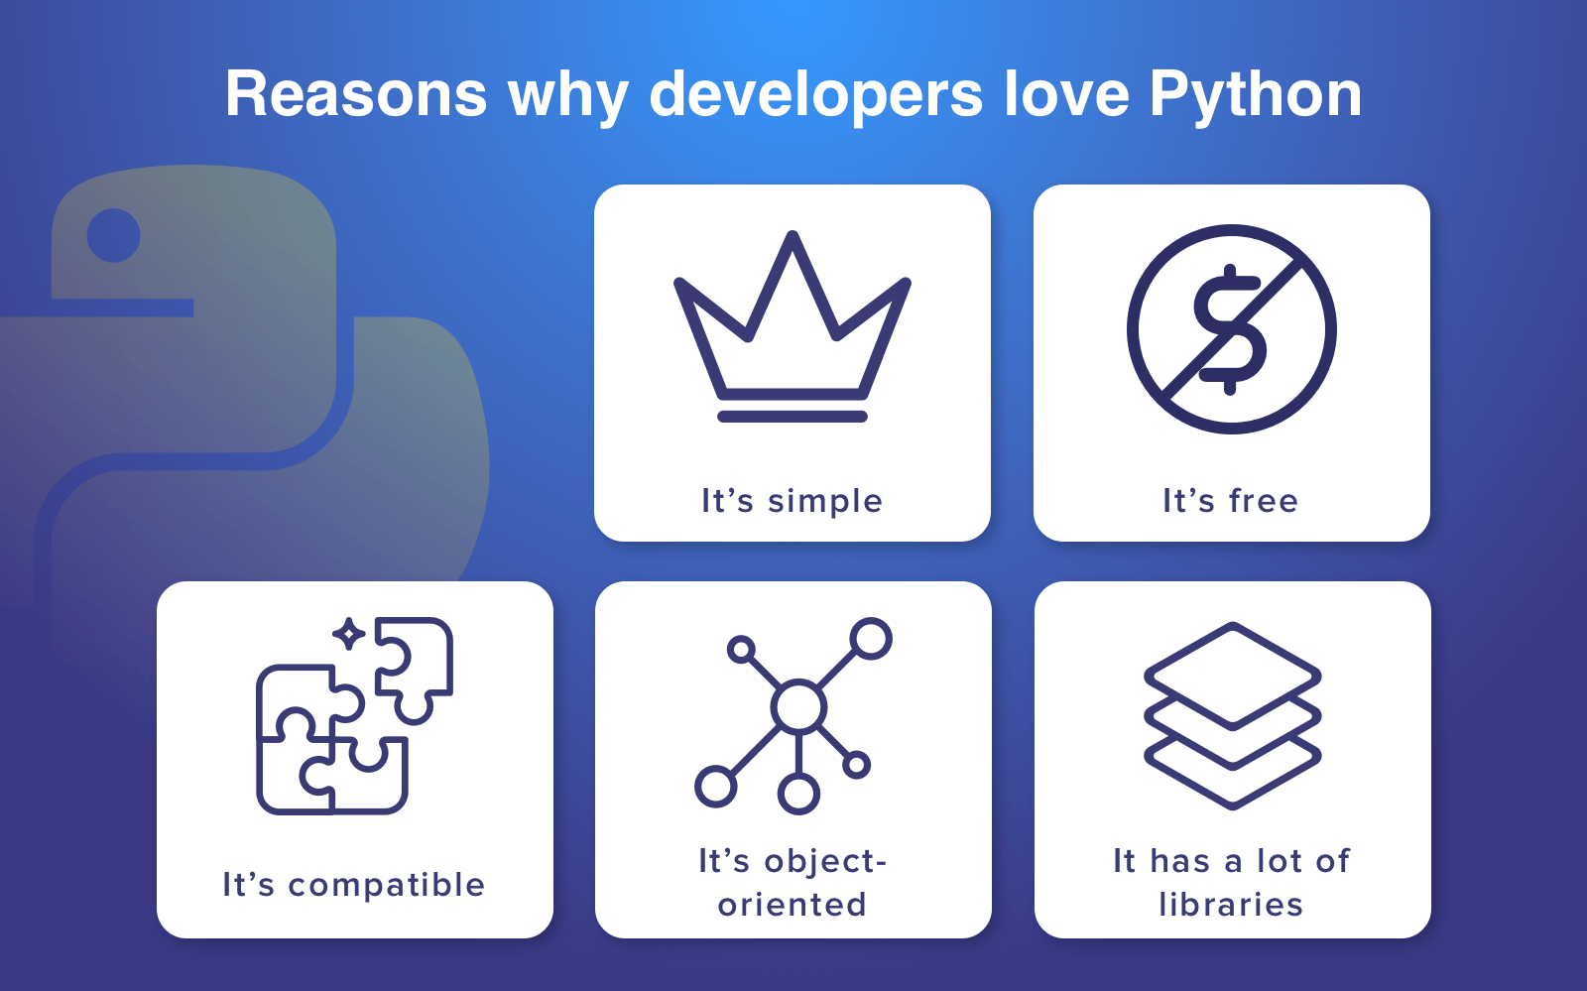
Why Python
https://medium.com/codesharp/what-makes-python-different-getting-started-with-python-techblog-c340f4458ef0

Slide 6
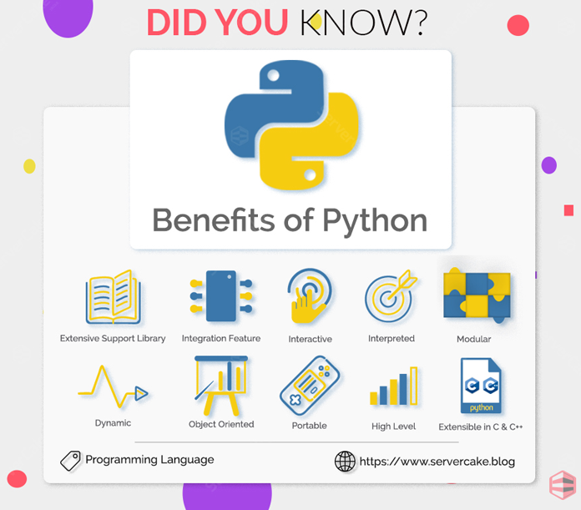
Benefits of Python
https://www.servercake.blog/advantages-benefits-python/

Slide 7

Python can do:
https://www.techapple.com/archives/25806
https://www.techapple.com/archives/27499
Notes:
TensorFlow example
Matplotlib
scikit-learn
Django
pandas

Slide 8
Python version
Python 3.7.2, released on 2018-12-24.
https://www.python.org/downloads/

Slide 9

Data Visualization
“The representation and presentation of data to facilitate understanding” (Andy Kirk, 2016)
To facilitate understanding of the data
Classification
Comparison
Summarize and Overview
Understanding evolution over time and space
Statistical analysis
Realizing patterns in the data
Convey messages via visualization
Notes:
Go throght these with examples in matlibplot

Slide 10
Data Visualization Process
Extract
Acquire
Transform
Parse
Analyze
Mine
Visualize
Represent
Filter
Refine
Interact
Refine
Refine
4 major phases of Data Visualization Cycle
Extract
Acquire data from different data sources
Transform
Parse, Filter, Refine
Transpose, Pivot
Joins, Unions, Intersects
Analyze
Refine, Data Mining
Machine Learning
Visualize
Represent, Present, Interact
Notes:
We cover
openrefine

Slide 11
Environment IDE
Python Development with Anaconda and Jupyter Notebook
https://oranwind.org/python-python-ji-chu-jiao-xue/
Spyder Code Editor
Web based environment
https://repl.it/
https://www.learnpython.org/en/

Slide 12
Comments and Indentation
# Python interpreter ignores them
Indentation
Python uses indentation for blocks
Four space or Tab
Four spaces and Tab = 8 spaces
Notes:
Show the if block, function block

Slide 13
Tokens
Identifiers
Starts with a letter or _
Case sensitive
Punctuation chars such as @, $, and % are not allowed in identifiers
Convention:
Class name starts with uppercase
Identifiers with lowercase
Keywords
Notes:
Ref to expression

Slide 14
Variables and data types
Integer
Float
String
Boolean
Notes:
Ref to expression

Slide 15
Expression
x=12
y=12.3
z='12.34'
print(x,y,z)
print(type(x), type(y), type(z))
Notes:
12 12.3 12.34
<class 'int'> <class 'float'> <class 'str'>

Slide 16
String
a = "string“
String can be enclosed by either single quotes (‘Kitty’) or double quotes (“Kitty”)
print (a[1:3])
print (a[:-1])
Notes:
tr
strin

Slide 17
Common String Methods in Python
stringVar.count(‘x’) – counts the number of occurrences of ‘x’ in stringVar
stringVar.find(‘x’) – returns the position of character ‘x’
stringVar.lower() – returns the stringVar in lowercase (this is temporary)
stringVar.upper() – returns the stringVar in uppercase (this is temporary)
stringVar.replace(‘a’, ‘b’) – replaces all occurrences of a with b in the string
stringVar.strip() – removes leading/trailing white space from string

Slide 18
Function
Functions are a convenient way to divide your code into useful blocks, allowing us to order our code, make it more readable, reuse it and save some time.
def helloWorld():
print ("hello")
print (“world")
helloWorld()
Function without parameters
def keyword defines a function.
This is the point where the function will be invoked

Slide 19
Functions
def someFunction(a, b):
print(a+b)
someFunction(2,4)
someFunction(3,4)
someFunction(4,4)

Slide 20
Advantages of Functions
Concept of re-use
someFunction(2,4)
someFunction(4,8)
One-stop code amendment
Reflect to other places where being called
print(a*b)
Notes:
A times B

Slide 21
Logic
Python uses boolean variables to evaluate conditions. The boolean values (True or False) are returned when an expression is evaluated.
Concept of ==
name = "Vincent"
age = 25
if name == "Vincent" and age == 25:
print("Your name is Vincent, and you are 25 years old.")
if name == "Ronald" or name == "Vincent":
print(“Will this be printed")
Notes:
Concept of ==

Slide 22
Exercise I
https://github.com/vwylum/python-training/blob/master/convert-date.txt
取出民國年
將數值轉為二位數字串
106/11/11->20171111
if len(date) != 9:
print('wrong format’)
Notes:
https://github.com/vwylum/python-training/blob/master/convert-date.txt
Function, logic, expression, string handling

Slide 23
Loop
There are two types of loops in Python, for and while.
primes = [2, 3, 5, 7]
for prime in primes:
print(prime)

Slide 24
For loop
for x in range(5):
print(x)
for x in range(3, 6):
print(x)
for x in range(3, 8, 2):
print(x)
Notes:
0 is the starting, not include the end
Step size, default is 1
# Prints out the numbers 0,1,2,3,4
# Prints out 3,4,5
# Prints out 3,5,7

Slide 25
While Loop
While loops repeat until a Boolean condition is met.
count = 0
while count < 5:
print(count)
count += 1 # This is the same as count = count + 1
Notes:
0,1,…..4

Slide 26
Lists and Dictionaries
Build-in data structure for storing data set
Useful when integrate with Loop operations

Slide 27
List
List is a container that stores a sequence of values.
students = [‘tester1’, ‘tester2’, ‘tester3’]
lists = [‘Paul’, ‘Mathematics’, 123, 2018]
Get the value from list using index (start from 0)
>> print (students[1])
tester2
>> print (lists[3])
2018
Notes:
Start from 0

Slide 28
Reading files
f = open("test.txt","r") #opens file with name of "test.txt"
list = []
for line in f:
list.append(line)
print(list)
f.close()
Notes:
['Hello word!!\n', 'It works!!\n', 'Python is excellent!!\n', '\n']

Slide 29
Dictionary
A dictionary is a data type similar to arrays, but works with keys and values instead of indexes
{“John”:”91234567”, “Jack”:”91234568”, “Michael”:” 91234569”}
{“name”:”John”, “phone”:”91234567”, “gender”:”male”}
List[‘John’]=?
Notes:
List[‘John’]

Slide 30
List and Dictionary
You can have list of dictionary...
librarians = [{‘name’:’Vincent', ‘email’:’vincent@cuhk', 'age’:25},
{'name’:’Peter’, ‘email’:’peter@cuhk’, 'age’:43}]
Retrieve values by:
librarians[1] => {?}
librarians[0][‘age’] => ‘?'

Slide 31
Pandas
Pandas is a high-level data manipulation tool
It is built on the Numpy package
Its key data structure is called the DataFrame
DataFrames allow you to store and manipulate tabular data
Notes:
Co-operate with excel, read/write
Ploting for data visualization

Slide 32
Pandas
import pandas as pd
df1 = pd.DataFrame({
# Propagate dataframe as a dictionary object
'Student ID': [1, 2, 3, 4],
# add other fields
'Name': ['tester1','tester2','tester3','tester4'],
'Age':['25','26','27','28']
})
print(df1)
Notes:
Student ID Name Age
0 1 tester1 25
1 2 tester2 26
2 3 tester3 27
3 4 tester4 28

Slide 33
Output
Student ID Name Age
0 1 tester1 25
1 2 tester2 26
2 3 tester3 27
3 4 tester4 28

Slide 34
Pandas
https://www.learnpython.org/en/Pandas_Basics
cars = pd.read_csv('cars.csv’)
pd.read_csv('zoo.csv', delimiter = ',')

Slide 35
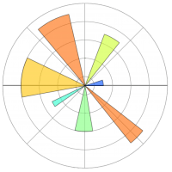
What is matplotlib
Matplotlib tries to make easy things easy and hard things possible.
You can generate plots, histograms, power spectra, bar charts, errorcharts, scatterplots, etc., with just a few lines of code.

Slide 36
matplotlib
from matplotlib import pyplot as plt
ax = plt.subplot()
plt.bar(range(len(df1.Name)),df1.Age)
ax.set_xticks([0,1,2,3])
ax.set_xticklabels(df1.Name, rotation=40)
plt.show()

Slide 37
Data visualization
import matplotlib.pyplot as plt
import numpy as np
t = np.arange(0.0, 2.0, 0.01)
s = 1 + np.sin(2*np.pi*t)
plt.plot(t, s)
plt.xlabel('time (s)')
plt.ylabel('voltage (mV)')
plt.title('About as simple as it gets, folks')
plt.grid(True)
plt.savefig("test.png")
plt.show()
Notes:
What is numpy

Slide 38
Colaboratory
Colaboratory is a free Jupyter notebook environment that requires no setup and runs entirely in the cloud.
https://colab.research.google.com/notebooks/charts.ipynb#scrollTo=08RTGn_xE3MP
Notes:
https://colab.research.google.com/drive/1LYY03M_q0wyKpsxBQ2o7iaqY1kbK7CPL

Slide 39
Final exercise
A stock report
Get URL request
Interoperable with json
Export to csv file
For loop handing
Pandas df
Matplotlib

Slide 40
Interoperability and open standards
Data Exchange
Interoperability
Data can be exchanged between different systems from different vendors
Data can be processed by past and future revisions of the same or different systems
Interoperability = Open Standards

Slide 41
Interoperability and open standards
Some well-known open standard formats
Images
PNG
SVG
Web pages
HTML
Audio
FLAC
Documents
PDF/X
Tabular Data
XML
CSV
JSON
Notes:
SVG vector

Slide 42
Data Analytics
Iterative approach:
https://developers.google.com/machine-learning/crash-course/reducing-loss/an-iterative-approach
Linear Regression:
https://developers.google.com/machine-learning/crash-course/descending-into-ml/linear-regression
Training and loss:
https://developers.google.com/machine-learning/crash-course/descending-into-ml/training-and-loss
Gradient Descent:
https://developers.google.com/machine-learning/crash-course/reducing-loss/gradient-descent
Notes:
Decision tree applied on loan approval.
from sklearn import tree
clf = tree.DecisionTreeClassifier()
Cluster analysis for classification marketing group, customer segmentation.
Multiple linear regression. For Assess real estate price
Logistic regression/naive bayes. For choice of candidate (True or False) and Probability theory.
from sklearn.linear_model import LogisticRegression
Time series with Apriori algo (ASSOCIATION rule). For market basket analysis 神奇的啤酒和尿布，他們是如何關聯起來的？
美國沃爾瑪超市中，沃爾瑪的超市管理人員分析銷售數據時發現了一個令人難於理解的現象：在某些特定的情況下，「啤酒」與「尿布」兩件看上去毫無關係的商品會經常出現在同一個購物籃中
年輕的父親前去超市購買尿布。父親在購買尿布的同時，往往會順便為自己購買啤酒，這樣就會出現啤酒與尿布這兩件看上去不相干的商品經常會出現在同一個購物籃的現象。如果這個年輕的父親在賣場只能買到兩件商品之一，則他很有可能會放棄購物而到另一家商店，直到可以一次同時買到啤酒與尿布為止。沃爾瑪發現了這一獨特的現象，開始在賣場嘗試將啤酒與尿布擺放在相同的區域，讓年輕的父親可以同時找到這兩件商品，並很快地完成購物 原文網址：https://kknews.cc/zh-hk/news/jvnz89y.html
from sklearn.model_selection import TimeSeriesSplit
Spatial analysis
NLP. Text analy/categorization and mining

Slide 43
References
Python sample code in machine learning:
https://softnshare.com/github-machine-learning-octave/
K-means clustering(Unsupervised):
Les Misérables as example: http://uatislandora.cuhk.dgicloud.com:8000/media/filer_public/e0/4c/e04cd0d9-b2f7-4640-acce-2a18f1a713d5/les_miserables_co-occurrence.html
Python->json->HTML D3.js

Slide 44
TensorFlow in GCP
LinearRegressor class in TensorFlow to predict median housing price, at the granularity of city blocks, based on one input feature
https://colab.research.google.com/notebooks/mlcc/first_steps_with_tensor_flow.ipynb
Notes:
https://colab.research.google.com/drive/1nJ8EIe2xifnBWCqN9tOyyGwmyw2bXUwP

Slide 45
Thank you

