Slide 1


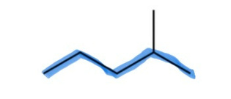
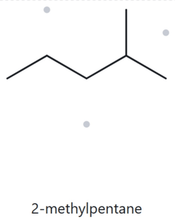

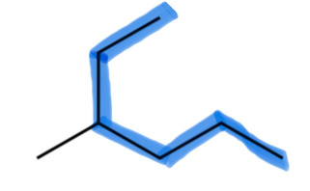
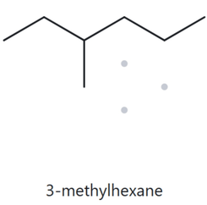
CARD A01 · STRUCTURE ➡️ NAME
FOUNDATION ⚫️ MOLECULAR FORMULA:
  Numbered Parent
  Naming Trail
Parent: longest chain = 5 C pentane. Several possible 5-C paths exist, all carrying a methyl group.
Numbering: left right gives 2 and right left gives 4. First point of difference: 4 > 2, so number from left to right.
Substituents: methyl on C2 → 2-methyl.
4
5
3
2
1
3. My Name (Written First)
  The Alkane Check
2-methylpentane
✔️Match
✔️longest chain confirmed ✔️lowest locants ✔️alphabetical order ✔️punctuation ✔️formula counted
CARD A02 · STRUCTURE ➡️ NAME
FOUNDATION ⚫️ MOLECULAR FORMULA:
  Numbered Parent
  Naming Trail
1
Parent: longest chain = 6 Chexane. More than one possible 6-C paths exist, but all carry a methyl group.
Numbering: top bottom right gives 3 and bottom left → top gives 4. First point of difference: 4 > 3, so number from top to bottom right.
Substituents: methyl on C3 3-methyl.
2
3
5
4
6
3. My Name (Written First)
  The Alkane Check
✖️Mismatch
IUPAC rules require starting from the end that yields the lower locant (3 < 4), making 3-methylhexane correct.
4-methylhexane
✔️longest chain confirmed ✔️lowest locants ✔️alphabetical order ✔️punctuation ✔️formula counted

Slide 2
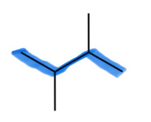
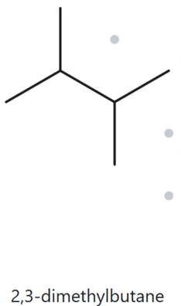

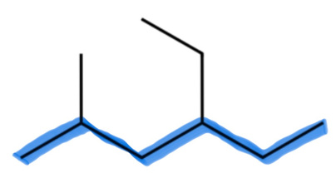
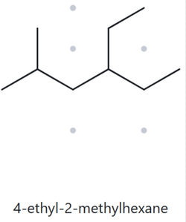
CARD A03 · STRUCTURE ➡️ NAME
FOUNDATION ⚫️ MOLECULAR FORMULA:
  Numbered Parent
  Naming Trail
Parent: longest chain = 4 C → butane. More than one possible 4-C paths exist, but both carry a methyl group so they lead to the same name.
Numbering: left → right gives 2,3 and right → left also gives 2,3. Either way, both are numbered the same.
Substituents: methyl on C2 and C3 2,3-dimethyl.
1
2
3
4
3. My Name (Written First)
  The Alkane Check
2, 3-dimethylbutane
✔️Match
✔️longest chain confirmed ✔️lowest locants ✔️alphabetical order ✔️punctuation ✔️formula counted
CARD A04 · STRUCTURE ➡️ NAME
DEVELOPING ⚫️ MOLECULAR FORMULA:
  Numbered Parent
  Naming Trail
Parent: longest chain = 6 Chexane. Several possible 6-C paths exist, but all carry the same methyl and ethyl group so they lead to the same name.
Numbering: left→ right gives 2,4 and right left gives 3,5. We choose 2,4 because it is the lower set at the first point of difference. Therefore, number from left to right.
Substituents: methyl on C2 and ethyl on C4→ 4-ethyl-2-methyl.
2
3
4
6
1
5
3. My Name (Written First)
  The Alkane Check
✖️Mismatch
IUPAC rules require citing "ethyl" before "methyl" regardless of their position numbers, making 4-ethyl-2-methylhexane correct.
2-methyl-4-ethylhexane
✔️longest chain confirmed ✔️lowest locants ✔️alphabetical order ✔️punctuation ✔️formula counted

Slide 3

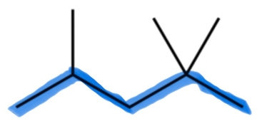
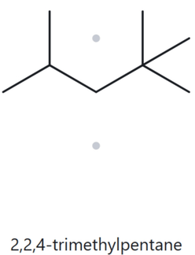

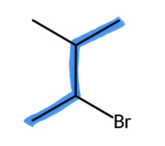
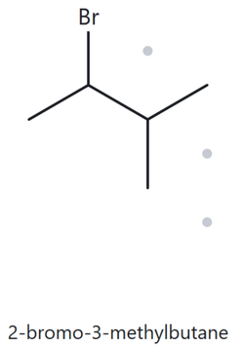
CARD A05 · STRUCTURE ➡️ NAME
DEVELOPING ⚫️ MOLECULAR FORMULA:
  Numbered Parent
  Naming Trail
Parent: longest chain = 5 C pentane. Several possible 5-C paths exist, but all carry 3 methyl groups.
Numbering: left right gives 2,4,4 and right → left gives 2,2,4. 4 > 2; 2,2,4 is lower at the first point of difference. Therefore, number from right to left.
Substituents: 2 methyl on C2 and one on C4 → 2,2,4-trimethyl
4
2
1
5
3
3. My Name (Written First)
  The Alkane Check
2,2,4-trimethylpentane
✔️match
✔️longest chain confirmed ✔️lowest locants ✔️alphabetical order ✔️punctuation ✔️formula counted
CARD A06 · STRUCTURE ➡️ NAME
DEVELOPING ⚫️ MOLECULAR FORMULA:
  Numbered Parent
  Naming Trail
4
Parent: longest chain 4 C butane. More than one 4-C paths exist, but both carry a methyl and bromo group.
Numbering: bottom top gives 2,3 and top bottom also gives 2,3. Since both give the same set of numbers (2, 3), the tie is broken alphabetically: bromo comes before methyl, so bromo gets the lower number. Therefore, number from lower left-end to top.
Substituents: methyl on C3 and a bromo substituent on C2 → 2-bromo-3-methyl
3
1
2
3. My Name (Written First)
  The Alkane Check
2-bromo-3-methylbutane
✔️match
✔️longest chain confirmed ✔️lowest locants ✔️alphabetical order ✔️punctuation ✔️formula counted

Slide 4

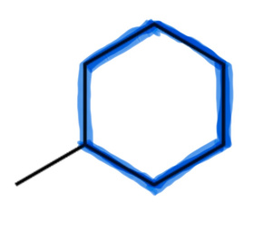
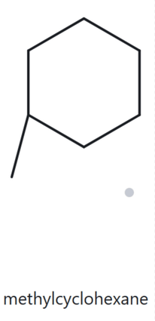

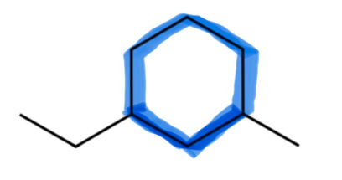
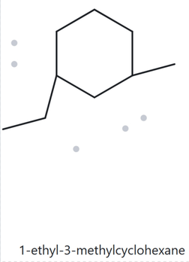
CARD A07 · STRUCTURE ➡️ NAME
DEVELOPING ⚫️ MOLECULAR FORMULA:
  Numbered Parent
  Naming Trail
3
Parent: longest chain ring with 6 C cyclohexane. It carries a methyl group.
Numbering: There is no need to assign a number because there's only one substituent on the ring. That carbon is automatically C-1.
Substituents: methyl on C1 (but there's only one substituent on the ring; therefore, "1-" before methyl is unnecessary.) → methyl
2
4
1
6
5
3. My Name (Written First)
  The Alkane Check
methylcyclohexane
✔️match
✔️longest chain confirmed ✔️lowest locants ✔️alphabetical order ✔️punctuation ✔️formula counted
CARD A08 · STRUCTURE ➡️ NAME
CHALLENGE ⚫️ MOLECULAR FORMULA:
  Numbered Parent
  Naming Trail
5
Parent: longest chain ring with 6 C cyclohexane. It carries a methyl and an ethyl group.
Numbering: Both directions give 1,3, but the substituent that comes first alphabetically (ethyl) gets C-1. Therefore, number from the ethyl group and counterclockwise.
Substituents: ethyl on C1 and methyl on C3 1-ethyl-3-methyl
6
4
1
2
3
3. My Name (Written First)
  The Alkane Check
1-ethyl-3-methylcyclohexane
✔️match
✔️longest chain confirmed ✔️lowest locants ✔️alphabetical order ✔️punctuation ✔️formula counted

Slide 5

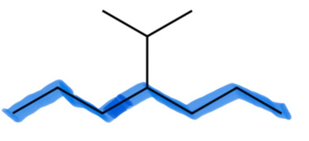
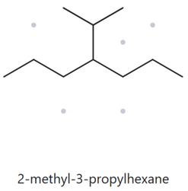

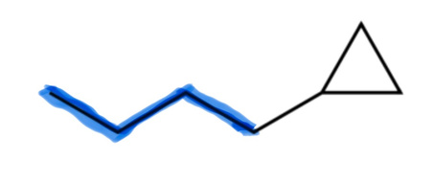
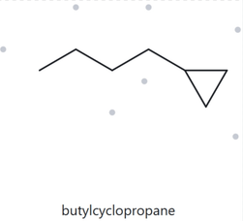
CARD A09 · STRUCTURE ➡️ NAME
CHALLENGE ⚫️ MOLECULAR FORMULA:
  Numbered Parent
  Naming Trail
Parent: longest chain 6 Chexane. It carries a methyl and propyl group.
Numbering: top lower-end right gives 2,3 and top → lower-end left also gives 2,3. Therefore, we can number from either side and it will still be the same.
Substituents: methyl on C2 and propyl on C3 2-methyl-3-propyl
2
6
1
3
4
5
7
3. My Name (Written First)
  The Alkane Check
✖️Mismatch
⁠3-propylheptane⁠ stops tracing at a branch point instead of following the full continuous 9-carbon path. IUPAC rules require identifying the longest continuous chain (\bm{\text{nonane}}), making 4-methylnonane correct.
3-propylheptane
✔️longest chain confirmed ✔️lowest locants ✔️alphabetical order ✔️punctuation ✔️formula counted
CARD A10 · STRUCTURE ➡️ NAME
CHALLENGE ⚫️ MOLECULAR FORMULA:
  Numbered Parent
  Naming Trail
Parent: 3-carbon ring cyclopropane. It carries a 4-carbon chain substituent. The longest-chain rule does not override the ring-parent. Therefore, the ring is the parent.
Numbering: The carbon of the cyclopropane ring where the butyl chain attaches is considered C1. However, because there's only one substituent on the ring, there is no need to include the locant in the name.
Substituents: butyl (A locant is unnecessary because there is only one substituent on the cyclopropane ring.) → butyl
4
2
3
1
3. My Name (Written First)
  The Alkane Check
✖️Mismatch
1-cyclopropylpentane⁠ selects the 5-carbon open chain as the parent instead of the ring. Per the 2013 IUPAC rules used in this activity, any ring present is designated as the parent, making pentylcyclopropane correct.
1-cyclopropylpentane
✔️longest chain confirmed ✔️lowest locants ✔️alphabetical order ✔️punctuation ✔️formula counted

Slide 6
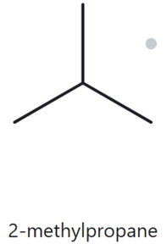
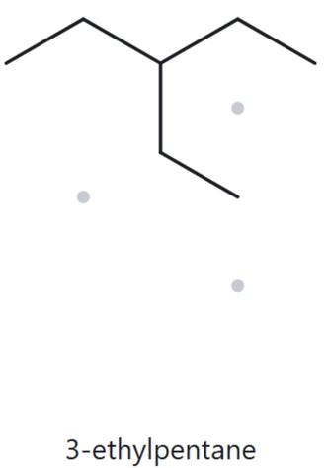
CARD B01 · NAME ➡️ STRUCTURE
FOUNDATION ⚫️ 2 - methylpropane
  Name Decoded
  Bond-line Structure (The Alkane)
Parent: Propane → a 3-carbon chain.
Substituents: Methyl on C2.
Expected formula: 3 + 1 = 4 carbons; open chain → C₄H₁₀
  Formuka Check
  Back-Check
Counted from the structure: C₄H₁₀.
Open-chain formula: CₙH₂ₙ₊₂ = C₄H₁₀. ✓
Returned by The Alkane: 2-methylpropane.
✓ The returned name matches the given name.
✔️Parent Length Matches ✔️Substituent Position Match ✔️Formula Agrees ✔️Back-Check Recorded
CARD B02 · NAME ➡️ STRUCTURE
FOUNDATION ⚫️ 3 - ethylpentane
  Name Decoded
  Bond-line Structure (The Alkane)
Parent: Pentane → a 5-carbon chain.
Substituents: Ethyl on C3.
Expected formula: 5 + 2 = 7 carbons; open chain → C₇H₁₆
  Formuka Check
  Back-Check
Counted from the structure: C₇H₁₆.
Open-chain formula: CₙH₂ₙ₊₂ = C₇H₁₆. ✓
Returned by The Alkane: 3-ethylpentane.
✓ The returned name matches the given name.
✔️Parent Length Matches ✔️Substituent Position Match ✔️Formula Agrees ✔️Back-Check Recorded

Slide 7
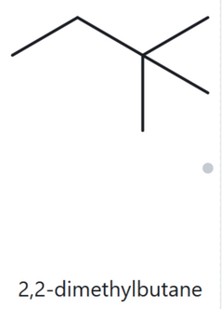
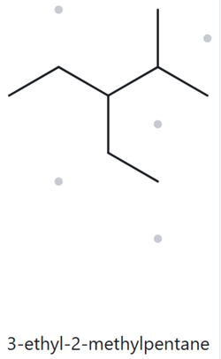
CARD BO3 · NAME ➡️ STRUCTURE
FOUNDATION ⚫️ 2, 2 - dimethylbutane
  Name Decoded
  Bond-line Structure (The Alkane)
Parent: Butane → a 4-carbon chain.
Substituents: Two methyl groups on C2.
Expected formula: 4 + 2 = 6 carbons; open chain → C₆H₁₄
  Formuka Check
  Back-Check
Counted from the structure: C₆H₁₄.
Open-chain formula: CₙH₂ₙ₊₂ = C₆H₁₄. ✓
Returned by The Alkane: 2,2-dimethylbutane.
✓ The returned name matches the given name.
✔️Parent Length Matches ✔️Substituent Position Match ✔️Formula Agrees ✔️Back-Check Recorded
CARD B04 · NAME ➡️ STRUCTURE
FOUNDATION ⚫️ 3 - ethyl-2-methylpentane
  Name Decoded
  Bond-line Structure (The Alkane)
Parent: Pentane → a 5-carbon chain.
Substituents: Ethyl on C3; methyl on C2.
Expected formula: 5 + 2 + 1 = 8 carbons; open chain → C₈H₁₈
  Formuka Check
  Back-Check
Counted from the structure: C₈H₁₈.
Open-chain formula: CₙH₂ₙ₊₂ = C₈H₁₈. ✓
Returned by The Alkane: 3-ethyl-2-methylpentane.
✓ The returned name matches the given name.
✔️Parent Length Matches ✔️Substituent Position Match ✔️Formula Agrees ✔️Back-Check Recorded

Slide 8
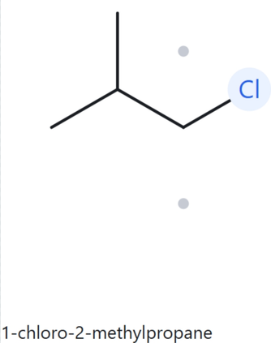
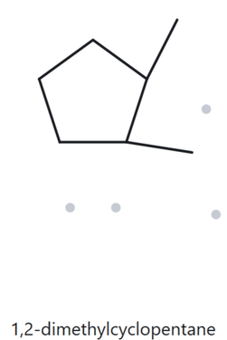
CARD BO5 · NAME ➡️ STRUCTURE
FOUNDATION ⚫️ 1-chloro-2-methylpropane
  Name Decoded
  Bond-line Structure (The Alkane)
Parent: Propane → a 3-carbon chain.
Substituents: Chloro on C1; methyl on C2.
Expected formula: 3 + 1 = 4 carbons; open chain → C₄H₁₀. One hydrogen is replaced by chlorine → C₄H₉Cl
  Formuka Check
  Back-Check
Returned by The Alkane: 1-chloro-2-methylpropane.
✓ The returned name matches the given name.
Counted from the structure: C₄H₉Cl.
Open-chain formula: C₄H₁₀; replacing one hydrogen with chlorine gives C₄H₉Cl. ✓
✔️Parent Length Matches ✔️Substituent Position Match ✔️Formula Agrees ✔️Back-Check Recorded
CARD BO6 · NAME ➡️ STRUCTURE
FOUNDATION ⚫️ 1,2 -dimethylcyclopentane
  Name Decoded
  Bond-line Structure (The Alkane)
Counted from the structure: C₄H₉Cl.
Open-chain formula: C₄H₁₀; replacing one hydrogen with chlorine gives C₄H₉Cl. ✓
  Formuka Check
  Back-Check
Returned by The Alkane: 1,2-dimethylcyclopentane.
✓ The returned name matches the given name
Counted from the structure: C₇H₁₄.
One-ring formula: CₙH₂ₙ = C₇H₁₄. ✓
✔️Parent Length Matches ✔️Substituent Position Match ✔️Formula Agrees ✔️Back-Check Recorded

Slide 9
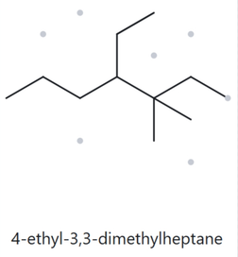
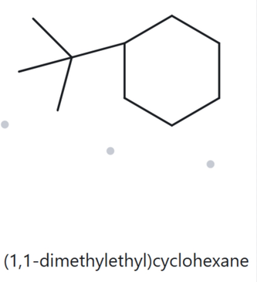
CARD B07 · NAME ➡️ STRUCTURE
FOUNDATION ⚫️ 4-ethyl-3,3-dimethylheptane
  Name Decoded
  Bond-line Structure (The Alkane)
Parent: Heptane → a 7-carbon chain.
Substituents: Ethyl on C4; two methyl groups on C3.
Expected formula: 7 + 2 + 1 + 1 = 11 carbons; open chain → C₁₁H₂₄.
  Formuka Check
  Back-Check
Returned by The Alkane: 4-ethyl-3,3-dimethylheptane.
✓ The returned name matches the given name.
Counted from the structure: C₁₁H₂₄.
Open-chain formula: CₙH₂ₙ₊₂ = C₁₁H₂₄. ✓
✔️Parent Length Matches ✔️Substituent Position Match ✔️Formula Agrees ✔️Back-Check Recorded
CARD B08 · NAME ➡️ STRUCTURE
FOUNDATION ⚫️ tert-butylcyclohexane
  Name Decoded
  Bond-line Structure (The Alkane)
Parent: Cyclohexane → a 6-carbon ring.
Substituents: tert-Butyl on C1.
Expected formula: 6 + 4 = 10 carbons; one ring → C₁₀H₂₀.
  Formuka Check
  Back-Check
Returned by The Alkane: (1,1-dimethylethyl)cyclohexane.
✖️mismatch:
The Alkane returned a systematic name using the substituent name "1,1-dimethylethyl" instead of the commonly retained name "tert-butyl." Both names describe the same substituent and molecular structure. Therefore, the given name, tert-butylcyclohexane, represents the intended structure.
Counted from the structure: C₁₀H₂₀.
One-ring formula: CₙH₂ₙ = C₁₀H₂₀. ✓
✔️Parent Length Matches ✔️Substituent Position Match ✔️Formula Agrees ✔️Back-Check Recorded

Slide 10
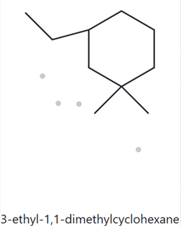
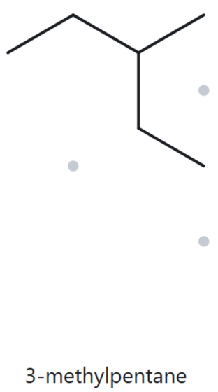
CARD B09 · NAME ➡️ STRUCTURE
FOUNDATION ⚫️ 3-ethyl-1,1-dimenthylclohexane
  Name Decoded
  Bond-line Structure (The Alkane)
Parent: Cyclohexane → a 6-carbon ring.
Substituents: Ethyl on C3; two methyl groups on C1.
Expected formula: 6 + 2 + 1 + 1 = 10 carbons; one ring → C₁₀H₂₀.
  Formuka Check
  Back-Check
Returned by The Alkane: 3-ethyl-1,1-dimethylcyclohexane.
✓ The returned name matches the given name.
Counted from the structure: C₁₀H₂₀.
One-ring formula: CₙH₂ₙ = C₁₀H₂₀. ✓
✔️Parent Length Matches ✔️Substituent Position Match ✔️Formula Agrees ✔️Back-Check Recorded
CARD B10 · NAME ➡️ STRUCTURE
FOUNDATION ⚫️ 2-ethylbutane
  Name Decoded
  Bond-line Structure (The Alkane)
Parent: Butane → a 4-carbon chain.
Substituents: Ethyl on C2.
Expected formula: 4 + 2 = 6 carbons; open chain → C₆H₁₄.
  Formuka Check
  Back-Check
Returned by The Alkane: 3-methylpentane.
✖️mismatch:
The Alkane returned 3-methylpentane because the structure contains a continuous chain of five carbon atoms, which is longer than the four-carbon butane chain in the given name. According to IUPAC naming rules, the longest continuous carbon chain must be selected as the parent chain. Therefore, the correct IUPAC name for the drawn structure is 3-methylpentane, not 2-ethylbutane.
Counted from the structure: C₆H₁₄.
Open-chain formula: CₙH₂ₙ₊₂ = C₆H₁₄. ✓
✔️Parent Length Matches ✔️Substituent Position Match ✔️Formula Agrees ✔️Back-Check Recorded

