Slide 1

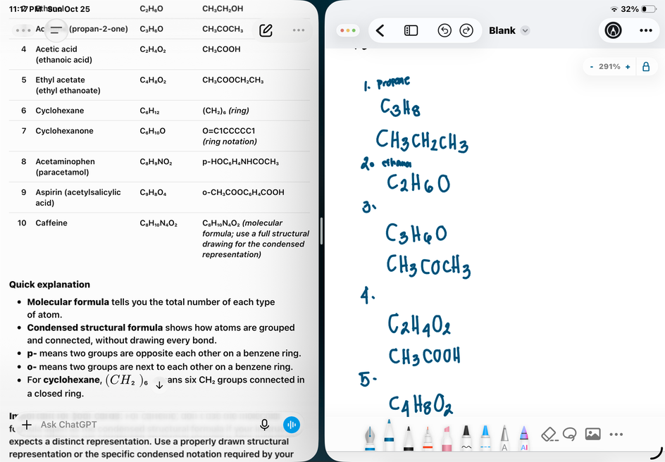
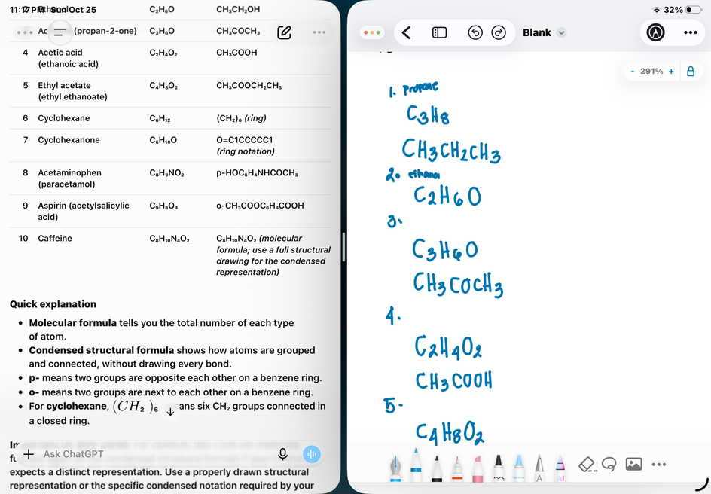
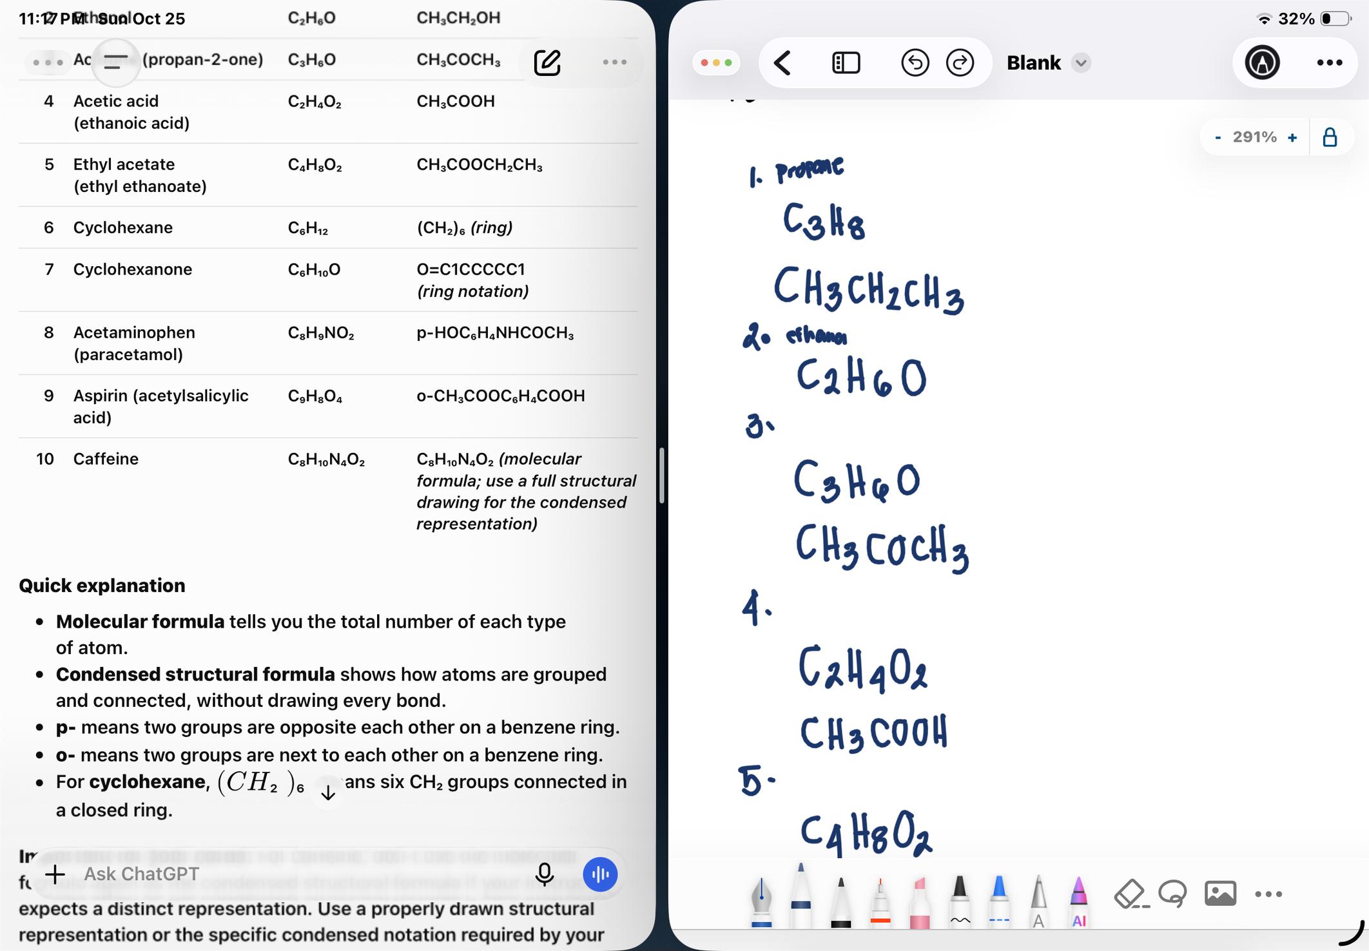
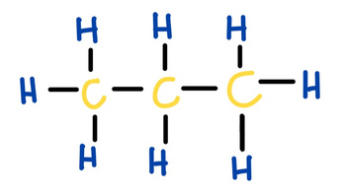
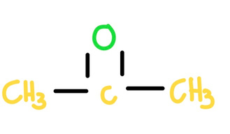

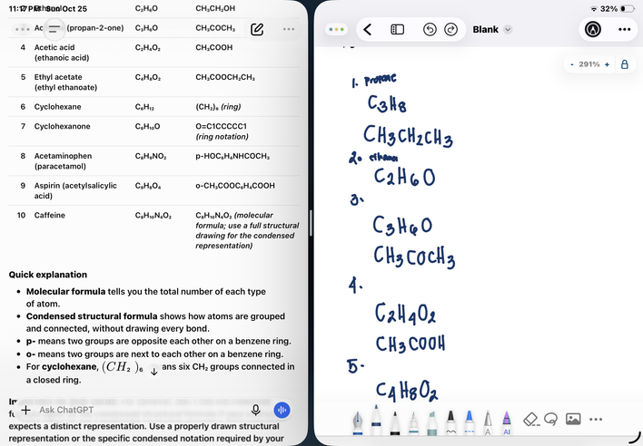
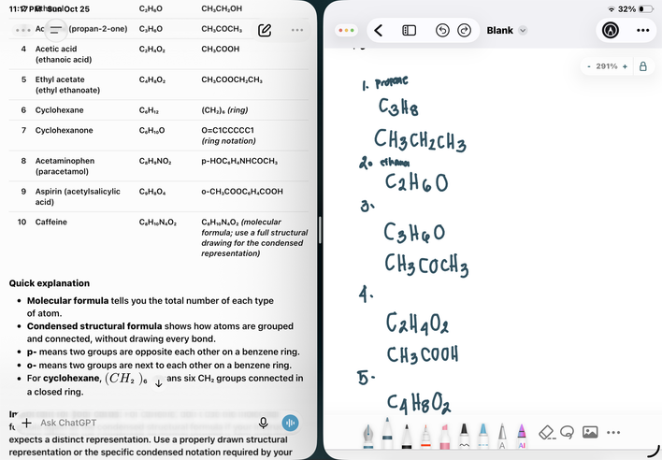
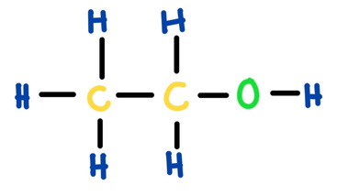
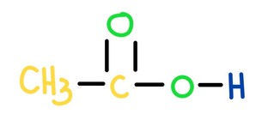



One Molecule, Four Representations:
CARD 01- PROPANE
CARD 03- Acetone
Molecular Formula:
Molecular Formula:
1. Molecular Formula
2. Lewis Structure
1. Molecular Formula
2. Lewis Structure
From
Molecular
3. Condensed Structural formula
4. Bond-Line Formula
3. Condensed Structural formula
4. Bond-Line Formula
Formula
To
Atom acount verified, valance checked, bond order check, same connectivity
confrimed
Bond-Line
Atom acount verified, valance checked, bond order check, same connectivity
confrimed
CARD 02- Ethanol
Structure
CARD 04- Acetic acid
Molecular Formula:
Molecular Formula:
1. Molecular Formula
2. Lewis Structure
1. Molecular Formula
2. Lewis Structure
3. Condensed Structural formula
4. Bond-Line Formula
3. Condensed Structural formula
4. Bond-Line Formula
Atom acount verified, valance checked, bond order check, same connectivity
confrimed
Atom acount verified, valance checked, bond order check, same connectivity
confrimed

Slide 2
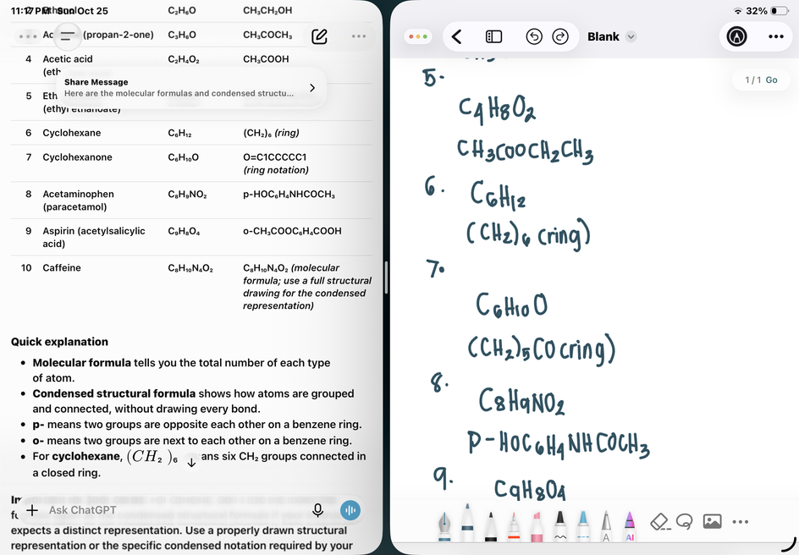
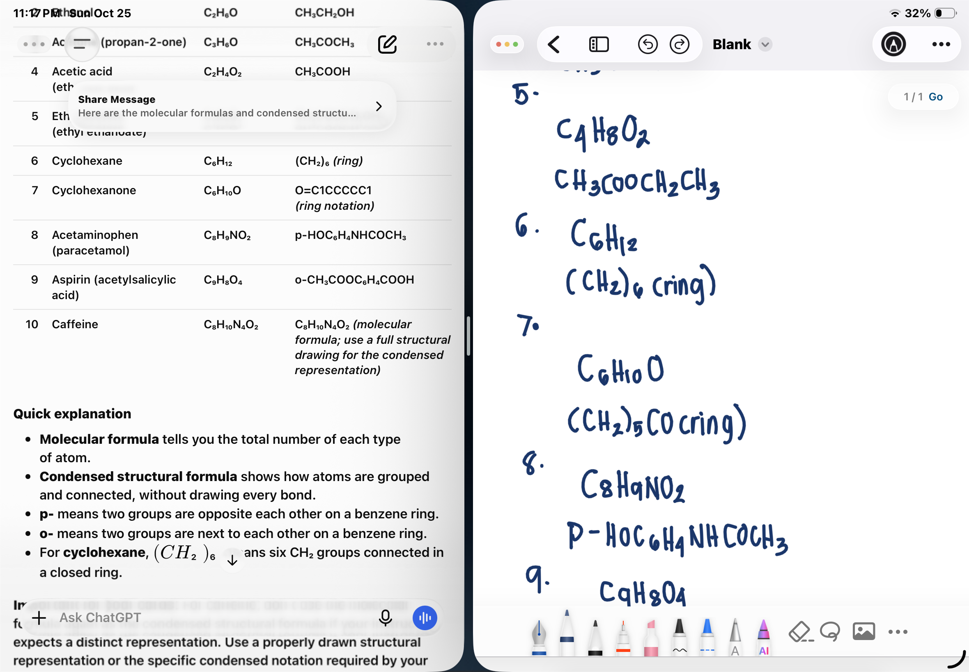
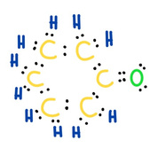
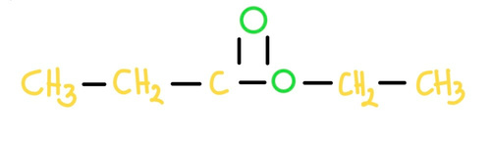


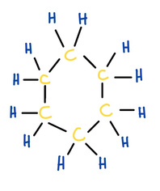
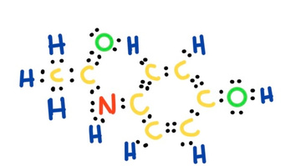

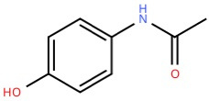
One Molecule, Four Representations:
CARD 05- Ethyl acetate
CARD 07- Cyclohexanone
Molecular Formula:
Molecular Formula:
1. Molecular Formula
2. Lewis Structure
1. Molecular Formula
2. Lewis Structure
From
Molecular
3. Condensed Structural formula
4. Bond-Line Formula
3. Condensed Structural formula
4. Bond-Line Formula
Formula
To
Atom acount verified, valance checked, bond order check, same connectivity
confrimed
Bond-Line
Atom acount verified, valance checked, bond order check, same connectivity
confrimed
CARD 06- Cyclohexane
Structure
CARD 08- Acetaminophen
Molecular Formula:
Molecular Formula:
1. Molecular Formula
2. Lewis Structure
1. Molecular Formula
2. Lewis Structure
3. Condensed Structural formula
4. Bond-Line Formula
3. Condensed Structural formula
4. Bond-Line Formula
Atom acount verified, valance checked, bond order check, same connectivity
confrimed
Atom acount verified, valance checked, bond order check, same connectivity
confrimed

Slide 3
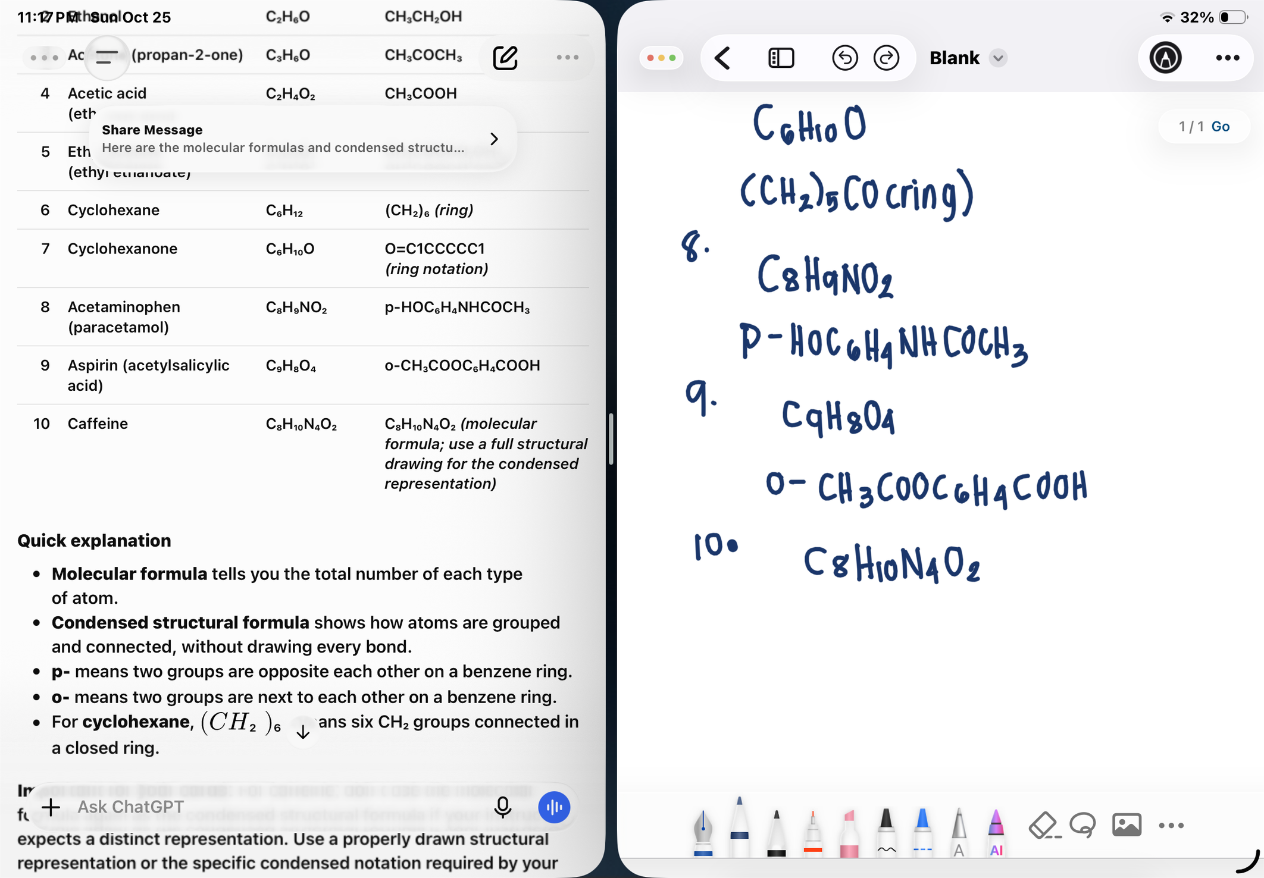
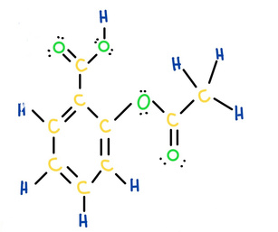
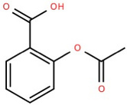
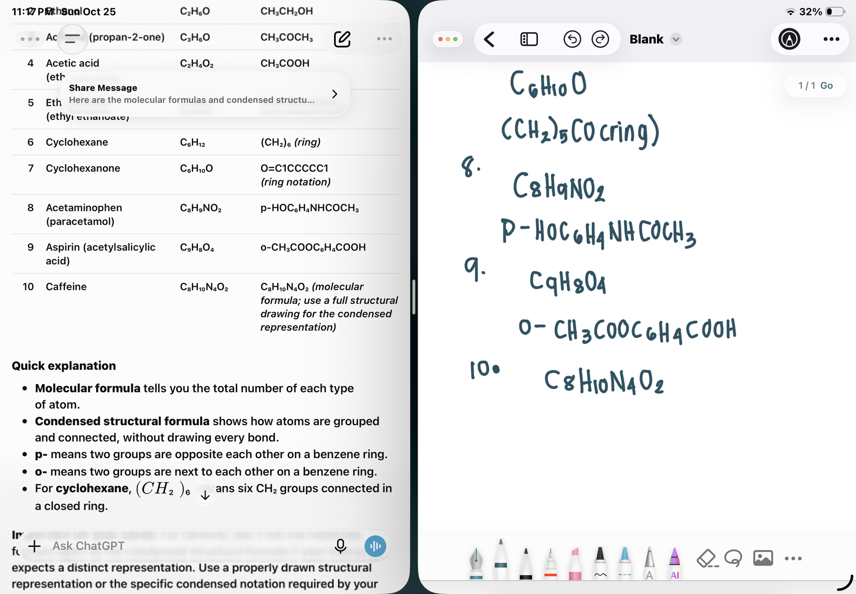
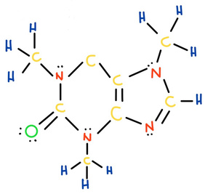
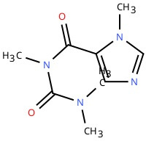
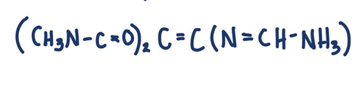
One Molecule, Four Representations:
CARD 09- Aspirin
Molecular Formula:
1. Molecular Formula
2. Lewis Structure
3. Condensed Structural formula
4. Bond-Line Formula
Atom acount verified, valance checked, bond order check, same connectivity
confrimed
CARD 10- Caffeine
Molecular Formula:
1. Molecular Formula
2. Lewis Structure
3. Condensed Structural formula
4. Bond-Line Formula
Atom acount verified, valance checked, bond order check, same connectivity
confrimed

