Slide 1
3. Functions

Slide 2
The plan
Recap on relations
Functions
Properties of functions
Example functions
Recursion

Slide 3
Recap
Set operations: A∪B, A∩B, A⨁B, A-B, A^{c}
Ordered pairs:
(u, v) ∈ A x B = {(a, b) | a∈A, b∈B}
Relations: any subset of A x B
For AxA
Reflexive: aRa for every a∈A
Symmetric: aRb implies bRa
Transitive: aRb and bRc implies aRc
Anti-symmetric if aRb and a ≠ b, then bRa (b doesn’t relate to a)

Slide 4
Exercises
For each relation over {1,2,3,4}, is it reflexive, symmetric, transitive, anti-symmetric?
{(1,3),(2,3),(1,2),(3,1),(1,1),(3,3),(2,1),(2,2),(3,2)}
{(1,1),(1,2),(2,3),(1,3),(2,2),(3,3),(3,4),(4,4)}
{(1,2),(1,3),(1,4),(2,3),(2,4),(3,4),(2,1),(3,2),(3,1), (4,3),(4,2),(4,1)}
{(1,2),(2,3),(3,4),(1,3),(2,4)}
{(1,2),(2,3),(3,4),(1,3),(2,4),(1,4)}

Slide 5
Exercises
For each of the following, is it reflexive, symmetric, transitive, anti-symmetric?
{(1,3),(2,3),(1,2),(3,1),(1,1),(3,3),(2,1),(2,2),(3,2)}
Transitive and symmetric
{(1,1),(1,2),(2,3),(1,3),(2,2),(3,3),(3,4),(4,4)}
Reflexive, anti-symmetric

Slide 6
Exercises
{(1,2),(1,3),(1,4),(2,3),(2,4),(3,4),(2,1),(3,2),(3,1),(4,3),(4,2),(4,1)}
Symmetric
{(1,2),(2,3),(3,4),(1,3),(2,4)}
Anti-symmetric
{(1,2),(2,3),(3,4),(1,3),(2,4),(1,4)}
Transitive and anti-symmetric

Slide 7
Functions
A function from A to B is a subset of AxB where each a∈A occurs in the left hand side of exactly one pair.
Written f: A → B
A is the domain
B is the co-domain
{f(a) | a∈A} is the range

Slide 8
Inverse functions
Inverse function. If
f: A → B
is a function, then the inverse:
f⁻¹: B → A
is given by f⁻¹ = {(b,a) | (a,b) ∈ f}

Slide 9
Partial functions and composition
A partial function is one where the function is not defined for every value of the domain
Function composition: (f◦g)(x) = f(g(x)), co-domain of g and domain of f match

Slide 10
Coursework
This week!
10 questions, MCQs
40 mins to answer them
Opens 5pm Tuesday, closes 5pm Sunday (Nov 5th)
(So start by 4:20pm)
You choose your time to tackle them
Covers everything up and including to today
Exercises and definitions (have the notes handy)
Right: 4 marks, Wrong: -1 mark, Blank: 0 marks
Feedback: immediate marks, comments later when the quiz closes

Slide 11
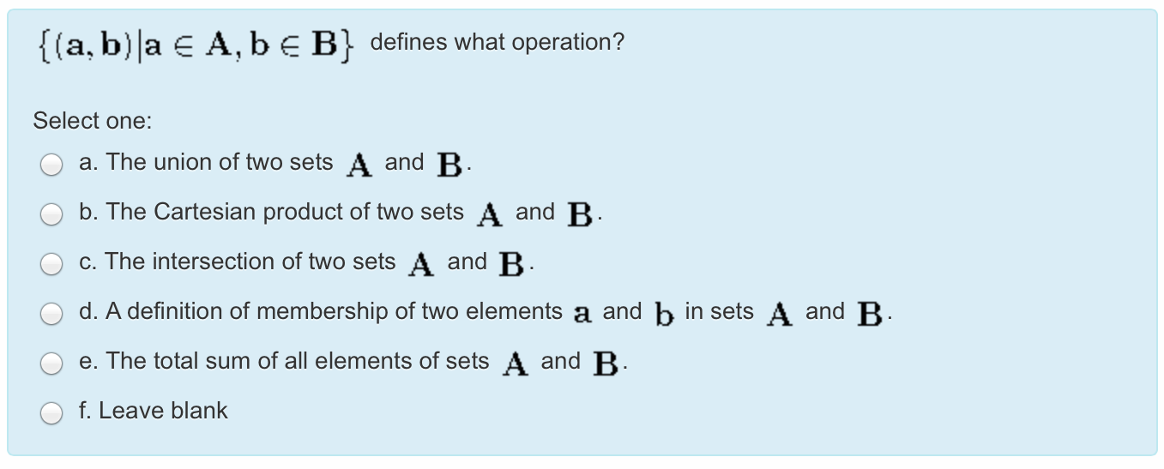
Example
There is a practice quiz

Slide 12
Properties of functions
A function f:A⟶B is 1-to-1 (injective) when b∈B occurs at most once.
A function f:A⟶B is onto (surjective) when for every b∈B there is a∈A with f(a)=b.
A function f:A⟶B is bijective when it is 1-to-1 and onto.
The inverse is a function (or partial function) when f is 1-to-1. For f⁻¹ to be a total function, f must be surjective.

Slide 13
Exercise
For each of the following functions, is it injective? surjective? bijective? neither?
f: Z → Z, f(x) = x + 1
f: R → R, f(x) = x²
f: Z → Z, f(x) = 2x

Slide 14
Exercise
For each of the following functions, is it injective? surjective? bijective? neither?
f: Z → Z, f(x) = x + 1
bijective (injective and surjective)
f: R → R, f(x) = x²
neither
f: Z → Z, f(x) = 2x
injective

Slide 15
Some functions
⎣x⎦, floor
⎡x⎤, ceiling
ABS(x)
INT(x)
x (mod M)
x!

Slide 16

Powers and sums
(x^{n})^{m} = x^{nm}
x^{n} * x^{m} = x^{n+m}
x^{m}/x^{n} = x^{m-n}
$\sum_{n=0}^{k}{f(n)}=f\left(0\right)+…+f(k)$

Slide 17
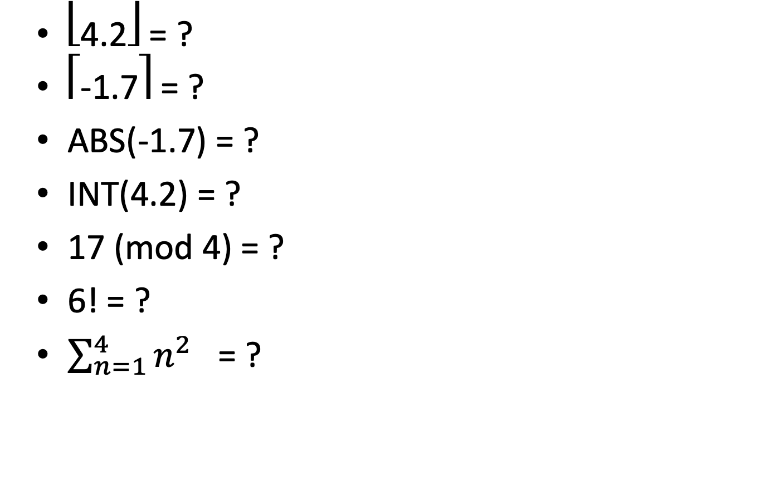
Exercise
⎣4.2⎦ = ?
⎡-1.7⎤ = ?
ABS(-1.7) = ?
INT(4.2) = ?
17 (mod 4) = ?
6! = ?
$\sum_{n=1}^{4}{n^{2}}$ = ?

Slide 18
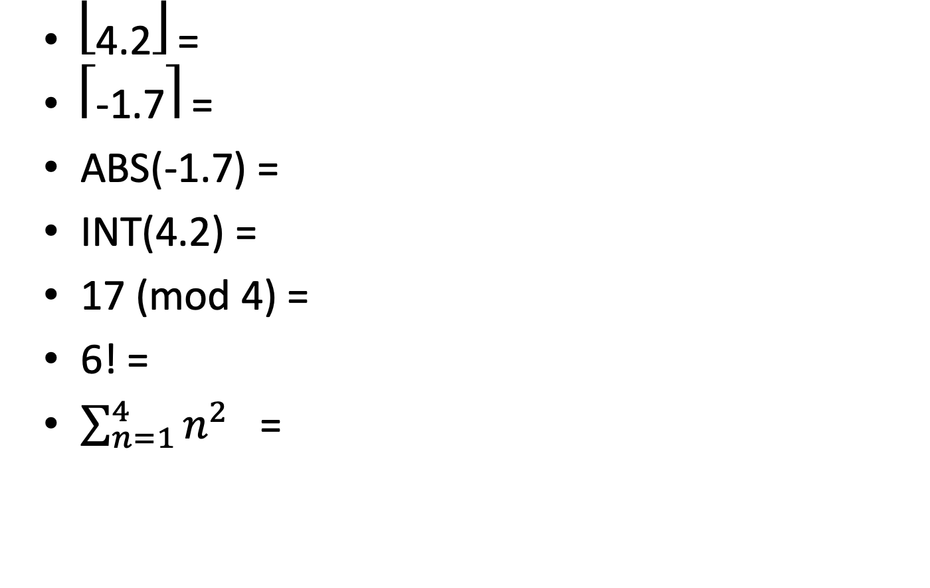
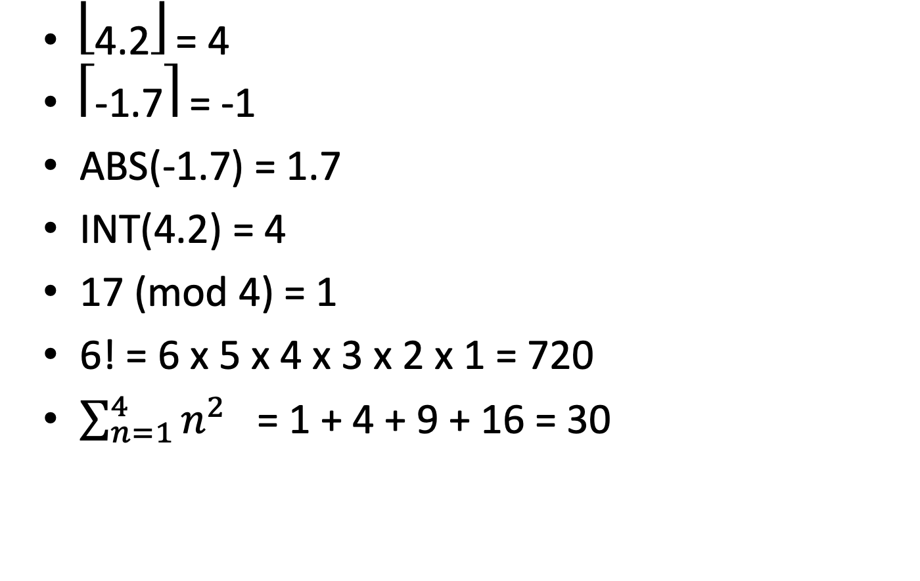
Exercise
⎣4.2⎦ =
⎡-1.7⎤ =
ABS(-1.7) =
INT(4.2) =
17 (mod 4) =
6! =
$\sum_{n=1}^{4}{n^{2}}$ =
⎣4.2⎦ = 4
⎡-1.7⎤ = -1
ABS(-1.7) = 1.7
INT(4.2) = 4
17 (mod 4) = 1
6! = 6 x 5 x 4 x 3 x 2 x 1 = 720
$\sum_{n=1}^{4}{n^{2}}$ = 1 + 4 + 9 + 16 = 30

Slide 19
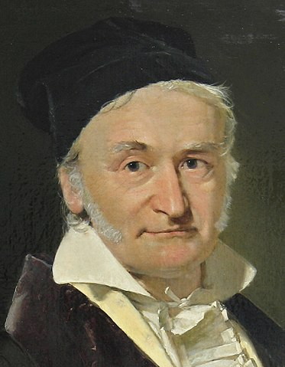
Gauss

Slide 20
Recursion
A recursive function is one that calls itself.
It will have one or more base case, and one or more recursive cases
For example:
GCD(a,0) = a
GCD(a,b) = GCD(b, a (mod b))

Slide 21
Exercise
Give a recursive function for factorial:
0! = 1
1! = 1
n! = n * (n-1)! if n>1
fact(0) = 1
fact(1) = 1
fact(n) = n * fact(n-1) if n>1
(This may not be the best way to calculate factorial.)

