Slide 1
2. Sets and Relations

Slide 2
The plan
Set operations
Venn diagrams and membership tables
Counting
Russell’s paradox
Products and pairs
Relations and some properties

Slide 3
Recap
{ }
{ | }
∈
⊆
∅, P(A)
Eg, 5 ∈{5, 8} ⊆ {x | x ∈ N, 4 ≤ x ≤ 9}

Slide 4
Recap: number systems
Naturals: N
Integers: Z
Rationals: Q
Reals: R
Complex: C

Slide 5
Set Operations
Union, ∪
Intersection, ∩
Symmetric Difference, ⊕
Complement, A^{C}
Set Difference, A-B
A, B disjoint if A∩B = ∅

Slide 6
Exercise
U = {a, b, c, d, e, f, g, h}
A = {a, b, c, d}, B = {b, d, f, h}, C = {a, c, e, g}
A ∩ B
B ∩ C
A∪C
A ⊕ B
A – C
B – C
(A∪B)^{C}

Slide 7
Exercise
U = {a, b, c, d, e, f, g, h}
A = {a, b, c, d}, B = {b, d, f, h}, C = {a, c, e, g}
A ∩ B = {b, d}
B ∩ C = ∅
A∪C = {a, b, c, d, e, g}
A ⊕ B = {a, c, f, h}
A – C = {b, d}
B – C = {b, d, f, h}
(A∪B)^{C} = {e, g}

Slide 8
Venn Diagrams

Slide 9
Membership tables
A B C A ∩ C (A ∩ C) ⊕ B
0 0 0 0 0
0 0 1 0 0
0 1 0 0 1
0 1 1 0 1
0 0 0 0
1 0 1 1 1
1 1 0 0 1
1 1 1 1 0

Slide 10
Membership tables
A B C A ⊕ B (A ⊕ B) ∩ C
0 0 0 0 0
0 0 1 0 0
0 1 0 1 0
0 1 1 1 1
1 0 0 1 0
1 0 1 1 1
1 1 0 0 0
1 1 1 0 0

Slide 11
Counting (inclusion/exclusion)
For disjoint sets: |A∪B| = |A|+|B|
Otherwise:
|A∪B| = |A|+|B|-|A∩B|
|A-B|=|A| - |A∩B|
and: | A∪B∪C | =
|A|+|B|+|C|-|A∩B|-|A∩C|-|B∩C|+|A∩B∩C|

Slide 12
Exercise
Suppose 120 students are asked about their laptops:
95 have laptops running Windows
20 have laptops running MacOS
8 have both
How many students have do no have a laptop running Windows or MacOS?
120-(95+20-8) = 13

Slide 13
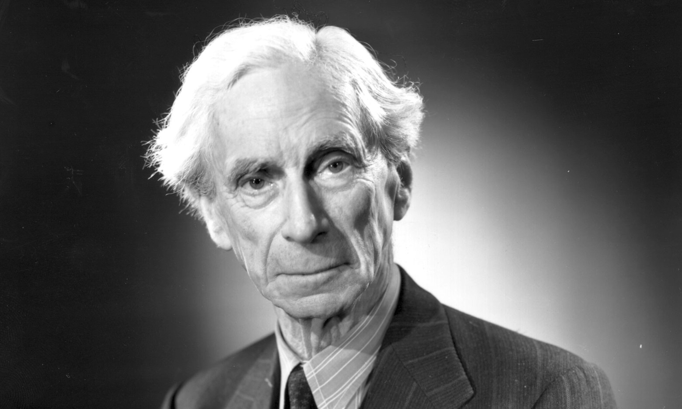
Bertrand Russell
http://www.theguardian.com/commentisfree/2014/jan/06/bertrand-russell-everyday-value-of-philosophy

Slide 14
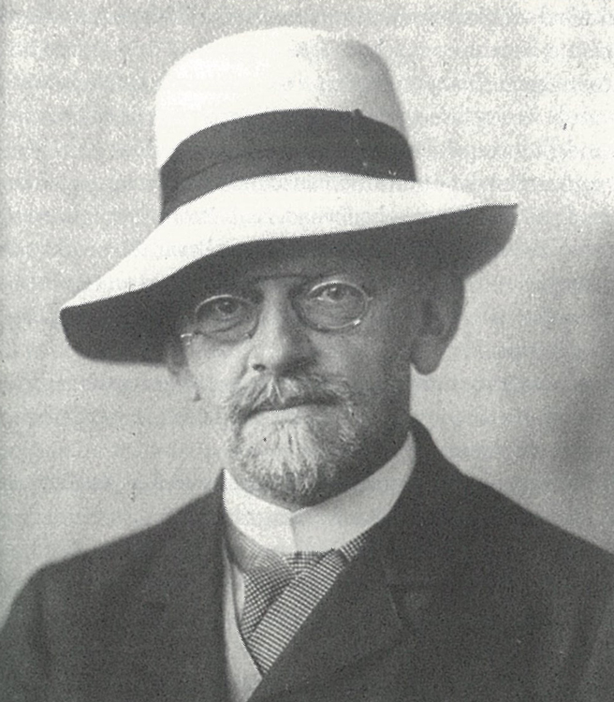
David Hilbert
http://www.aventdudomainepublic.org/2013/12/david-hilbert/

Slide 15
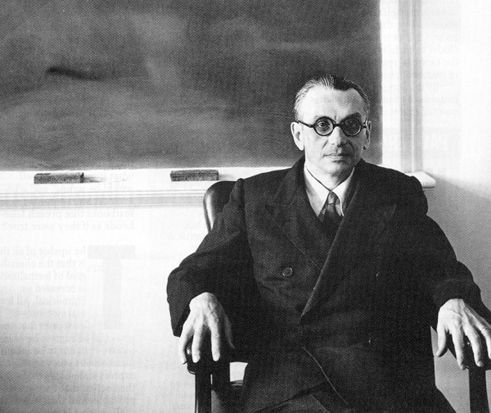
Kurt Gödel
http://www.rudyrucker.com/blog/2012/08/01/memories-of-kurt-godel/

Slide 16
Cartesian Product and ordered pairs
(u, v) ∈ A x B = {(a, b) | a∈A, b∈B}
A x B ≠ B x A

Slide 17
Exercise
A = {1, 2, 3}, B = {a, b}
What is A x B ?
A x B = {(1,a), (1,b), (2,a), (2, b), (3,a), (3,b)}

Slide 18
Binary relations
(a, b)∈R or aRb
Eg a ≤ b (or (a,b)∈≤ )
Reflexive: aRa
Symmetric: aRb implies bRa
Transitive: aRb and bRc imples aRc
Anti-symmetric if aRb and a ≠ b, then bRa

Slide 19
Exercise
Suppose U = {1,2,3,4}
Consider {(1,1),(1,2),(2,3),(2,1),(3,2),(2,2)}
Is this reflexive, symmetric, transitive, antisymmetric?
Symmetric, but not the other three.
Consider {(1,2),(2,3),(3,4),(1,3),(1,4),(2,4)}
Is this reflexive, symmetric, transitive, antisymmetric?
Transitive and antisymmetric, not other two

