Slide 1
The State of Fibers for the JVM
Lightweight Threads
Virtual
and ...
Why all your JVM coroutines are cool, but broken,
and Project Loom is gonna fix that!
(Kilim threads, Quasar fibers, Kotlin coroutines, etc.)
Volkan Yazıcı
https://vlkan.com
@yazicivo
2019-12-10
2018-08-25
2018-03-08

Slide 2
Agenda
Motivation
History
Continuations
Processes, threads, and fibers
Project Loom
Structured concurrency
Scoped variables

Slide 3
Motivation: I/O
Quoting from Gor Nishanov's 2016 "LLVM Coroutines: Bringing resumable functions to LLVM" talk.

Slide 4
Without I/O, you don’t exist!
println()
file access
network socket access
database access
etc.

Slide 5
In 1958, ...
Quoting from Gor Nishanov's 2016 "LLVM Coroutines: Bringing resumable functions to LLVM" talk.

Slide 6
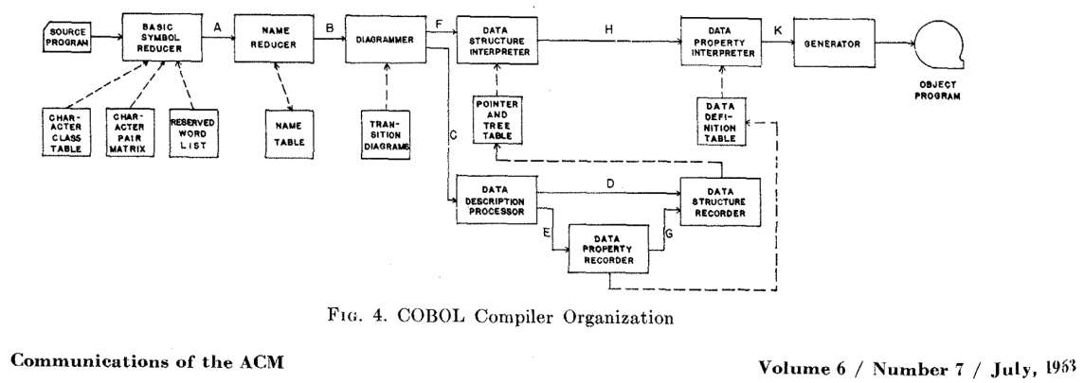

The legend of Melvin Conway
Quoting from Gor Nishanov's 2016 "LLVM Coroutines: Bringing resumable functions to LLVM" talk.

Slide 7
Subroutine ⊂ Coroutine
Subroutine A
Subroutine B
“Coroutines” – Melvin Conway, 1958
Subroutine A
Coroutine C
…
B start
…
C start
call B
“Generalization of subroutine” – Donald Knuth, 1968
call C
end
suspend
 | subroutines | coroutines
call | allocate frame, pass params | allocate frame, pass params
return | free frame, return result | free frame, return result
suspend | No | Yes
resume | No | Yes
B start
resume C
suspend
call B
resume C
end
end
…
…
Quoting from Gor Nishanov's 2016 "LLVM Coroutines: Bringing resumable functions to LLVM" talk.

Slide 8
Where did all the coroutines go?
Algol-60
… introduced code blocks and the begin and end pairs for delimiting them. ALGOL 60 was the first language implementing nested function definitions with lexical scope. – Wikipedia “ALGOL 60”
Quoting from Gor Nishanov's 2016 "LLVM Coroutines: Bringing resumable functions to LLVM" talk.

Slide 9
One “continuation” to rule them all...

Slide 10
“Continuation Sandwich”
The earliest description by Adriaan van Wijngaarden in 1964.
“… a data structure that represents the computational process at a given point in the process's execution; ...” – Wikipedia “Continuation”
“Say you're in the kitchen in front of the refrigerator, thinking about a sandwich. You take a continuation right there and stick it in your pocket. Then you get some turkey and bread out of the refrigerator and make yourself a sandwich, which is now sitting on the counter. You invoke the continuation in your pocket, and you find yourself standing in front of the refrigerator again, thinking about a sandwich. But fortunately, there's a sandwich on the counter, and all the materials used to make it are gone. So you eat it.” – Luke Palmer, 2004

Slide 11
A glimpse of “continuation”
(define the-continuation #f)
(define (test)
(let ((i 0))
; call/cc calls its first function argument, passing
; a continuation variable representing this point in
; the program as the argument to that function.
(call/cc (lambda (k) (set! the-continuation k)))
; The next time the-continuation is called, we start here.
(set! i (+ i 1))
i))
> (test)
1
> (the-continuation)
2
> (the-continuation)
3
> ; stores the current continuation (which will print 4 next) away
> (define another-continuation the-continuation)
> (test) ; resets the-continuation
1
> (the-continuation)
2
> (another-continuation) ; uses the previously stored continuation
4
See Oleg Kiselyo’s An argument against call/cc and Undelimited continuations are not functions articles.

Slide 12
A glimpse of “delimited continuation”
Unlike regular continuations, delimited continuations return a value, and thus may be reused and composed.
; The reset delimits the continuation that shift captures (named by k in this example).
; The use of shift will bind k to the continuation (+ 1 []),
; where [] represents the part of the computation that is to be filled with a value.
(* 2 (reset (+ 1 (shift k (k 5)))))
(reset (* 2 (shift k (k (k 4)))))
; invokes (k 4) first (which returns 8),
; and then (k 8) (which returns 16).
; At this point, the shift expression has terminated,
; and the rest of the reset expression is discarded.
; Therefore, the final result is 16.

Slide 13
What is so important about continuations?
Using continuations you can implement
longjmp (C)
exceptions (C++, Java, etc.)
generators (Icon, Python, etc.)
backtracking (Prolog, etc.)
and… guess what else?

Slide 14
continuation + scheduler = ?

Slide 15

How do we compose I/O?
(without changing neither the language, nor the VM byte code)
Blocking calls
public SearchResponse search(SearchRequest request) {
// Check caches.
SearchResponse cachedResponse = cache.find(reqest);
if (cachedResponse != null) {
return cachedResponse;
}
// Check redirects.
SearchResponse redirectedResponse = redirectService.find(request);
if (redirectedResponse != null) {
return redirectedResponse;
}
// Perform plain search enriched with suggestions.
SearchRequest enrichedRequest = suggestionService.enrich(request);
return plainSearch(enrichedRequest);
}
Callbacks (non-blocking)
public void search(
SearchRequest request,
Consumer<SearchResponse> callback) {
// Check caches.
return cache.find(request, cachedResponse -> {
if (cachedResponse != null) {
callback.accept(cachedResponse);
} else {
// Check redirects.
redirectService.find(request, redirectedResponse -> {
if (redirectedResponse != null) {
return callback.accept(redirectedResponse);
} else {
// Perform plain search enriched with suggestions.
suggestionService.enrich(request, enrichedRequest -> {
plainSearch(enrichedRequest, searchResponse -> {
callback.accept(searchResponse);
});
});
}
});
}
});
}
Reactor (non-blocking)
public Mono<SearchResponse> search(SearchRequest request) {
return Flux
.concat(cache.find(request),
redirectService.find(request),
suggestionService
.find(request)
.flatMap(this::plainSearch))
.take(1)
.singleOrEmpty();
}

Slide 16
Blocking what?
executed instructions
thread
activity
Blocking calls
time
public SearchResponse search(SearchRequest request) {
// Check caches.
SearchResponse cachedResponse = cache.find(reqest);
if (cachedResponse != null) {
return cachedResponse;
}
// Check redirects.
SearchResponse redirectedResponse = redirectService.find(request);
if (redirectedResponse != null) {
return redirectedResponse;
}
// Perform plain search enriched with suggestions.
SearchRequest enrichedRequest = suggestionService.enrich(request);
return plainSearch(enrichedRequest);
}
running
blocked

Slide 17
How does asynchronous I/O get composed?
callchain
Reactor (non-blocking)
public Mono<SearchResponse> search(SearchRequest request) {
return Flux
.concat(cache.find(request),
redirectService.find(request),
suggestionService
.find(request)
.flatMap(this::plainSearch))
.take(1)
.singleOrEmpty();
}

Slide 18
Why all this reactive hassle?
Request-1
Request-2
Request-3
...
Request-100
Request-1
Request-2
Request-3
...
Request-100
Thread-1
Thread-2
Thread-3
Thread-100
Thread-1
...
Blocking calls
...
Callchain-100
Callchain-3
Callchain-2
Reactor (non-blocking)
Callchain-1
If spawning and context
switching costs of threads
would be equal to the ones
in callchains, would you
still favor the latter?

Slide 19
Process-vs-thread
(single-threaded)
OS Process
(multi-threaded)
OS Process
...
Stack₁
Stack₂
Stack₁
Stack₂
Stack₃
Stack_{N}
Registers₁
Registers₂
Registers₁
Registers₂
Registers₃
Registers_{N}
Code₁
Code₂
Code
Data₁
Files₁
Data₂
Files₂
Data
Files
OS Scheduler
OS Scheduler
CPU₁
CPU₂
...
CPU_{K}
CPU₁
CPU₂
...
CPU_{K}
Both processes and threads denote a continuation: a sequence of instructions that can be suspended and resumed.
process = continuation + scheduler
Cheaper!
thread = continuation + scheduler

Slide 20
What is a fiber?
M >> N
OS Process
1
2
3
...
M
User-level scheduler
Stack₁
Stack₂
Stack₃
...
Stack_{N}
Registers₁
Registers₂
Registers₃
Registers_{N}
Both processes and threads denote a continuation: a sequence of instructions that can be suspended and resumed.
Code
Data
Files
OS Scheduler
CPU₁
CPU₂
...
CPU_{K}
process = continuation + scheduler
kernel
Cheaper!
thread = continuation + scheduler
kernel
both share memory
fiber = continuation + scheduler
Cheaper!
user

Slide 21
Does JVM support fibers?
in essence, “continuations”
Yes, it can, but it (natively) doesn’t.
Lisp^{(call/cc)}, BEAM^{(Erlang VM)}, Haskell, Go, JavaScript^{(async, await)} (natively) do.
Quasar, Kilim, etc. provides continuations and fibers for JVM.
  What if someone calls Thread.sleep()?
  What if a coroutine calls a non-coroutine method?
  What if that non-coroutine method is blocking?
What about Kotlin coroutines?

Slide 22
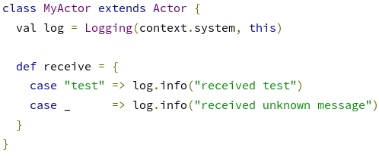


What about actors^{(Erlang, Akka)} / channels^{(Go, Kotlin)}?
m_{N}
...
m₃
m₂
m₁
fiber { BlockingQueue<V>(bufferSize) } = Channel<V>(bufferSize)

Slide 23
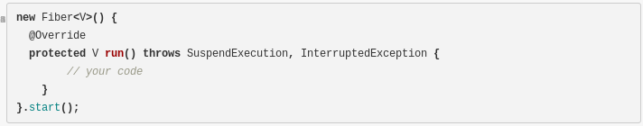
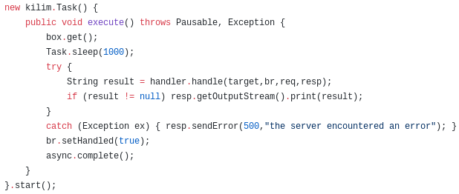
A glimpse of Quasar & Kilim
Quasar
Kilim

Slide 24

So what is the problem?
Asynchronous task composition
Callbacks
Reactive Streams
Fibers
Language-agnostic
Difficult to write
(callbackhell.com)
Difficult to debug & profile
Misses batteries
Viral
Language-agnostic
Includes batteries
Widely supported
Need to learn a new language
Difficult to write & get right
Difficult to debug & profile
Difficult to optimize (by compiler)
Viral
Just works
Language-specific
Requires explicit marking
Misses batteries
Reflective calls are always considered suspendable. This is because the target method is computed at runtime, so there’s no general way of telling if it’s going to call a suspendable method or not before execution.
Java 8 lambdas too are always considered suspendable. This is because they can’t declare checked exceptions, they are ultimately linked (via invokedynamic) to synthethic static methods that can’t be annotated and it is difficult to tell at instrumentation time if lambdas implement a suspendable interface.
Quasar will reject with an error any attempt to mark special methods (that is, constructors and class initializers) as suspendable. This is because suspending in an initializer could expose objects or classes before they’re fully initialized and this is an error-prone, difficult-to-troubleshoot situation that can always (and must) be avoided.

Slide 25
Enter Loom…

Slide 26
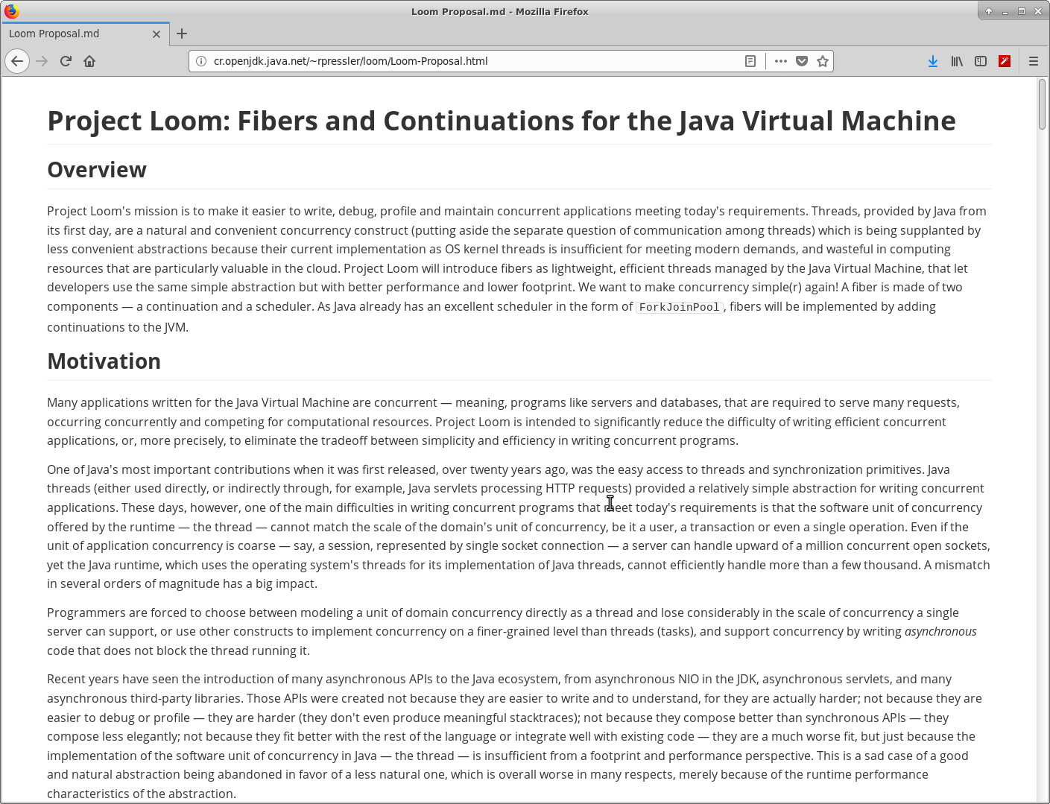
The proposal
Project Loom proposal by Ron Pressler
http://cr.openjdk.java.net/~rpressler/loom/Loom-Proposal.html

Slide 27


Who is Ron Pressler anyway?
Lead at Project Loom
(since 2017)
http://www.paralleluniverse.co/
http://openjdk.java.net/census#loom
In 2012, founded Parallel Universe with the following F/OSS product line:
Quasar: lightweight threads (fibers) for the JVM
Comsat: fiber-aware impl’s of servlets, JAX-RS/Spring REST services, HTTP clients and JDBC
SpaceBase: in-memory spatial and geo-spatial database
Galaxy: distributed in-memory data grid that horizontally scales

Slide 28
Proposal highlights
One of Java's most important contributions when it was first released, over twenty years ago, was the easy access to threads and synchronization primitives.
… today's requirements is that the software unit of concurrency offered by the runtime — the thread — cannot match the scale of the domain's unit of concurrency, …
… asynchronous APIs ... were created
  not because they are easier to write and to understand
    for they are actually harder
  not because they are easier to debug or profile
    they are harder (they don't even produce meaningful stacktraces)
  not because they compose better than synchronous APIs
    they compose less elegantly
  not because they fit better with the rest of
  the language or integrate well with existing code
    they are a much worse fit
but just because the implementation of the software unit of concurrency in Java — the thread — is insufficient from a footprint and performance perspective.

Slide 29

The key project deliverable
Lightweight threads
Asymmetric
one-shot (non-reentrant)
stackful
multi-prompt
delimited
continuations.
See Ron Pressler's detailed post in the loom-dev mailing list.

Slide 30
Are we there yet?
OIO rewrite
Continuations
Strand → Fiber → Lightweight thread → Virtual thread
Structured concurrency
Scoped variables
A word on “legacy”...

Slide 31
Structured concurrency

Slide 32


The curse of control flow constructs
sequence
goto
if
loop
call
...
...
...
...
...
Quoting from Martin Sustrik's "Structured Concurrency" talk in FOSDEM'19.

Slide 33
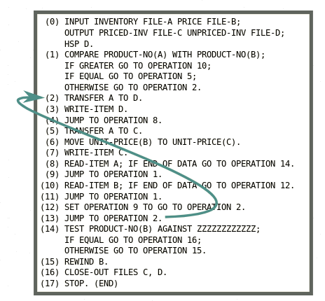
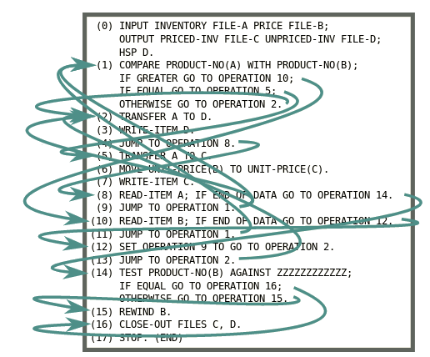
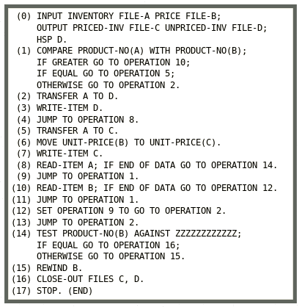
Is GOTO harmful?
(So are threads!)
Quoting from Nathaniel J. Smith's "Notes on structured concurrency" blog post.

Slide 34
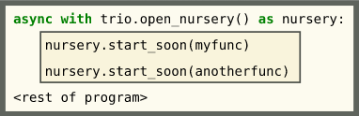
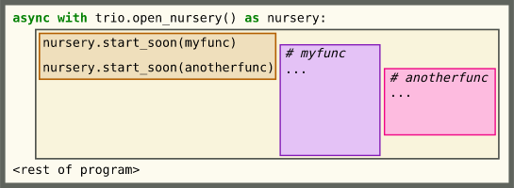
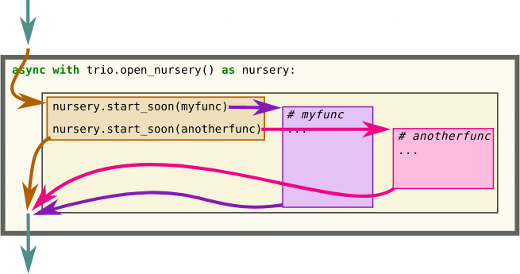
What does structured concurrency look like?
with open("my-file") as file_handle:
...
...
...
...
Quoting from Nathaniel J. Smith's "Notes on structured concurrency" blog post.

Slide 35
A glimpse of Trio
import trio
async def child1():
print(" child1: started! sleeping now...")
await trio.sleep(1)
print(" child1: exiting!")
async def child2():
print(" child2: started! sleeping now...")
await trio.sleep(1)
print(" child2: exiting!")
async def parent():
print("parent: started!")
async with trio.open_nursery() as nursery:
print("parent: spawning child1...")
nursery.start_soon(child1)
print("parent: spawning child2...")
nursery.start_soon(child2)
print("parent: waiting for children to finish...")
# -- we exit the nursery block here --
print("parent: all done!")
trio.run(parent)
parent: started!
parent: spawning child1...
parent: spawning child2...
parent: waiting for children to finish...
child2: started! sleeping now...
child1: started! sleeping now...
[... 1 second passes ...]
child1: exiting!
child2: exiting!
parent: all done!
A word on cancellation...

Slide 36
Scoped variables

Slide 37
Don’t we already have scoped variables?
public class ScopeDemo {
private static final Logger LOGGER = LoggerFactory.getLogger(ScopeDemo.class);
private final List<Runnable> tasks = new ArrayList<>();
private final ThreadLocal<StringBuilder> stringBuilderRef =
ThreadLocal.withInitial(StringBuilder::new);
public void addTask(Runnable task) {
tasks.add(task);
}
public static void main(String[] args) throws IOException {
try (InputStream inputStream = new FileInputStream("/etc/passwd")) {
int firstByte = inputStream.read();
{
int randomByte = (int) Math.abs(Math.random() * 0xFF);
firstByte += randomByte;
}
}
}
}
What is the scope of a ThreadLocal?

Slide 38
Static-vs-Dynamic scoping
> x=1
> function g() {
echo $x;
x=2;
}
> function f() {
local x=3;
g;
}
> f
> echo $x
What do these two statements output?

Slide 39
Dynamic scoping and structured concurrency
> color=null
> function terrier(nursery) {
echo “Terrier sees $color.”;
}
> function dog(nursery) {
echo “Dog sees $color.”
color=”black-and-white”;
nursery.schedule(terrier)
}
> function cat(nursery) {
echo “Cat sees $color.”
}
> with nursery {
color=”colorful”
nursery.schedule(dog)
nursery.schedule(cat)
}
What does this statement output?

Slide 40
Conclusions
Loom will radically change I/O composition in JVM.
Structured concurrency and scoped variables will supplement that ease.

Slide 41
Thank you!
(Questions?)
Volkan Yazıcı
https://vlkan.com
@yazicivo

