Slide 1



Varnishing Search Performance
Changing the (search) engine of a racecar going 300 km/h
SERIOUSLY!
Volkan Yazıcı
http://vlkan.com/

Slide 2
Secret Agenda
I will try to convince you Elasticsearch performance and caching are indeed difficult subjects. So that I can justify our complex caching setup.

Slide 3
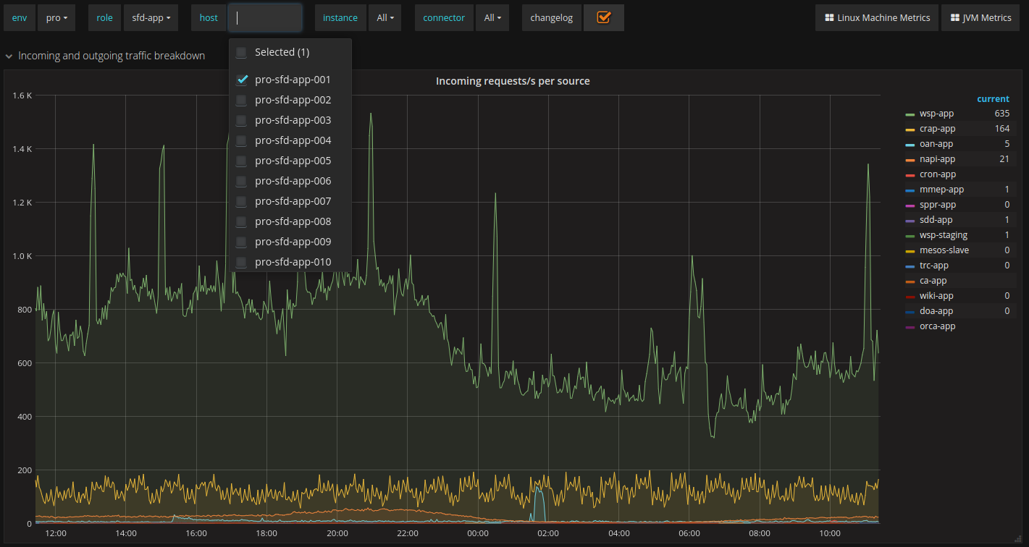
Who uses search anyway?
Consumed by 15 services!
Metrics for 1 out
of 10 nodes!

Slide 4

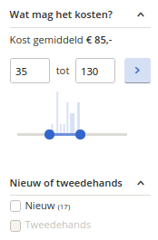



The Untold Story of
Performance in Elasticsearch
FAST
Hey! There aren’t
20 facets here!
You have a couple of constant_score
filters on analyzed fields.
Add some boost
and should spice.
Needed a dozen more fields initially weren’t foreseen.
Exploded the index size using a grenade of 30k synonyms!
Needed to group hits by color, size, etc. Now you have a collapse.
Decided to add 20 aggregations.
Doubled the amount of aggregations.
Just realized you’re serving 5% of calls on production behind an A/B test.
SLOW

Slide 5

SLOW QUERY
CACHED
CACHED

Slide 6
The Untold Story of
Caching with Elasticsearch
SIMPLE
You decided to cache query responses.
Reproducing production problems
becomes more cumbersome.
Tune eviction this and there.
Management interfaces:
- which clusters are used for search
- which clusters are getting indexed
- in-progress index operations
You have to switch between multiple clusters.
Switching to a cold cluster hurts a lot!
How to warm-up?
- replay traffic
- gradually move traffic (session stickiness)
You need to migrate from a legacy system.
COMPLEX

Slide 7

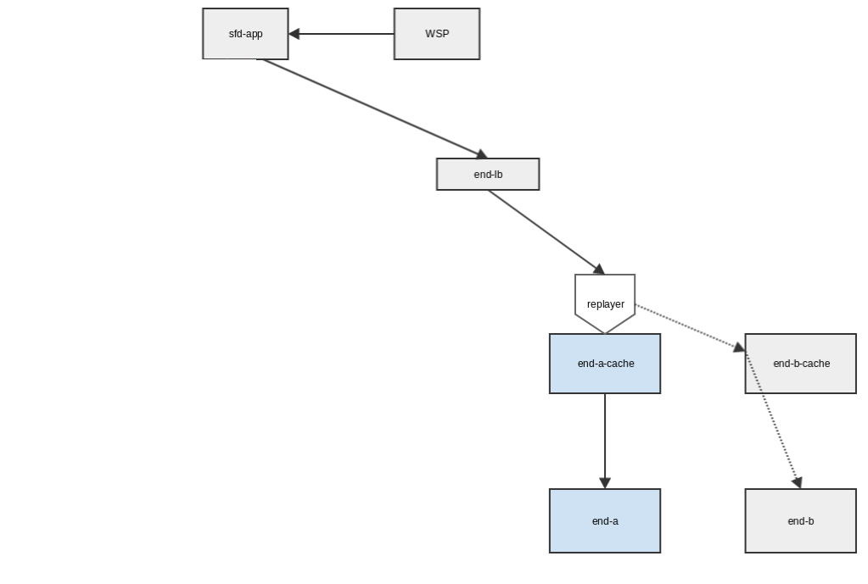



Hail the Legacy!
Shop Find
Just before the season, the collapse became
obvious and team decided to add caching
without tempering much the rest of the system.
A mudball of bash scripts mutating
LB routes, SSH’ing into machines,
executing sudo commands via cron!

Slide 8
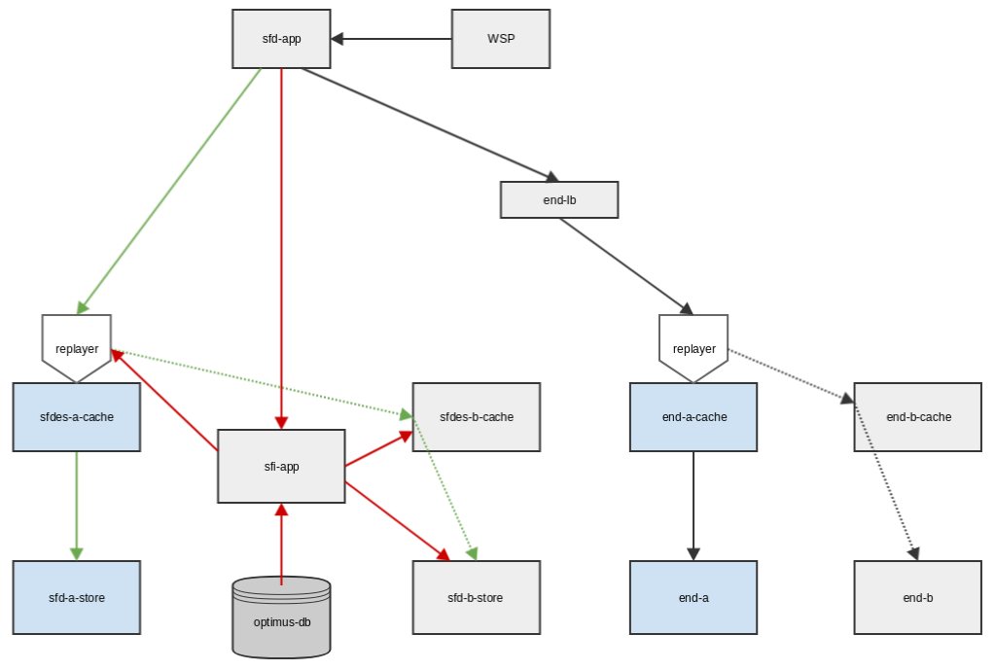

Long live the king!
Shop Find
All inter-service comm. via REST
Actions are
  trackable
  observable
  manageable
Queries are routed to both
END and ES via A/B tests.
Retrieve the cluster states,
i.e., active-vs-inactive.
Start-stop replayers.
Empty caches.
Shop Find Indexer
Tune, index, and retune.

Slide 9
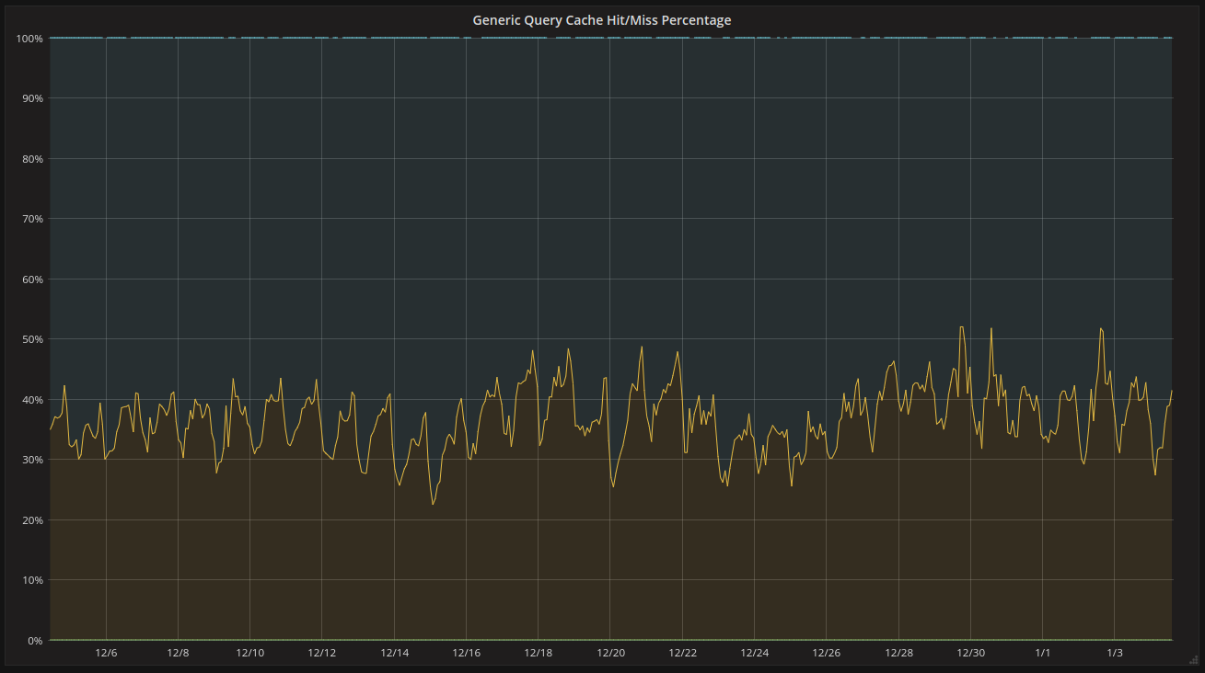
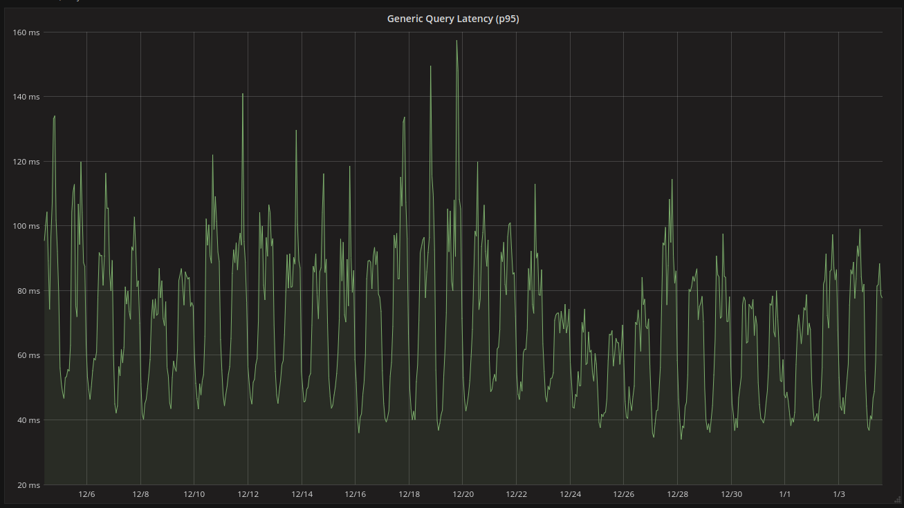
Did it work? (1/2)
(for generic queries)

Slide 10
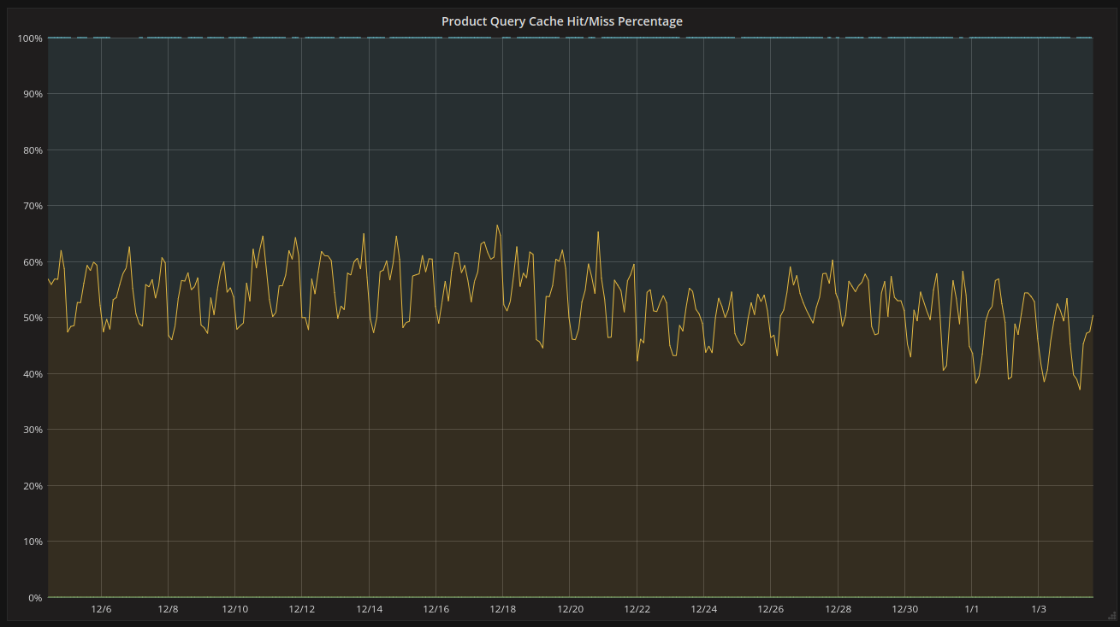
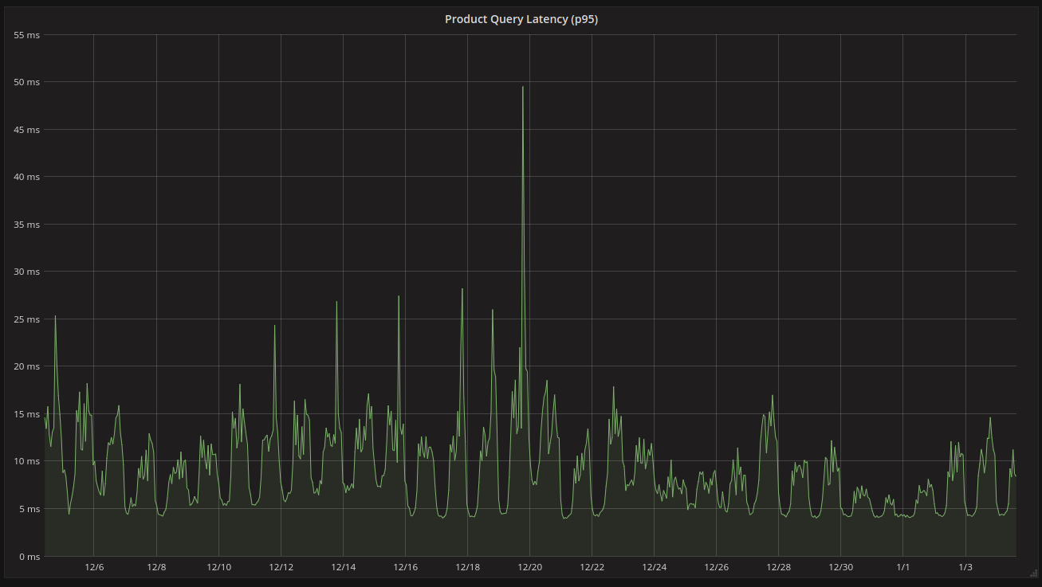
Did it work? (2/2)
(for single product queries)

Slide 11
Questions?
(Do you still want to have caching?)

