Slide 1

Fibers
Green threads
Light weight threads
Coroutines
in Virtual Machine
Volkan Yazıcı
http://vlkan.com/

Slide 2


Multitasking
You have two CPUs.
You can read and watch simultaneously.
You have one CPU.
You can still read and watch simultaneously.
How?
Via multitasking!
But how?

Slide 3
Parallelism vs. Concurrency
1
3
5
1
2
3
4
5
6
CPU₁
2
4
6
executed
concurrently
executed
in parallel
1
3
5
1
3
5
CPU₁
2
4
6
2
4
6
CPU₂
time

Slide 4
What is an OS process and thread?
Process
Process
Data
Files
Data
Files
Code
Code
Registers
Registers
Registers
Registers
Stack
Stack
Stack
Stack
thread
Threads share the same address space
→ consumes less memory
→ spawning is cheaper
→ context switching is cheaper

Slide 5
How does OS map processes/threads to CPUs?
Process
Process
Process
Process
Process
Process
Process
executed
in parallel
executed
concurrently
executed
concurrently
and in parallel
OS
OS
OS
CPU
CPU
CPU
CPU
CPU
Process
Process
Process
Process
OS
OS
OS
CPU
CPU
CPU
CPU
CPU

Slide 6
What is a JVM process and thread?
≤1.1 releases were using green threads
>1.1 releases maps to native OS processes and threads

Slide 7
What is a fiber?
Process
Data
Files
Code
Registers
Registers
Registers
Stack
Stack
Stack
suspension point
fiber
→ preemption entry points are set by the programmer
→ scheduling is performed cooperatively at the user-level

Slide 8
How do fibers work?
fiber
suspension points
Both processes
are interleaved
according to the
suspension points
defined by the
programmer.
program flow

Slide 9
How are fibers implemented?
thread pool

Slide 10
When to use fibers?
Fibers are not meant to replace threads.
Fibers should be used when its body blocks very often waiting on other fibers
→ waiting for messages sent by other fibers on a channel
→ or waiting for the value of a dataflow-variable.
For long-running computations that rarely block, traditional threads are preferable.
Fibers and threads interoperate very well.
Fibers are specially useful for replacing callback-ridden asynchronous code.

Slide 11
Quasar http://docs.paralleluniverse.co/quasar/
Quasar is a Java library that provides
→ high-performance lightweight threads,
→ Go-like channels,
→ Erlang-like actors,
→ and other asynchronous programming tools.
Quasar fibers rely on bytecode instrumentation.
This can be done
→ at classloading time via a Java Agent,
→ or at compilation time. (Ant/Maven plugins are available.)

Slide 12
Running Quasar Code
dependency:
<dependency>
<groupId>com.vlkan</groupId>
<artifactId>quasar-maven-plugin</artifactId>
<version>0.6.2</version>
</dependency>
plugin:
<plugin>
<groupId>com.vlkan</groupId>
<artifactId>quasar-maven-plugin</artifactId>
<version>0.6.2</version>
<configuration>
<check>true</check>
<debug>true</debug>
<verbose>true</verbose>
</configuration>
<executions>
<execution>
<goals>
<goal>instrument</goal>
</goals>
</execution>
</executions>
</plugin>
or via Java Agent: java -javaagent:/path/to/quasar-core.jar ...

Slide 13
Sample Quasar Fiber
Fiber<V> fiber = new Fiber<V>() {
@Override
protected V run() throws SuspendExecution, InterruptedException {
// your code
}
}.start();
// do other stuff
fiber.join();
V value = fiber.get();
Marks a suspension point.
more will
follow in
the demo

Slide 14

What is an actor?
mailbox
fiber
suspension points
loop

Slide 15
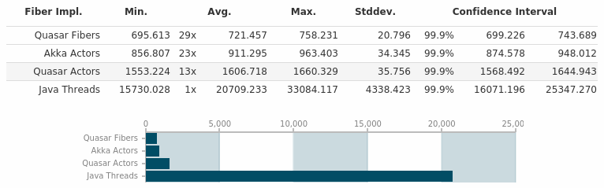
Performance Benchmark: Thread-Ring http://vlkan.com/blog/post/2014/09/01/java-fiber-test/
Thread-ring benchmark:
http://www.sics.se/~joe/ericsson/du98024.html
n threads are spawned and connected as a ring structure. Through this ring a message – an integer comprising 4 bytes – is circulated involving m message passings.
→ Ubuntu GNU/Linux 14.04 (LTS)
→ 6 physical core Intel(R) Xeon(R) E5645 2.40GHz
→ 64-bit Java HotSpot VM (build 1.8.0_20-ea-b05)
→ JMH: 5+5 warmup rounds and 3 JVM forks
→ 503 threads
→ 1e7 message passings
→ Results are in milliseconds

Slide 16
JVM Fiber Implementations
Akka
http://akka.io/
Kilim
http://www.malhar.net/sriram/kilim/
Orbit
http://orbit.bioware.com/
Quasar
http://www.paralleluniverse.co/quasar/

Slide 17
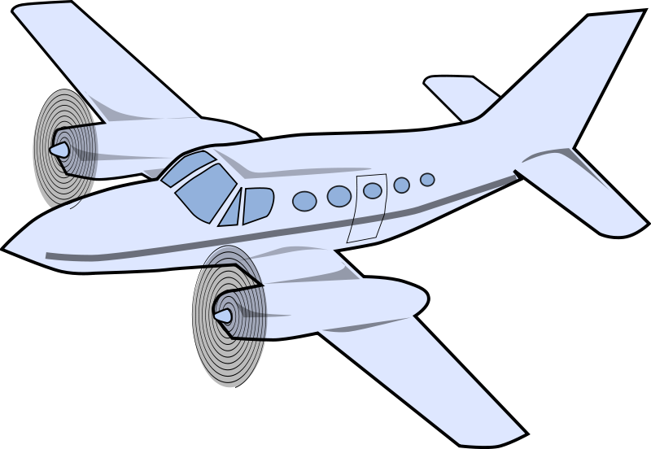

Quasar vs. Akka

Slide 18
Take Away
Multitasking Model | Scheduled by | Memory Model
Process | Kernel | Unshared
Thread | Kernel | Shared
Fiber | Kernel + User | Shared

Slide 19
Questions?

