Slide 1



(The art of not shooting yourself in the foot using Elasticsearch)
Using Elasticsearch as the
Primary Data Store
CNCML Vienna
2019-04-24
@cloudnativecv
#CNCML19
Volkan Yazıcı
https://vlkan.com
@yazicivo

Slide 2
Poll time!
Recently purchased an item online?
Elasticsearch users?
Elasticsearch users with 10+ node clusters?
Updating Elasticsearch indices real-time?

Slide 3
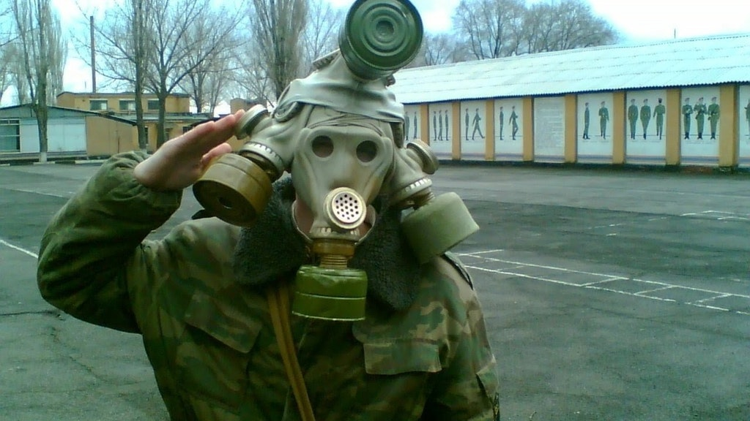
Who am I?
Volkan Yazıcı (vlkan.com – @yazicivo – github/vy)
Java plumber in the domain of search (bol.com, since 2014)
interested in networking & concurrency
  OpenJDK Project Loom (aka. fibers/coroutines for JVM)
  Reactive Streams (Reactor, RxJava)
F/OSS contributor
  log4j2-logstash-layout
  HRRS (HTTP Request Replay Suite)
  quasar-maven-plugin
BS in math, MS and PhD in CS
<number>/28
Photo by Falgscccp, Reddit

Slide 4

Disclaimer
time spent on subject
problem
you are
(somewhere)
here
solution
Photo by Cindy Tang
<number>/28

Slide 5

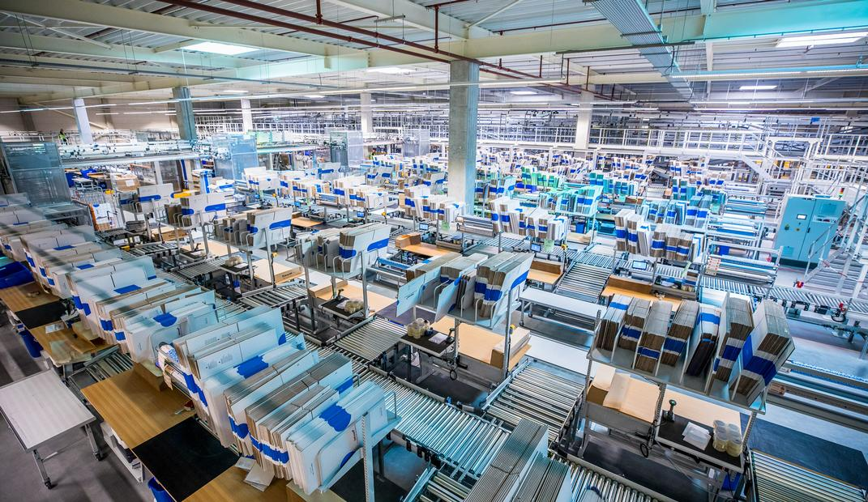
9+ million active¹ clients²
17+ million articles²
200k+ sellers²
1500+ employees²
62+ million visits/month²
¹ Customers who ordered an item in the last 365 days.
² As of October 2018.
<number>/28

Slide 6


E-commerce search
Search
  Matching
  Ranking
  Faceting
Guidance
  Suggestions
  Auto-corrections
  Recommendations
Photo by Alexander Hafemann
<number>/28

Slide 7
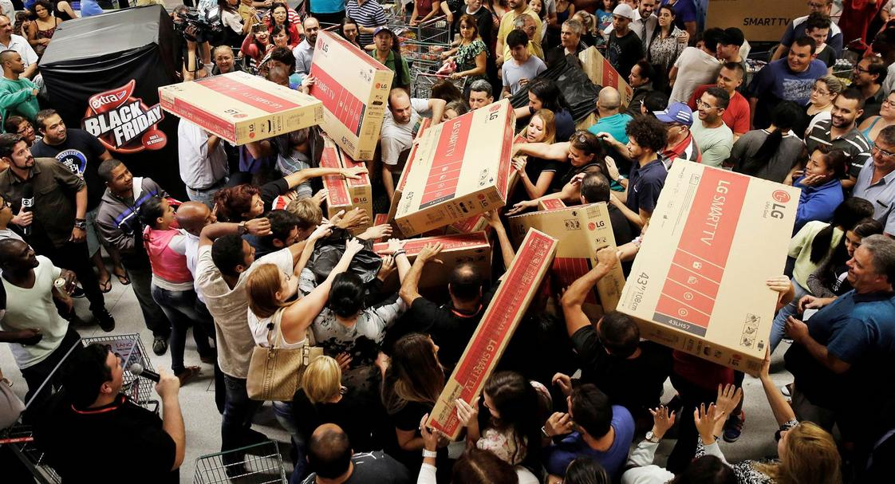
Who is using search?
Customers
Sellers
  via web
  via API
Bots
  search engines (Google, Bing, etc.)
  competitors
Internal services
<number>/28
Photo by Nacho Doce, Reuters

Slide 8


Search input
Product attributes (title, EAN, ISBN, color, etc.)
Seller offers (price, availability, deliverability)
Derived content (for ranking)
  Sale popularity
  Price quality
  Customer feedback (reviews, etc.)
Configuration (faceting, value translations, etc.)
volume
&
volatility
Photo by Jezael Melgoza
<number>/28

Slide 9

Search output
Hits (products and offers)
Facets
Auto-corrections
Redirects (huge SEO impact)
Photo by Samuel Zeller
<number>/28

Slide 10










Architecture overview
Configuration
- Categories
- Facets
- Synonyms
- ...
Search
Gateway
Users
Content
- Attributes
- Offers
- ...
ETL Pipeline
Search Index
(Elasticsearch)
Photo by Chad Kirchoff
<number>/28
Notes:
caching layers
orchestrating multiple clusters
custom flush/replay
resiliency mechanisms
maintaining deprecated search entities
circuit breakers
throttlers
load balancers

Slide 11

Data arrival latency
Source | Past | Present | Future
Attributes | 1/24h | streaming | streaming
Offers | streaming | streaming | streaming
Facets | 1/24h | 1/24h | streaming
Indexing | 1/24h | 1/5h | streaming
Photo by Matthew Smith
<number>/28

Slide 12


Performance
Search
ETL
Caching
(see Varnishing Search Performance)
Photo by Vidar Nordli-Mathisen
Photo by Adrian Schulte, MSC Public Affairs, U.S. Navy

Slide 13
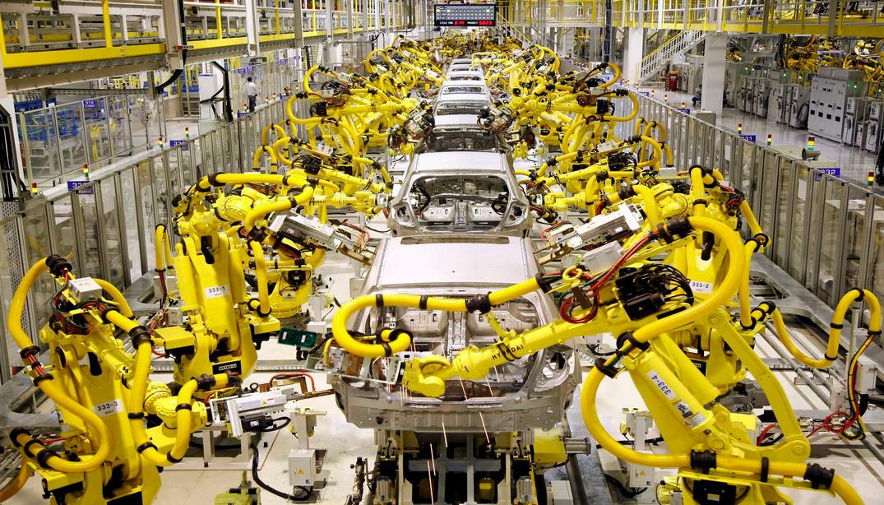
ETL
(Extract, Transform, Load)
Photo by "Robots on a Hyundai vehicle assembly line"

Slide 14
if (attrs.gpc.family_id == 1234 &&
attrs.gpc.chunk_id == 5678) {
doc.category = “books”
}
Configuration
- Categories
- Facets
- Synonyms
- ...
Low-volume (~8/day) traffic triggering multiple (millions!) product updates
if (attrs.disk_capacity_bytes != null) {
doc.disk_capacity_gigabytes =
attrs.disk_capacity_bytes / 1e9
}
High-volume (millions/day) traffic each triggering single product updates
category == “smart phones”
if (attrs.disk_capacity_bytes != null) {
doc.disk_capacity_terabytes =
attrs.disk_capacity_bytes / 1e12
}
category == “computers”
exposure rules (signaling search gateway to when/where to expose these facets)
Content
- Attributes
- Offers
- Discounts
- ...
ETL Pipeline
{
gpc: {
family_id: …,
chunk_id: …
},
disk_capacity_bytes: …,
…
}
Photo by "Robots on a Hyundai vehicle assembly line"
<number>/28

Slide 15
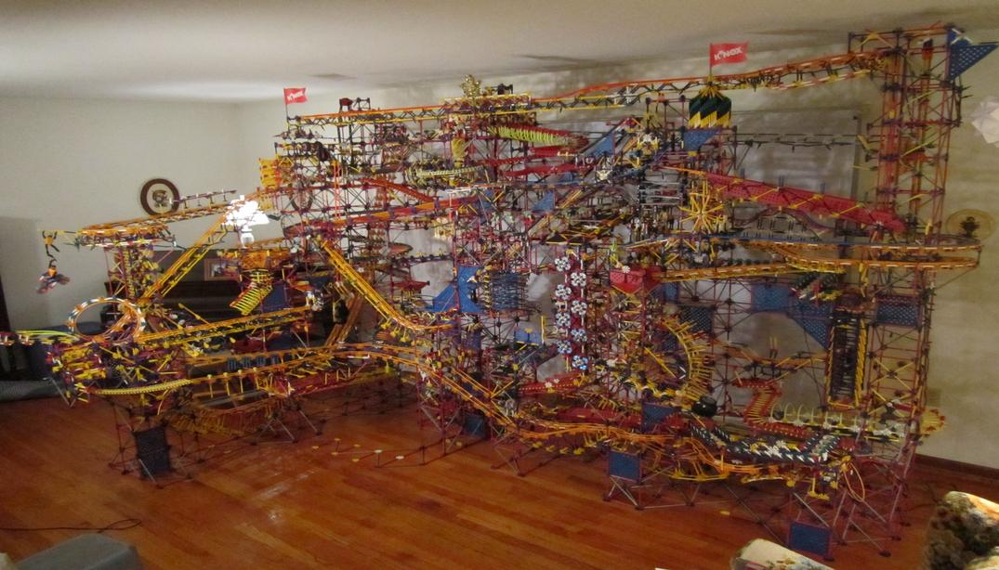
Why ETL at all?
Strategy | Advantages | Disadvantages
Without ETL | Changes take immediate effect | Latency and throughput hurts Aggregations become impractical
With ETL | Optimal query-time performance | Need to bake affected products
Photo by "K'nex ball contraption"
<number>/28
Notes:
9 months
2 lifts
16 different paths
31k pieces
45kg

Slide 16
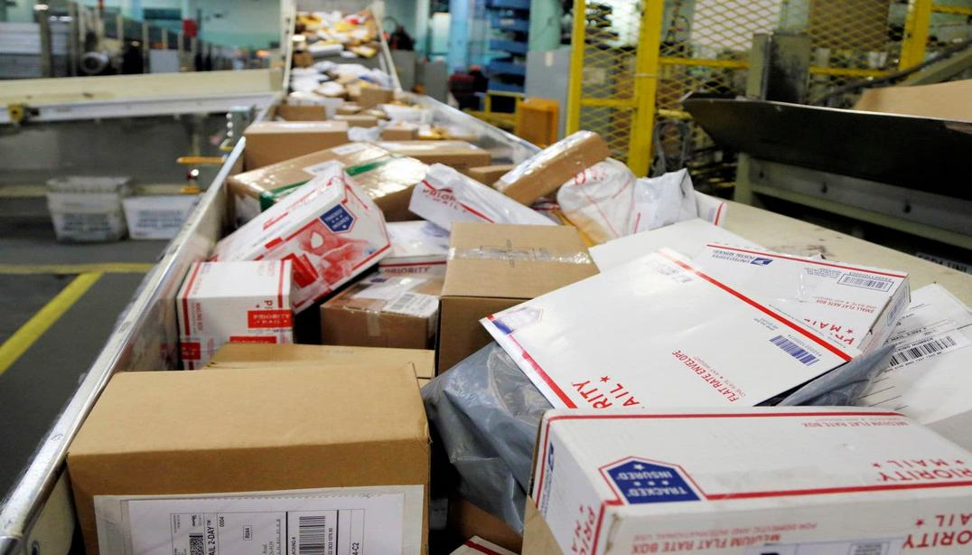
Content stream
Sources
  Content
  Offer
  Ranking
  ...
Volatility
ETL’ing is expensive
(due to tens of thousands of configurations)
if (attrs.gpc.family_id == 1234 &&
attrs.gpc.chunk_id == 5678) {
doc.category = “books”
}
Photo by Nati Harnik, Associated Press
<number>/28

Slide 17

Configuration stream
Business screens
  Configuration snapshots
  Query on any field
Volatility
Retrospective changes
if (attrs.gpc.family_id == 1234 &&
attrs.gpc.chunk_id == 5678) {
doc.category = “books”
}
Photo by Patryk Grądys
<number>/28

Slide 18

ETL
Operational Overview
Photo by Kaleidico

Slide 19
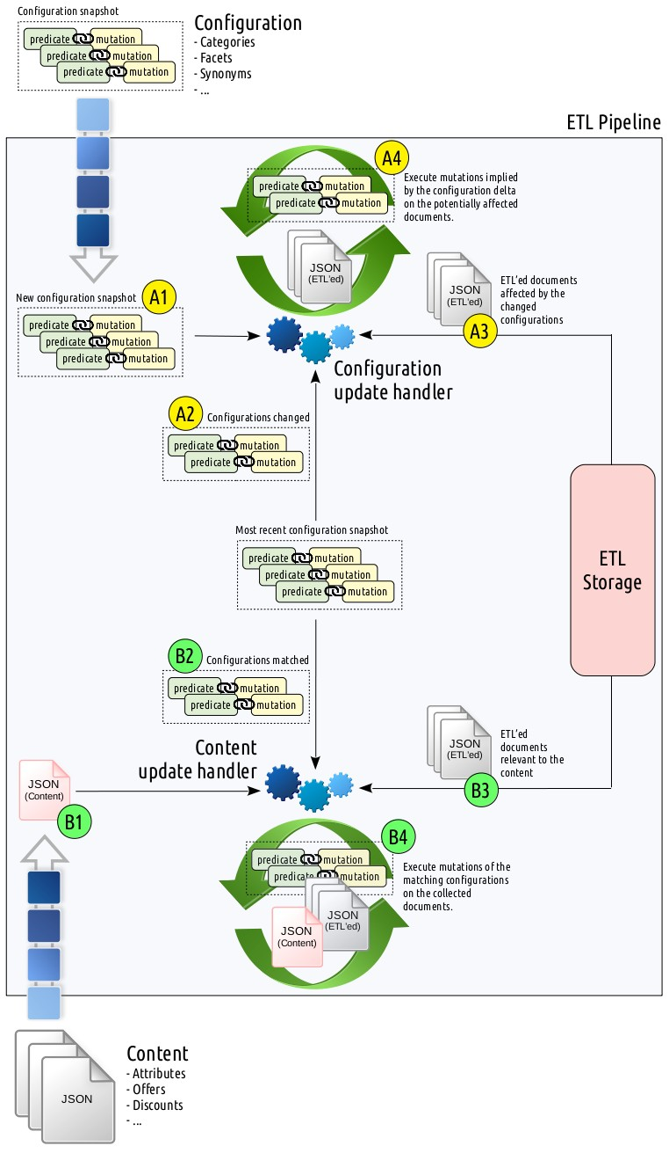
Photo by Kaleidico
<number>/28

Slide 20



Configuration snapshot
Configuration
- Categories
- Facets
- Synonyms
- ...
predicate
mutation
A4
predicate
mutation
predicate
mutation
Execute mutations implied by the configuration delta on the potentially affected documents.
predicate
mutation
predicate
mutation
ETL
Storage
A1
ETL’ed documents affected by the changed configurations
New configuration snapshot
predicate
mutation
A3
predicate
mutation
predicate
mutation
Configuration
update handler
A2
Configurations changed
if (attrs.gpc.family_id == 1234 &&
attrs.gpc.chunk_id == 5678) {
doc.category = “books”
}
predicate
mutation
predicate
mutation
Most recent configuration snapshot
predicate
mutation
predicate
mutation
predicate
mutation
Photo by Kaleidico
<number>/28

Slide 21
Most recent configuration snapshot
if (attrs.gpc.family_id == 1234 &&
attrs.gpc.chunk_id == 5678) {
doc.category = “books”
}
predicate
mutation
predicate
mutation
predicate
mutation
B2
Configurations matched
predicate
mutation
ETL
Storage
predicate
mutation
Content
update handler
ETL’ed documents relevant to the content
B3
B1
B4
predicate
mutation
Execute mutations of the matching configurations on the collected documents.
predicate
mutation
Content
- Attributes
- Offers
- Discounts
- ...
{
gpc: {
family_id: …,
chunk_id: …
},
disk_capacity_bytes: …,
…
}
Photo by Kaleidico
<number>/28

Slide 22

Old ETL
One giant PL/SQL troop marching 1/24h
“Baseline” taking ~12h
Failures hurt a lot
Difficult to
  innovate
  debug
  observe
At the edge of software limits
  e.g. max column count
  multiple threads in PL/SQL
  optimizer hints getting broken as
    upgrades take place
    data size change
Photo by Jon Sailer
<number>/28

Slide 23
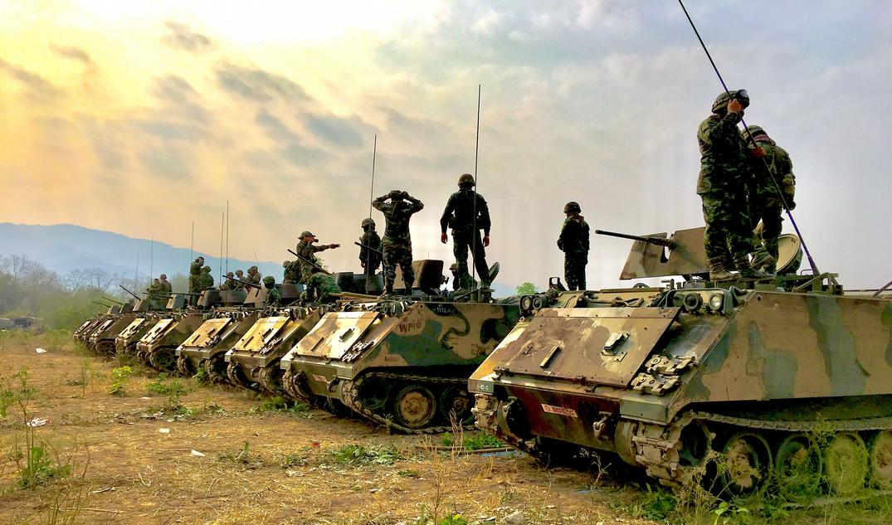

Battle of ETL Storage Solutions
Storage Solution | Distributed? | Sharded? | Required Indices | Integrity Measure
PostgreSQL | No | No | One¹ | Transactions
PostgreSQL (partitioned) | No | Yes² | One¹ | Transactions
MongoDB | Yes | Yes³ | Some⁴ | Transactions/CAS⁵
Elasticsearch | Yes | Yes | None | CAS⁶
PostgreSQL jsonb index covers all fields.
PostgreSQL partitioning is not sharding in distributed sense, but still serves a similar purpose.
MongoDB sharding requires manual configuration.
MongoDB requires an explicit index for each whitelisted field allowed in ETL configuration predicates.
MongoDB updateMany() or findAndModify() can be leveraged for the desired integrity.
Elasticsearch _version field can be leveraged to implement a CAS (compare-and-swap) loop.
Photo by Chuanchai Pundej
<number>/28

Slide 24

New ETL
Photo by Pablo Heimplatz

Slide 25
Storage solution winner: Elasticsearch
Versatile query support
Implicit indexing
Scales good for reads, ok’ish for writes
Easy to maintain
Extensive experience
Photo by Pablo Heimplatz
<number>/28

Slide 26

Configuration model
predicate
predicate
mutation
mutation
Old representation
SQL WHERE clause
predicate
PL/SQL procedure
New representation
Elasticsearch-like
structured predicate
Extension
Functional Extension
JSON
Groovy
JSON
Predicate
Elasticsearch Executor
Predicate
JSON Executor
Extension
JSON Executor
Functional Extension
JSON Executor
Elasticsearch
JSON
Photo by Pablo Heimplatz
<number>/28

Slide 27

TL;DR
Google-like search != e-commerce search
(though both employ full-text search)
ETL = the art of cooking content (for search)
ETL rules necessitate search as well
(due to excessive faceting)
Elasticsearch is a good candidate for storage in ETL
Photo by Hutomo Abrianto
<number>/28

Slide 28
Thank you!
(Questions?)
Volkan Yazıcı
https://vlkan.com
@yazicivo #CNCML19

