Slide 1
Shape Context and Shape Matching
Computer Vision
Exercise session 8

Slide 2
Teaching assistant:
Yawei Li
  yawei.li@vision.ee.ethz.ch

Slide 3
Assignment Tasks:
Shape Matching
Hand-out: 21-11-2019
Hand-in: 28-11-2019 23:00

Slide 4
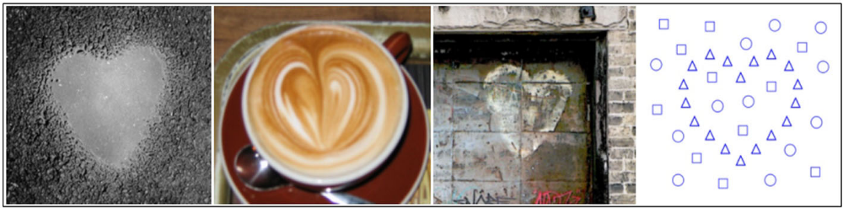
Shape Matching
Objectives
Compute shape context descriptors
2. Match a template shape to a target set of points using shape contexts
Task 1

Slide 5
Overview of Algorithm
Given a set of template and target points:
Compute shape context descriptors for both sets of points
Estimate cost matrix between two sets of descriptors
Use cost matrix to solve the correspondence problem between two sets of descriptors (e.g. with Hungarian algorithm)
From the correspondence, estimate a transformation from template to target points (e.g. with Thin Plate Splines) and perform this transformation on the template points
e. Iterate steps a-d.
Task 1

Slide 6
Overview of Algorithm
Given a set of template and target points:
Compute shape context descriptors for both sets of points
Estimate cost matrix between two sets of descriptors
Use cost matrix to solve the correspondence problem between two sets of descriptors (e.g. with Hungarian algorithm)
From the correspondence, estimate a transformation from template to target points (e.g. with Thin Plate Splines) and perform this transformation on the template points
e. Iterate steps a-d.
Task 1

Slide 7

How to Represent Shapes?
Model
Task 1
Belongie, et al, PAMI 2002, Shape matching and object recognition using shape contexts

Slide 8
Shape Context Descriptor
Count number of points inside each bin
Compact representation of distribution of points relative to each point
Count = 4
Model
Count = 10
Task 1
Belongie, et al, PAMI 2002, Shape matching and object recognition using shape contexts

Slide 9
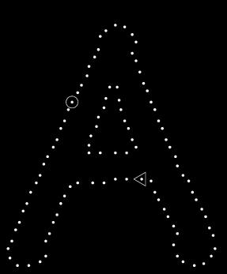
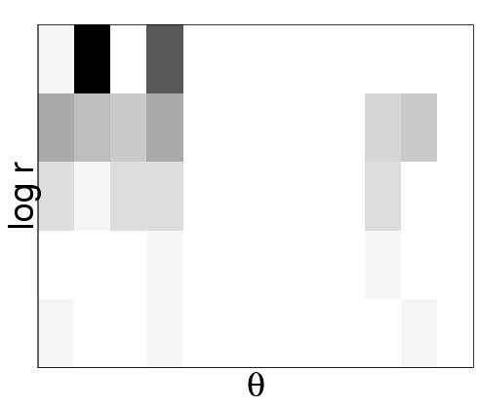
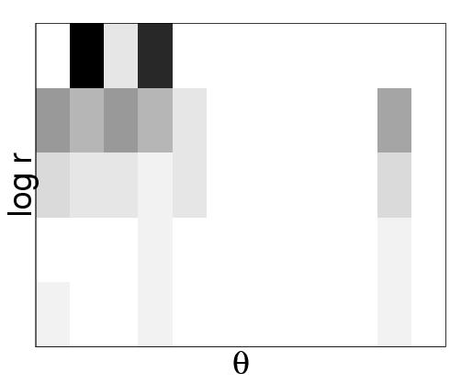
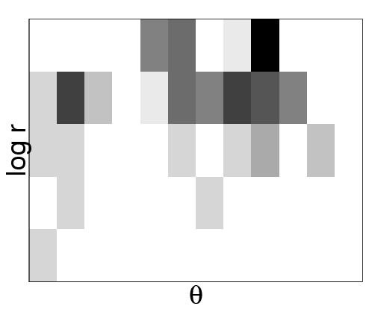
Shape Context Descriptor (2)
Task 1
Belongie, et al, PAMI 2002, Shape matching and object recognition using shape contexts
Notes:
Image from: http://www.cs.berkeley.edu/~malik/

Slide 10
Overview of Algorithm
Given a set of template and target points:
Compute shape context descriptors for both sets of points
Estimate cost matrix between two sets of descriptors
Use cost matrix to solve the correspondence problem between two sets of descriptors (e.g. with Hungarian algorithm)
From the correspondence, estimate a transformation from template to target points (e.g. with Thin Plate Splines) and perform this transformation on the template points
e. Iterate steps a-d.
Task 1

Slide 11
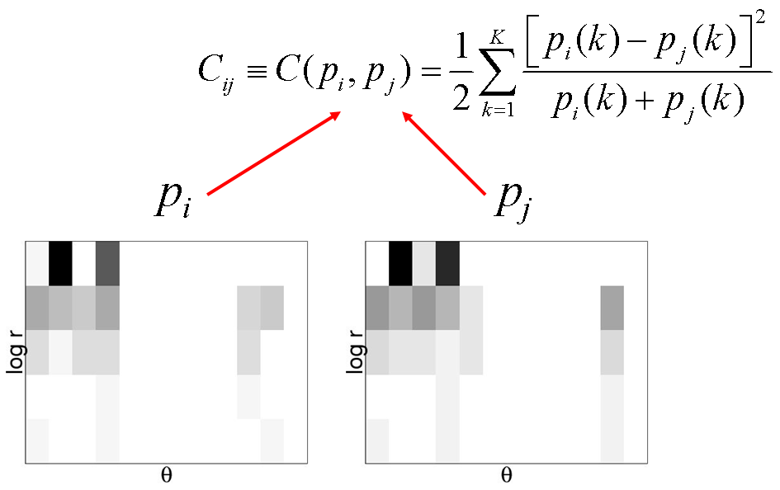
Matching Costs
Chi-squared distance between descriptors i and j.
Task 1
Belongie, et al, PAMI 2002, Shape matching and object recognition using shape contexts
Notes:
Image from: http://www.cs.berkeley.edu/~malik/

Slide 12
Overview of Algorithm
Given a set of template and target points:
a. Compute shape context descriptors for both sets of points
b. Estimate cost matrix between two sets of descriptors
Use cost matrix to solve the correspondence problem between two sets of descriptors (e.g. with Hungarian algorithm)
From the correspondence, estimate a transformation from template to target points (e.g. with Thin Plate Splines) and perform this transformation on the template points
e. Iterate steps a-d.
Task 1

Slide 13
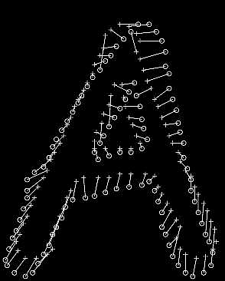
Correspondence Problem
Minimize total cost of matching such that matching is one-to-one
E.g. with Hungarian algorithm
Task 1
Belongie, et al, PAMI 2002, Shape matching and object recognition using shape contexts

Slide 14
Overview of Algorithm
Given a set of template and target points:
a. Compute shape context descriptors for both sets of points
b. Estimate cost matrix between two sets of descriptors
c. Use cost matrix to solve the correspondence problem between two sets of descriptors (e.g. with Hungarian algorithm)
From the correspondence, estimate a transformation from template to target points (e.g. with Thin Plate Splines) and perform this transformation on the template points
e. Iterate steps a-d.
Task 1

Slide 15
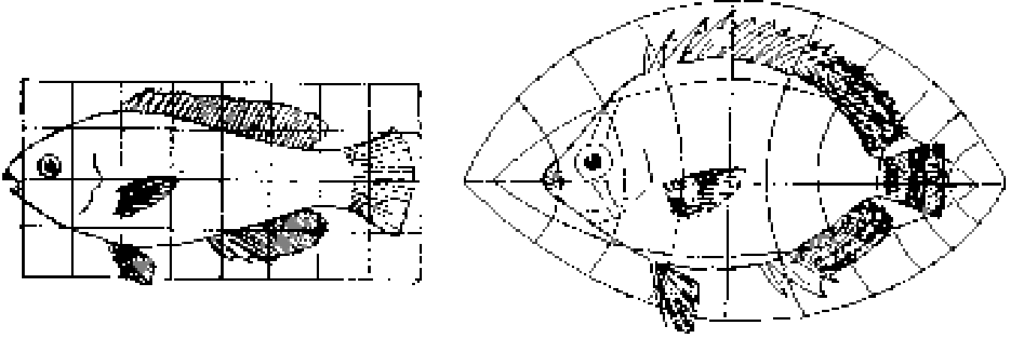
Transformation
Model
Target
Task 1
Belongie, et al, PAMI 2002, Shape matching and object recognition using shape contexts

Slide 16
Thin Plate Splines(1)
A
T
B
We are given a set of correspondences
We want to estimate the function T: R² →R² that transforms A into B
Task 1
Belongie, et al, PAMI 2002, Shape matching and object recognition using shape contexts

Slide 17
Thin Plate Splines(2)
A
T
B
From the correspondences, we get a displacement:
=
+
Vertical Horizontal
Each component (vertical and horizontal) is a single function
that we want to interpolate with a TPS.
Task 1

Slide 18

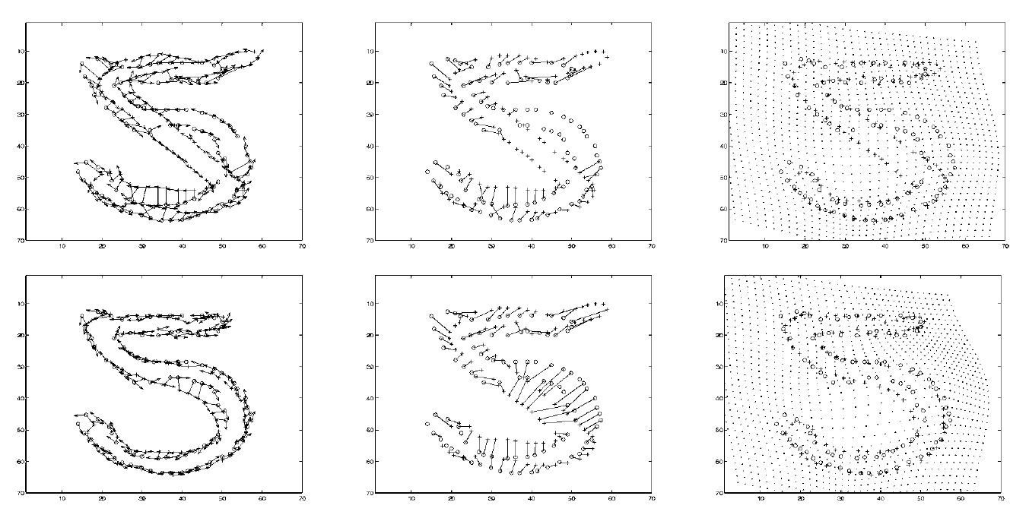
Thin Plate Splines(3)
Task 1
Belongie, et al, PAMI 2002, Shape matching and object recognition using shape contexts

Slide 19
Overview of Algorithm
Given a set of template and target points:
a. Compute shape context descriptors for both sets of points
b. Estimate cost matrix between two sets of descriptors
c. Use cost matrix to solve assignment problem between two sets of descriptors (e.g. with Hungarian algorithm)
d. From the assignment, estimate a transformation from template to target points (e.g. with Thin Plate Splines)
e. Iterate steps a-d.
Task 1

Slide 20
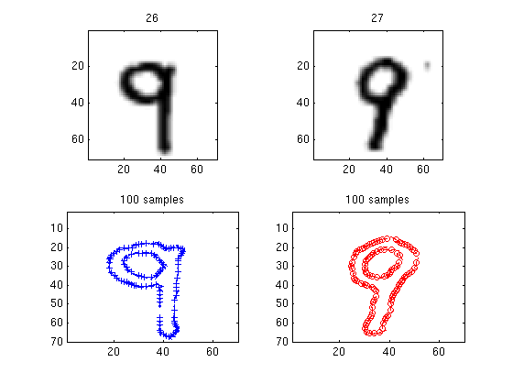
Example 1 - Numbers
Task 1
Belongie, et al, PAMI 2002, Shape matching and object recognition using shape contexts

Slide 21
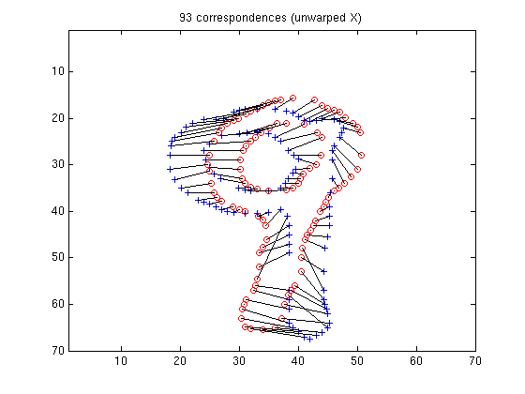
Example 1 - Numbers
Task 1
Belongie, et al, PAMI 2002, Shape matching and object recognition using shape contexts

Slide 22
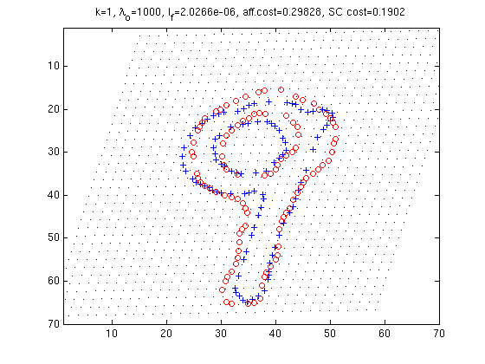
Example 1 - Numbers
Task 1
Belongie, et al, PAMI 2002, Shape matching and object recognition using shape contexts

Slide 23
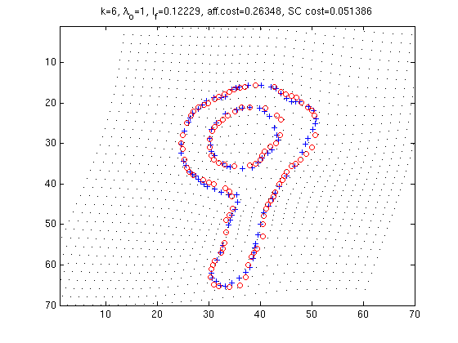
Example 1 - Numbers
Task 1
Belongie, et al, PAMI 2002, Shape matching and object recognition using shape contexts

Slide 24
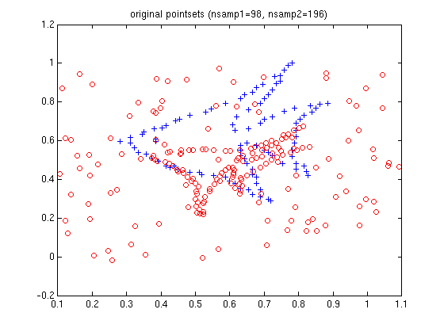
Example 2 - Fish
Task 1
Belongie, et al, PAMI 2002, Shape matching and object recognition using shape contexts

Slide 25
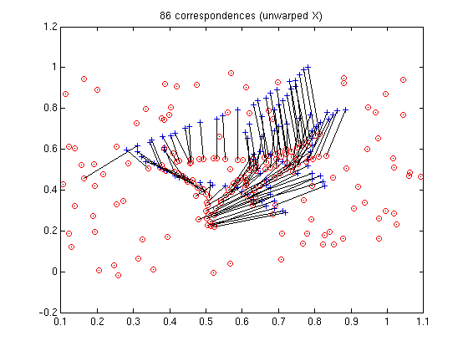
Example 2 - Fish
Task 1
Belongie, et al, PAMI 2002, Shape matching and object recognition using shape contexts

Slide 26
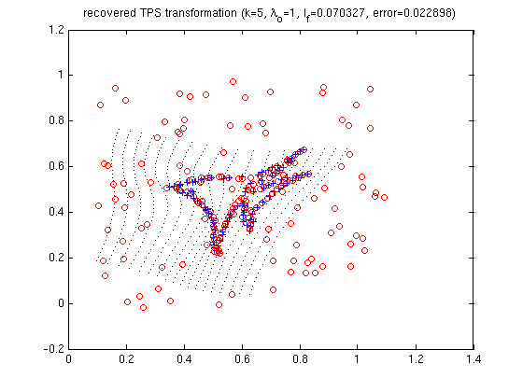
Example 2 - Fish
Task 1
Belongie, et al, PAMI 2002, Shape matching and object recognition using shape contexts

Slide 27
Send your reports and your implementation of the required Matlab functions
  explain main steps of your implementation
  comment the results
  answer the questions in the hand-out paper
Ask questions: email to yawei.li@vision.ee.ethz.ch

