Slide 1
Predicting NFL QB Fantasy Performances
DAT 8
Victor Yang

Slide 2
The procrastinator is often remarkably optimistic about his ability to complete a task on a tight deadline; this is usually accompanied by expressions of reassurance that everything is under control. (Therefore, there is no need to start.) Lulled by a false sense of security, time passes. At some point, he crosses over an imaginary starting time and suddenly realizes, "Oh no! I am not in control! There isn't enough time!"
- Cal Poly study on procrastination

Slide 3
Why we care
Fantasy football is a multibillion dollar industry and began back in the 1960s
Recent surge in funding and advertisements due to advent of weekly leagues
Similar to online poker in its early days, not just luck
Can we model QB fantasy points using historical data and Las Vegas odds?
Bonus question: Can we predict better than Yahoo?

Slide 4
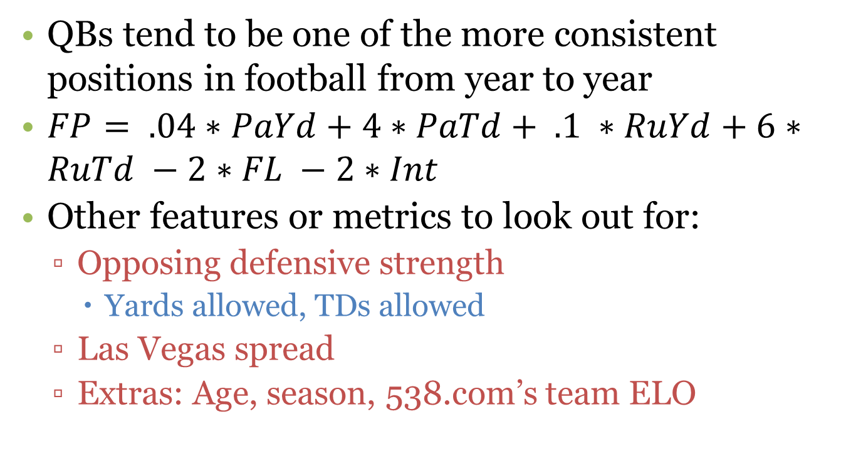
How a QB is scored in fantasy football
QBs tend to be one of the more consistent positions in football from year to year
$FP= .04∗PaYd+4∗PaTd+ .1 ∗RuYd+6∗RuTd −2∗FL −2∗Int$
Other features or metrics to look out for:
Opposing defensive strength
Yards allowed, TDs allowed
Las Vegas spread
Extras: Age, season, 538.com’s team ELO

Slide 5
Data sources
Python packages called nflgame and nfldb
APIs that retrieve and parse JSON data from NFL.com’s GameCenter (only goes back to 2009)
FootballLOCKS.com
Sells “expert picks” for bettors claiming it can beat Vegas’s spread (goes back to 2006)
Repole.com
A professional handicapper’s personal website that keeps track of historical lines and other stats (goes back to 1978)
16 weeks of 14-16 games between 2 starting QBs over last 5 seasons ~ 2400 observations
Would like to stretch this further if possible

Slide 6
The data and bumps so far
Team stats scraped
Formatting changed between seasons
Most series/columns need cleaning
Historic Vegas lines downloaded
CSV’s were missing comma at end
Bash scripting and sed fixed this relatively painlessly
Game-level player stats collected
Documentation lacking in certain areas
Reddit and IRC served as excellent resources

Slide 7
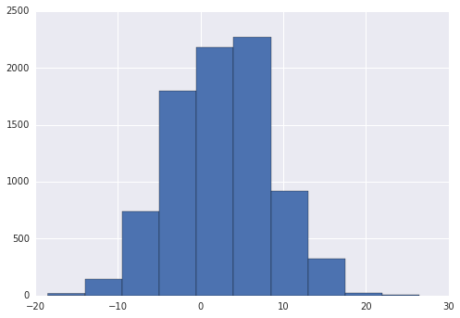
Distribution of Vegas spreads since 1978
Count
2007 Patriots @ Ravens
2007 Jets @ Patriots
Vegas Line

Slide 8
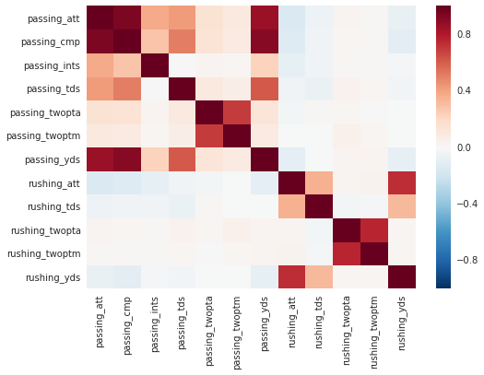
QB Stat Correlations

Slide 9
Setting up the data
Create game IDs based on season and teams playing
Normalize team names
Create rolling averages to date using pd.expanding_mean() by QB
Features:
'season', 'week', 'home', 'Line', 'TotalLine’, , 'fumbles_lost', 'passing_att', 'passing_cmp', 'passing_ints', 'passing_tds','passing_twopta', 'passing_twoptm', 'passing_yds', 'rushing_att', 'rushing_tds', 'rushing_twopta','rushing_twoptm', 'rushing_yds', 'year', 'FirstDownOff', 'SackNumOff','PenYdsOff', 'TimePossOff', 'FirstDownDef', 'PenYdsDef'

Slide 10
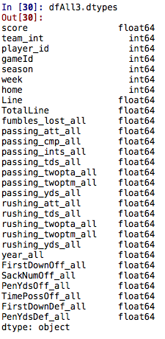
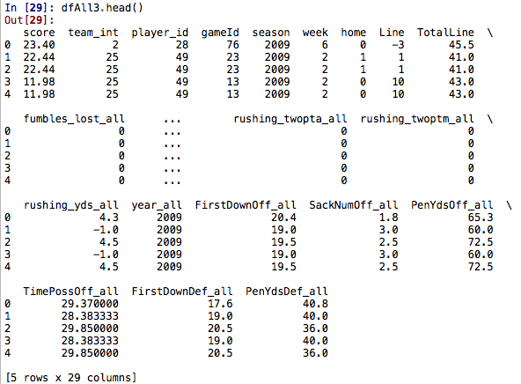

Setting up the data (cont’d)

Slide 11
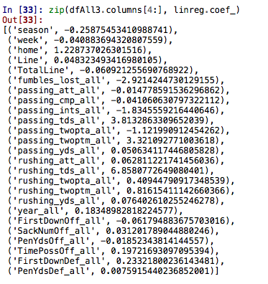
Model results
Questionable results?
Weights on rolled up averages seem remarkably similar to actual scoring…
Predicted low-scoring games yield higher predicted fantasy points
Sacks allowed increases our projection
First downs and penalties
Somewhat reassuring
NFL has become more pass-happy
Teams tend to get better as they progress into the season
Home QBs do better than visiting QBs
Favored teams do better
Greater possession time yields a higher score

Slide 12
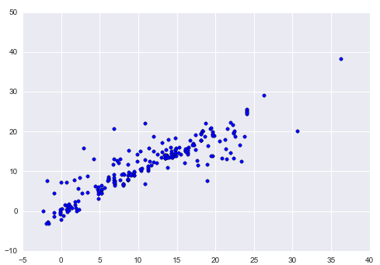
Model results (cont’d)
Predicted Score
R² = 79.5%
RMSE = 4.27
Actual Score

Slide 13
Rambling thoughts for next time
Don’t underestimate processing time before modeling can actually begin
Compare predictions vs. actuals over time
Use a random forest as the next model
Regularized regression models (ridge vs. lasso)
Calculate rolling averages for defensive stats
Calculate rolling averages across different sized windows
Were the rolling averages to date used correctly excluding that game’s statistics?
Ensemble the models together and interpret its results

