Slide 1
DAT8 Kaggle
or: How I Learned to Use Vowpal Wabbit and Rip Utilize Other People’s Code

Slide 2
Understanding the problem/competition
2-year old competition with $20k on the line
Multiclass classification problem vs. binary classification problem
Existing code would have to be reworked for a binary problem
Relies on an open source library called Vowpal Wabbit

Slide 3
Extract and convert
Extract train.csv to train_.csv using extract.py
Separate body text into words
Remove apostrophes
Normalize white space
Lower-case everything
Perform similar cleaning on title and tags
Convert 0s to -1s
Convert train_.csv to train.vw using csv2vw.py
Converts to VW readable format
Features examined:
Post ID, reputation, answer count, body, title, tags, tag count

Slide 4
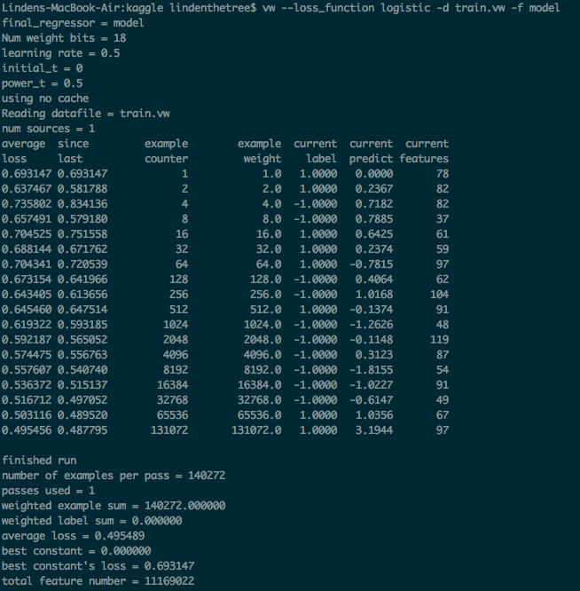
Train Vowpal-Wabbit
Went through the 130k+ examples in a few seconds
Settled on 97 features
.495 average loss on training data
Very much a blackbox
Converts feature names to integers
Inverting this hash crashed terminal

Slide 5
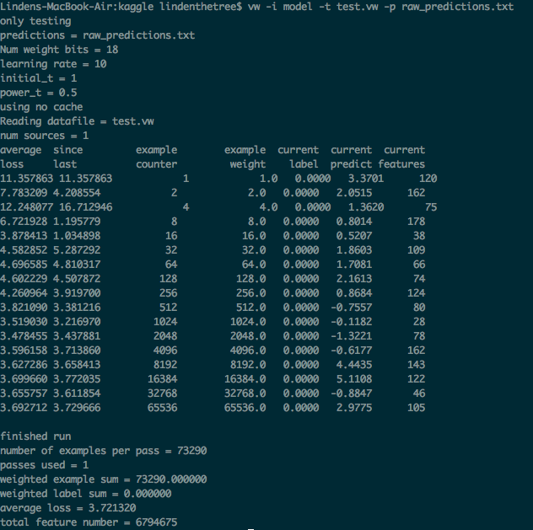
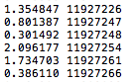
Predict and examine output
Log odds of closing and Post ID
Notes:
Outputs post id and log odds of closing

