Slide 1
ATLIQ HARDWARES CONSUMER GOODS AD-HOC INSIGHTS
Presented by – Vyankatesh Bhimrathi

Slide 2
Introduction and Task
Atliq Hardware is one of the leading computer hardware producers in India and well expanded in other countries too.
Atliq Hardware has 74 customers in 27 countries worldwide. Along with Asia Pacific(ACPC) , Europe(EU), North America(NA) and Latin America.
The management of atliq hardware informed the data analytics team to generate the some insights regarding customer behaviour to make some data driven decision.
The task was to review 10 Ad-Hoc request.
Run SQL queries to answer ad-hoc request.
create visually appealing and engaging presentation to communicate insights.

Slide 3
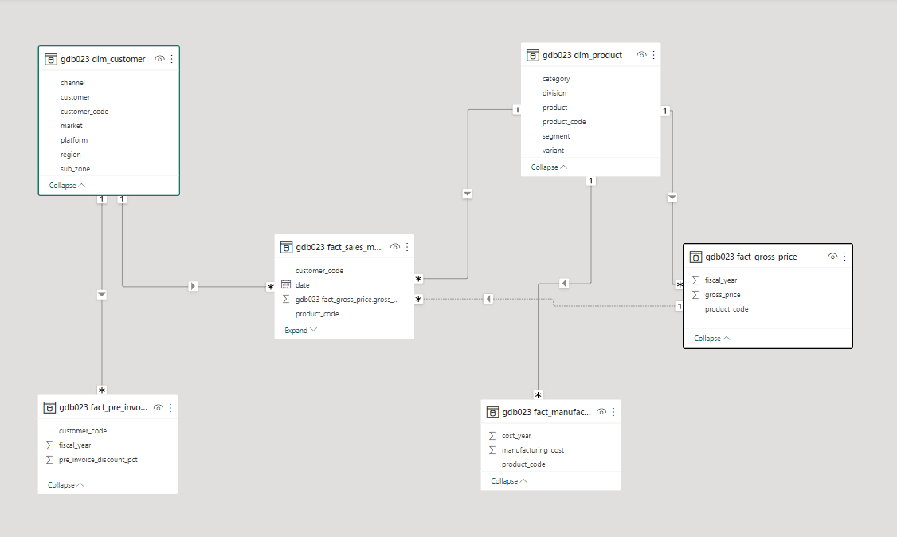
Data Model

Slide 4
AD-HOC REQUESTS, QUERIED RESULTS, INSIGHTS AND VISULIZATION

Slide 5
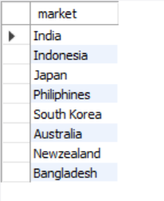
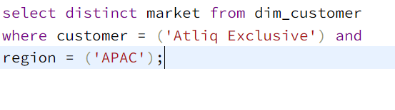
1. Provide the list of markets in which customer "Atliq Exclusive" operates its business in the APAC region.
Input Query
Output

Slide 6
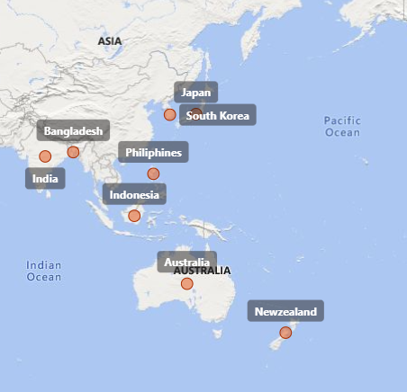
Visualization and Insight
Atliq Exclusive operates it’s business in 8 countries in the Asia Pacific region i.e. India, Australia, Indonesia, Bangladesh, New Zealand, Philippines, Japan and South Korea.

Slide 7
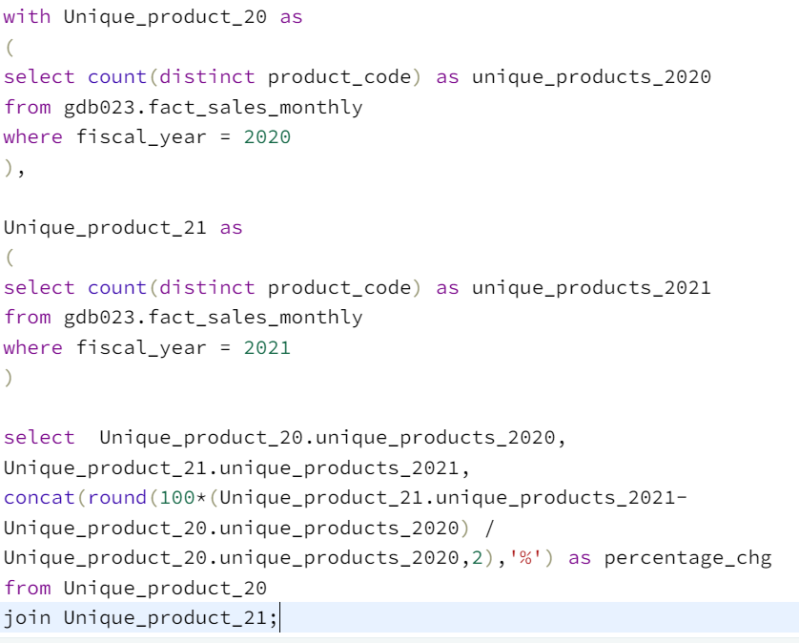

2. What is the percentage of unique product increase in 2021 vs. 2020?
Input Query
Output

Slide 8
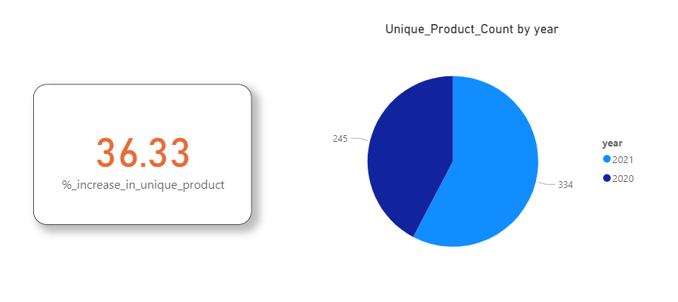
Visualization and Insight
The growth in number of unique products is a positive indicator of atliq Hardware’s performance. Atliq is producing more new products to meet customer’s demand.

Slide 9
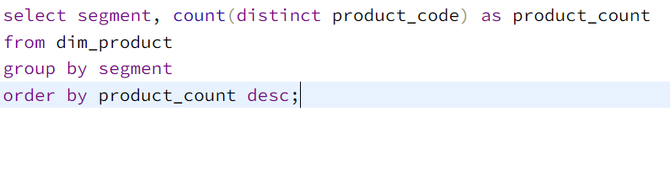
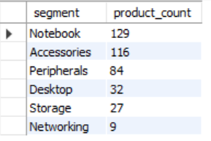
3. Provide a report with all the unique product counts for each segment and sort them in descending order of product counts.
Input Query
Output

Slide 10
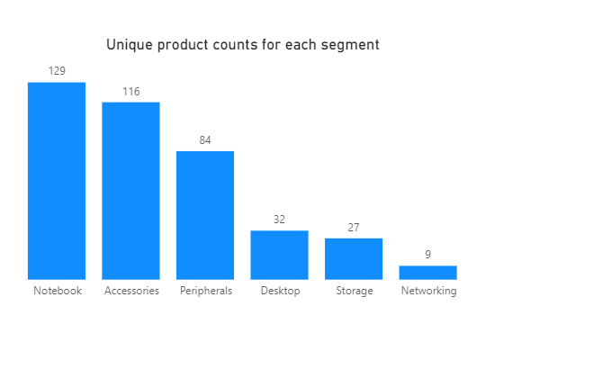
Visualization and Insight
Atliq Hardware products are diversely categorised in 6 different segments.
Notebook Segment contains the 129 maximum number of unique products and Networking segment contains the minimum number of unique products count is 9.

Slide 11
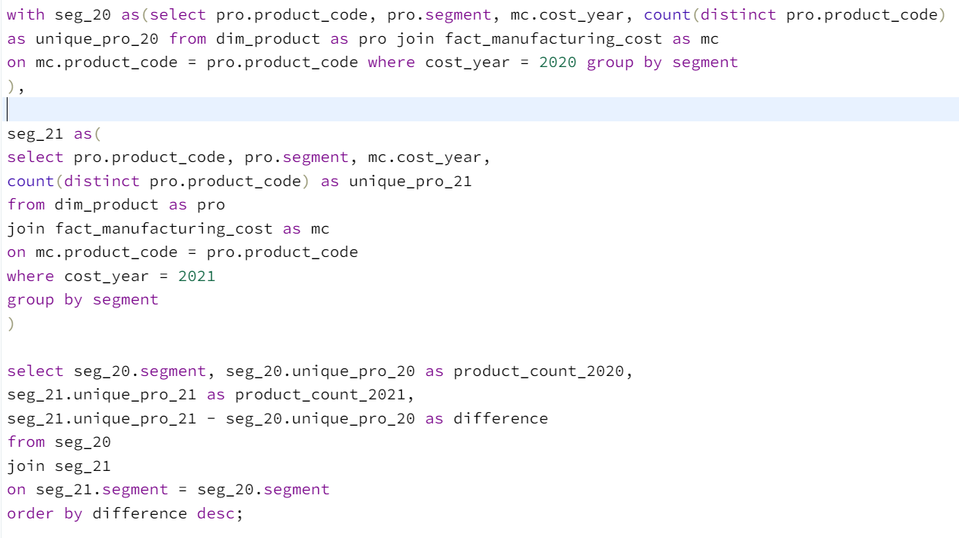
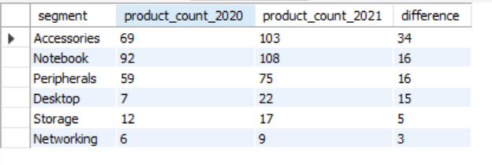
4. Which segment had the most increase in unique products in 2021 vs 2020?
Input Query
Output

Slide 12
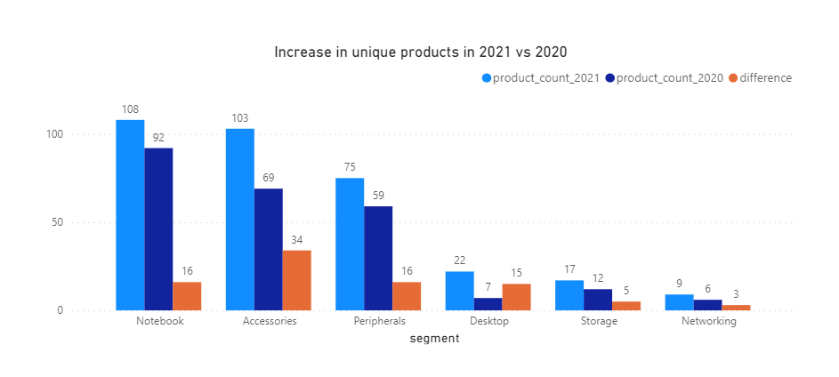
Visualization and Insight
There are total of 34 new and unique products added to the Accessories segment in 2021, which is the highest and 3 new unique product added to the networking segment in 2021 which is lowest among all 6 segment.

Slide 13
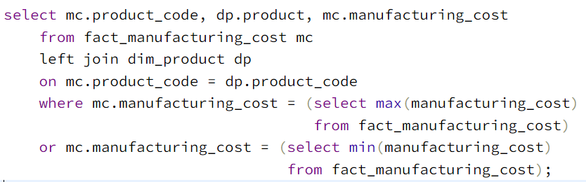

5. Get the products that have the highest and lowest manufacturing costs.
Input Query
Output

Slide 14
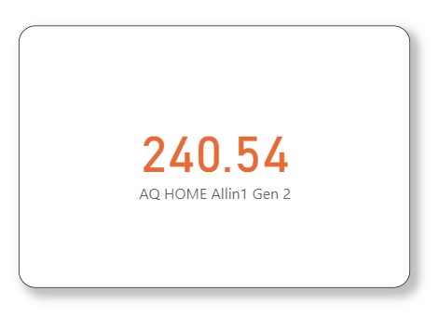
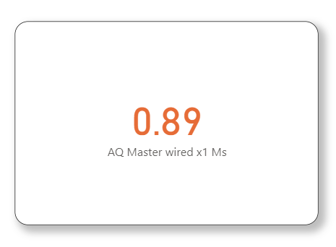
Visualization and Insight
Highest Manufacturing Cost
Lowest Manufacturing Cost

Slide 15
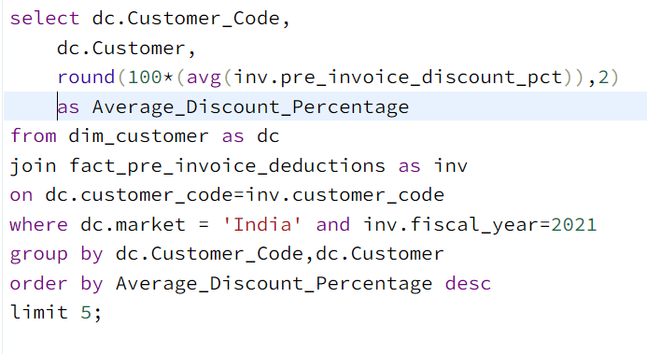
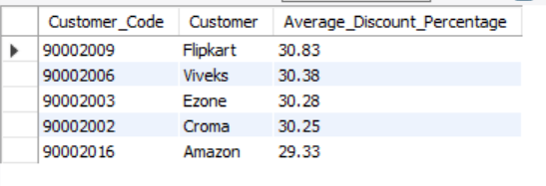
6. Generate a report which contains the top 5 customers who received an average high pre_invoice_discount_pct for the fiscal year 2021 and in the Indian market.
Input Query
Output

Slide 16
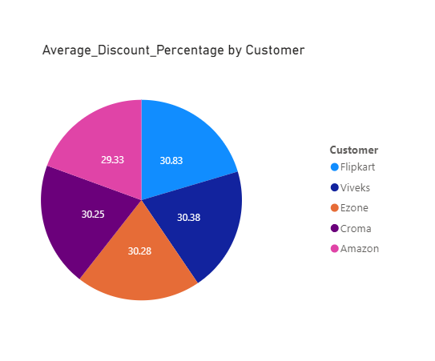
Visualization and Insight
In the Indian market the top 5 Customer were offered similar discount.
Flipkart has received highest discount(30.83%) and Amazon have received lowest discount(29.33%) among all top 5 Customer

Slide 17
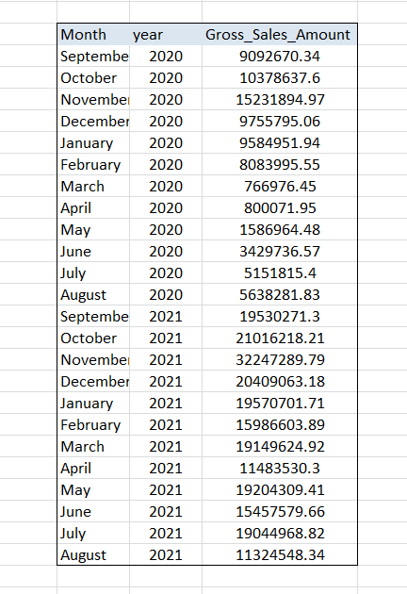
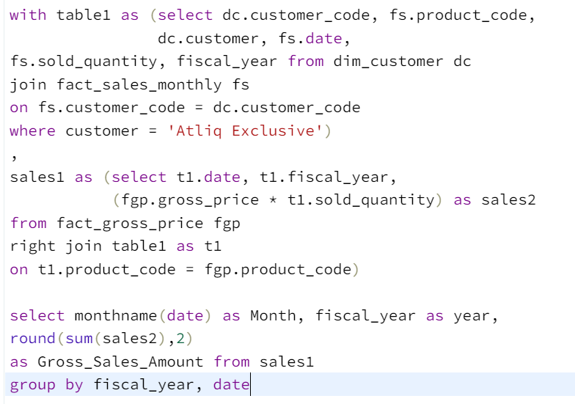
7. Get the complete report of the Gross sales amount for the customer “Atliq Exclusive” for each month . This analysis helps to get an idea of low and high-performing months and take strategic decisions.
Input Query
Output

Slide 18
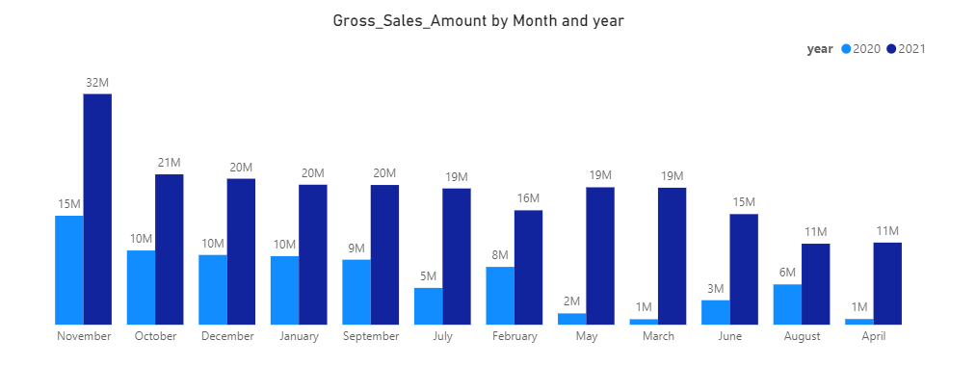
Visualization and Insight
At the beginning of fiscal year 2020 gross sales dropped which is lowest sales amount. This was most probably due to COVID-19 pandemic.
But after that gross sales increased significantly and in the same fiscal year atliq has recoded highest gross sales in November which is 32.25 million.

Slide 19
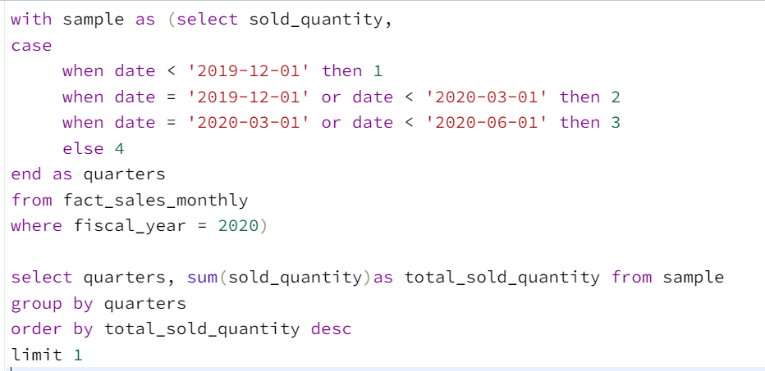

8. In which quarter of 2020, got the maximum total_sold_quantity? The final output contains these fields sorted by the total_sold_quantity
Input Query
Output

Slide 20
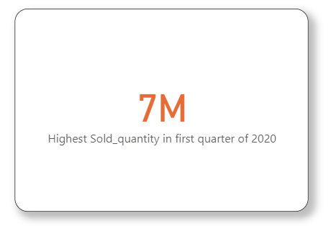
Visualization and Insight
highest Sold Qty in 2020 year is in Q1 which is 7 million.

Slide 21
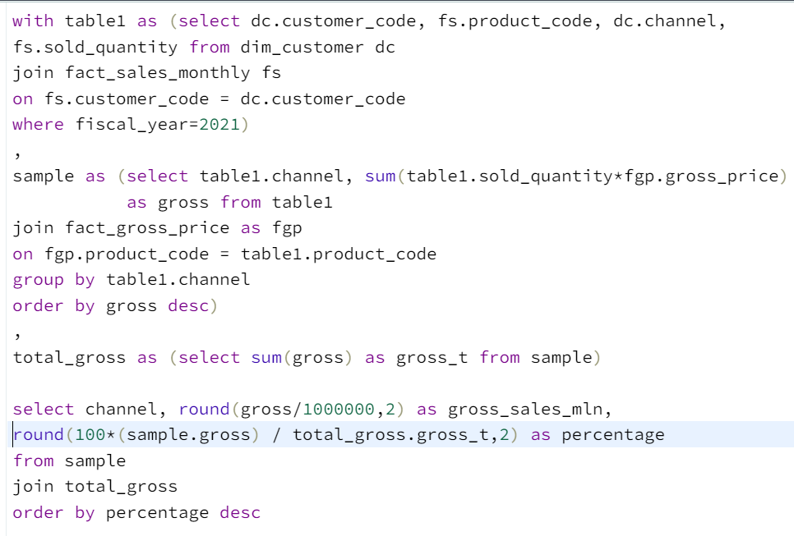
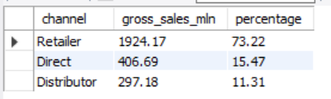
9. Which channel helped to bring more gross sales in the fiscal year 2021 and the percentage of contribution?
Input Query
Output

Slide 22
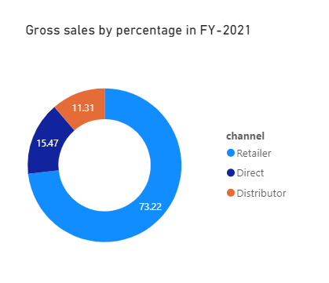
Visualization and Insight
Here we can see that company’s sales heavily depend on the Retailer, as it contribute 73.22% to total sales.

Slide 23
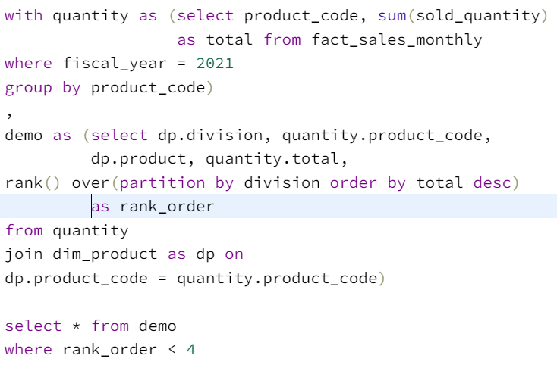
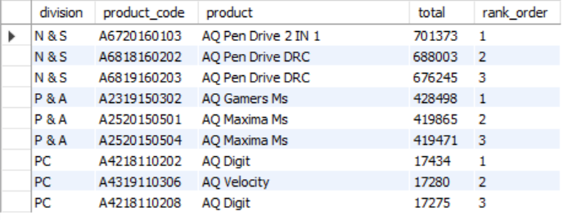
10. Get the Top 3 products in each division that have a high total_sold_quantity in the fiscal_year 2021?
Input Query
Output

Slide 24
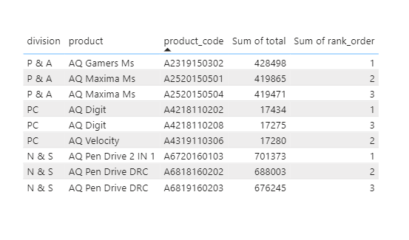
Visualization and Insight
The “N&S” division has highest total sold Quantity among 3 division listed and the “PC” has three lowest selling products.
The Product “AQ Pen Drive 2 in 1” sold the highest quantity overall, followed by AQ Pen Drive DRC plus and AQ Gamers Ms.

Slide 25
Thank You

