Slide 1
Sole Survivor?
A Data-Driven Analysis of Nike's Market Position and a Strategy to Reclaim Generation Z
Nike Product Analytics Team · April 2025

Slide 2
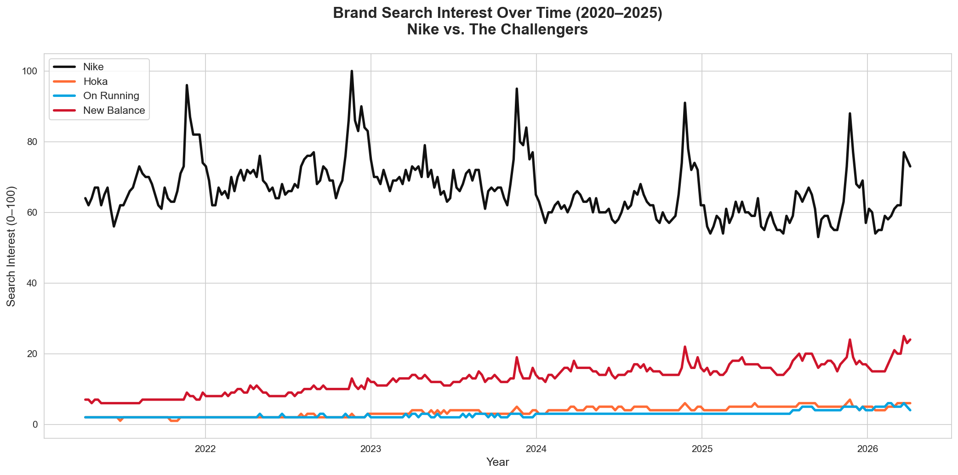
The Ground Is Shifting Under Nike's Feet
-2%
+138–183%
-10%
Nike 5yr search interest
Challenger brand growth
Nike revenue growth 2025
For the first time in decades, Nike is the only major athletic brand that is shrinking.

Slide 3
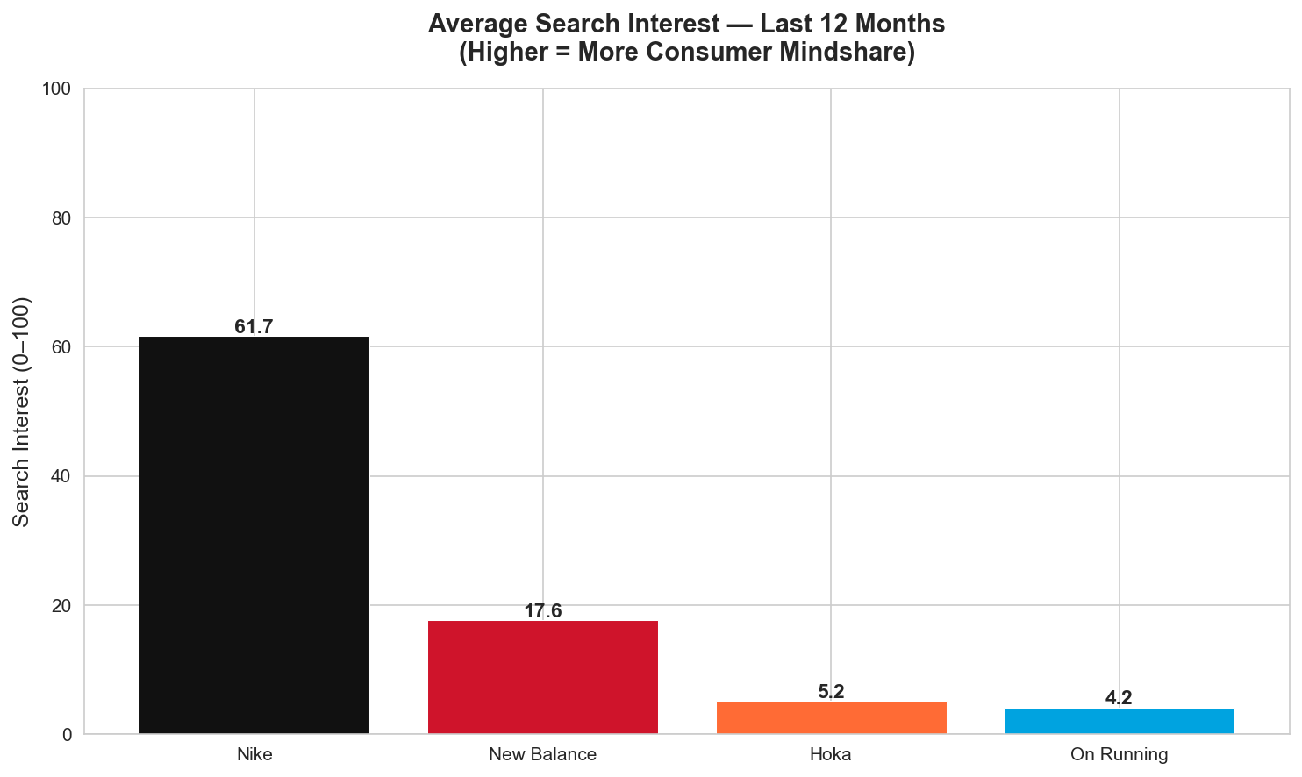
The Global Athletic Footwear Market
Global market: $115B in 2024 → projected $200B by 2030
Nike market share: ~27% — down from 35% in 2019
Fastest growing: Performance Running & Lifestyle
Key challengers: New Balance, Hoka, On Running, Adidas
Nike’s share of a GROWING market is falling — a compounding crisis.

Slide 4
Meet the Brands Eating Nike's Lunch
NEW BALANCE
HOKA
ON RUNNING
+183%
+160%
+138%
search interest (5yr)
search interest (5yr)
search interest (5yr)
$3.3B → $7.0B
$3.2B → $5.0B
$1.2B → $3.0B
revenue
revenue
revenue
Owns the GenZ casual space
Owns performance running
Owns premium aspirational
All three grew revenue 58–147% while Nike declined.

Slide 5
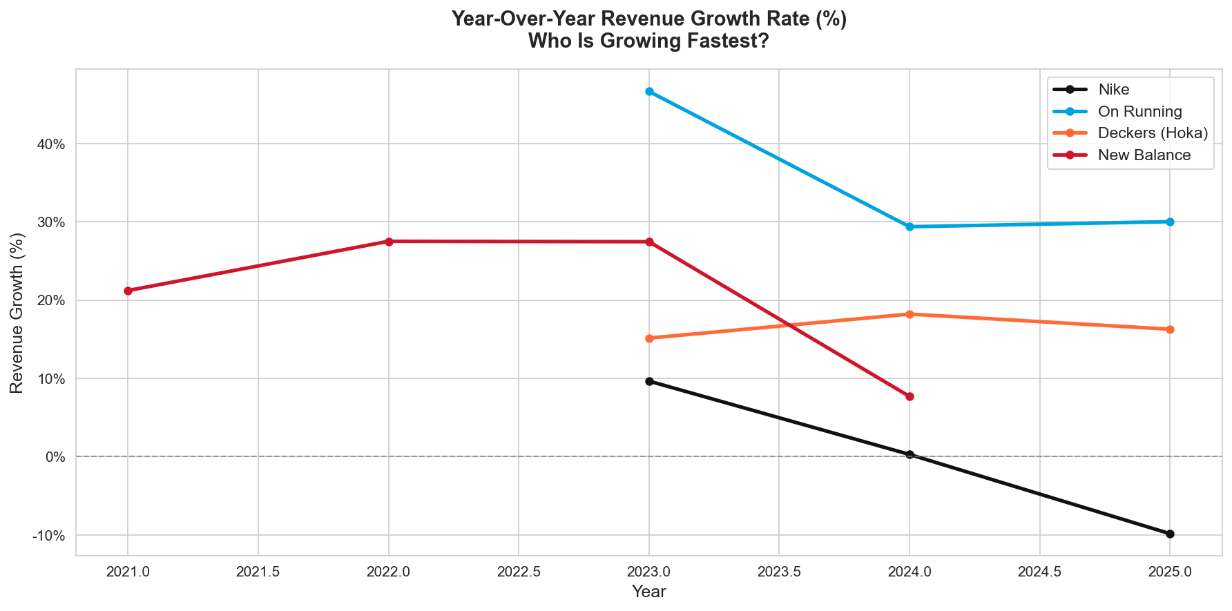
Nike By The Numbers: A Brand in Decline
Revenue is shrinking.
Nike posted -10% revenue growth in FY2025 — its steepest decline in over a decade. Every challenger brand grew 15–30% in the same period.
Client Implications:
· Nike is losing ground in its core markets
· Challengers are accelerating while Nike retreats
Nike crossed below 0% growth in 2024 — the only brand in the room going backwards.

Slide 6
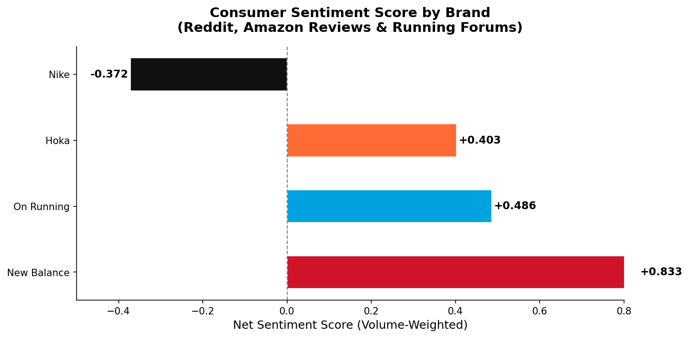
What Consumers Are Actually Saying
KEY FINDING
Nike is the ONLY brand with negative consumer sentiment.
-0.372
Nike
+0.833
New Balance
Reddit, Amazon Reviews, Running Forums · 38 themes

Slide 7
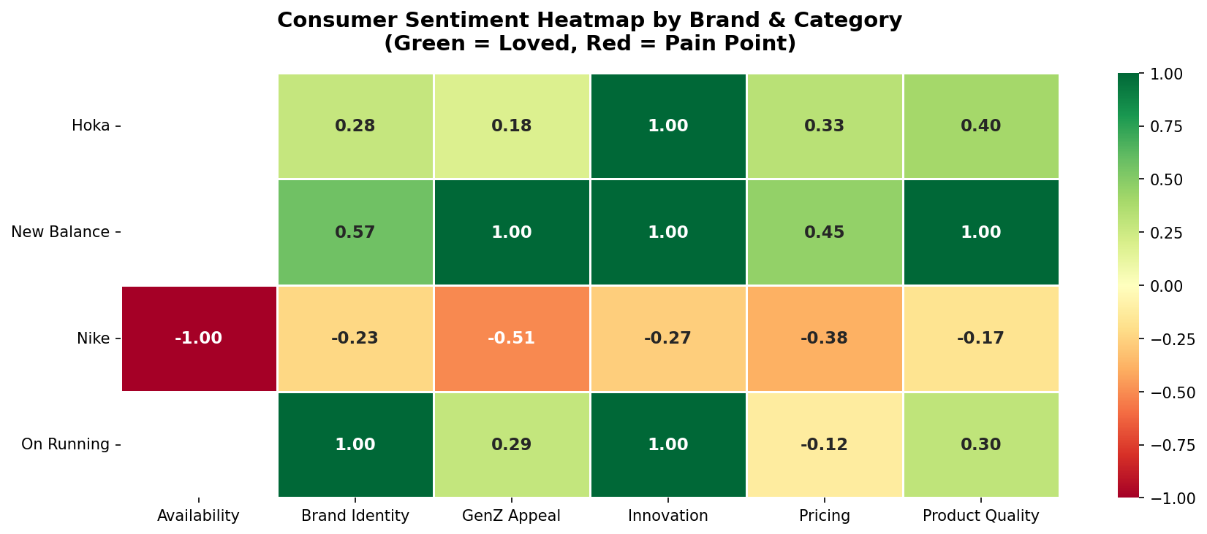
Category-by-Category: Where Nike Is Failing
GenZ Appeal -0.51
GenZ sees Nike as their parents’ brand — #1 pain point by volume
Availability -1.00
Bots and resellers destroyed the community drop culture
Pricing -0.38
Too expensive for the quality consumers are getting

Slide 8
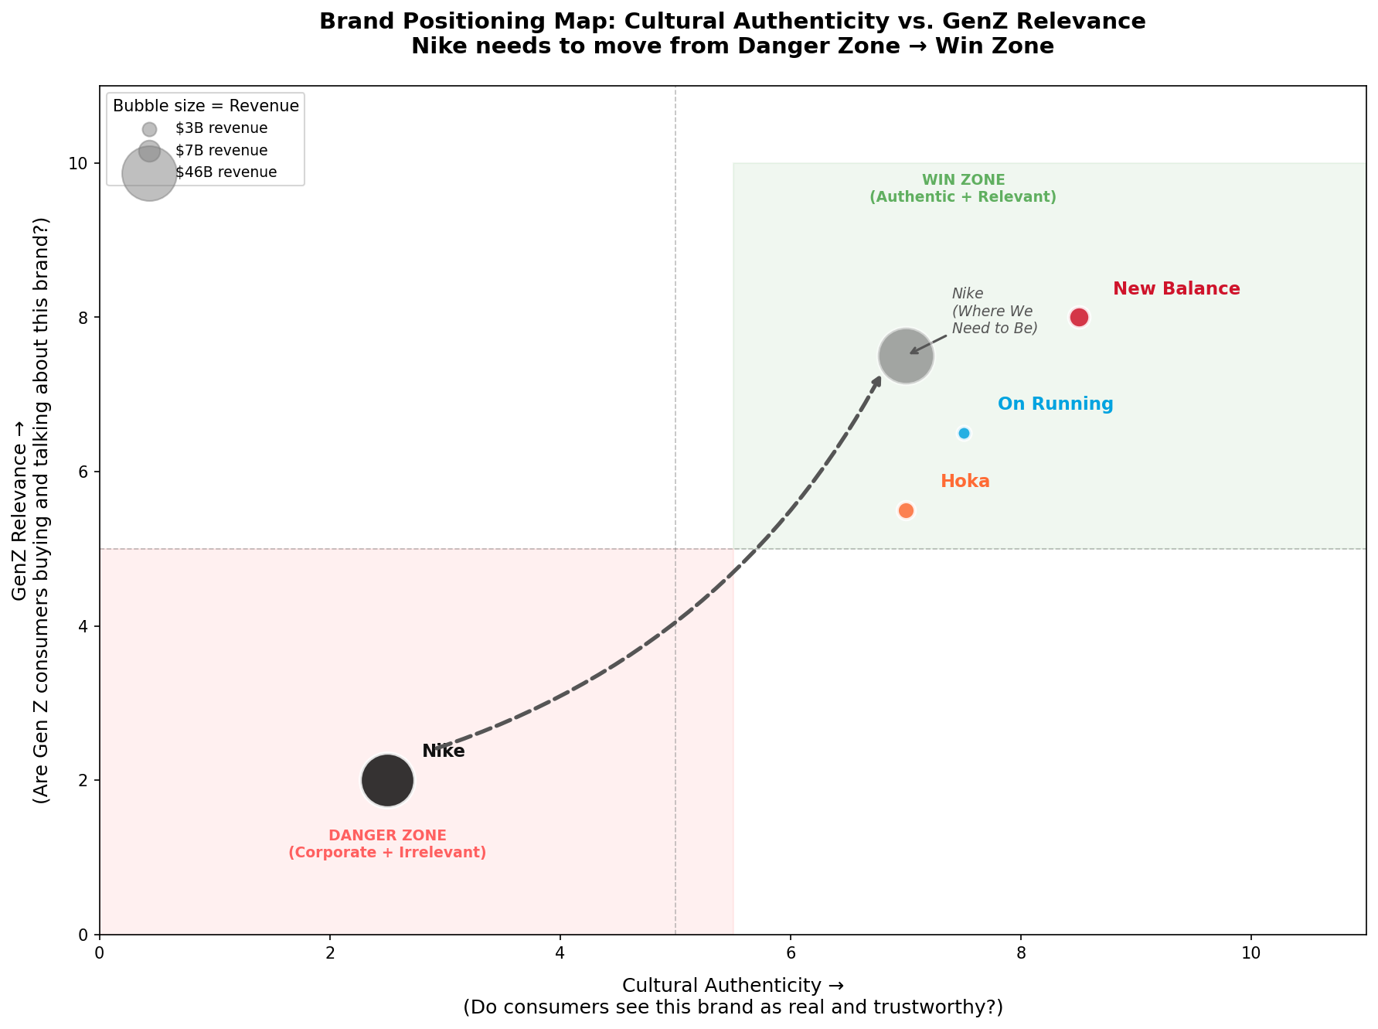
The Opportunity: Nike Is in the Wrong Zone
Every competitor has moved to the Win Zone. Nike sits alone in the Danger Zone.
Path forward: Earn back cultural authenticity — the one thing money alone cannot buy.

Slide 9
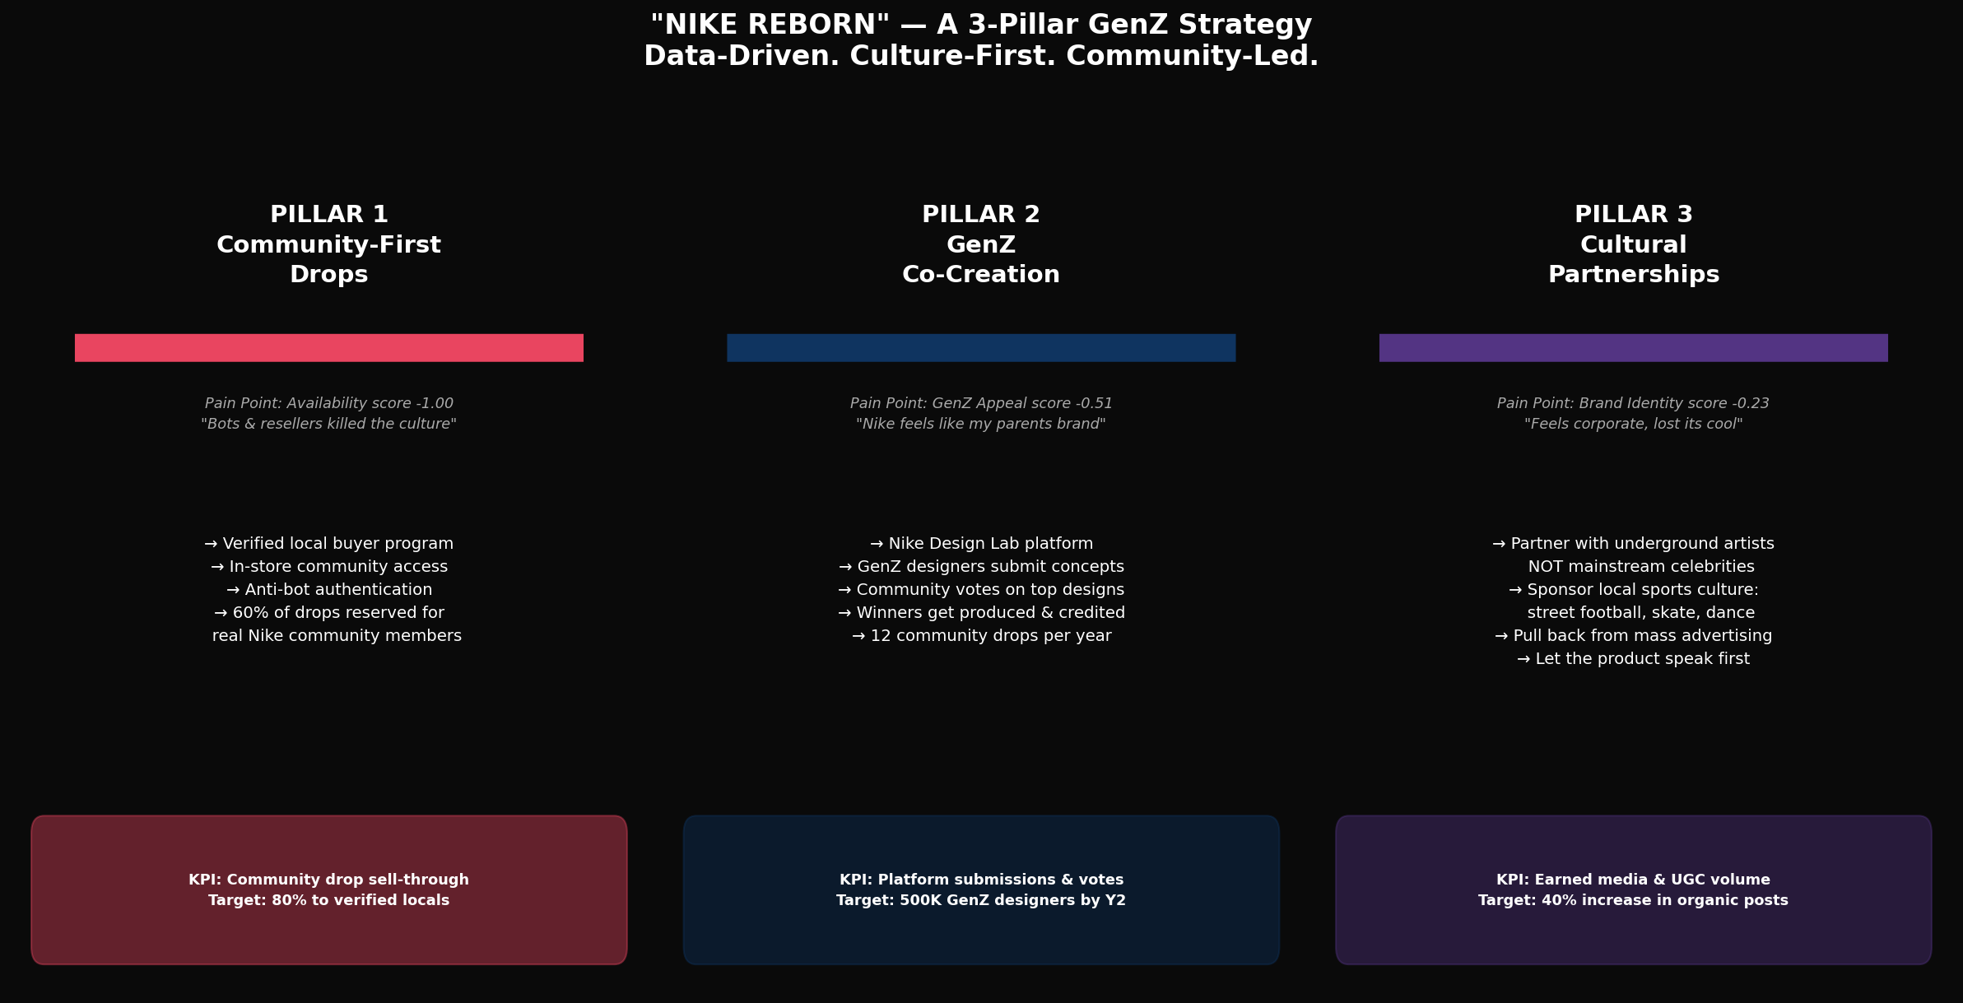
“Nike Reborn” — A 3-Pillar GenZ Strategy
Data-Driven. Culture-First. Community-Led.
Community-First Drops
GenZ Co-Creation
Cultural Partnerships

Slide 10
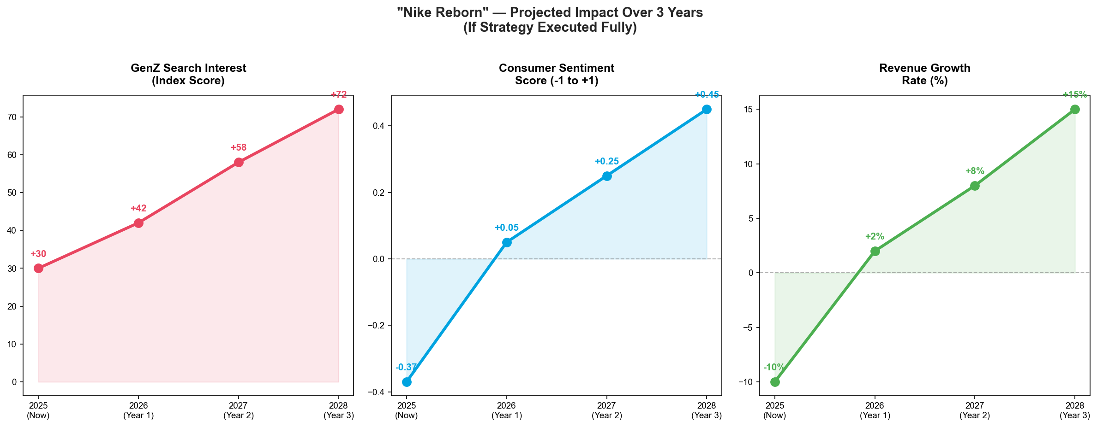
If We Execute: A 3-Year Roadmap Back to Growth
GenZ Search Index
Consumer Sentiment
Revenue Growth
30 → 72 (+140%)
-0.37 → +0.45
-10% → +15%
“Nike doesn’t need a new shoe. It needs a new relationship with the next generation.”

