Slide 1


SALES FORECASTING -TIME SERIES APPROACH
CIVE – 7100
Yash Vyas

Slide 2
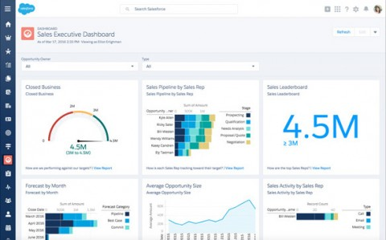

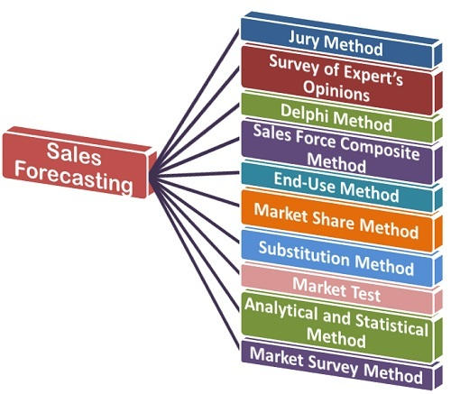
Introduction
- Sales forecasting is the process of estimating future sales. Accurate sales forecasts enable companies to make informed business decisions and predict short-term and long-term performance.
Normally forecast are based on
Past Sales Records Industry Wide comparison Economic Trends
There are many software applications such as Salesforce Oracle Demantra that help in forecasting
There are many other conventional methods such as surveying finding your market share etc..
But the problem is not all explain the underlining phenomenon associated with past values
and in case the forecast is not meet it leads to problems.
Not technical Salesperson does not grasp the statistical phenomenon and they are more concentrated on Sales methodology

Slide 3
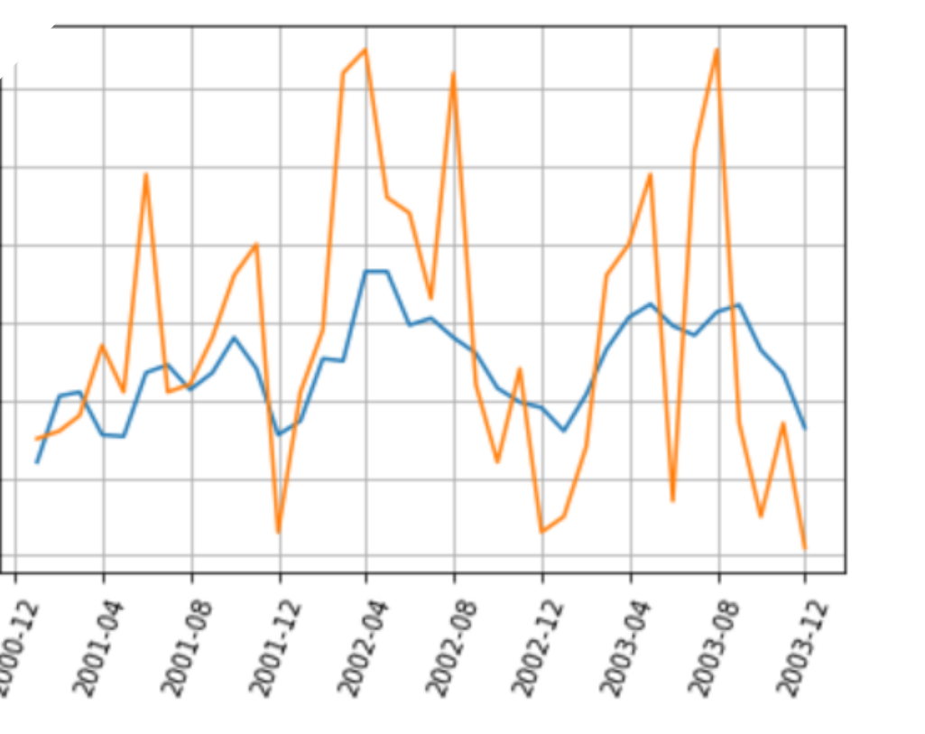
Data
The data obtained is time series containing the following three fields
- Date :- format yyyy/mm Starting from 2001 Jan to 2003 Dec i.e. 36 periods
- Advertising :- the advertising budget for each period in ‘000s
- Sales :- Sales revenue for each period in ‘000s
The data is of a product based company
Data source :- https://datamarket.com/data/set/22kw/advertising-and-sales-data-36-consecutive-monthly-sales-and-advertising-expenditures-of-a-dietary-weight-control-product#!ds=22kw!2ekl&display=line
- It was obtained in CSV format and data wrangling was done in excel and than loaded to Python and R for analysis

Slide 4
Time Series Methods
Time Series approach is applied for the purpose of sales forecasting. The results are documented and suggestion are made
The following methodologies were used to investigate the Sales Data
- ARMA :- the conventional time series approach looking at the influence of previous values and errors to make forecasts
- SARIMA :- Try to investigate the influence of a seasonal component and base forecast based on a seasonal model
VAR :- Try to model sales forecast based on previous sales and find the influence of advertising on the sales numbers and validate results
LSTM :- Design a model based on long short term memory and compare its results to other methodologies

Slide 5
ARMA Model
ACF and PACF graphs were plotted and order for ARMA chosen was (1,1)
The model was estimated and the results
as shown.
The results were not great in predicting
Extreme values but could capture trend
The rms recorded was of 12.14
The approach could be made better
Thus SARIMA model was further
implemented.

Slide 6
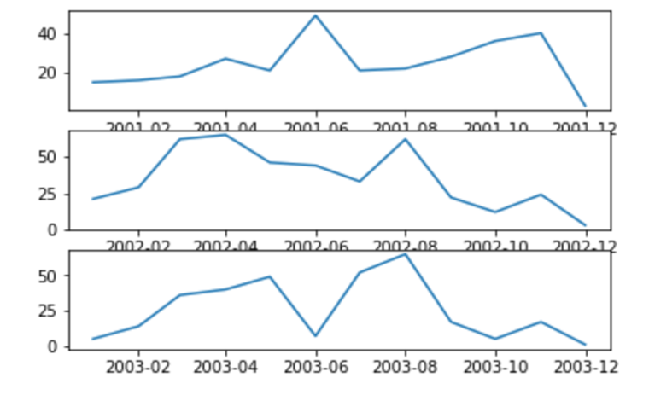
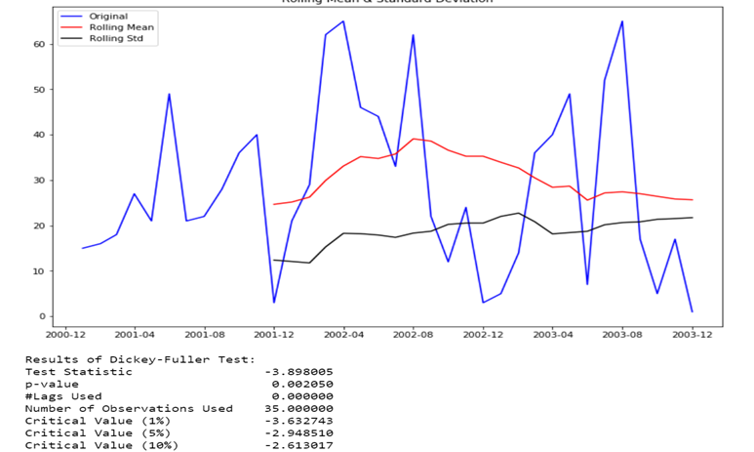
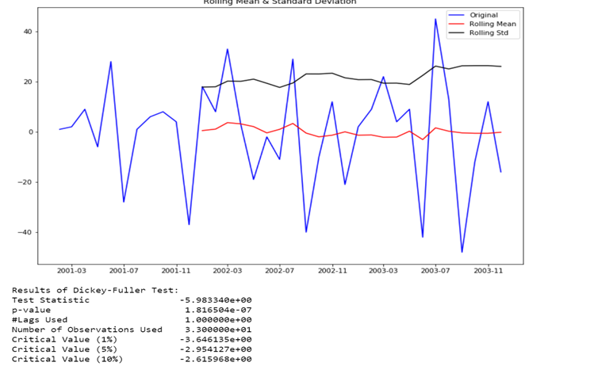
SARIMA
Upon visualization a seasonal component could be determine
for the time series
- The series was made stationary by first order differencing
SARIMAX model (0,1,0)(1,1,0,12) was estimated by grid search
parameter approach
- rms of 22 was recorded

Slide 7
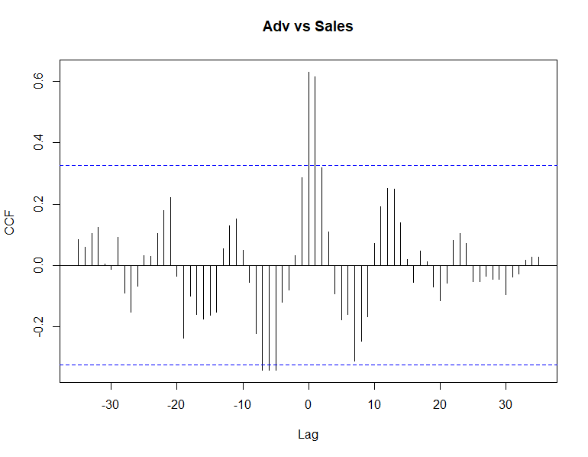
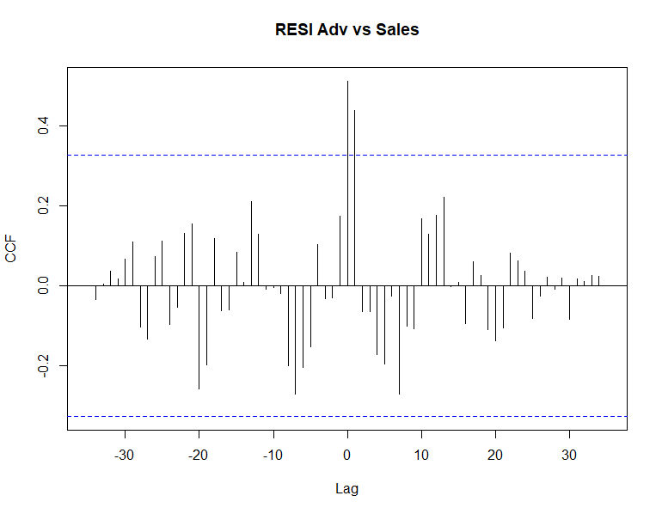
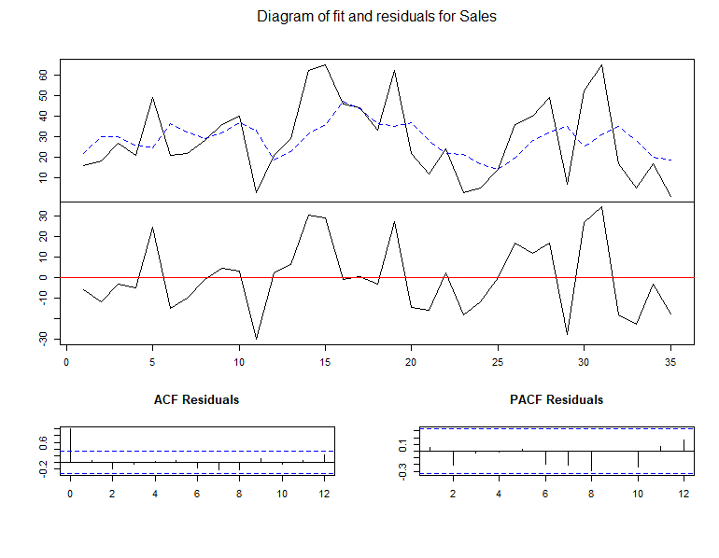
Vector auto regression
We try to see if there is any relation between sales and advertising series based on VAR model
The CCF of the series is model and significant lag is noticed at around -4 and 2
- A VAR(1) model is estimated and coefficients are examined
- Since the summary does not indicate a significant value
we conclude that there is not a strong relation between the
two series

Slide 8
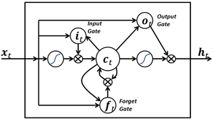
Long short term memory
- LSTM are an extension of RNN’s. A common LSTM unit is composed of a cell, an input gate, an output gate and a forget gate
- The model can be described as a system that helps remember data from short period before(previous few time steps) for a
Long time in the future
For LSTM the data needs to be modelled into a three dimensional format in a frame such
the values represent xt (current state) and xt-1(previous state)
The model was run only a few ’00s of epochs and we notice decrease in RMSE
having a large dataset and more training will further enhance the model estimation
* Code directly used from internet

Slide 9
Conclusion
- From the above model we see the past month value is associated with current month sales
- A strong seasonal component affects the sales and that should be investigated further
- There seems to be no relationship between advertising spending and sales revenue generated from VAR
This scenario should be studied and appropriate management changes is suggested
Overall we can conclude that from analyzing several models we can say that sales are strongly associated with previous sales performance
This should be explained to the management to further enhance assigning of quota and make better forecast
Since the dataset had just 36 records trend could not be determined
It is suggested that for analysis a large dataset should be there to further investigate trend and take it into consideration
Now that we have concluded that seasonality is an important factor in our sales, management should strategize accordingly for low revenue and high revenue months
Time series approach helps explain the underlying phenomenon to non – statiscal background personal by providing insights and hinting out at how models are integrated in Industry softwares.

Slide 10
Citation
- https://machinelearningmastery.com/time-series-forecasting-long-short-term-memory-network-python/
http://www.seanabu.com/2016/03/22/time-series-seasonal-ARIMA-model-in-python
https://www.youtube.com/watch?v=jEt53dLm4Ik – for VAR
/

