Slide 1

MSc Data Analytics
Professor: Ade Fajemisin
Subject: Advanced Data Mining
Project Members:
Arth Vyas (x17170516)
Ranu Parate (x17161452)
Samir Khan (x17161461)
Mitul Choksi (x17154855)
Win Prediction of Players Unknown’s Battle Ground Game

Slide 2
Introduction:
Mobile gaming is one of the favorite hobbies among children's and adults and on an average each individual spends around six hours in playing games.
PUBG is one of the latest game which has caught tremendous attention of people in the year 2017.
Tencent Games and PUBG Corporation has developed PUBG MOBILE, it is based on “PLAYERUNKNOWN’S BATTLEGROUND”, available for cellphones, PC and Xbox.
There are total 400 million subscribers of PUBG mobile as of 19th June 2018.
Total 100 players parachute on remote location and forces players under shrinking zone where the battle begins. Players must find their weapons, medic kit, boost and so on for the battle. Last man on island is declared as winner of the game.
There has been trend in research for analyzing or predicting the winner of different games.

Slide 3
Literature Review

Slide 4
Prediction based Researches in Online Gaming Domain(Dota 2,Destiny,PUBG)
Dota 2
KNN, RF, logistic regression and achieved 67-83% accuracy
Novelty based on Dataset size, addition of more game relevant data(e.g. Real time game data),filtering techniques (Match making rating, game duration based filtering).
Web based recommendation system for gamers.
Destiny
Individual game mode based model and general combined model based on Gradient boosting and RF achieved 63-99% accuracy.
Analysis of players performance features in a FPS (first person shooting) game.
PUBG
Research based on mathematical modelling.
Analyzed aspects such as jump time &location, strategical movement of players based on azimuth judgement to improve hit rate.
We take forward this topic by predicting win percentage of players in gaming sessions based on several important factors.

Slide 5
Prediction based Researches in Sports
Most of data used in sports analytics is structured data.
Some studies focused on real-time data, use data from first half of game to predict second half or make use of all data available.
Many researchers have predicted different kinds of outcome like win-loss-draw, number of goals scored, points scored/not-scored.
Feature selection methods like correlation coefficient scores, genetic algorithm, RFE, etc. used to identify best of the attributes.
Popular algorithms like Naïve Bayes, DT, RF, SVM, Gradient boosted tree, ANN, etc. used and accuracy of 52-87 % was achieved.

Slide 6
Implementation:
The methodology used in this project is Knowledge Data Discovery (KDD).
For implementation of this project the data is taken from the Kaggle website. The data consists of 26 different attributes.
Exploratory Data Analysis is carried out on data before implementing the models.
Missing values using mice, outliers by plotting box-plot were checked. The necessary cleaning and transformation were carried out.

Slide 7
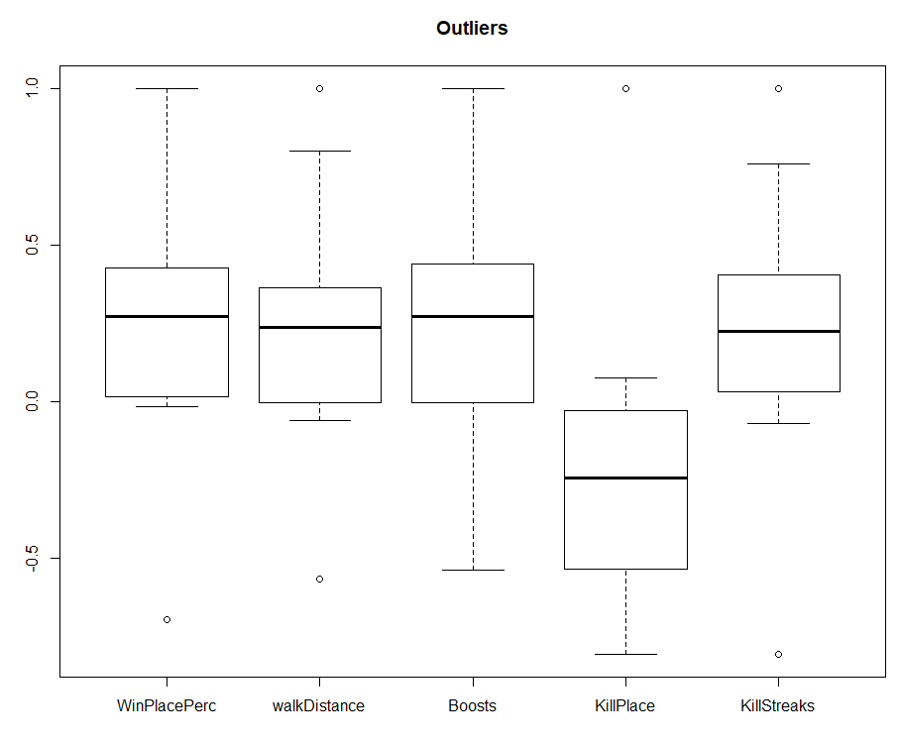
Box-Plot for outliers: It is graphical method depicted by quartiles and inter quartiles that helps in defining the upper and lower limit beyond this limits the data is considered as the outliers.

Slide 8
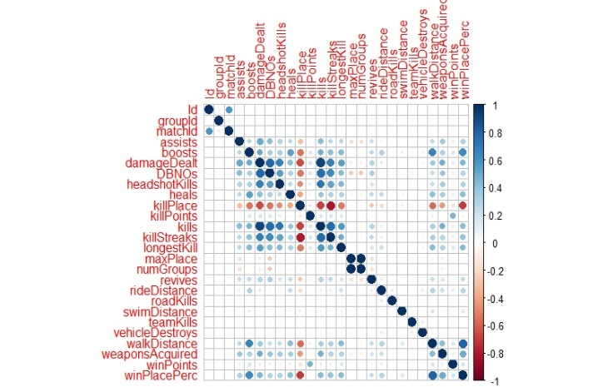
Feature Selection:
Correlation Matrix: A correlation matrix was tested against all the features and to visualize this corrplot. The dependent variable winPlacePerc is highly correlated with walkDisatnce and boosts from the plot with the high color intensity.
Boruta: Boruta model has given only one important feature. That is Boosts.

Slide 9
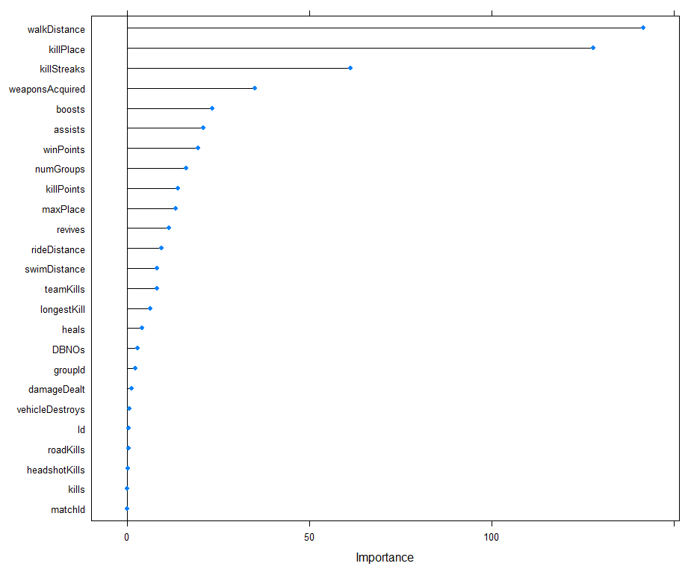
3. Feature Importance: This gives top four important features.They are walkDistance, killPlace, killStreaks, and wesponAcquired.

Slide 10
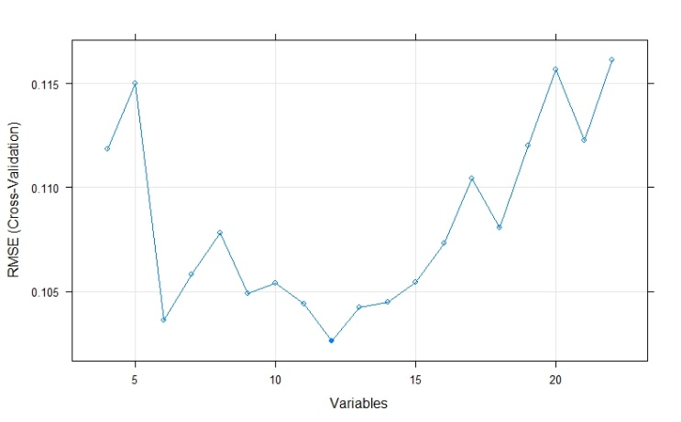
4. Recursive Feature Elimination: Shows the accuracy by considering all the features. The model can be built by considering the 4 features.

Slide 11
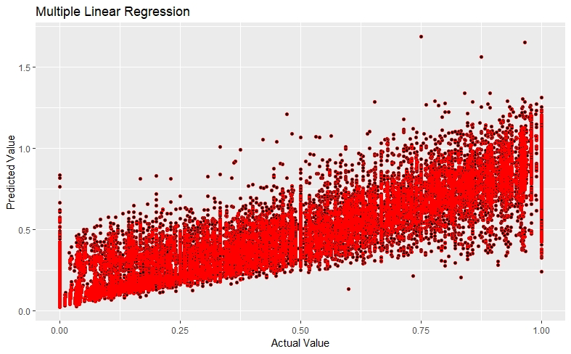
Model Implemented:
Linear Regression: Most simple and accurate models.
Dependent Variable: WinPlacePerc
Independent Variables: walkDistance, boosts, killPlace and killStreaks.
Adjusted R Square: 0.7586
Accuracy: 72.89%
Further, k-fold cross validation is done using 10 folds. From this the Root Mean Square Error (RMSE) obtained as 0.85

Slide 12

2. Support Vector Regression: The SVM function is used with type as eps-regression and kernel as Linear.
Dependent Variable: WinPlacePerc
Independent Variables: walkDistance, boosts, killPlace and killStreaks.
Accuracy: 59.74%
Further, k-fold cross validation is done using 10 folds. From this the Root Mean Square Error (RMSE) obtained as 0.06

Slide 13
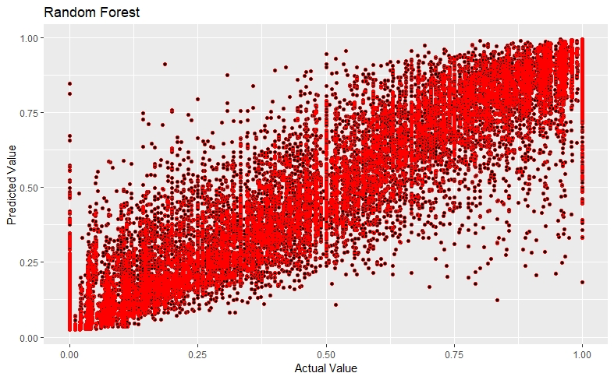
3. Random Forest: Random Forest is used with ntress = 100.
Dependent Variable: WinPlacePerc
Independent Variables: walkDistance, boosts, killPlace and killStreaks.
Accuracy: 76.08%
Further, k-fold cross validation is done using 10 folds. From this the Root Mean Square Error (RMSE) obtained as 1.317

Slide 14
Team Work Distribution
Arth Vyas: Data gathering, EDA, discussion for selection of appropriate model and review of report.
Ranu Parate: Implementation of model, EDA, discussion for selection of appropriate model, and review of report.
Samir Khan: Literature review, EDA, discussion for selection of appropriate model, and review of report.
Mitul Choksi: Literature review, EDA, discussion for selection of appropriate model, and review of report.
Active participation of every one in the solving the errors occurred while implementation of model.
Report writing was equally divided among all of us appropriately.

Slide 15
Conclusion
The prediction of win place for PUBG can be of great help for players as well as the developer of PUBG. The players can plan different strategies to win the game and developer can build more complex game to restrict the players so they can enjoy the challenge.

Slide 16
Thank You

