Slide 1
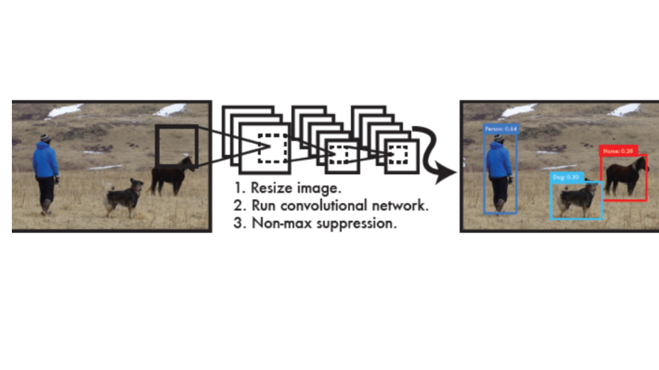
YOLO Algorithm

Slide 2
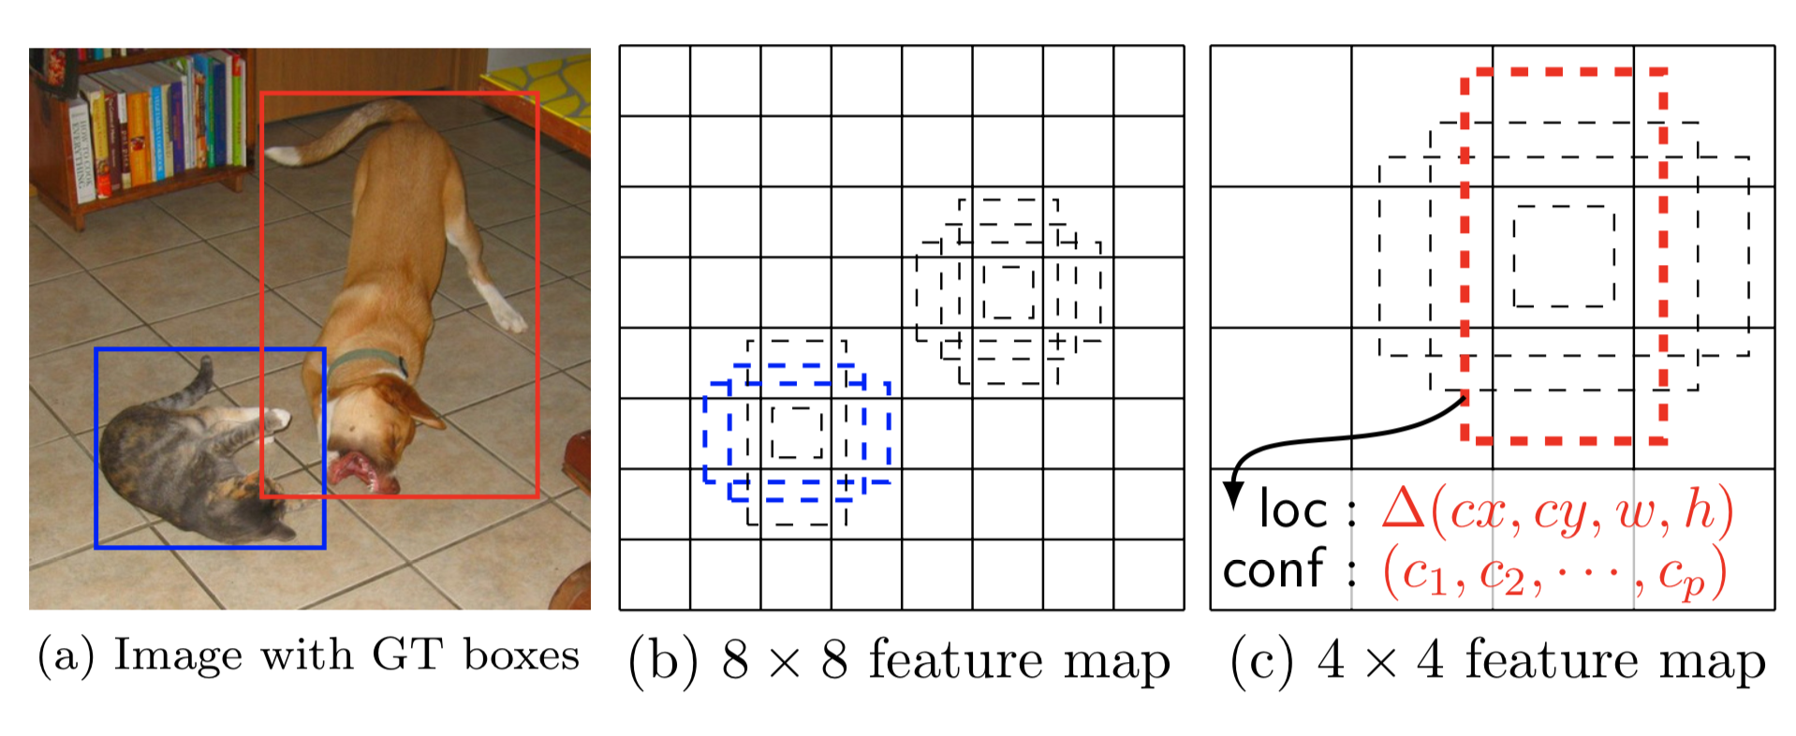
Anchor Boxes

Slide 3
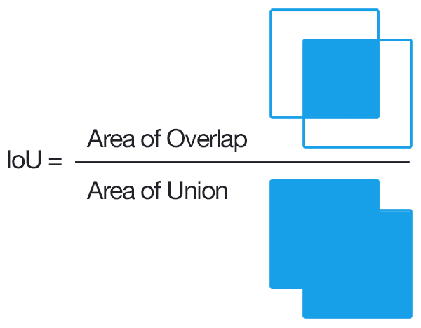
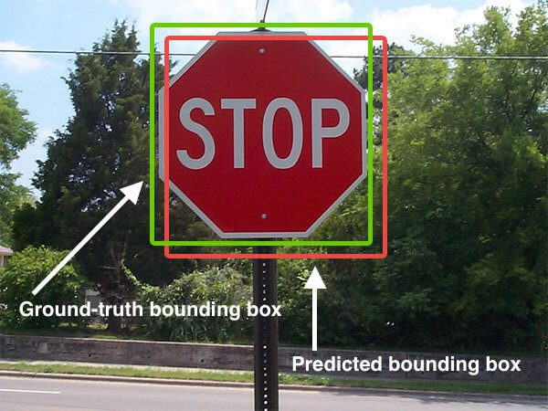
Intersection Over Union

Slide 4
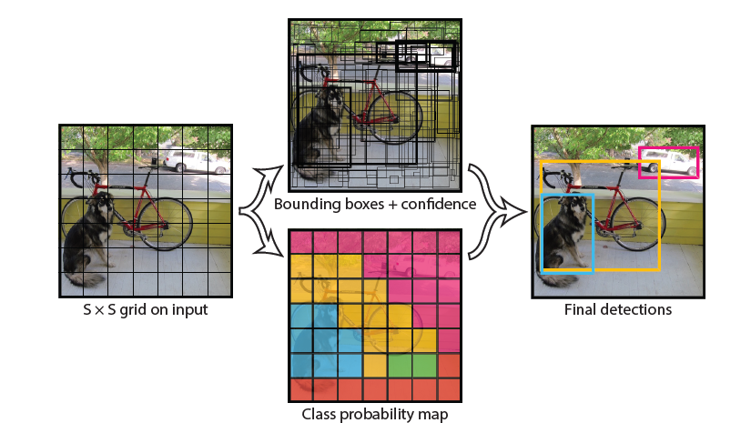
Unified Object Detection with YOLO

Slide 5
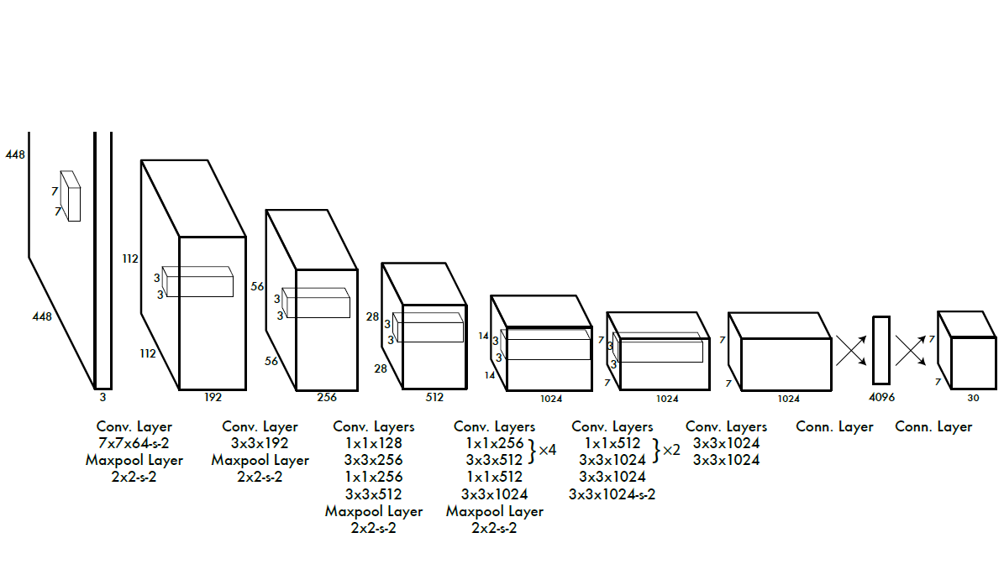
YOLO Structure

Slide 6
Project Design

Slide 7
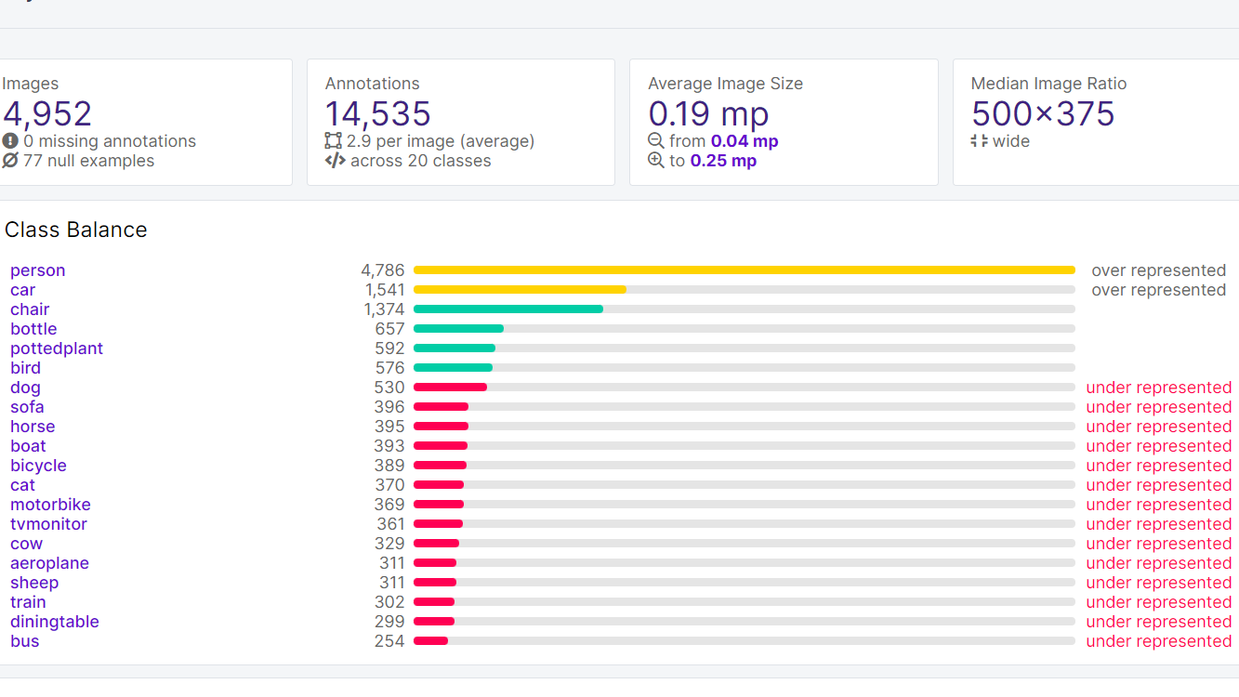
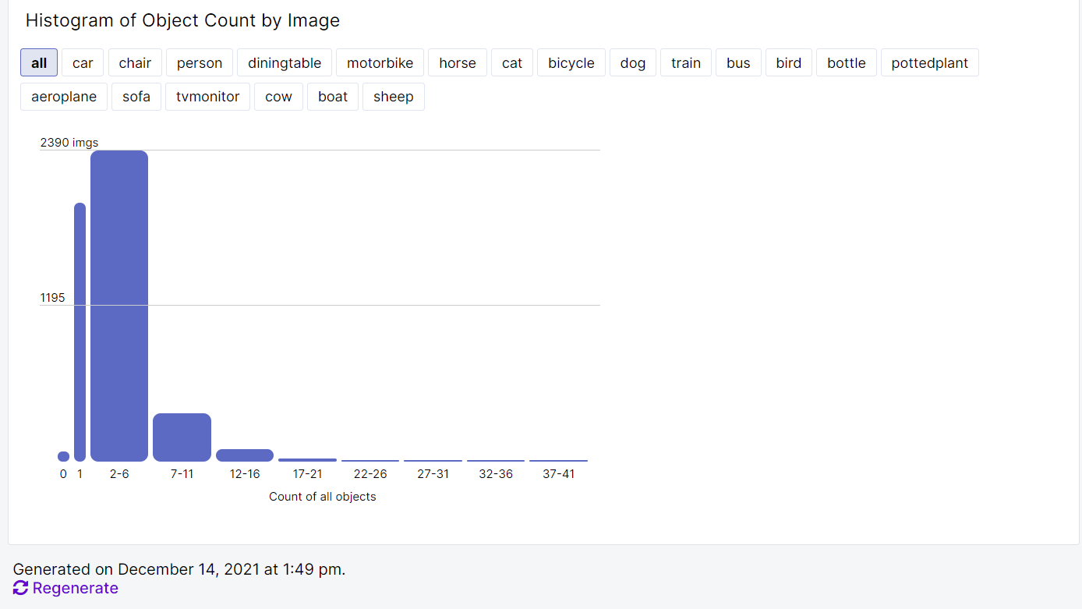
PASCAL VOC Dataset

Slide 8
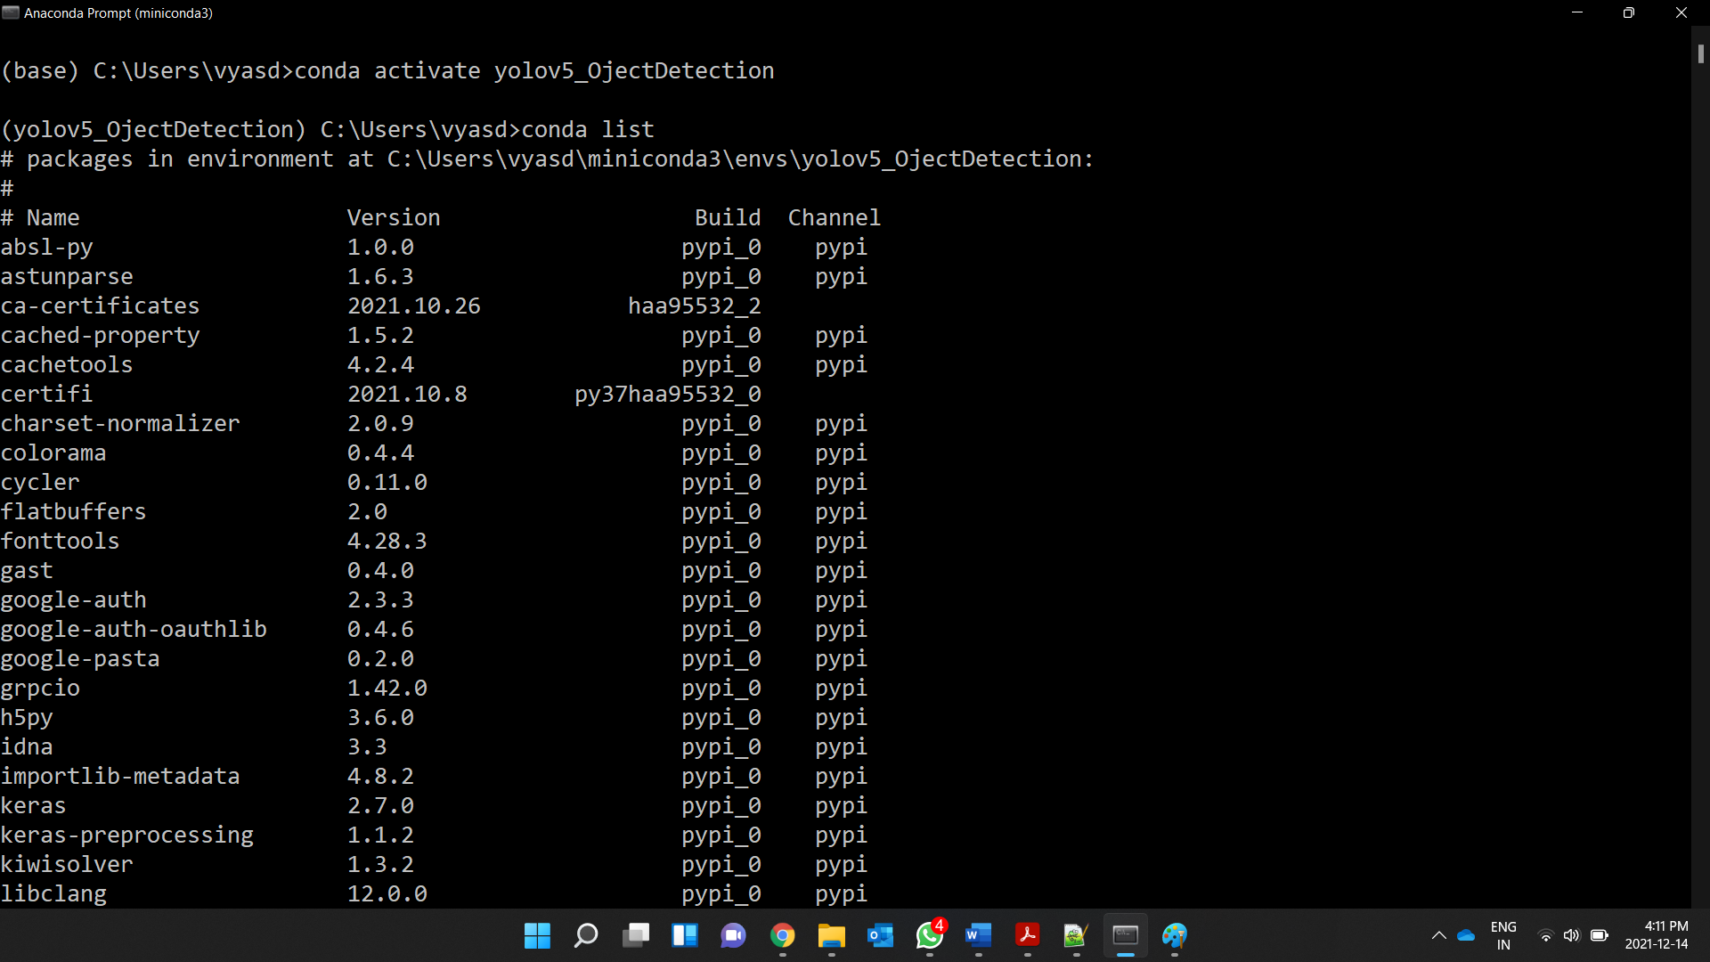
1) Environment Setup
Conda create -n yolov5_ObjectDetection python=3.7
Basic: Numpy, Pillow, Pandas, Matplotlib
Image Processing: OpenCV
AI Framework: Pytorch
GPU Toolkit: CUDA
Training Results: Tensorboard

Slide 9

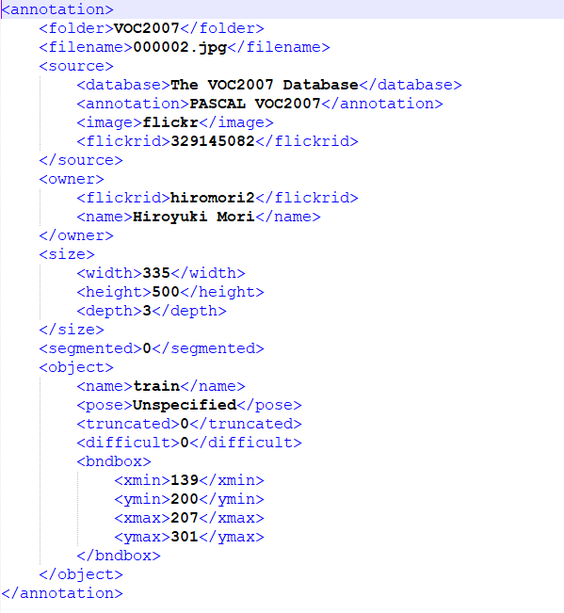
2) Dataset Preprocessing
YOLO Format
Xmin, Ymin, Xmax, Ymax
Xc, Yc, Width, Heigth
XML Format
13: Dataset Class ID (in VOC20007 case 20 Classes are there)
0.516: Normalized X Coordinate of the Centre of Bounding Box
0.501: Normalized Y Coordinate of the Centre of Bounding Box
0.203: Normalized Width of the Bounding Box
0.202: Normalized Height of the Bounding Box

Slide 10
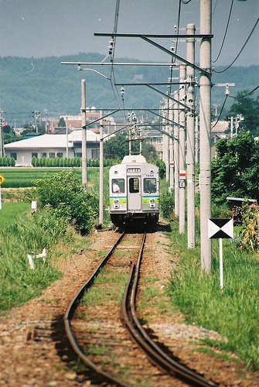

Image Resize
Dataset Structure
We need to split data as 70% Training Data, 20% Testing Data and 10% Validation Data.
VOC 2007 Dataset : 9963 Images
Training Data: 5928 Images
Testing Data: 3043 Images
Validation Data: 992 Images
500 x 375
320 x 320
To make them compatible with Yolov5 model provided by Ultralytics.

Slide 11
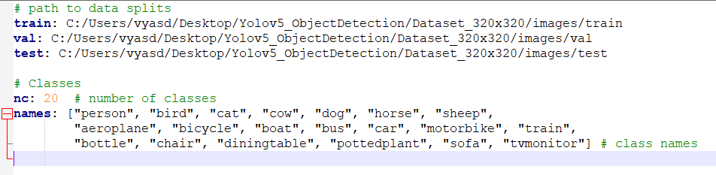
3) Configuring Training
Pascal_voc_2007.yaml
YAML File Includes
Train/Test/Val Dataset folder file paths.
label map which tells the training file what each object is by defining a mapping of class names to class ID numbers.

Slide 12
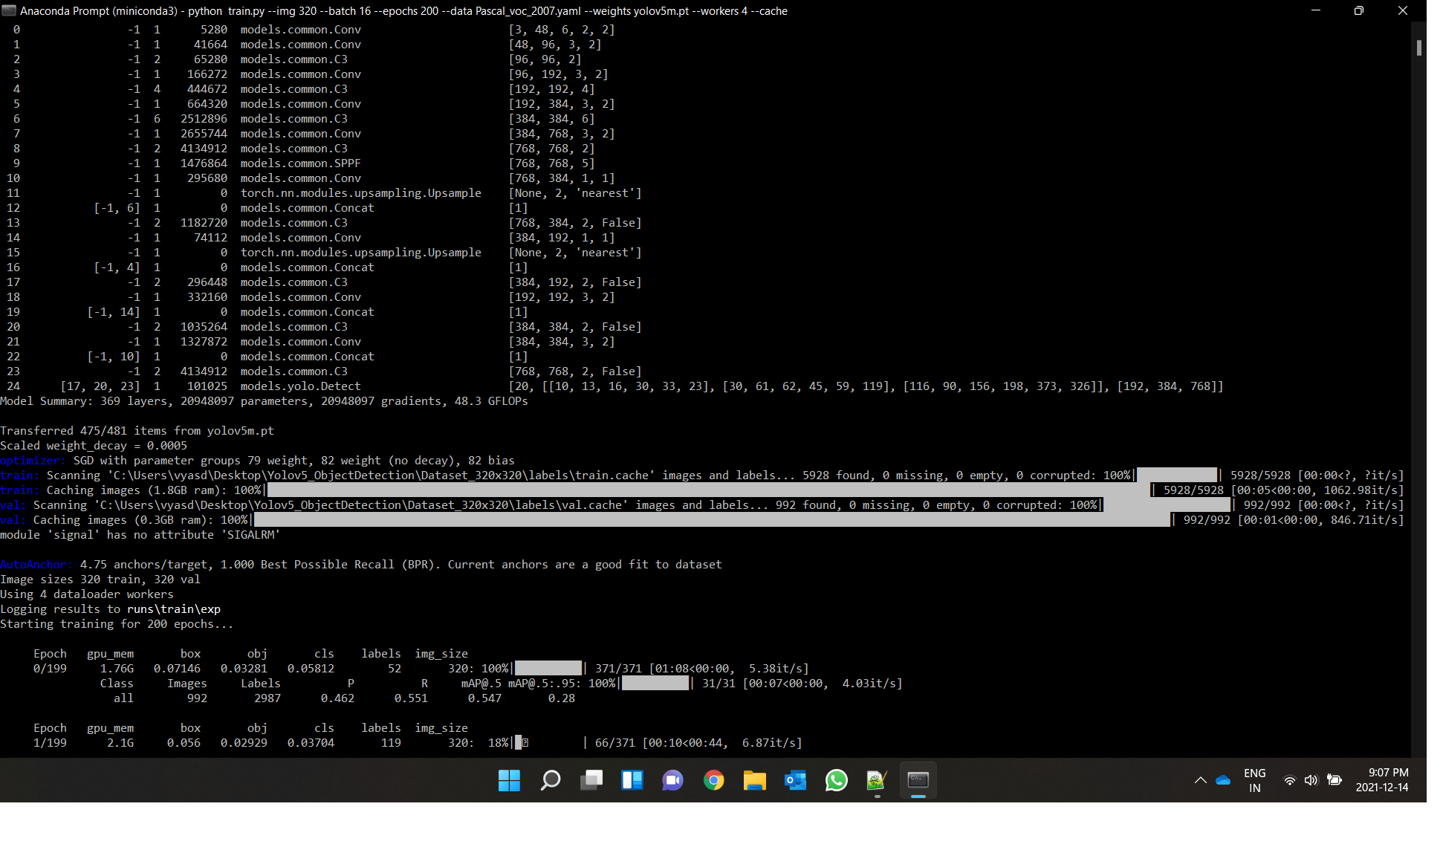
4) Run Training
python train.py --img 320 --batch 16 --epochs 200 --data Pascal_voc_2007.yaml --weights yolov5m.pt --workers 4 –cache

Slide 13
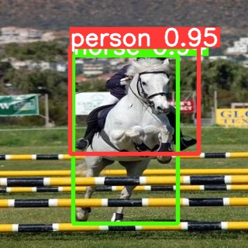
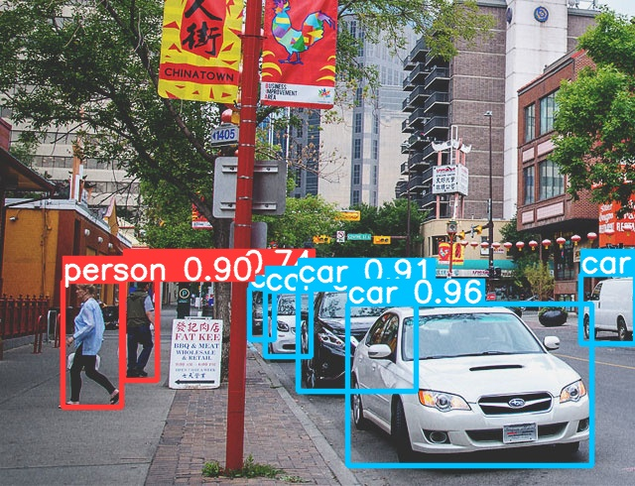
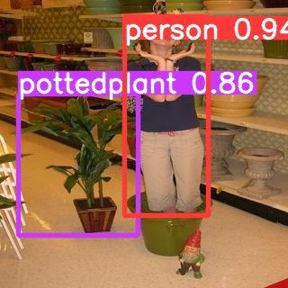
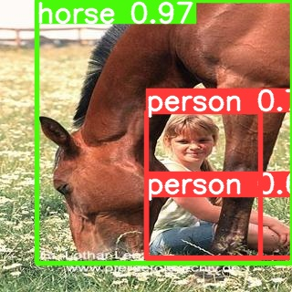
5) Testing Model
python test.py --img 320 --batch 16 --data Pascal_voc_2007.yaml --weights Yolov5m_PascalVoc2007.pt --workers 4
This command will generate confusion matrix test dataset.
All results can be seen in /yolov5/runs/train directory.

Slide 14
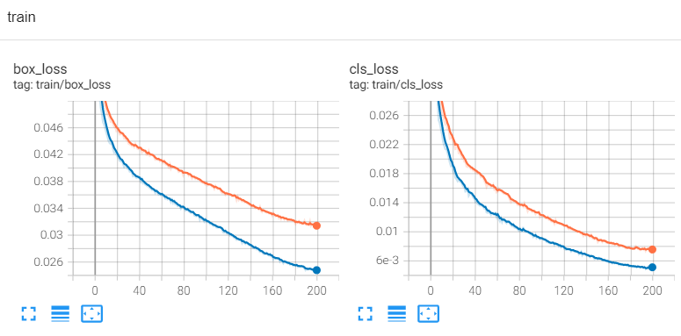
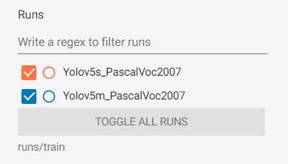
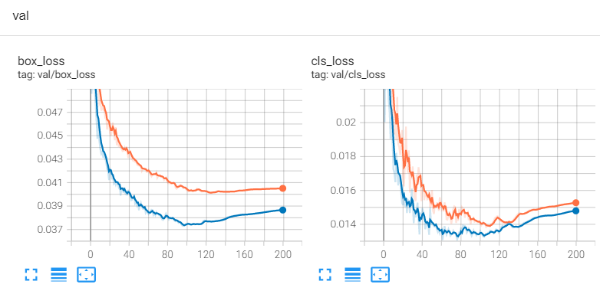
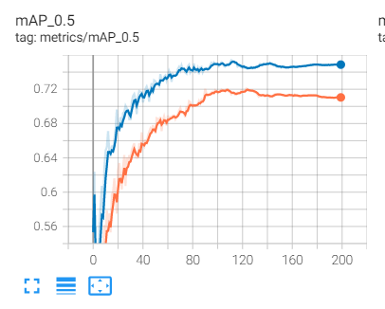
6) Training and Validation Results
Stop Training! Overfitting

Slide 15
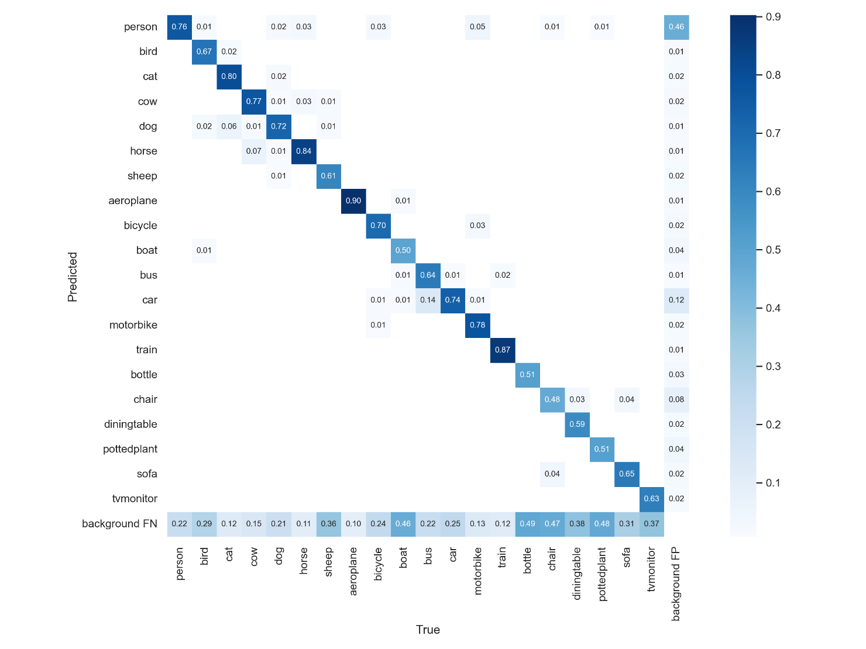
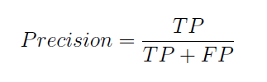
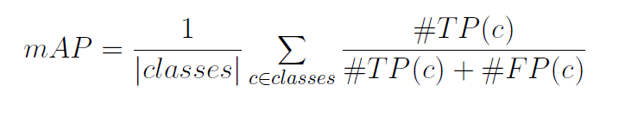
7) Test Results
Yolov5m Confusion Matrix:
Mean Average Precision(mAP) = 70.1%

Slide 16
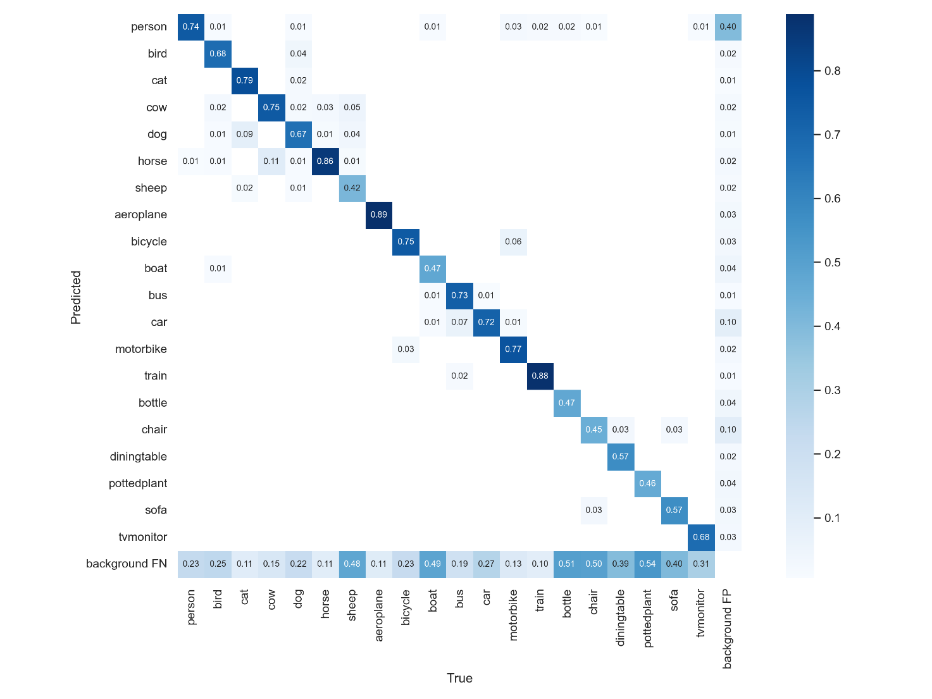
Yolov5s Confusion Matrix:
Mean Average Precision(mAP) = 68.3%

Slide 17
Thank You

