Slide 1
Decision Tree
Machine Learning
ITCS 4156
Sharat Vyas
Mike Subedi

Slide 2
Decision Trees
A decision tree T encodes d (a classifier or regression function) in form of a tree.
A node t in T without children is called a leaf node. Otherwise t is called an internal node.

Slide 3
Decision Tree by Induction
Induction vs. Deduction
Induction is the development of a general theory or model from a set of specific facts.
Deduction is the prediction or identification of specific facts that logically follow from a general theory or model.
Classification Algorithms:
Tree-structure classifiers:
IND, S-Plus Trees, C4.5, FACT, QUEST, CART, OC1, LMDT, CAL5, T1
Statistical methods:
LDA, QDA, NN, LOG, FDA, PDA, MDA, POL
Neural networks:
LVQ, RBF

Slide 4
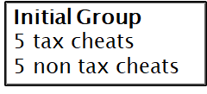
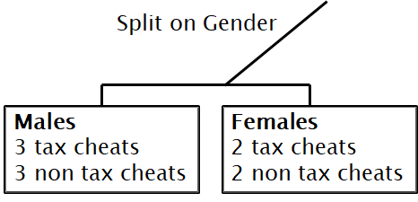
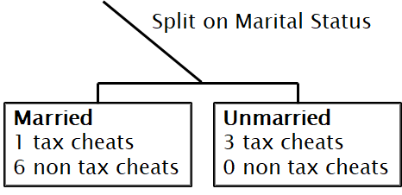
Finding Which Attribute to Split on
We can split on any of the attributes…so how do we decide on which one?
Example: We have two attributes (gender and marital status) and we are trying to build a tree to detect tax cheats.
Decision Tree Induction – How to Split Attributes
Depends on attribute types Depends on number of ways to split
Nominal
Ordinal
Continuous
Splitting on gender still leaves us with 50% tax cheats in each group
Splitting on marital status does a much better job of creating purer grouping of tax cheats
2 - ways split
Multi-way split

Slide 5



Splitting Attributes
Binary Data
Binary data is easy. Just split values into two groups

Slide 6







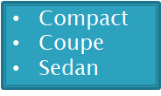

Splitting Attributes
Nominal Data
With nominal data, we can do a multi-way split
Or we can do a binary split (Some algorithms require it)
The split shown here in only ONE option.. There are actually 2^{k-1}-1 ways to binary split an attribute with k values.

Slide 7
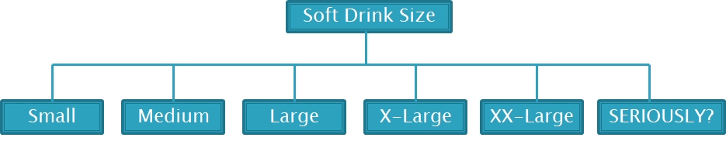
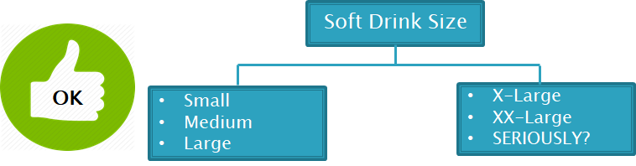
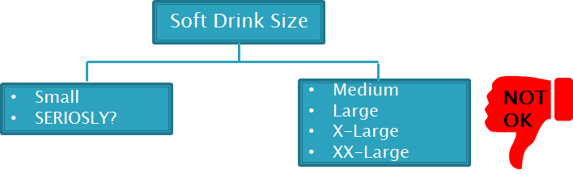
Splitting Attributes
Ordinal Attributes
Ordinal attributes can use a multi-way split just like with nominal data
Ordinal attributes can be binary split up like nominal ones…but without violating the order property

Slide 8
Different ways of handling splitting continuous attributes
Discretization to form an ordinal categorical attribute:
Static – discretize once at the beginning
Dynamic – ranges can be found by equal
Interval bucketing, equal frequency Bucketing (percentiles), or Clustering
Binary Decision: (A < v) or (A >= v)
Consider all possible splits and finds the best cut
Can be more compute intensive

Slide 9
Summary
Powerful data mining model for classification (and regression) problems
Easy to understand and to present to non-specialists
Decision tree by induction looks for patterns in a subset of known records that helps to develop a model to classify future, unknown records.
Used frequently in predictive modeling, how they are created, and how they can optimized for the best result.

