Slide 2

Map-Reduce
ADBMS Presentation
- Yash Vyavahare

Slide 3
Map-reduce is a data processing paradigm for condensing large volumes of data into useful aggregated results.
To perform map-reduce operations, MongoDB provides the mapReduce database command.
The map-reduce function first queries the collection, then maps the result documents to emit key-value pairs, which is then reduced based on the keys that have multiple values.

Slide 4
map is a javascript function that maps a value with a key and emits a key-value pair
reduce is a javascript function that reduces or groups all the documents having the same key
out specifies the location of the map-reduce query result
query specifies the optional selection criteria for selecting documents
sort specifies the optional sort criteria
limit specifies the optional maximum number of documents to be returned

Slide 5
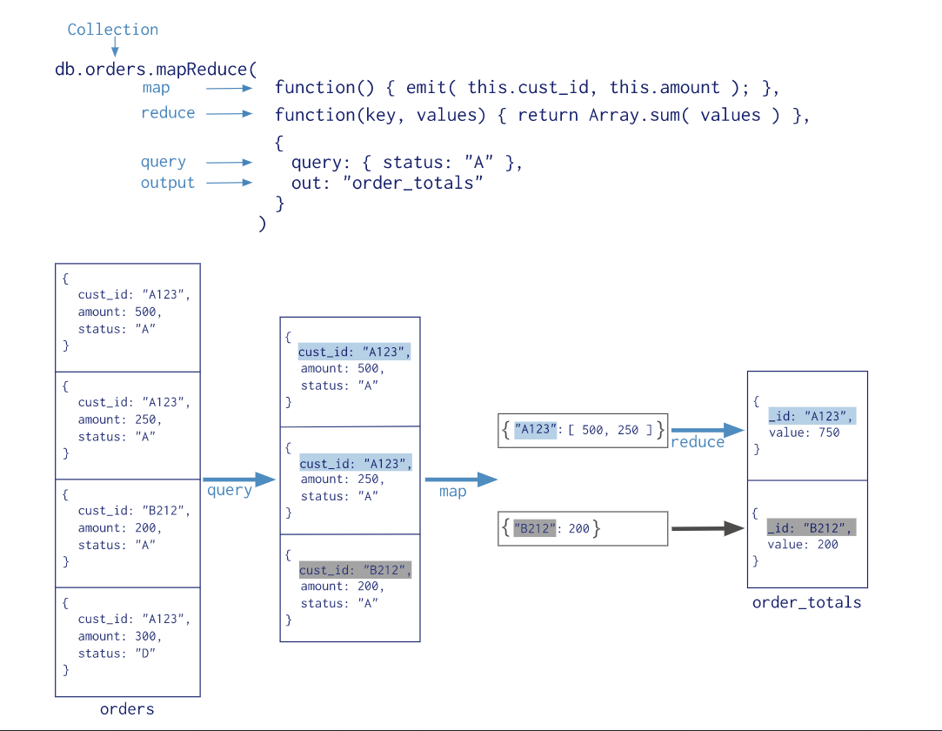

Slide 13
Aggregation Pipeline as Alternative to Map-Reduce
Starting in MongoDB 5.0, map-reduce is deprecated.
Instead of map-reduce, you can use an aggregation pipeline. Aggregation pipelines provide better performance and usability than map-reduce.
You can rewrite map-reduce operations using aggregation pipeline stages, such as $group, $merge, and others.
For map-reduce operations that require custom functionality, you can use the $accumulator and $function aggregation operators, available starting in version 4.4. You can use those operators to define custom aggregation expressions in JavaScript.

Slide 14
Thank You

