Slide 1


Модули
Докладчик: Евграфов Михаил

Slide 2


Модули

Slide 3
Мотивация использования
$ python
>>> def print_greeting(name: str) -> None:
... greeting = f"Hello, {name}!"
... print(greeting)
...
>>> print_greeting("Saul Goodman")
...
>>> exit()
$ python
>>> print_greeting("Lalo")
...
NameError: name 'print_greeting' is not defined

Slide 4
Создание модуля
# greeting.py
def print_greeting(name: str) -> None:
greeting = f"Hello, {name}!"
print(greeting)
>>> import greeting
>>> print(type(greeting).__name__)
module

Slide 5
Доступ к содержимому
>>> import greeting
>>> print(greeting.__name__)
>>> print_greeting("Gustavo Fring")
...
NameError: name 'print_greeting' is not defined
>>> greeting.print_greeting("Gustavo Fring")
Hello, Gustavo Fring!

Slide 6
Этап выполнения модуля
# greeting.py
print("start import")
def print_greeting(name: str) -> None:
greeting = f"Hello, {name}!"
print(greeting)
print("finish import")
>>> import greeting
start import
finish import

Slide 7
Импорт отдельных объектов
# greeting.py
GREET_TEMPLATE = "Hello, {}!"
def print_greeting(name: str) -> None:
greeting = GREET_TEMPLATE.format(name)
print(greeting)
>>> from greeting import print_greeting
>>> print_greeting("Hector")
Hello, Hector!
>>> print(greeting)
...
NameError: name 'greeting' is not defined

Slide 8
Связывание модуля
# greeting.py
GREET_TEMPLATE = "Hello, {}!"
def print_greeting(name: str) -> None:
greeting = GREET_TEMPLATE.format(name)
print(greeting)
>>> import greeting as grt
>>> grt.print_greeting("Hector")
Hello, Hector!
>>> print(greeting)
...
NameError: name 'greeting' is not defined

Slide 9
Связывание содержимого
# greeting.py
GREET_TEMPLATE = "Hello, {}!"
def print_greeting(name: str) -> None:
greeting = GREET_TEMPLATE.format(name)
print(greeting)
>>> from greeting import GREET_TEMPLATE as template
>>> print(template)
Hello, {}!
>>> print(GREET_TEMPLATE)
...
NameError: name 'GREET_TEMPLATE' is not defined

Slide 10
from ... import *
# greeting.py
GREET_TEMPLATE = "Hello, {}!"
def print_greeting(name: str) -> None:
greeting = GREET_TEMPLATE.format(name)
print(greeting)
>>> from greeting import *
>>> print(GREET_TEMPLATE)
>>> print_greeting("Mike")
Hello, {}!
Hello, Mike!

Slide 11
Проблемы from ... import *
# greeting.py
GREET_TEMPLATE = "Hello, {}!"
def print_greeting(name: str) -> None:
greeting = GREET_TEMPLATE.format(name)
print(greeting)
>>> from greeting import *
>>> GREET_TEMPLATE = "wrong"
>>> print(GREET_TEMPLATE)
>>> print_greeting("Mike")
wrong
Hello, Mike!

Slide 12
Приватные поля модуля
# greeting.py
def print_greeting(name: str) -> None:
greeting = _greeting_template.format(name)
print(greeting)
_greeting_template = "Hello, {}!"
>>> from greeting import _greeting_template
>>> print(_greeting_template)
Hello, {}!

Slide 13
Приватные поля модуля и *
# greeting.py
def print_greeting(name: str) -> None:
greeting = _greeting_template.format(name)
print(greeting)
_greeting_template = "Hello, {}!"
>>> from greeting import *
>>> print_greeting("Mike")
>>> print(_greeting_template)
Hello, Mike!
...
NameError: name '_greeting_template' is not defined

Slide 14
Выполнение модуля как скрипта
# greeting.py
def print_greeting(name: str) -> None:
greeting = f"Hello, {name}!"
print(greeting)
name = input("Enter your name: ")
print_greeting(name)
$ python greeting.py

Slide 15
__pycache__
└───greeting.py
T1
$ python greeting.py
├───__pycache__
│ │
│ └───greeting.cpython-311.pyc
│
└───greeting.py
T1
T1

Slide 16
Обновление __pycache__
├───__pycache__
│ └───greeting.cpython-311.pyc
└───greeting.py
T1
T1

Slide 17
Обновление __pycache__
├───__pycache__
│ └───greeting.cpython-311.pyc
└───greeting.py
T1
T2
$ python greeting.py
├───__pycache__
│ └───greeting.cpython-311.pyc
└───greeting.py
T2
T2

Slide 18
Порядок поиска модулей
# greeting.py
from typing import Optional
from third_party import cool_greeting
def print_greeting(
name: Optional[str] = None
) -> None:
greeting = f"Hello, {name}!"
print(greeting)
cool_greeting()

Slide 19
Порядок поиска модулей
Директории
$ python greeting.py
>>> from typing import ...
./
?

Slide 20
Порядок поиска модулей
Директории
$ python greeting.py
>>> from typing import ...
./
NO
.../Python/...
?

Slide 21
Порядок поиска модулей
Директории
$ python greeting.py
>>> from typing import ...
./
NO
.../Python/...
YES

Slide 22
Порядок поиска модулей
Директории
$ python greeting.py
>>> from typing import ...
./
?
>>> from third_party import ...

Slide 23
Порядок поиска модулей
Директории
$ python greeting.py
>>> from typing import ...
./
NO
>>> from third_party import ...
.../Python/...
?

Slide 24
Порядок поиска модулей
Директории
$ python greeting.py
>>> from typing import ...
./
NO
>>> from third_party import ...
.../Python/...
NO
.../site-packages/...
?

Slide 25
Порядок поиска модулей
Директории
$ python greeting.py
>>> from typing import ...
./
NO
>>> from third_party import ...
.../Python/...
NO
.../site-packages/...
YES

Slide 26
builtins
>>> import greeting
>>> greeting.__builtins__
{
...
'abs': <function abs(x, /)>,
'all': <function all(iterable, /)>,
'any': <function any(iterable, /)>,
...
}
>>> import builtins
>>> greeting.__builtins__["len"] is builtins.len
True

Slide 27
Исполняемые модули

Slide 28
__name__
# name_printer.py
print(__name__)
$ python name_printer.py
__main__
$ python
>>> import name_printer
>>> print(name_printer.__name__)
name_printer
name_printer

Slide 29
Идиома __name__ == "__main__"
# name_printer.py
if __name__ == "__main__":
print(__name__)
$ python name_printer.py
__main__
$ python
>>> import name_printer
>>> print(name_printer.__name__)
name_printer

Slide 30
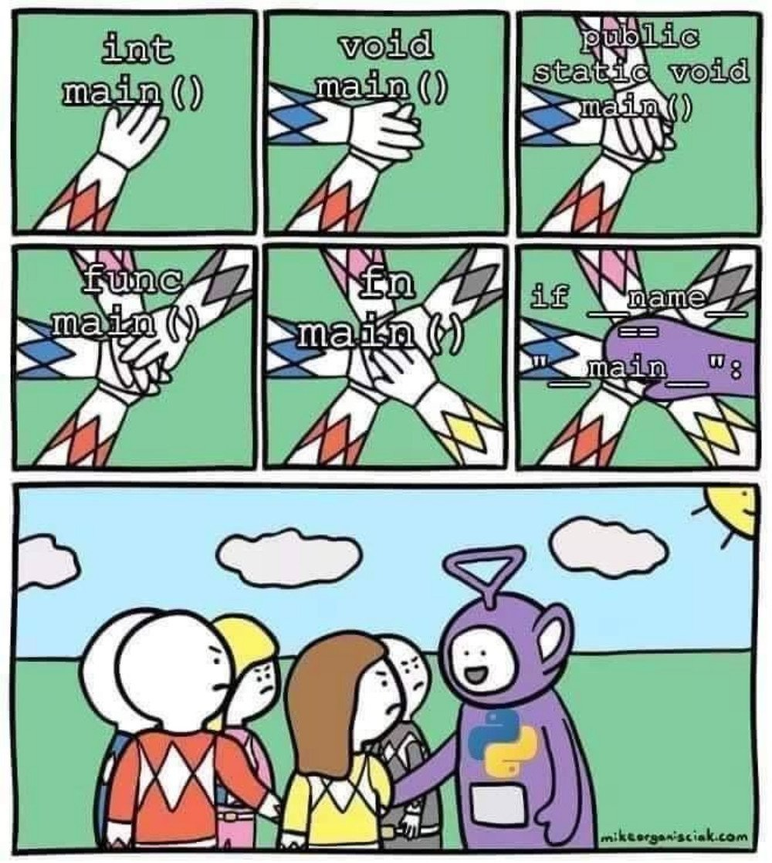
Идиома - не точка входа

Slide 31
Мотивация использования
# argv_user.py
import sys
if __name__ == "__main__":
print(sys.argv)
$ python argv_user.py
['.\\argv_user.py']
$ python argv_user.py 42
['.\\argv_user.py', '42']

Slide 32
Пакеты

Slide 33
Файловая структура
└───package
│
├───__init__.py
│
├───module1.py
│
└───module2.py

Slide 34
Импорт модулей пакета
# package/module1.py
def print_module_info() -> None:
print(f"I am function from {__name__}")
# package/module2.py
def print_module_info() -> None:
print(f"I am function from {__name__}")
>>> import package
>>> package.module1
...
AttributeError: module 'package' has no attribute 'module1'

Slide 35
Импорт модулей пакета
# package/module1.py
def print_module_info() -> None:
print(f"I am function from {__name__}")
# package/module2.py
def print_module_info() -> None:
print(f"I am function from {__name__}")
>>> import package.module1 as mod1
>>> mod1.print_module_info()
I am function from package.module1

Slide 36
__init__.py
# package/__init__.py
from package import module1
from package import module2
print("Init package")
>>> import package
>>> print(package.module1)
>>> print(package.module2)
Init package
<module 'package.module1' ...>
<module 'package.module2' ...>

Slide 37
import ... from *
>>> from package import *
>>> module1.print_module_info()
>>> module2.print_module_info()
...
NameError: name 'module1' is not defined

Slide 38
__all__
# package/__init__.py
__all__ = ["module1", "module2"]
>>> from package import *
>>> module1.print_module_info()
>>> module2.print_module_info()
I am function from package.module1
I am function from package.module2

Slide 39
Семинар

