Slide 1
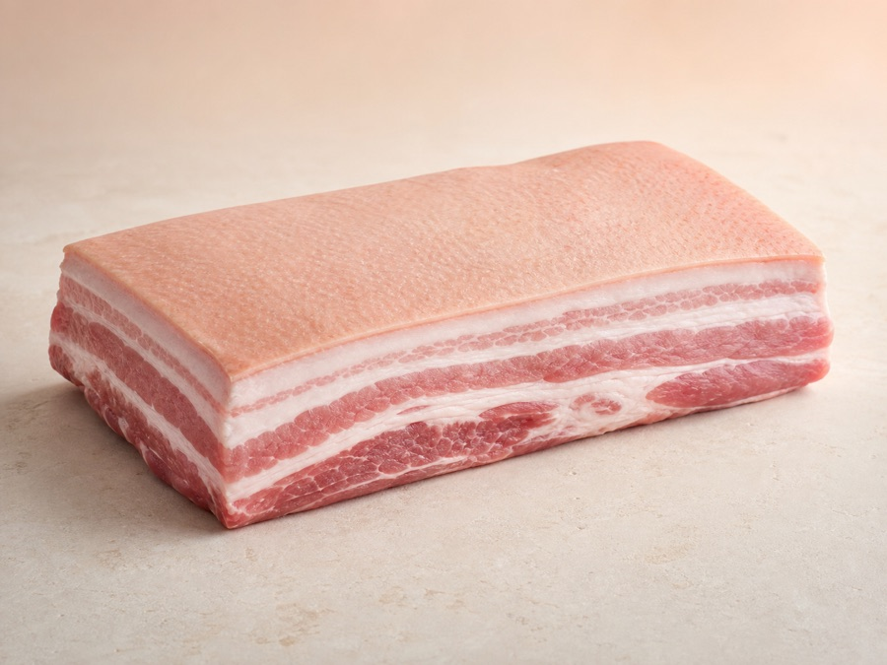
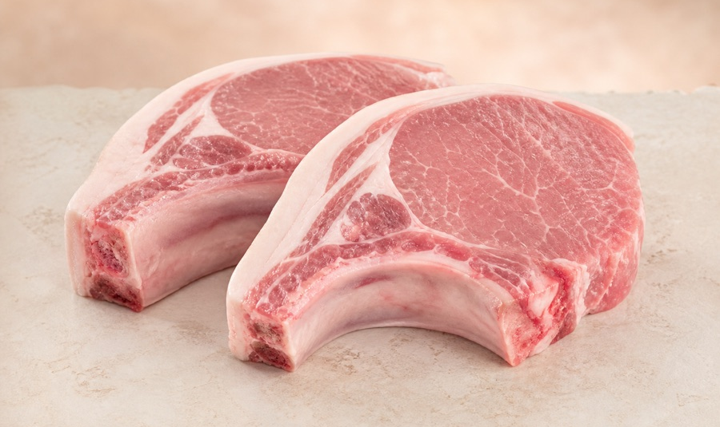
P
BUILD ON ARC 2026 · CHECKPOINT 2
PorkPay
Source better.
Pay smarter.
A USDC-native pork marketplace for buyer-to-supplier settlement on Arc.
DEFI TRACK · TESTNET MVP
Notes:
Open with the product promise: buy pork, pay in USDC, track the order.
[Sources]
- https://github.com/vybao39-rgb/porkpay
- Project product imagery: AI-generated assets in the PorkPay repository
[/Sources]

Slide 2
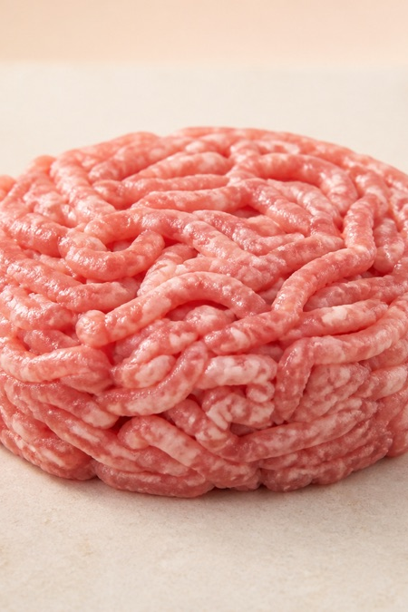
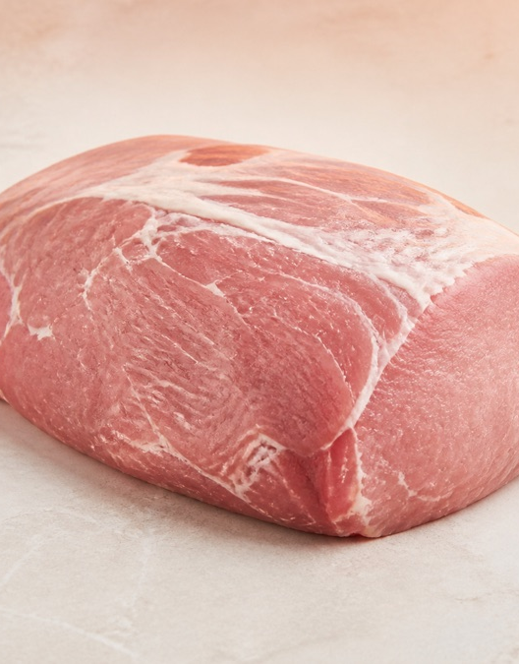
THE PROBLEM
Pork trade still runs on fragmented coordination.
Prices are hard to compare
Buyers discover offers across disconnected messages and spreadsheets.
Settlement is slow to verify
Cash and bank transfers separate payment confirmation from the order record.
Delivery has no shared state
Buyer and supplier lack one timeline for payment, fulfilment and settlement.
One USDC-denominated commerce record.
PORKPAY · CHECKPOINT 2 · DEFI TRACK
02
Notes:
[Sources]
- Project problem statement: https://github.com/vybao39-rgb/porkpay#the-problem
- Project product imagery: AI-generated assets in the PorkPay repository
[/Sources]

Slide 3
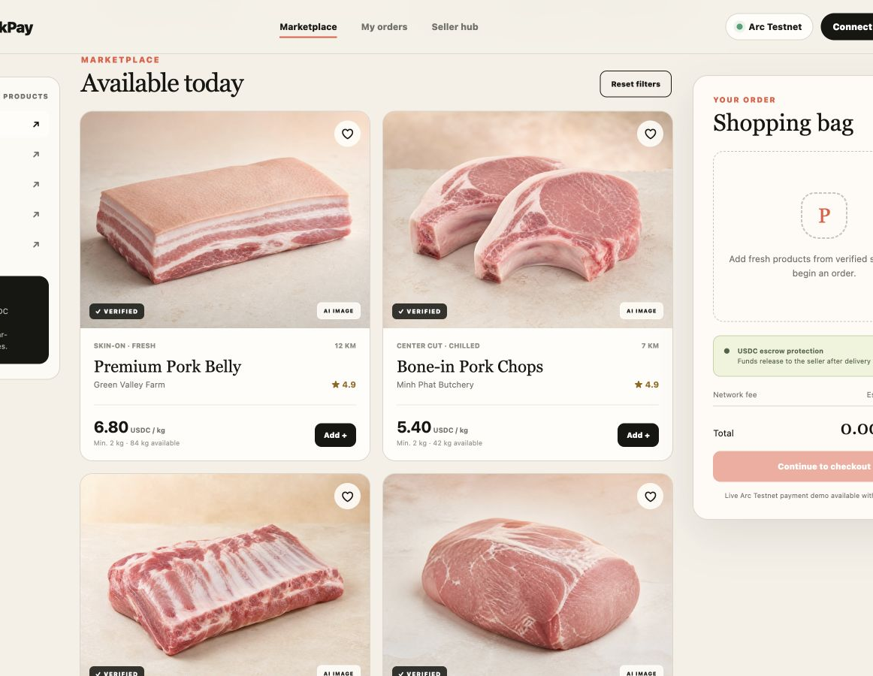
THE PRODUCT
One flow connects discovery, ordering and USDC settlement.
01
Discover
Compare verified suppliers, cuts and USDC prices.
02
Order
Build a cart and capture delivery details.
03
Settle
Connect an EVM wallet and confirm the payment path.
Functional frontend MVP · dependency-free static web app
PORKPAY · CHECKPOINT 2 · DEFI TRACK
03
Notes:
[Sources]
- Live product: https://vybao39-rgb.github.io/porkpay/
- Code: https://github.com/vybao39-rgb/porkpay
- Screenshot captured from the public PorkPay GitHub Pages demo
[/Sources]

Slide 4
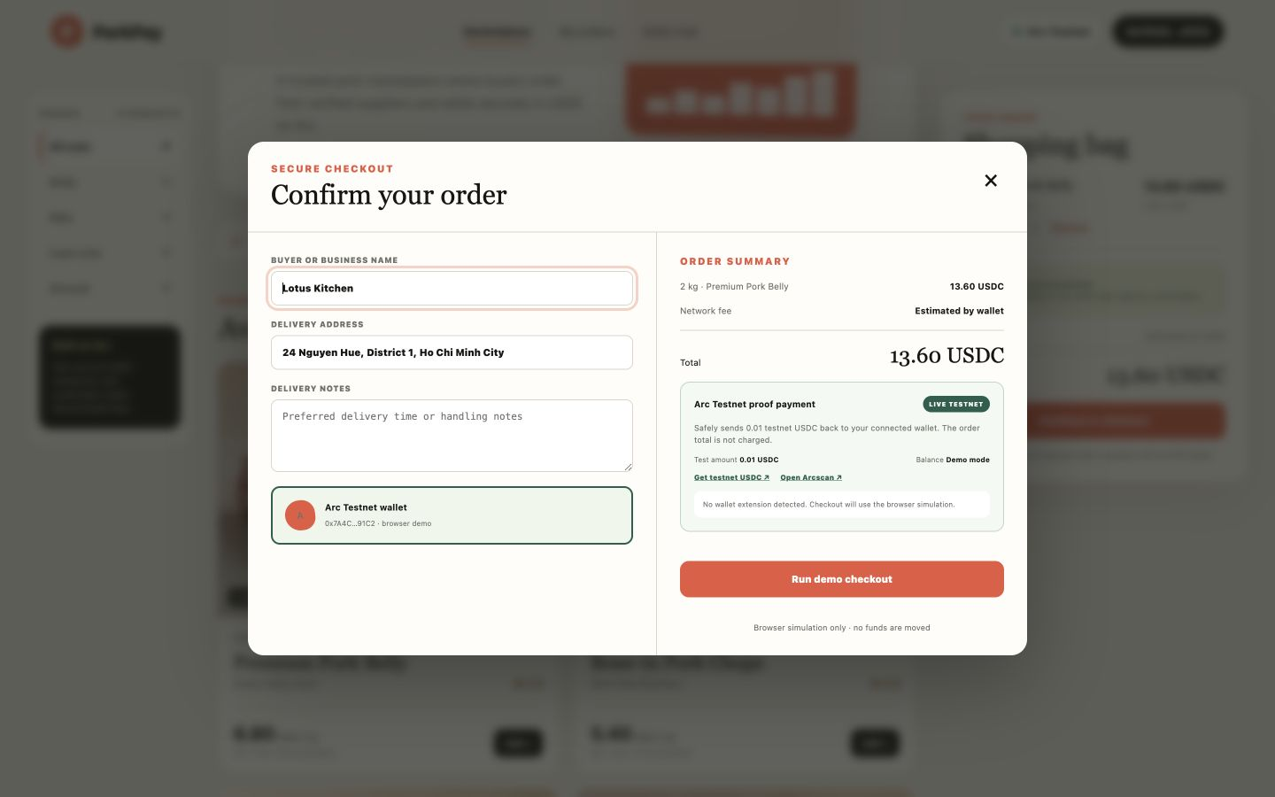
CHECKPOINT 2 SHIPPED
The demo now creates an Arc Testnet proof payment.
✓
Connect and switch
Request an EVM account and move the wallet to Arc Testnet.
✓
Read USDC balance
Query the official Arc Testnet USDC ERC-20 contract.
✓
Send a 0.01 proof
Submit a self-transfer so the displayed order total is never charged.
✓
Verify finality
Poll the receipt and expose the Arcscan transaction link.
TESTNET ONLY · NEVER USE REAL FUNDS
PORKPAY · CHECKPOINT 2 · DEFI TRACK
04
Notes:
The browser screenshot is in demo mode because no wallet extension is injected. With an EVM wallet, the same UI requests the 0.01 testnet USDC transaction.
[Sources]
- Implementation: https://github.com/vybao39-rgb/porkpay/blob/main/index.html
- Live demo: https://vybao39-rgb.github.io/porkpay/
- Arc Testnet USDC address: https://developers.circle.com/stablecoins/usdc-contract-addresses
- Arc connection parameters: https://docs.arc.io/integrate/connect-to-arc
[/Sources]

Slide 5
WHY ARC
Arc makes USDC the payment asset and the gas asset.
USDC
01
Dollar-denominated gas
USDC is Arc's native gas token, removing the need for a separate volatile fee asset.
02
Sub-second deterministic finality
one balance for value transfer and network fees
Transactions finalize in under one second with no chain-reorganization risk.
03
EVM compatibility
Arc Testnet
Existing Solidity contracts and standard Ethereum tooling remain usable.
Chain ID 5042002
RPC rpc.testnet.arc.network
PORKPAY · CHECKPOINT 2 · DEFI TRACK
05
Notes:
[Sources]
- https://docs.arc.io/arc-chain
- https://docs.arc.io/arc/concepts/stablecoin-native-model
- https://docs.arc.io/arc/references/rpc-endpoints
[/Sources]

Slide 6
CURRENT ARCHITECTURE
The MVP keeps the payment path simple and inspectable.
BUYER
PORKPAY WEB
EVM WALLET
ARC TESTNET
ARCSCAN
→
→
→
→
Browses and orders
Calculates USDC total
Signs the transaction
Executes USDC transfer
Shows proof and status
No custodial keys
No real funds
Escrow is next
The wallet signs from the user's browser.
The proof flow is restricted to Arc Testnet.
Checkpoint 3 adds the minimal settlement contract.
PORKPAY · CHECKPOINT 2 · DEFI TRACK
06
Notes:
[Sources]
- Implementation: https://github.com/vybao39-rgb/porkpay/blob/main/index.html
- Arc RPC and explorer: https://docs.arc.io/arc/references/rpc-endpoints
- Arc Testnet USDC contract: https://developers.circle.com/stablecoins/usdc-contract-addresses
[/Sources]

Slide 7
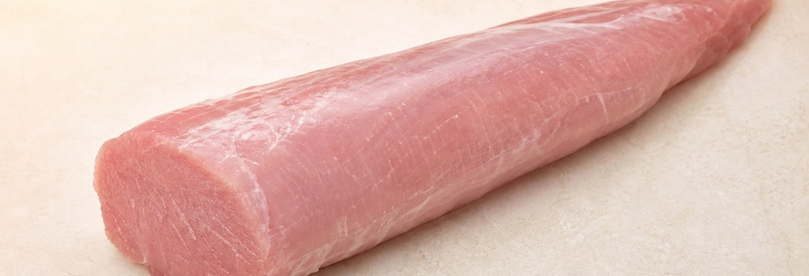
NEXT MILESTONE
Checkpoint 3 turns the proof into supplier settlement.
01
02
03
04
Supplier payment
Minimal escrow
Delivery release
Refund path
Send testnet USDC to the selected supplier.
Lock the order amount in a verified contract.
Buyer confirmation releases funds onchain.
Cancelled orders return funds with a clear record.
Checkpoint 2 complete
Wallet → USDC proof → receipt → Arcscan
PORKPAY · CHECKPOINT 2 · DEFI TRACK
07
Notes:
[Sources]
- Project roadmap: https://github.com/vybao39-rgb/porkpay#roadmap
- Project product imagery: AI-generated assets in the PorkPay repository
[/Sources]

Slide 8
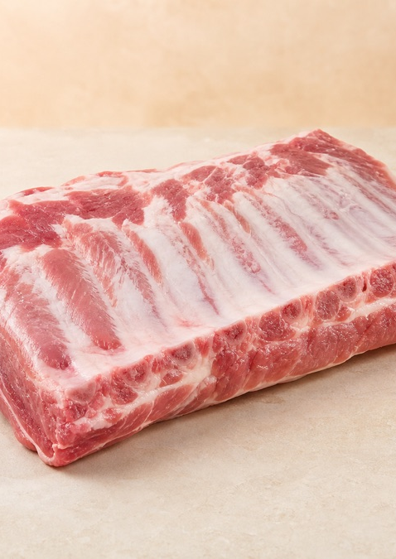
SUBMISSION READY
Ready for
DeFi Track review.
Buy pork. Pay in USDC. Settle on Arc.
CODE
github.com/vybao39-rgb/porkpay
DEMO
vybao39-rgb.github.io/porkpay
DECK
vybao39-rgb.github.io/porkpay/presentation.html
CHECKPOINT 2 · DEFI
Notes:
Close by giving reviewers the three public artifacts they need: code, live demo and deck.
[Sources]
- https://github.com/vybao39-rgb/porkpay
- https://vybao39-rgb.github.io/porkpay/
- https://vybao39-rgb.github.io/porkpay/presentation.html
- Project product imagery: AI-generated assets in the PorkPay repository
[/Sources]

