Slide 1
Conditions
Anemia
HeartFailure
PericardialEffusion
Preprocess
HeartDriver
BeginCardiacCycle
CalculateHeartElastance
ProcessActions
Hemorrhage
PericardialEffusionAction
CPR
CardiacArrest
Process
Solve Circuit
Advective Transport
CalculateVitalSigns
PostProcess
Advance Circuit

Slide 2
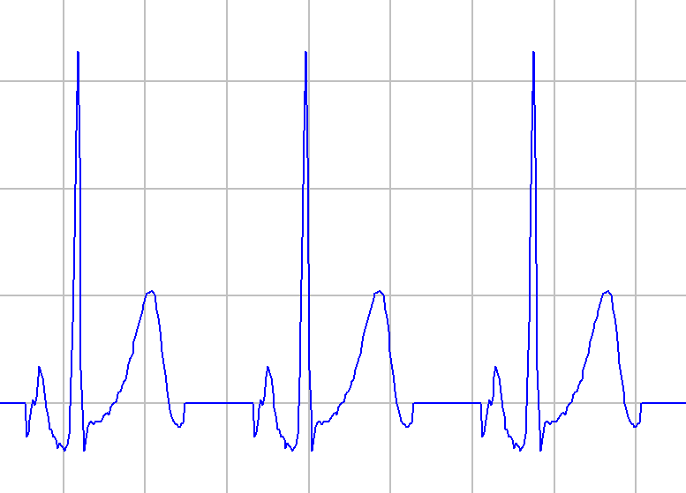
R
R-R
T
P-R
P
Q
S
S-T
Q-R-S
Q-T

Slide 3
