Slide 1
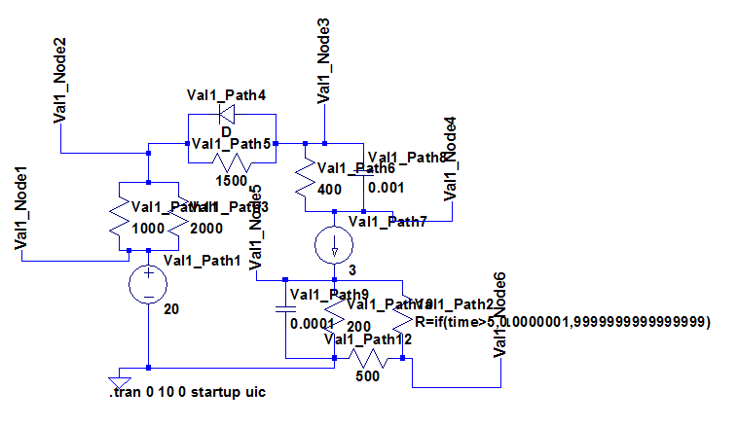
ValidationComprehensive1

Slide 2
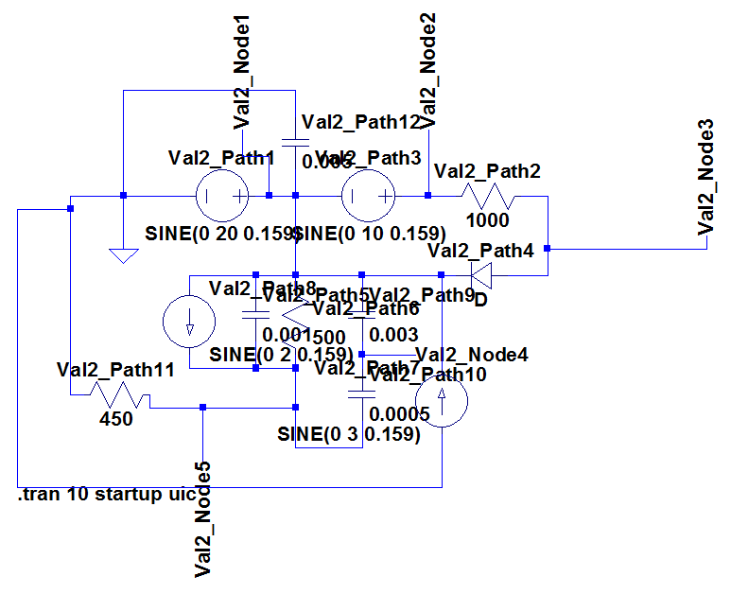
ValidationComprehensive2

Slide 3

Preprocess
Modified Nodal Analysis
Setup/Modify Next Values
Calculate Fluxes
Process
Modify Valve States
No
Valves Pass?
Yes
Advance Time
Calculate Quantities
Postprocess

Slide 4





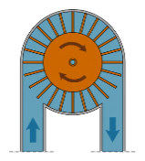
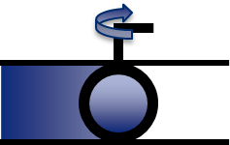

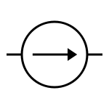

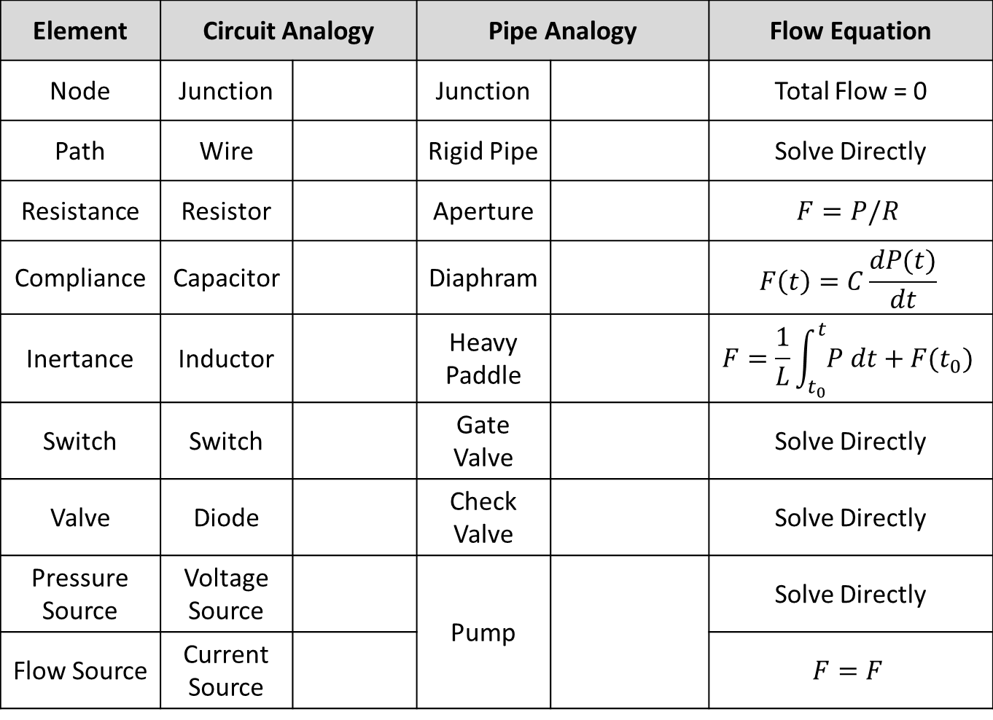
Element | Circuit Analogy |  | Pipe Analogy |  | Flow Equation
Node | Junction |  | Junction |  | Total Flow = 0
Path | Wire |  | Rigid Pipe |  | Solve Directly
Resistance | Resistor |  | Aperture |  | $$F=P/R$$
Compliance | Capacitor |  | Diaphram |  | $$F\left(t\right)=C\frac{dP(t)}{dt}$$
Inertance | Inductor |  | Heavy Paddle |  | $$F=\frac{1}{L}\int_{t_{0}}^{t}{P dt}+F(t_{0})$$
Switch | Switch |  | Gate Valve |  | Solve Directly
Valve | Diode |  | Check Valve |  | Solve Directly
Pressure Source | Voltage Source |  | Pump |  | Solve Directly
Flow Source | Current Source |  |  |  | $$F=F$$

Slide 5
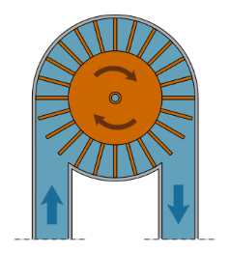




Slide 6
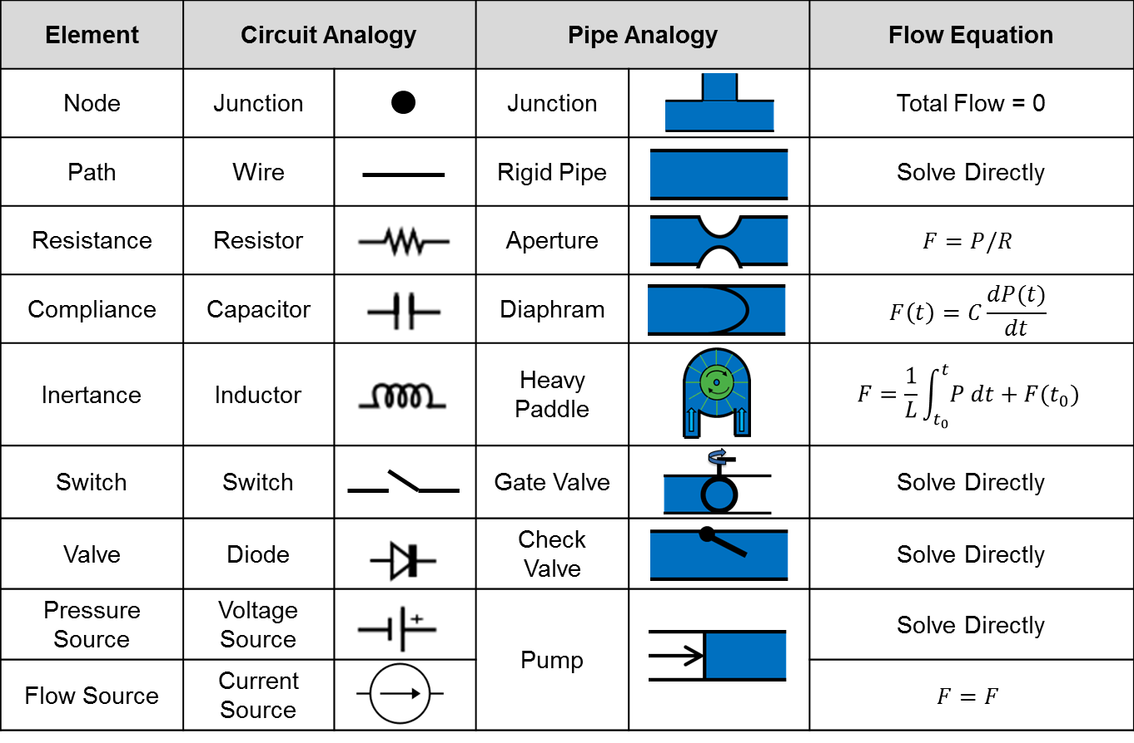

Slide 7

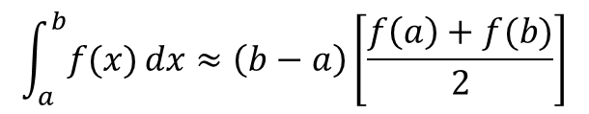

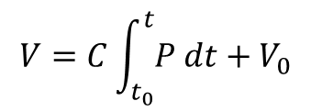
$$A=P^{−1}{LUQ}^{−1}$$
$$V=C\int_{t_{0}}^{t}{P dt+V_{0}}$$
$$\int_{a}^{b}{f(x)}dx≈\left(b−a\right)\left[\frac{f\left(a\right)+f(b)}{2}\right]$$
Q$\left(t\right)=C∙V(t)$

Slide 8
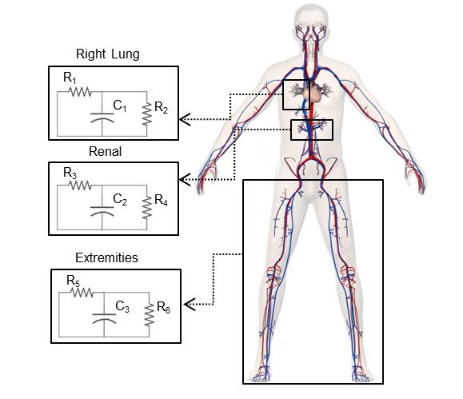
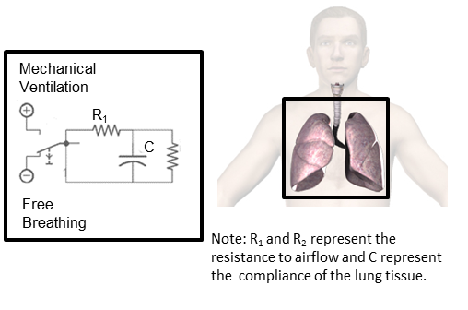

Slide 9
Legend:
Node
Path
Element

