Slide 1
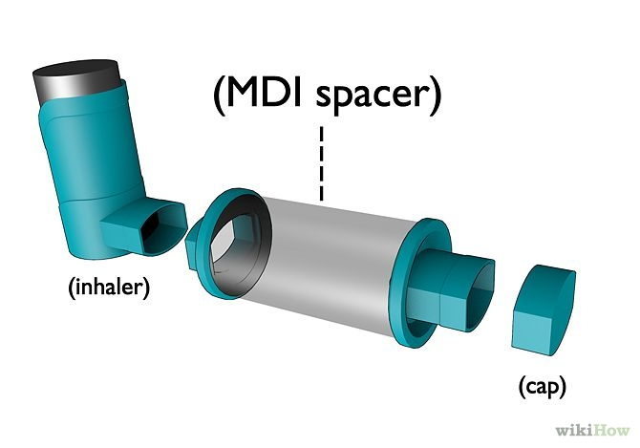

Slide 2
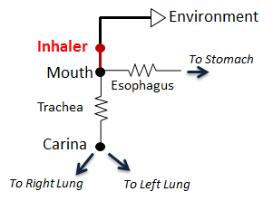
Figure 2
Environment
Inhaler
Mouth
To Stomach
Esophagus
Trachea
Carina
To Right Lung
To Left Lung

Slide 3
Preprocess
Administer
RemoveActiveCommand
Remove drug mass from the system based on oropharynx deposition
Process
Combined Circuit Solved by Respiratory
PostProcess
Combined Circuit Time Advanced by Respiratory

Slide 4
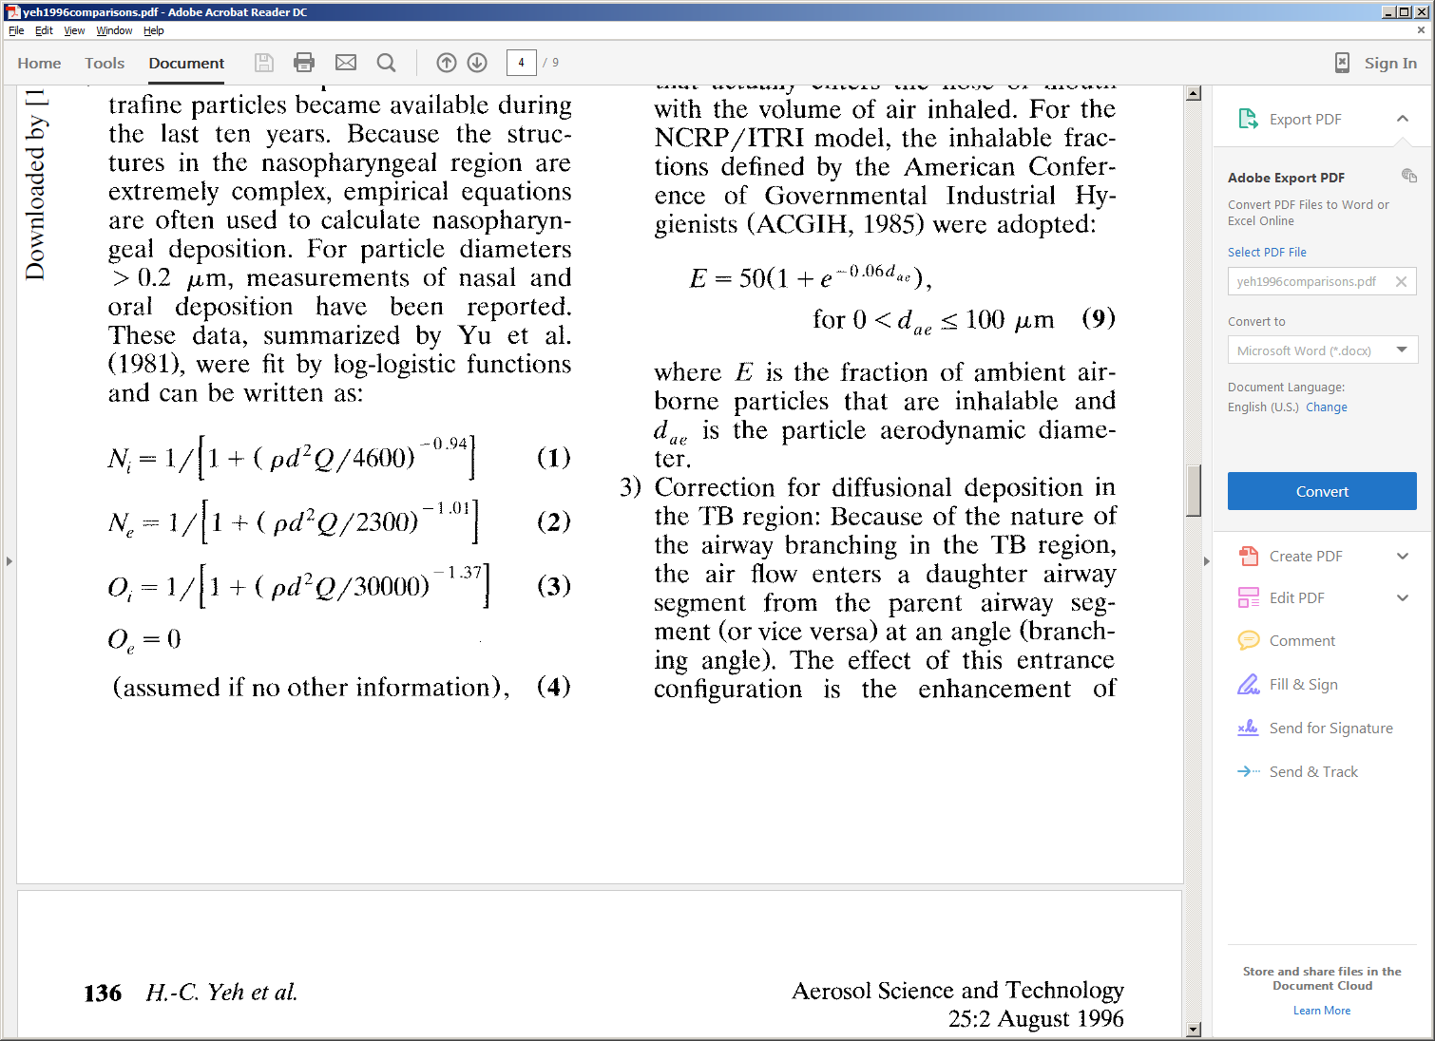
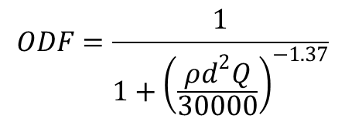
Equation 1
Oral Deposition Fraction =
Droplet Density
Droplet Diameter
Flow (mouth & trachea)
Oral Deposition Fraction = 1 / [1 + (ρd²Q/30000)^{-1.27}]
$$ODF=\frac{1}{1+{\left(\frac{ρd^{2}Q}{30000}\right)}^{−1.37}}$$

