Slide 1
Conditions
Enable Dehydration and Starvation (if active)
Process
Combined Circuit Solved by Cardiovascular
ProteinStorageAndRelease
FatStorageAndRelease
CalculateMetabolicConsumptionAndProduction
CalculatePulmonaryCapillarySubstanceTransfer
CalculateDiffusion
ManageSubstancesAndSaturation
CalculateVitals
PreProcess
CalculateTissueFluidFluxes
PostProcess
Combined Circuit Time Advanced by Cardiovascular

Slide 2
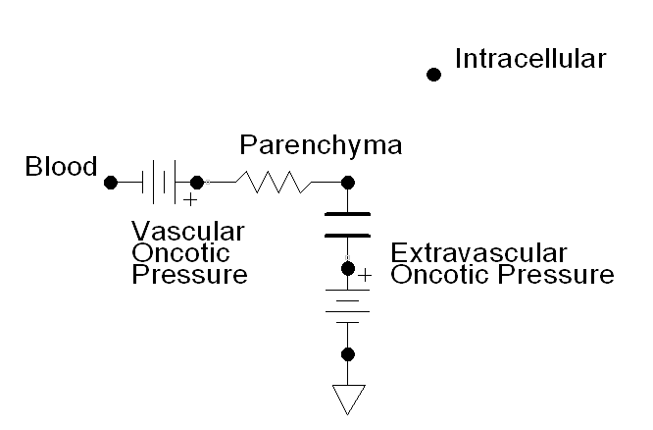

Slide 3
Please do not delete this.
Time = 0
Time = 10

Slide 4
Alveolar Air
Water
Barrier
Blood
Alveolar Diffusion
P_{O2}
[O₂]
[O₂]
[O₂] + Bound O₂

Slide 5
Blood Compartment
Tissue Compartment
Extracellular Fluid
Intracellular Fluid
Parenchyma
Active Transport
Active Transport
Instant Diffusion
Instant Diffusion
Facilitated Diffusion
Facilitated Diffusion
Perfusion Limited Diffusion

