Slide 1
Conditions
Coming Soon
ConsumeMeal
Starvation
Dehydration
Preprocess
CalculateMetabolicHeatGeneration
CalculateSweatRate
UpdateHeatResistance
Exercise
Process
Solve Temperature Circuit
CalculateVitalSigns
PostProcess
Advance Temperature Circuit

Slide 2
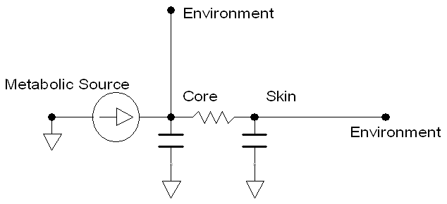

Slide 3
