Slide 1
Initialize
CalculateFilterability
Assessments
CalculateUrinalysis
Conditions
No UpdateBladderVolume
ConsumeMeal
RenalStenosis
Process
Combined Circuit Solved by Cardiovascular
Generic Transport Done by Cardiovascular
CalculateActiveTransport
CalculateGlomerularTransport
CalculateReabsorptionTransport
CalculateExcretion
CalculateSecretion
CalculateGluconeogenesis
CalculateAutomaticClearance
CalculateVitalSigns
Preprocess
CalculateUltrafiltrationFeedback
CalculateTubuloglomerularFeedback
CalculateReabsorptionFeedback
CalculateOsmoreceptorFeedback
CalculateFluidPermeability
CalculateColloidOsmoticPressure
UpdateBladderVolume
ProcessActions
Urinate
PostProcess
Combined Circuit Time Advanced by Cardiovascular

Slide 2
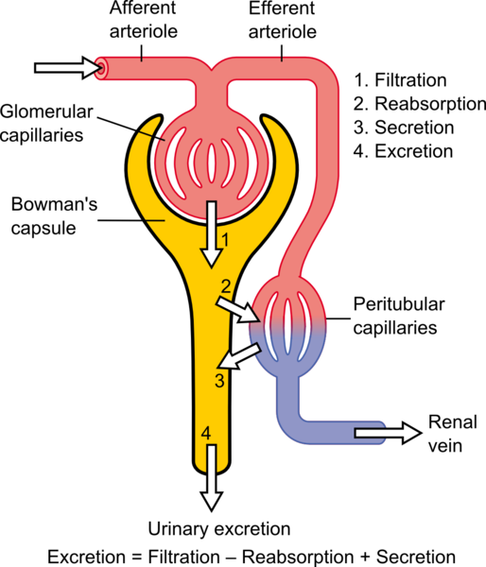
https://commons.wikimedia.org/wiki/File:Physiology_of_Nephron.png

Slide 3
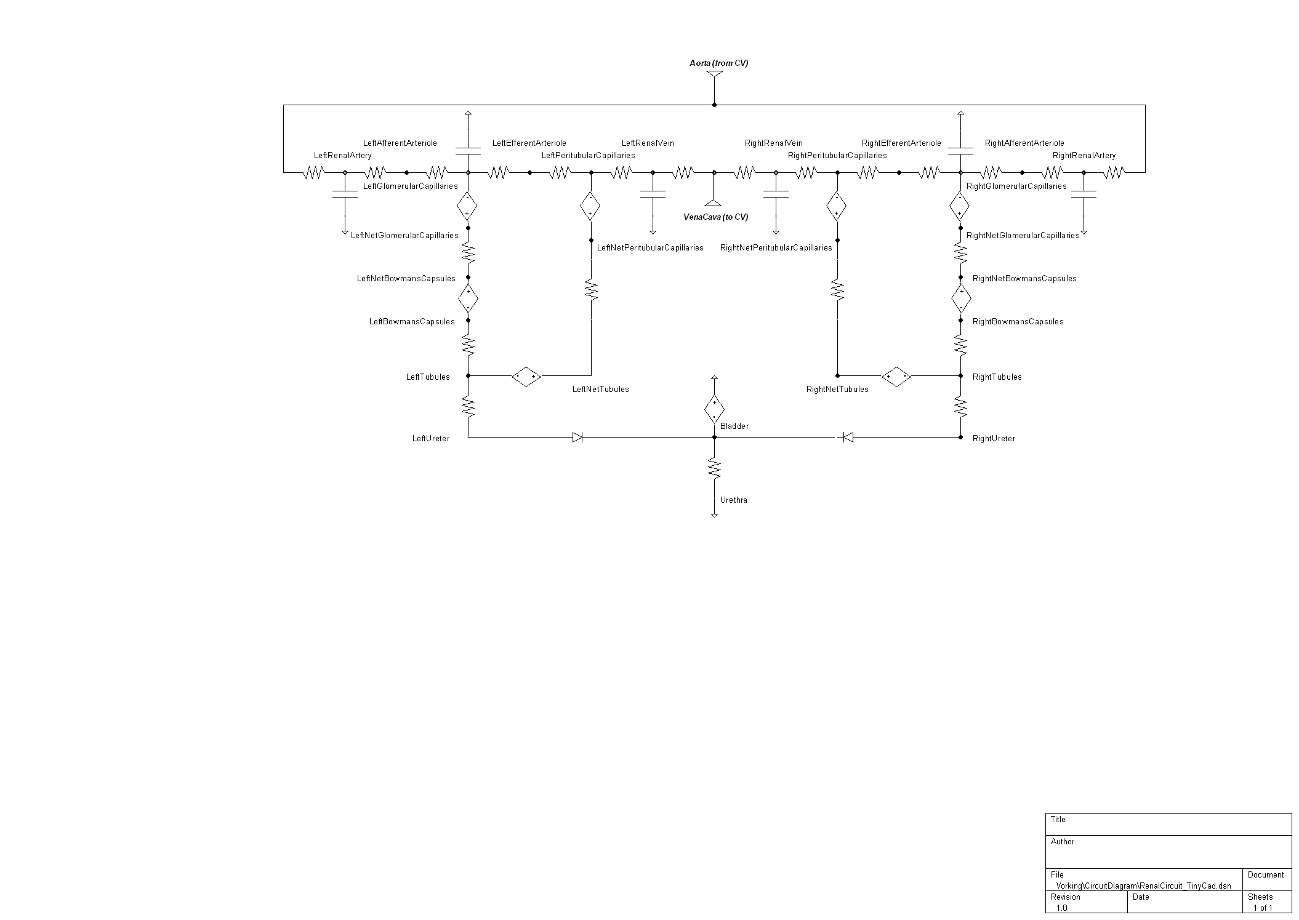
Blood
Reabsorption
T
T
T
T
Filtration
Excretion
Urine
T = Manual (i.e. active) transport; all others generic (i.e. passive)

Slide 4
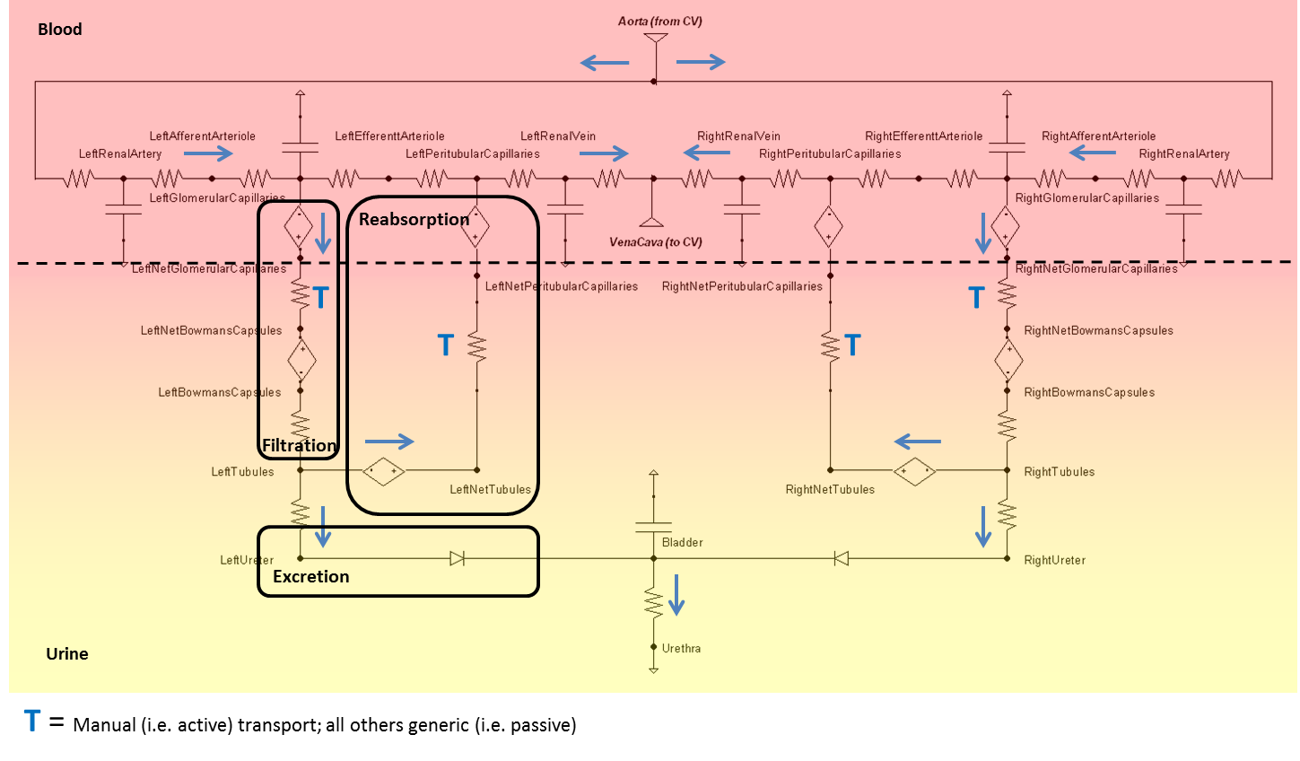

Slide 5
1
2
3
4
5
6
7
8
10
9
11
12

Slide 6
1
4
2
3

Slide 7

$$R_{Filt}$$

Slide 8


$$R_{Aff}$$
$${S_{F}}^{x}$$

Slide 9

Guyton
Pressure Increase
Mean Arterial Pressure
Pressure Decrease
Water Deficit
Plasma Fluid
Excess Water
Renal Blood Flow
Plasma Osmolarity
(Sodium Concentration)
Glomerular Filtration Rate
Tubules Permeability
Delivery of Sodium to Macula Densa
Water Reabsorption
Constriction
Afferent Arteriole Change
Dilation
Water Excreted
(Urine Production)
Tanner
$$k_{P}∗=\frac{{C_{SP}}^{x}}{{C_{SP,Set}}^{x}}$$

Slide 10
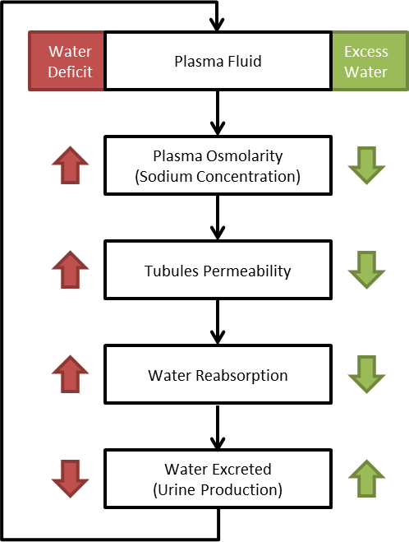
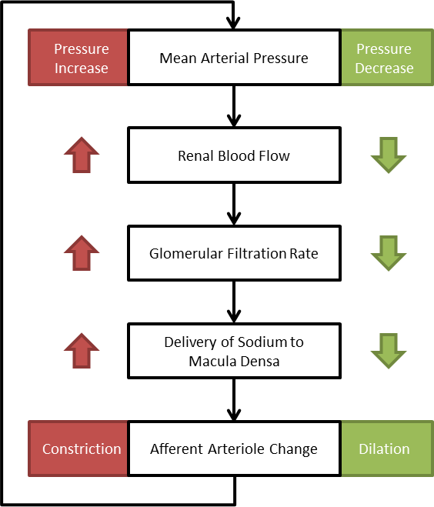

Slide 11
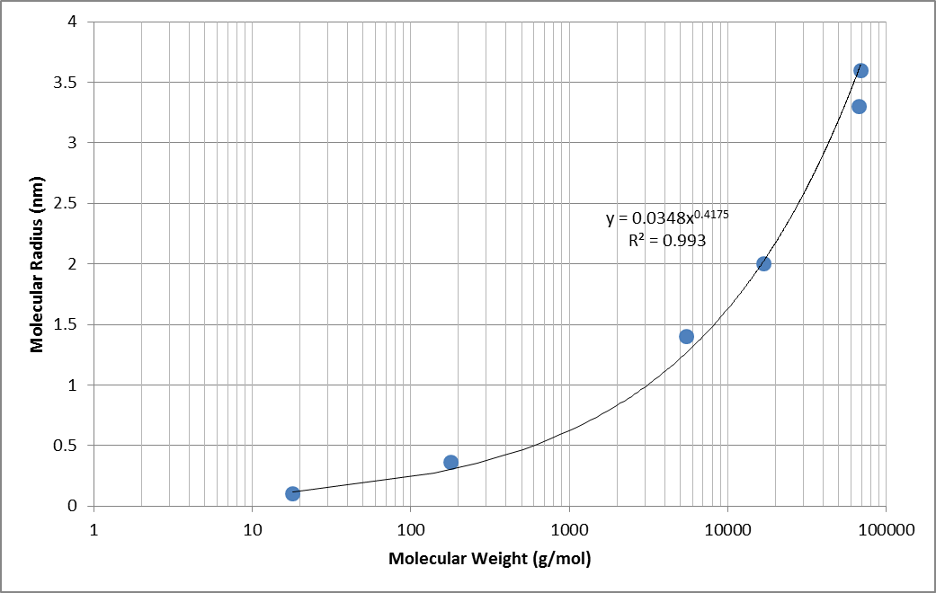
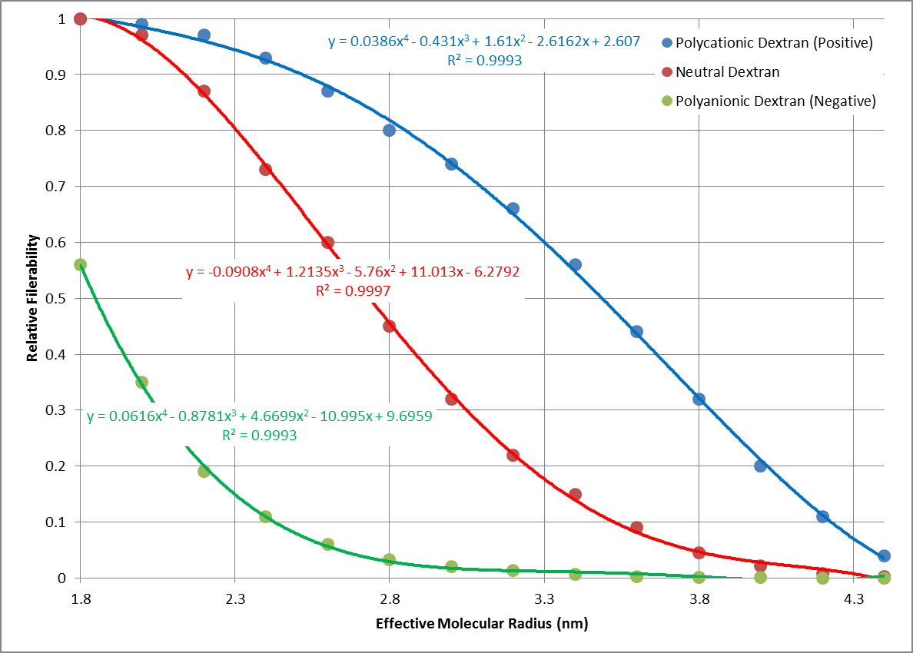
Boherer
Guyton & Tanner (2 references)
Note: Dog data, but widely accepted for humans (Guyton & Valtin)

