Slide 1
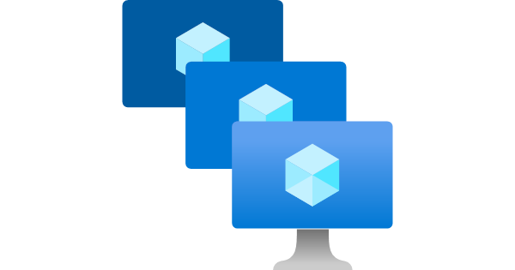
Azure Virtual Machine Scale Sets
Vy Cao

Slide 2
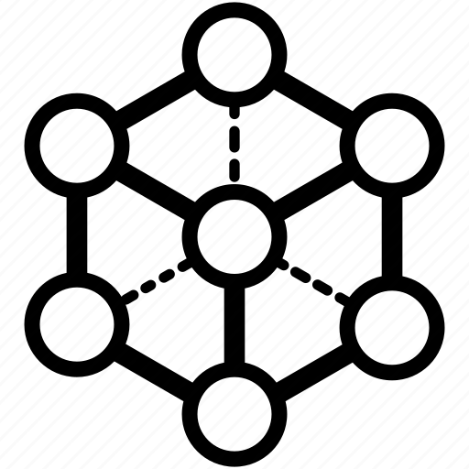

Scope and Problem Statement
Single control plane
Solutions for apps incompatible with App Services?
Solutions for running different frameworks?
How to auto-scale VMs?
How to manually set up multiple configurations?
Multi-Support

Slide 3
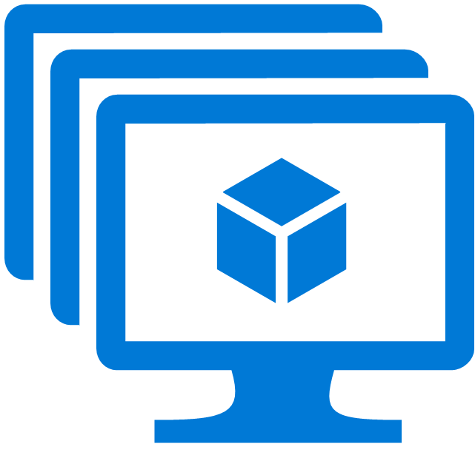

Azure Virtual Machine Scale Sets – Use Cases
Features
Provides high availability and application resiliency
Automatically scale as resource demand changes
Works at large-scale
Easy to create and manage multiple VMs
By distributing VMs across availability zones or fault domains
Scale out/in VM instances as application demand
Support 1,000 VM instances
Best performance with production workloads (Azure Managed Disks)
Support Azure load balancer and Azure Application Gateway
Pricing - SLES Basic Virtual Machines Scale Sets | Microsoft Azure

Slide 4
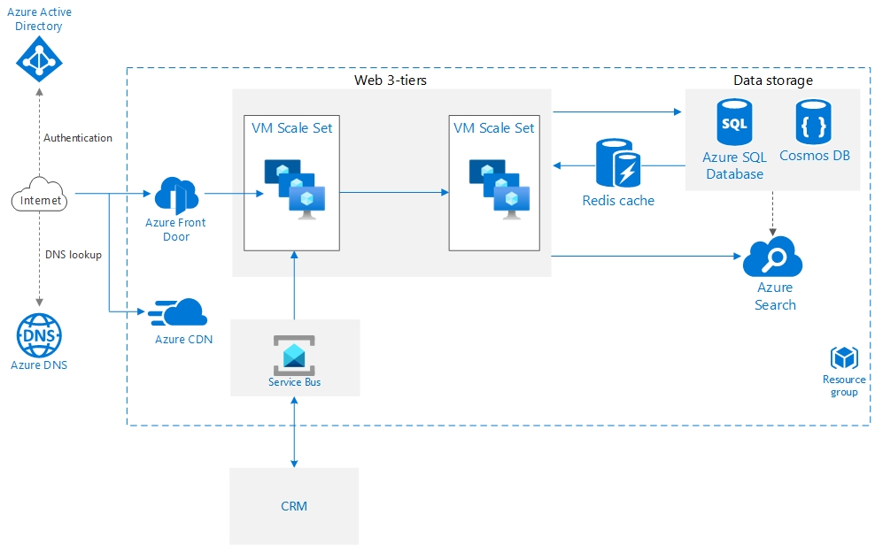
Overall Architecture

Slide 5
Virtual Machine Scale Set vs App Service
 | Azure Virtual Machine Scale Sets | Azure App Service
Key Differentiator | IaaS | PaaS
Scalability | Highly support | Include constraints
Management | More efforts | Less efforts
Deployment | More efforts but more control Support multiple languages | Simple and fast but less control Support less languages
Billing | Offer Pay-as-you-go | Not offer Pay-as-you go → Pay for Service Plan

Slide 6








Azure Services
Host service for DNS domains and manage DNS records with Azure DNS
Transmit messages from client to cloud with Service Bus Queues
Route HTTP requests with Front Door
Deliver static, cached content from locations close to users to reduce latency
with Azure CDN
Add search functionality
with Azure Cognitive Search
Store semi-static data
with Cache for Redis
Store relational data up to
with Azure SQL DB
Store non-relational data
with Azure Cosmos DB

