Slide 1

Git training
Notes:
This is a first more trainings involving more of coding

Slide 2
Flow of the course
General questions? Raise hand in teams, teacher will answer after each topic.
Having problems or questions? – Ask in chat.
Problems following examples? Join another room, assistant will follow to help you out.
Breaks planned for every 45-50 minutes for 10-15 minute break

Slide 3


How to follow the course
Watch closely and listen
Please code along with me

Slide 4
Agenda
Introduction
Theory combined with hands-on practice session

Slide 5

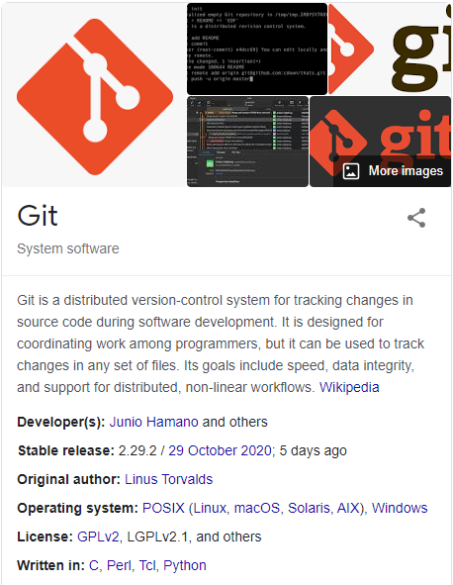
What is GIT?
Git is the most commonly used version control system. Git tracks the changes you make to files, so you have a record of what has been done, and you can revert to specific versions should you ever need to. Git also makes collaboration easier, allowing changes by multiple people to all be merged into one source.
So regardless of whether you write code that only you will see, or work as part of a team, Git will be useful for you. Already has 40mil + users on GitHub.

Slide 6
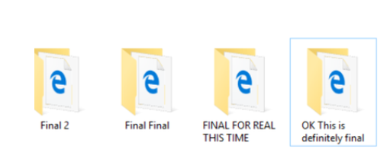
Why should we as analysts use it?
Sharing,
Describing your project, documenting it
Working together,
No more emails with code,
Ability to track all the changes,
Sharing code that not only runs on your laptop
And many more…
View all Gjensidige Repos, contribute, collaborate.

Slide 7

How to get started with git…

Slide 8


git in Gjensidige
master
main
Notes:
Git - tool
Bitbucket , github – service that is run somewhere and allowing
So, taken all together: Git vs. GitHub… what’s the difference? Simply put, Git is a version control system that lets you manage and keep track of your source code history. GitHub is a cloud-based hosting service that lets you manage Git repositories. If you have open-source projects that use Git, then GitHub is designed to help you better manage them allowing to easily share them among other contributors.

Slide 9
Getting started
Create new project in github and start from scratch
Initiate already existing project as git project and setup project in github and set it as upstream.

Slide 10
Getting started pt.1
Starting project from scratch:
Create new repo in github
Clone the repo on your machine git clone <git_url>
Start coding and committing
Enjoy benefits of code versioning.

Slide 11
Getting started pt.2
Starting project from scratch:
Create new repo in Github
Clone created repo
Copy the files from the project that you want to version
Continue coding and committing
Enjoy benefits of code versioning once more
Notes:
Mention restrictions shortly

Slide 12
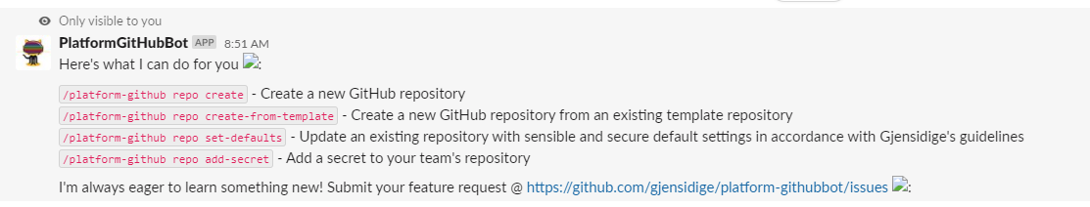
Repo creation at Gjensidige
Currently repo creation due to security reasons is created via bot at Slack channel
#github-at-gjensidige.
Ideally each team will have 1-2 people who will be on Slack – to create repos etc.

Slide 13
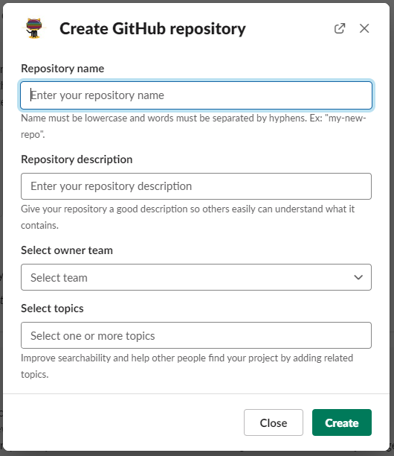
Creating repo

Slide 14
!!!Creating repo caution!!!
No data
No sensitive info
No credentials

Slide 15
Usual drill with git
Notes:
CHEATSHEET IN NEED
Trainings:
CREATING BRANCH
EACH creates separate branch
Create branches 2 people per branch. Tell 2 people to do the calculator implementation of Python and R calculators and push
ADD COMMIT PUSH
Start doing git add commit push -> everyone follows
GIT CHECKOUT COMMIT
Show git checkout how to get back in time.
MERGE
Create something on main branch and tell everyone to do git merge main so they grab newest stuff.
Implement different parts of Python calculator to show that it is possible to work on different functionalities in the same file.
REBASE
Demonstrate similar scenario with rebase – people will just watch
MERGE CONFLICT
IN the Python calculator everyone modifies one function and teacher modifies same function in order to get conflict.
PULL REQUEST:
DEMONSTRATE HOW TO ADD COMMENTS, APPROVE ETC.
BONUS REVERT RESET People just observe this one

Slide 16
git remote
For collaboration we require to have a remote – a place where we store/push or get the code from. Storage with all the history with the changes.
Currently at Gjensidige we store code at Github.

Slide 17



git remote
github.com/gjensidige/your_project
git push
git clone/
git pull
Notes:
Git remote vs local

Slide 18
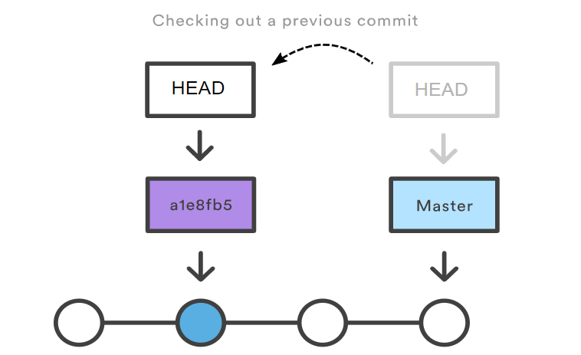
HEAD
Git’s way of referring to the current snapshot. Internally, the git checkout command simply updates the HEAD to point to either the specified branch or commit. When it points to a branch, Git doesn't complain, but when you check out a commit, it switches into a “detached HEAD” state.

Slide 19
git clone
If a project has already been set up in a central repository, the git clone command is the most common way for users to obtain a development copy.
Within this training session we will use repo:
https://github.com/gjensidige/analysts-trainings-git
To clone the repo we can simply do:
git clone https://github.com/gjensidige/analysts-trainings-git.git

Slide 20
Before starting
git config --global pull.rebase true
git config --global user.name ‘Name Surname’
git config --global user.email ‘name.surname@gjensidige.no’
Notes:
We are doing this in order to avoid messy commit history. So that potentially we will not end up in a merge conflict. But about rebase and merge conflicts we will talk a bit later on in the course

Slide 21
git pull/ git fetch
The git fetch command downloads commits, files, and refs from a remote repository into your local repo. Fetching is what you do when you want to see what everybody else has been working on.
The git pull command is used to fetch and download content from a remote repository and immediately update the local repository to match that content. Merging remote upstream changes into your local repository is a common task in Git-based collaboration work flows. The git pull command is actually a combination of two other commands, git fetch followed by git merge.

Slide 22
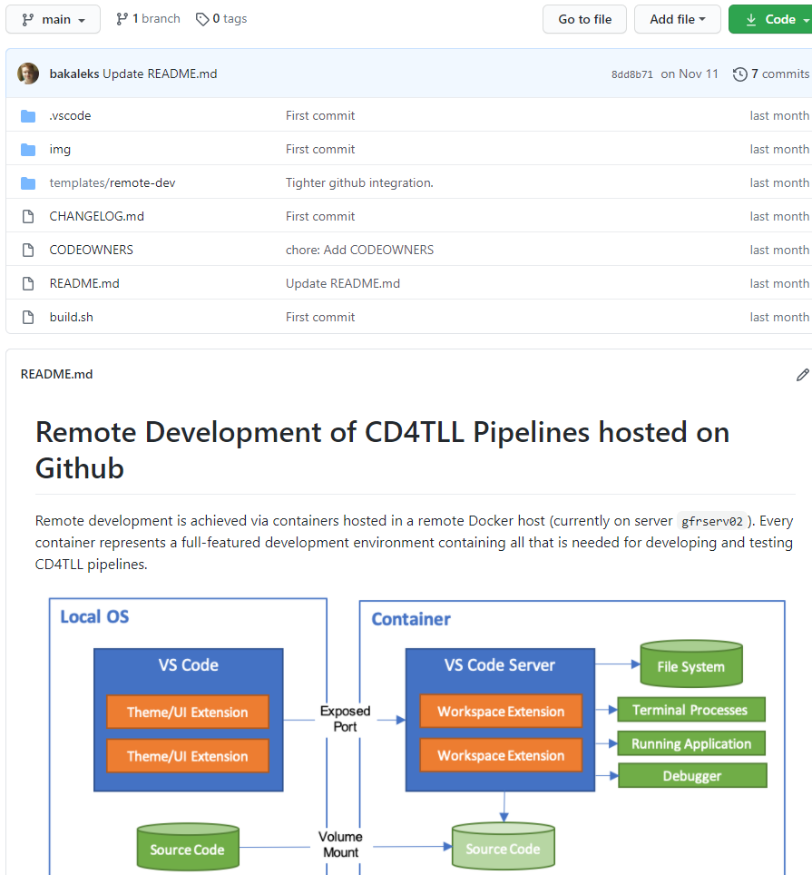
README.md What is it?
A README is a text file that introduces and explains a project. It contains information that is commonly required to understand what the project is about.

Slide 23
README.md Why should I make it?
It's an easy way to answer questions that your audience will likely have regarding how to install and use your project and also how to collaborate with you.
Tips how to make one:
https://commonmark.org/help/

Slide 24
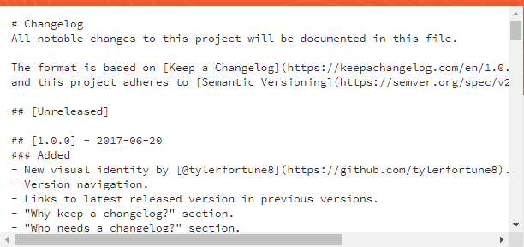
CHANGELOG.md
What is a changelog?
A changelog is a file which contains a curated, chronologically ordered list of notable changes for each version of a project.
Why keep a changelog?
To make it easier for users and contributors to see precisely what notable changes have been made between each release (or version) of the project.
Who needs a changelog?
People do. Whether consumers or developers, the end users of software are human beings who care about what's in the software. When the software changes, people want to know why and how.
https://keepachangelog.com/en/1.0.0/
Notes:
Mention that is super nice to have, once we have different versions of code etc.

Slide 25
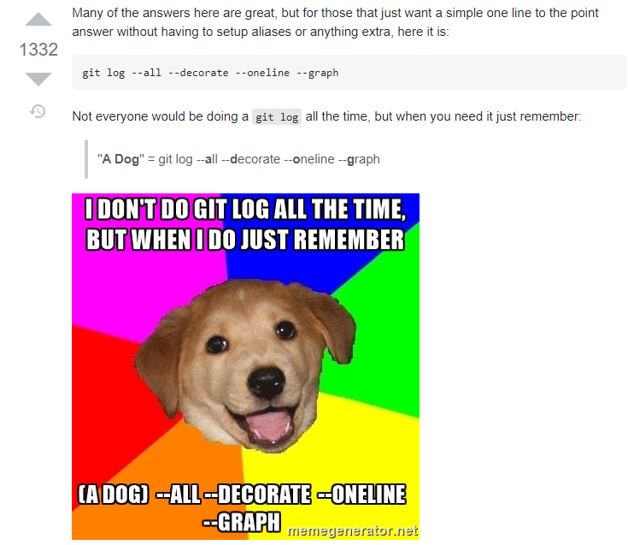
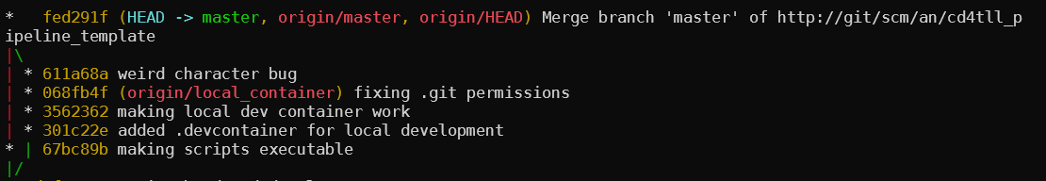
git log
This command allows us to view commits that led to the current HEAD state.
For pretty git branch graphs remember:
git log --all --decorate --oneline --graph
Notes:
Find commit hashes.

Slide 26
git status
The git status command displays the state of the working directory and the staging area. It lets you see which changes have been staged, which haven’t, and which files aren’t being tracked by Git. Status output does not show you any information regarding the committed project history. For this, you need to use git log.

Slide 27
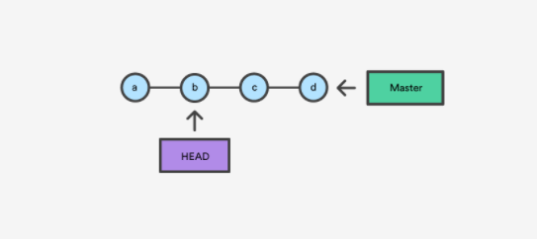
git checkout
A checkout is an operation that moves the HEAD ref pointer to a specified commit. To demonstrate this consider the following example.
Command also allows you to switch branches by specifying branch name:
git checkout <branch_name>

Slide 28
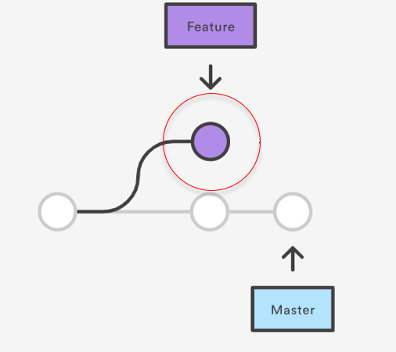
git checkout part 2
And also create new branches:
git checkout –b <branch_name>
Notes:
Demonstrate how to create a new branch – allow everyone to create branches.
Wait until everyone has done the step and have their branch name highlited in git bash session
Then let everyone once again create a new file file_on_bramch.txt commit and push
Demonstrate on github how it looks like

Slide 29
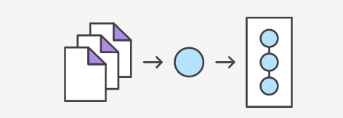
git add
The git add command adds a change in the working directory to the staging area. It tells Git that you want to include updates to a particular file in the next commit. However, git add doesn't really affect the repository in any significant way—changes
are not actually recorded until you run git commit.
git add <filename>
Notes:
ON THE MAIN BRANCH
Everyone creates text file with your gid.txt
Adds some text to it
Save it
Show git status
Demonstrate the changes git sees.
Modified untracked files
Add files to the staging area with git add.
Make sure people are following
Different options to git add
just updating modified files "-u“
updating everything "--all" adding whole current directory "." adding specific file
Difference between modified and tracked file

Slide 30
git commit
The git add and git commit commands compose the fundamental Git workflow. These are the two commands that every Git user needs to understand, regardless of their team’s collaboration model. They are the means to record versions of a project into the repository’s history.
git commit –m ‘message’
Notes:
Show how to commit the files from the staging area

Slide 31
git commit --amend
Comment of the commit was wrong? No problem
Notes:
Create file
Git add
Git commit –m “wrong message”
git commit –amend
Change message there and save it

Slide 32
git push
The git push command is used to upload local repository content to a remote repository. Pushing is how you transfer commits from your local repository to a remote repo.
git push
Notes:
After first attempt git will complain about the upstream that needs to be set up – emphasize this, that git knows that something is wrong and we need to do this step before pushing
After pushing, demonstrate the remote, that changes were done.
Even delete the whole repo and clone it one more time to demonstrate
that it works as expected and changes are saved.
Check if anyone needs help, as the branches should be there and there should be new commit

Slide 33
git add, commit, push recap
git add places files into staging area for a commit.
When files are added, we can place them into commit and provide a message
Once we are ready to push local changes to repository we do git push and they appear available to everyone to view.
git add <filename>
git commit –m ‘message’
git push

Slide 34
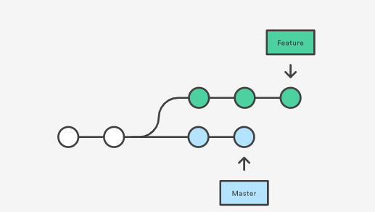
git merge vs rebase
Consider what happens when you start working on a new feature in a dedicated branch, then another team member updates the master branch with new commits. This results in a forked history, which should be familiar to anyone who has used Git as a collaboration tool.

Slide 35
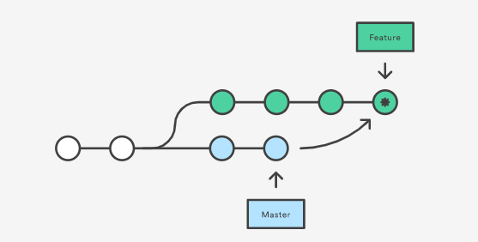
git merge vs rebase (merge)
The easiest option is to merge the master branch into the feature branch using something like the following:
git merge feature master
This creates a new “merge commit” in the feature branch that ties together the histories of both branches, giving you a branch structure that looks like this:
Notes:
Create couple of commits on master branch while everyone is on their separate branch.
Everyone then should do:
git pull –all
Everyone checksout to their branch with
git checkout branch_name
Now we can use git merge main, to get all of the updates and check git log to find the merge commit as shown in graph

Slide 36
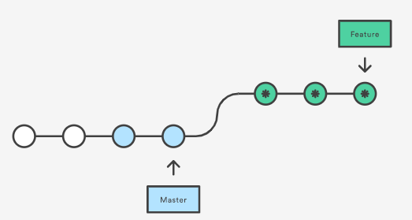
git merge vs rebase (rebase)
As an alternative to merging, you can rebase the feature branch onto master branch using the following commands:
git checkout feature git rebase master
This moves the entire feature branch to begin on the tip of the master branch, effectively incorporating all of the new commits in master. But, instead of using a merge commit, rebasing re-writes the project history by creating brand new commits for each commit in the original branch.
Notes:
Create couple of commits on master branch while everyone is on their separate branch.
Everyone then should do:
git pull –all
Everyone checksout to their branch
git checkout branch_name
And add some file called file_on_branch2.txt and write something there, then do git commit
Now we can use git rebase main, to get all of the updates and check git log to find all the commits that are applied before out commit.

Slide 37
merge conflicts
This is a common thing to bump into
If you in your branch modified a certain file it might be that that file bothered someone else as well and they pushed some changes to the very same file too! Git immediately notices this once you are trying to either pull latest changes from the branch or let’s say if you are trying to update your branch with the code from master/main branch.
Notes:
This one maybe just demonstrate how it looks like
So in master change some file and commit it and then also change the same file on your private branch
Try doing git merge, this should get us into the merge conflict
Show git status
show how conflicting file looks like,

Slide 38
Pull requests
Once feature branch is complete – we are ready to merge it with main.
On GitHub go to branches -> New Pull Request.
You colleagues are now able to review the work that you done, place comments, approve, decline and merge you work with main.

Slide 39
Bonus round

Slide 40
git tags
Tags are used to version our code properly, let’s say once we have something working we might create tag with:
git tag –a v0.0.1 –m “working product”
After that we can simply checkout to a certain git tag and view how that version looked like.

Slide 41
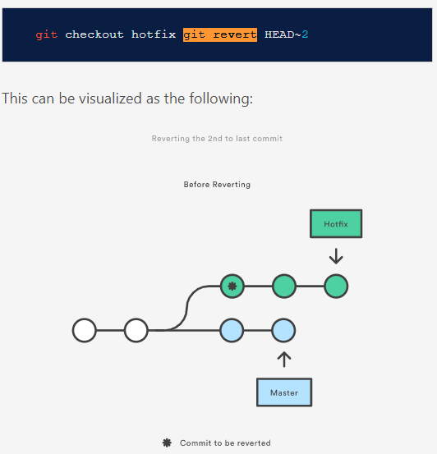
git revert
Let’s say you have done the commit but for some reason you want to revert it, because you don’t like it, you want to rollback the changes:
git revert <hash>
git revert –no-commit HEAD~<number>..HEAD
This command with help you to revert the commit that you want out of your project.
Notes:
Let’s now add one more changes to some file and add commit push
And then shot how to revert it back
Show git log –p
Just show how to revert last commit on the branch explain that it does exactly the opposite of the commit we picked

Slide 42
git reset (files)
If you used git add but suddenly changed your mind and want to place them back to staging area, you can use:
git reset <filename> - single file
Or
git reset .-> all of the files
This resets file to its last commit.
In newer versions of git it could be git restore
Notes:
Create text file
Git add it
Show git status
Git reset it show status
It’s been removed from staging area. Voila

Slide 43
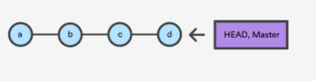
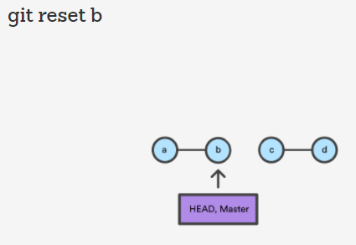
git reset (commits)
If working alone on the branch you decide that you wish to completely remove the commit/commits you also may use git reset command. But this is only advisable if working alone. Otherwise you might risk of ruining commit history for others!!! If working with others use git revert.
Notes:
Create text file
Git add it
Show git status
Git reset it show status
It’s been removed from staging area. Voila

Slide 44
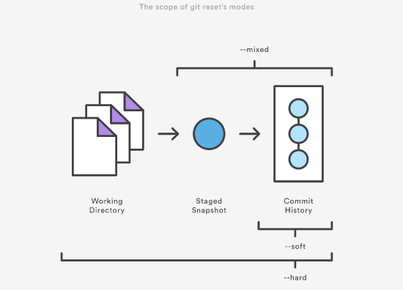
git reset (commits)
3 options here: --soft –mixed –hard
Soft will keep files that were changed in the staging area.
Mixed will keep them in the working directory but not staged.
Hard will completely remove all the changes.
git reset [OPTION] <commit_hash>

Slide 45
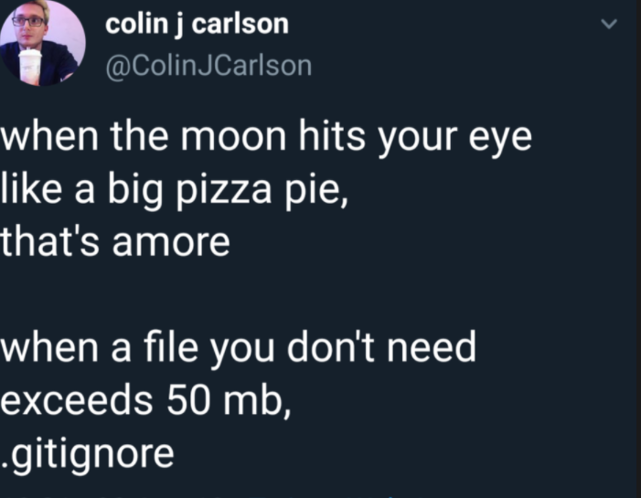
.gitingore
gitignore - Specifies intentionally untracked files to ignore.

Slide 46
Conclusion

Slide 47
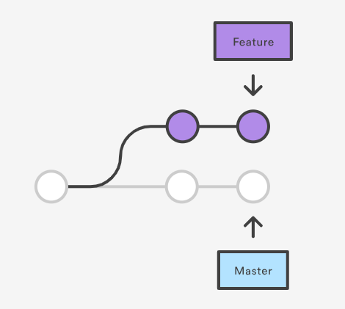
Workflow with git
Main branch contains all the work.
If need arises to work on some feature – we branch off:
git checkout –b <branch_name>
You work on something at the end of the day you do git add , git commit with message git push.
Once you decide that your work should go into the Main branch – you create pull request and let your colleagues to review your code give you feedback, leave comments.
If all is good you codebase becomes part of Main branch.

Slide 48
Good habits
For new features – create branches
Never push directly to master(unless it’s only you solely working on project)
git push –f NEVER ON MAIN or branch where you collaborate with others.
Use tags
Meaningful commit messages
Do not commit the files that are generated by the code

Slide 49

Congratulations
You have now implemented an additional feature while:
Collaborating with colleagues
Versioning your code
Learning bunch of new stuff

Slide 50
TO DISCUSS
What prerequisites should there be?
Anything else?

