Slide 1
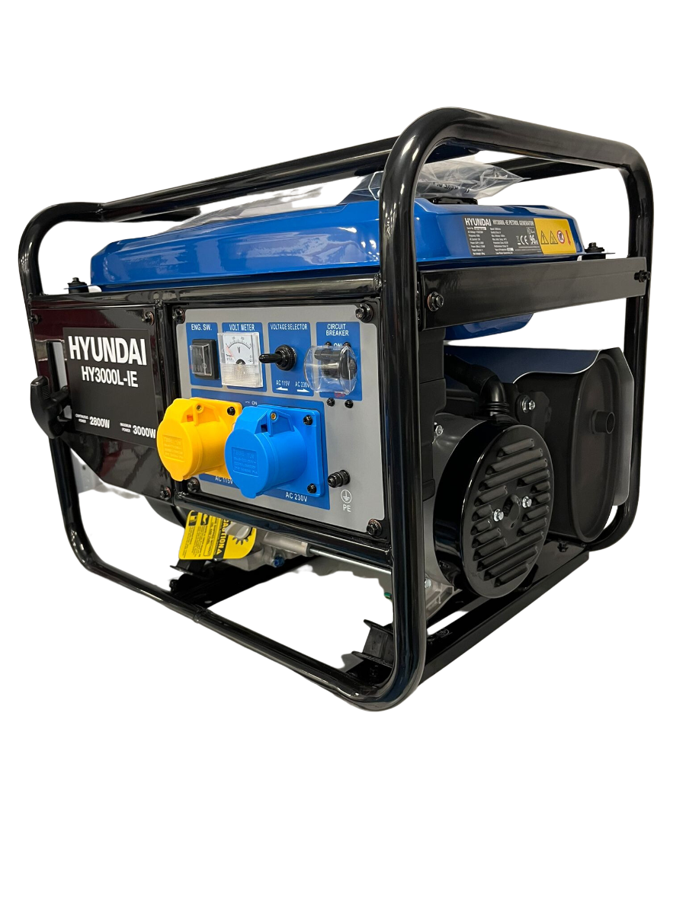

in

Slide 2
Generators in Python
in

Slide 3

About me
Name: Vytautas Sluckas
linkedin.com/in/vytautas-sluckas/
What do I do
Data Engineer at Exacaster
Python Lecturer at Code Academy
Hobbies
Jogging
Going to gym
Video games
Spending time with friends
Movies

Slide 4



Jogging
Going to gym
Video games
Spending time with friends
Movies

Slide 5
Generators in Python
Back to …
in

Slide 6
Okay so what it is and how to get started…

Slide 7

Why even bother using generators?
[]

Slide 8
Memory Efficiency: Generators produce values one at a time and don't store the entire sequence in memory, making them efficient for working with large datasets or infinite sequences.

Slide 9
Lazy Evaluation: Values are generated only when needed, which can improve performance and reduce unnecessary computation.

Slide 10
Infinite Sequences: Generators can represent infinite sequences, which is not feasible with lists.

Slide 11
Pipelining and Composition: Generators can be easily combined to create complex data processing pipelines, enabling modular and readable code.

Slide 12
Natural Iteration: Generators can be iterated over using for loops or consumed by functions that expect iterators, making them seamlessly integrate into Python's iteration model.

Slide 13
Natural Iteration: Generators can be iterated over using for loops or consumed by functions that expect iterators, making them seamlessly integrate into Python's iteration model.

Slide 14
Cleaner Code: Generators often result in more concise and readable code compared to traditional loop-based approaches.

Slide 15
Stateful Processing: Generators can maintain state across multiple calls, allowing for sequential processing of data.

Slide 16
Exception Handling: Generators can handle exceptions and cleanup in a more structured manner.

Slide 18
cons
pros

