Slide 1
Black formatter

Slide 2
Agenda
Intro
What is it?
Why should You use it?
How to get started
Examples
Questions

Slide 3
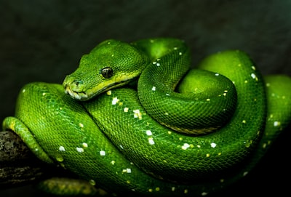
Python
Python programming language comes with a lot of freedoms: no strict typing is required by default, no strict structure requirement for projects, formatting can (shouldn't) be applied freely by anyone's will…

Slide 4
How many times did you look into your colleagues code and questioned formatting choices?
Or any other choices like naming etc…

Slide 5
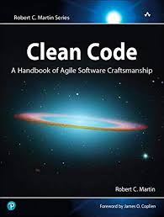
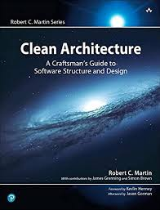
Robert C. Martin, that says that code is read ten times more than it's written

Slide 6

Black code formatter for python
What is it?

Slide 7
What is Black?
Straight from Black Github page:
Black is the uncompromising Python code formatter. By using it, you agree to cede control over minutiae of hand-formatting. In return, Black gives you speed, determinism, and freedom from pycodestyle nagging about formatting. You will save time and mental energy for more important matters.
Blackened code looks the same regardless of the project you're reading. Formatting becomes transparent after a while and you can focus on the content instead.
Black makes code review faster by producing the smallest diffs possible.

Slide 8
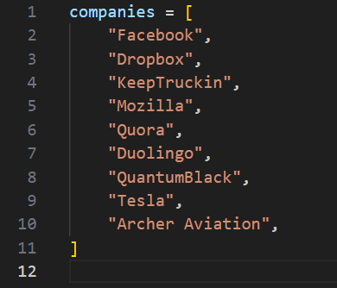
Who is using Black anyway?

Slide 9
Pros
Readability: Proper formatting makes code easier to read and understand
Debugging: Proper formatting can make it easier to spot errors in your code.
Consistency: A consistent code style across your project makes it easier to maintain and modifyYet another topic
Community Standards: There are widely accepted standards for formatting Python code, such as PEP 8, which is the official Python style guide

Slide 10
Pros again…
Overall, code formatting is important in Python because it helps to ensure that your code is readable, maintainable, and consistent with community standards.
​
Also improves your as a developers experience coding as you do not have to think about how to structure your code tidily

Slide 11
How to get started

Slide 12
DEMO TIME

Slide 13

Questions

