Slide 1


CIS550 Project Demo
Mini Yelp
Shan Luo, Gongyao Chen, Hanlin Xiao, Zhenchi Zhang

Slide 2
CIS550 Project Demo
Design a simplified web application similar to Yelp.
User Registration & login
Search shops by city, feature, open time
Get nearby shops by address, feature
Get popular shops by city, feature
Get user reviews by shop
Add comment to a shop

Slide 3
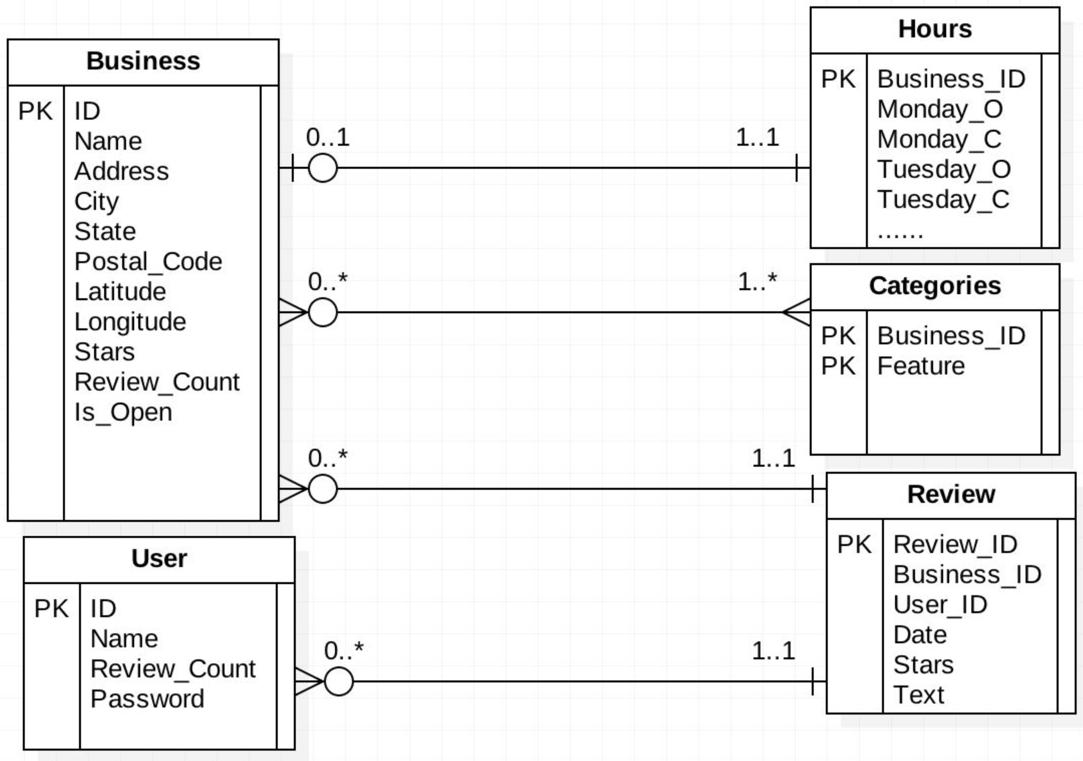
CIS550 Project Demo

Slide 4

CIS550 Project Demo
Demo Time

Slide 5
CIS550 Project Demo
Questions

Slide 6
CIS550 Project Demo
Thank You!

