Slide 1

DREAM GIRL
PROJECT BY: Harsha Gupta
Yash Jain
Vinay M

Slide 2

?
400 different agencies/programs
Each department –rules/regulation
Different eligibility criteria
Area, state specific, caste, religion, income level, widow, unemployed, elderly, pregnant, infant matter, etc
No Awareness of Programs
Too much documentation to interpret

Slide 3

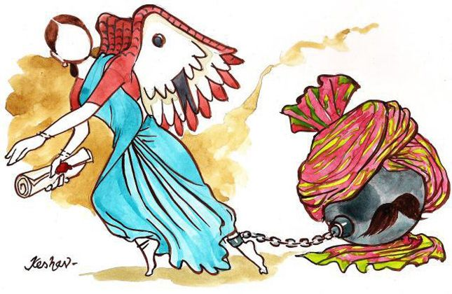

Slide 4
Complex information of government schemes
Claim benefits by retrieving information and details
The availability of information is widely in English
Key challenges
The complex procedures and eligibility conditions

Slide 5
PROPOSAL
The proposal is to create an Web Site phase which will decode the complex information of government schemes in brief interpretable information.
The challenge of the project is to design a system to interpret the complex information available in pdf, doc, scanned pages and web pages.
We will develop this website and decode the information based on the details filled by the women and will help her to get maximum profit for herself by Gov. schemes.

Slide 6
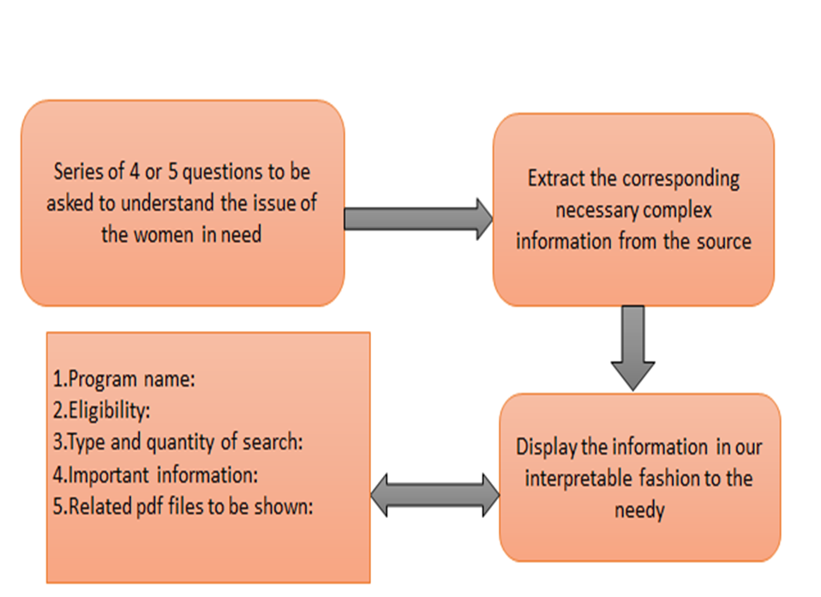
Processing Methodology

Slide 7
Working Procedure
Visit our website
Fill your details
You can access the schemes provided for your benefit

Slide 8
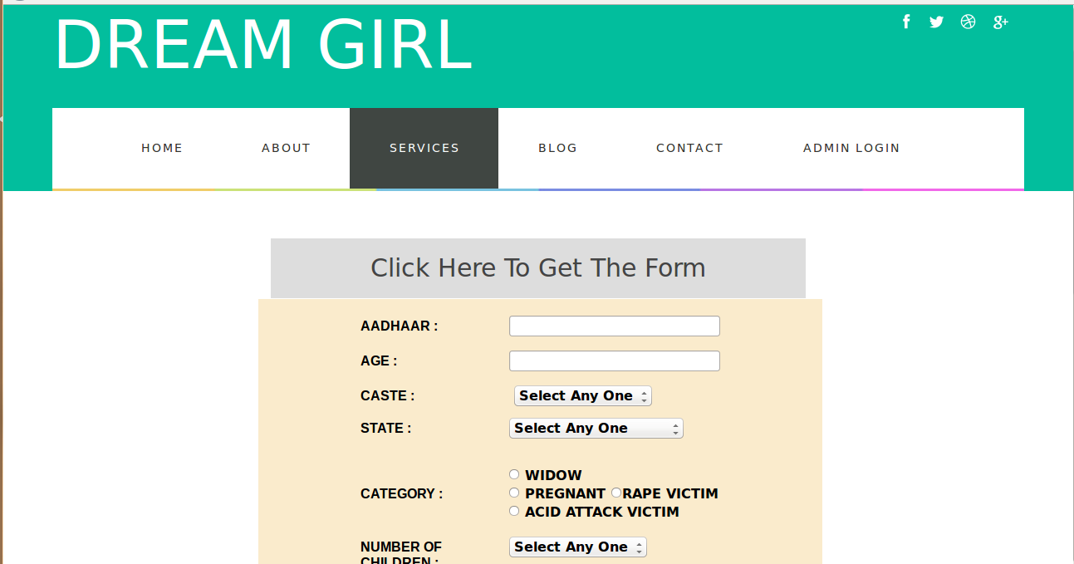

Slide 9


Slide 10

Impact
Building of website will spread the awareness and rural women who are really needy can get the help of government through our website. This will help in making society better and will help rural people to develop not only with respect to money but also in way of thinking.

Slide 11
It can serve a helping hand for a women who has huge financial burdens and hardships.
The government schemes availed by the rural women can help them in funding their investments in agriculture, lone business or basic employment.
The user can choose a appropriate script best understood by her and can avail for the government programs through the application to bring prosperity to her and lead to “Women Empowerment”.

Slide 12
Claim benefits by verifying your identity
Future add-ons
Funds directly transferred to bank account
Android Application
Thank you!! ☺

