Slide 1


LIBRARY MANAGEMENT SYSTEM

Slide 2
INTRODUCTION
Library Management System (LMS) is an Application designed for effective management of library from all aspects.
It also provides information about the availability of the books in the library to the members of the library and many other facilities.

Slide 3
The other facilities include:
To keep track of books issued and returned.
Online renewal and reservation of books.
Different criteria for searching the books like book_ name, author_ name and so on..
Online access to the registered users to know the status of their books, so that renewal of books can be done on time.
Registrations for the new members.
Keeping record of different categories like books , journals etc…

Slide 4



Book issued
Renew the book
after every 10 days
Refer the book

Slide 5
PROBLEM STATEMENT
Student’s difficulty in getting the books renewed every 10 days.
Currently our Central Library is using Libsoft software , which has been purchased.

Slide 6
OUR PROJECT PLAN:
LMS
DESKTOP
WEBSITE
ADMIN
USERS

Slide 7
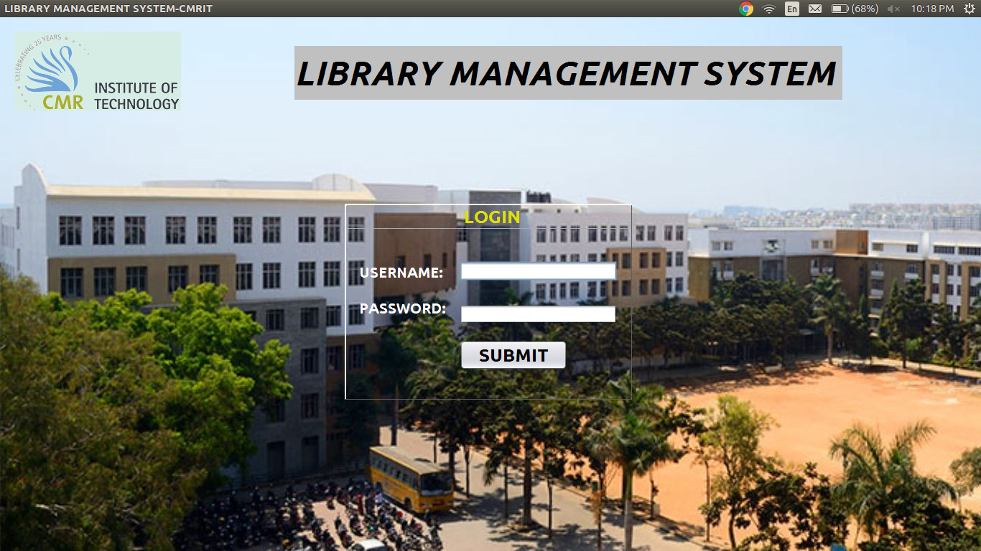
ADMIN LOGIN PAGE:

Slide 8
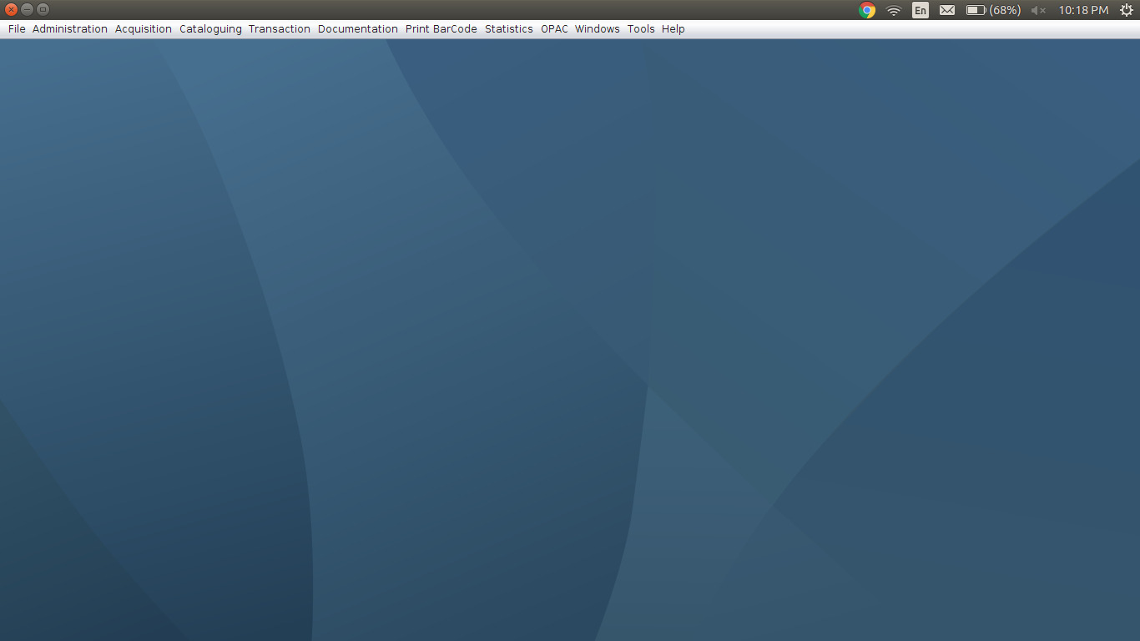
MAIN PAGE OF ADMIN INTERFACE

Slide 9
ADMIN INTERFACE
Admin interface is an desktop application which includes
these seven major functionalities:
File
Acquisition
Administrator
Cataloguing
Transaction
Print Bar-Code
Documentation

Slide 10
File: It includes backup , restore and change password.
Administrator: It includes member registration(like adding , deleting, searching and modifying any details of the members), purchase requisition, holiday master, collections.
Acquisition: It includes search by subject, language master, sub category master, publisher master, vendor master.
Cataloguing: It includes master material(like adding, deleting, searching and also modifying the material details.),subject master.
Transactions: It includes the transaction like issue book.

Slide 11
Print Bar-Code: It is used for generating bar codes.
The printed bar codes will be used to monitor the books.
Documentation: It is used for generating reports.
It includes:
Material Report
Journal Report
Member Report
Holiday Report
Fine Collection Report
Vendor Report and so on..

Slide 12
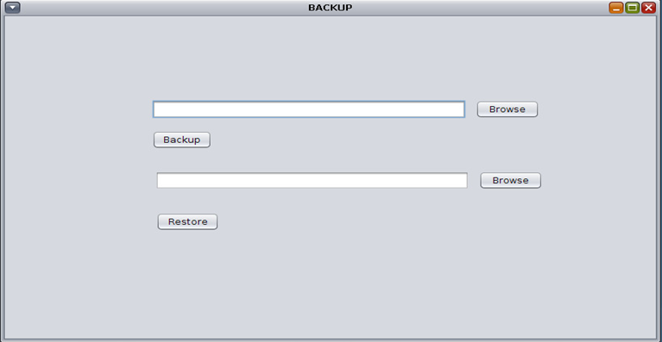
BACKUP AND RESTORE:

Slide 13
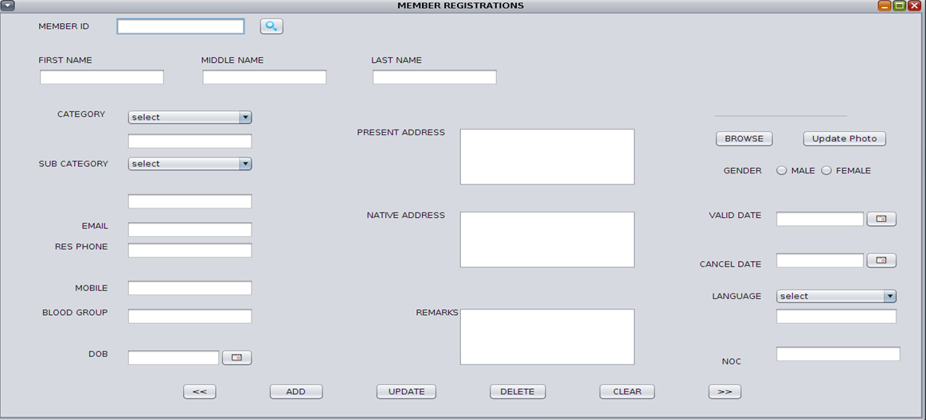
Member Registration

Slide 14
USER INTERFACE
User interface is a web application which includes:
Borrowed books : Books which are currently with students/faculty those book details are shown in tabular format.
Book History :All the books which have been returned , borrowed by user are shown with details in tabular format
Reminders : These are generated when the due date for return of book is exceeded or if it is today or tomorrow.
Search for Book/Availability : Searching of book by author or title.
Settings : Include change password and logout.

Slide 15
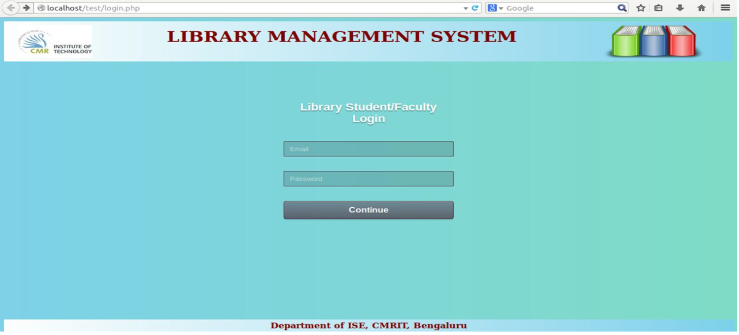
USER LOGIN PAGE:

Slide 16
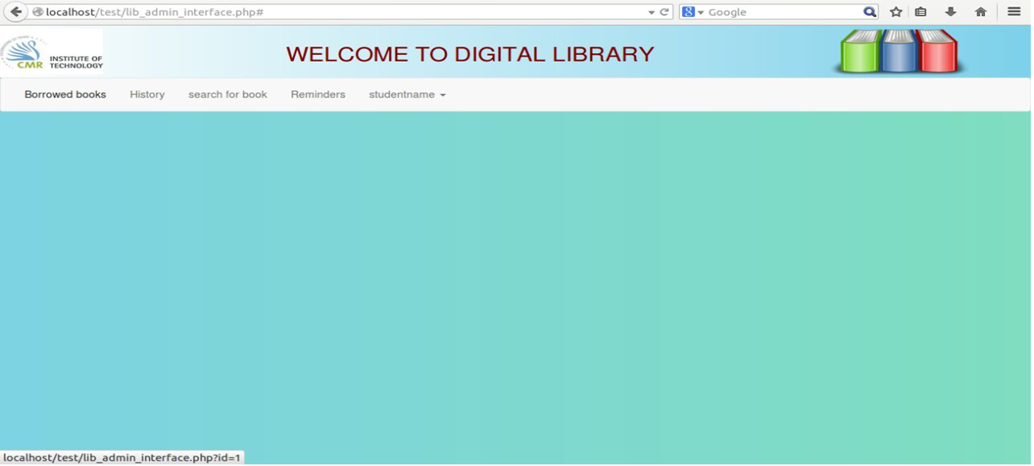
MAIN PAGE OF USER’S LOGIN

Slide 17


TECHNOLOGIES USED:
ADMIN INTERFACE
JAVA
JAVA2EE
MYSQL
USER INTERFACE
HTML
CSS
PHP
JAVASCRIPT
BOOTSTRAP

Slide 18

TEAM MEMBERS:
VINAY M
YASH JAIN

Slide 19


!
!

