Slide 1
S J C INSTITUTE OF TECHNOLOGY DEPARTMENT OF COMPUTER SCIENCE AND ENGINEERING
The Internship Project Review
On
“Sentix Pulse: Real-Time Sentiment Analyzer for Product Reviews ”
PRESENTED BY
Vydurya G Anand 1SJ22CS183
UNDER THE GUIDANCE OF
Project Guide | Internship Co-ordinators | Head of Department
Mrs.NavyaSri N | Mrs.Swetha T | Dr. Manjunatha Kumar B H
Assistant Professor | Assistant Professors | Dean-Academics and HoD
CSE, SJCIT | CSE, SJCIT | CSE, SJCIT

Slide 2
CONTENTS
I. ORGANIZATIONAL OVERVIEW
II. INTERNSHIP DETAILS
III. OBJECTIVE OF THE INTERNSHIP
IV. PROJECT TITLE AND DESCRIPTION
V. TOOLS AND TECHNOLOGIES USED
VI. OBJECTIVES AND METHODOLOGY
VII. SYSTEM DESIGN
VIII. IMPLEMENTATION
IX. RESULTS AND OUTCOMES
X. CHALLENGES FACED
XI. LEARNING OUTCOMES
XII. CONCLUSION
XIII. FUTURE WORK

Slide 3
Organizational Overview – Rooman Technologies
Rooman Technologies is a leading IT training and skill development company in India, established in 1999 and headquartered in Bangalore. The organization focuses on bridging the gap between academic learning and industry requirements by providing practical, industry-oriented training programs. It offers a wide range of services including IT training, internships, certification courses, and placement assistance, helping students build job-ready skills. Rooman Technologies specializes in high-demand domains such as Artificial Intelligence, Data Science, Cloud Computing, Cybersecurity, and Full Stack Development. With a strong presence across multiple cities and partnerships with global technology providers, the company has trained a large number of students and continues to empower them with the knowledge and skills needed to succeed in the IT industry.

Slide 4
Internship Details
Internship Title: AI Agent Developer
Domain: Artificial Intelligence & Machine Learning
Cohort: AI-ML Cohort V
Organization: Rooman Technologies
Duration: (Add your duration here)
Key Responsibilities:
Designing and developing intelligent AI agents
Implementing machine learning models and logic
Working with real-world datasets for automation tasks
Collaborating on project development and testing

Slide 5
Objective of the Internship
To gain practical experience in Artificial Intelligence and Machine Learning through real-world projects
To develop and deploy AI-based solutions for problem-solving and automation
To strengthen skills in programming, data handling, and model development
To understand industry workflows, tools, and best practices
To enhance analytical thinking, teamwork, and communication skills
To become industry-ready with hands-on technical exposure

Slide 6
Project Title & Project Description
Project Title - Sentix Pulse: Real-Time Sentiment Analyzer for Product Reviews
Project Description
This project focuses on developing an intelligent AI agent capable of automating routine tasks and assisting users in decision-making processes. The system leverages machine learning and natural language processing techniques to understand user inputs, process data, and generate meaningful outputs. It is designed to improve efficiency, reduce manual effort, and provide smart, real-time responses. The solution can be applied in areas such as customer support, personal assistance, and data-driven applications.

Slide 7
Tools & Technologies Used
Programming Languages: Python
Frameworks & Libraries:
TensorFlow / Scikit-learn
Pandas, NumPy
AI/ML & NLP:
Machine Learning Models
Natural Language Processing (NLP)
Tools & Platforms:
VS Code
Git & GitHub
Deployment & Services:
REST APIs
Cloud Platforms (AWS / Render – if used

Slide 8
Objectives & Methodology
Project Objectives
Develop an AI-powered intelligent agent for task automation
Implement machine learning & NLP techniques for smart responses
Reduce manual effort and improve efficiency
Provide accurate and real-time decision support
Build a scalable and user-friendly system
Methodology
Requirement Analysis: Identify problem and user needs
Data Collection & Preprocessing: Gather and clean data
Model Development: Apply ML/NLP algorithms
System Design: Define architecture (Frontend, Backend, Database)
Implementation: Develop and integrate modules
Testing & Evaluation: Validate performance and accuracy
Deployment: Make the system accessible to users

Slide 9
System Design
The system is designed as a modular and scalable application that integrates user interaction, intelligent processing, and data management. It follows a structured approach to ensure flexibility, efficiency, and easy maintenance.
Architecture Flow: • User sends input through the frontend interface • Request is sent to the backend server via API • Backend processes the request and forwards it to the AI/ML module • AI model analyzes the input and generates results • Processed output is sent back to the backend • Backend returns the final response to the user • Data is stored and retrieved from the database when required

Slide 10
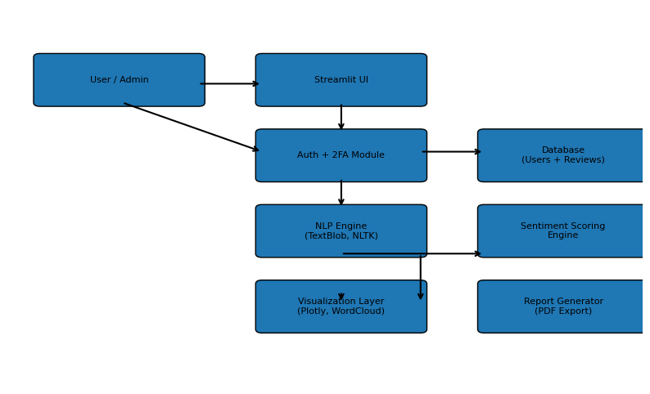
System Design

Slide 11
Implementation
Module Development:
Designed and developed frontend interface for user interaction
Built backend APIs using Flask for request handling
Integrated AI/ML models for intelligent processing
Connected system with database for data storage and retrieval
Core Functionality:
User inputs are captured and processed through the system
Backend sends data to the AI model for analysis
Model generates responses based on trained logic
Output is displayed to the user in real-time

Slide 12
Expected Results & Outcomes
Project Results:
Successfully developed a functional AI-powered intelligent agent
System provides accurate and real-time responses
Achieved efficient task automation and reduced manual effort
Smooth integration of frontend, backend, and AI modules
Performance & Impact:
Improved response time and system efficiency
Reliable handling of user inputs and data processing
Scalable design for future enhancements
Deliverables:
Working application prototype
Tested and validated system
Documentation and project report
.

Slide 13
Challenges Faced
Difficulty in understanding and implementing AI/ML models
Handling data preprocessing and cleaning for accurate results
Integrating frontend, backend, and AI modules smoothly
Managing real-time response and system performance
Debugging errors and resolving unexpected technical issues
Time constraints while balancing learning and development

Slide 14
Learning Outcomes
Gained hands-on experience in Artificial Intelligence & Machine Learning
Improved skills in Python programming and data handling
Learned to develop and integrate AI models with real-world applications
Understood system design, architecture, and API integration
Enhanced problem-solving and debugging skills
Improved team collaboration and communication
Gained exposure to industry tools and development practices

Slide 15
Conclusion
Successfully developed an AI-powered intelligent agent for task automation
Achieved the objective of building a real-time, efficient, and scalable system
Demonstrated the practical application of AI/ML techniques in solving real-world problems
Integrated frontend, backend, and AI modules into a complete working solution
Gained valuable technical and professional experience through the project

Slide 16
Future Enhancement
In the future, this project can be enhanced by improving the accuracy and efficiency of the AI models through advanced algorithms and larger datasets. Additional features such as voice-based interaction, multilingual support, and real-time analytics can be integrated to make the system more user-friendly and versatile. The application can also be scaled using cloud technologies to handle a larger number of users and data efficiently. Furthermore, incorporating advanced AI capabilities like deep learning and personalization can significantly improve user experience and make the system more intelligent and adaptive to different use cases.

Slide 17
THANK YOU

