Slide 1
FOUNDATIONS OF AI · APPLIED AI PROJECT
Timing traffic lights with classical AI
How a constraint-satisfaction search finds when each light should turn green, so cars hit as few red lights as possible.
A green wave: every light turns green just as the cars from the light before arrive.
Rudra Patel (2410111118) · Pruthvi Navadiya (2410111071)
ECSCT24301 Foundation of AI · Adani University · AY 2026–27
Supervisor: [placeholder] · Date: [placeholder]
Notes:
This deck is meant to be read next to the website. Every slide has a blue tag in the top right that tells you which page and section of the dashboard shows the same idea. Open the dashboard (python -m streamlit run app.py) and keep it beside the slides.

Slide 2
START HERE
How to read this deck with the website
Open the dashboard next to these slides. The website has four pages, read left to right.
Page 1
Page 2
Page 3
Page 4
Try it
How it works
Experiments
Under the hood
Describe a road and get the best timings, the savings per car and a picture of the traffic.
The problem, seven words, how a plan is scored and how the search works, with your numbers.
Five saved test roads and a live comparison that varies one thing at a time.
Was the answer double-checked, how much searching it took, the search step by step.
Slides 4–7, 26–27
Slides 5, 13–23
Slide 28
Slides 21–24, 29
On the website › Page › Section
This tag on each slide tells you where to look.
The deck is in six parts
1 The problem 2 What AI means in this course 3 FAI vocabulary
4 How AI is built into the project 5 Results 6 Limits and recap
Classical AI traffic signal coordination
2
Notes:
Read the slides in order. When a slide shows the 'On the website' tag, switch to that page and scroll to the named section: the website shows the same idea with live numbers. The default road on the website is the one used throughout this deck.

Slide 3
1
The problem
Why cars keep stopping at red lights, and what we want to fix.
Notes:
Part 1 explains the real-world problem in plain words before any AI is introduced.

Slide 4
PART 1 · THE PROBLEM
On the website › Try it › headline
Red light, drive, red light again
One straight road with five traffic lights, 400 m apart, speed limit 40 km/h.
400 m · 36 s drive
400 m · 36 s drive
400 m · 36 s drive
400 m · 36 s drive
Light 1
Light 2
Light 3
Light 4
Light 5
86.5 s
4.0
40
average waiting per car when the lights are not coordinated
stops per car: almost every light is red when the car gets there
cars in the test: 20 driving up the road, 20 driving down
Classical AI traffic signal coordination
4
Notes:
Picture driving down a city road: you pass one green light and then hit red at every light after it. On our default road, with the lights not coordinated, an average car waits 86.5 seconds and stops 4 times on a 5-light trip. That wasted time, fuel and braking is the problem the project solves. On the website, the 'Try it' page headline says 'waits 14 s instead of 86 s': the 86 is this number.

Slide 5
PART 1 · THE PROBLEM
On the website › How it works › The problem
Why it happens: every light turns green together
Light 1
What goes wrong
Light 2
Each light repeats a 60 s cycle: 30 s green, 30 s red.
With no coordination all five lights are green from 0 to 30 s.
A car leaving Light 1 at 0 s needs 36 s to reach Light 2.
At 36 s Light 2 is already red. The car stops and waits until 60 s.
The same thing happens at Light 3, 4 and 5.
Light 3
Light 4
Light 5
0 s
30 s
60 s
90 s
120 s
150 s
180 s
36 s: car reaches Light 2
Green bar = light is green, red bar = light is red. Every row is the same, so the lights are not helping each other.
Classical AI traffic signal coordination
5
Notes:
This is the core of the problem. The timing bars show 3 minutes of five lights that all start green at the same moment. Driving between lights takes 36 seconds, but the green only lasts 30 seconds, so a car always arrives just after its light turned red. The 'How it works' page opens with exactly this explanation, using your road's numbers.

Slide 6
PART 1 · THE PROBLEM
On the website › Try it › When each light turns green
The fix: delay each light's green (a green wave)
Light 1 +0
The idea
Light 2 +40
Shift each light's green later by a few seconds, the offset.
The list of offsets is the timing plan. Light 1 is always +0.
The plan on the left is the one our AI found: 0, +40, +10, +40, +15 s.
Now most cars in both directions arrive while the light is green.
Waiting per car drops from 86.5 s to 13.5 s.
Light 3 +10
Light 4 +40
Light 5 +15
0 s
30 s
60 s
90 s
120 s
150 s
180 s
Each row is shifted right compared with the one before: that shift is the delay.
Classical AI traffic signal coordination
6
Notes:
The fix is not to change how long lights stay green, only WHEN each one starts. That start time, measured from Light 1, is called the offset. One offset per light is a timing plan. The 'Try it' page shows this plan as animated lights and a table that compares each offset with the 36 s driving time. Why +40 and not +36? Because cars drive in both directions and the plan has to suit both; slide 7 explains why that is hard.

Slide 7
PART 1 · THE PROBLEM
On the website › How it works › Unknowns and their choices
Why we need AI: too many plans to check by hand
 | Count | Why
Choices per light | 12 | offsets 0, 5, 10, … 55 s (a 5 s step)
Lights to decide | 4 | Light 1 is fixed at 0
Possible plans, 5 lights | 12⁴ = 20,736 | every combination
Possible plans, 7 lights | 12⁶ ≈ 3 million | grows ×12 for every light
1 s step instead of 5 s | 60⁴ ≈ 13 million | finer choices explode the count
Two more reasons
Directions fight. A plan that is perfect for cars going up the road is usually bad for cars coming down.
Effects interact. Changing Light 3 changes when cars reach Light 4 and 5, so you cannot pick each light on its own.
So we need a systematic search that is guaranteed to find the best plan without trying every one blindly. That is classical AI.
Classical AI traffic signal coordination
7
Notes:
This slide is the bridge to AI. Each light has 12 possible offsets, so five lights give 20,736 different plans, and seven lights give almost 3 million. On top of that, the two directions want different plans and every light affects the next. We want the BEST plan and a PROOF that it is best, which is exactly what classical AI search gives us.

Slide 8
2
What 'AI' means in this course
Foundations of AI is about agents that solve problems by searching and reasoning, not about training neural networks.
Notes:
Part 2 explains what kind of AI this is, so the vocabulary in Part 3 makes sense.

Slide 9
PART 2 · AI IN THIS COURSE
Classical AI vs machine learning
What we use
Not used
Classical AI (this project)
Machine learning (not used here)
The problem is written down exactly: the unknowns, their choices and the rules.
A search algorithm explores the choices and proves which one is best.
No training data, no learning, no guessing. Same input → same answer.
Course topics: agents, search, heuristics, constraint satisfaction, logic.
Learns patterns from lots of example data, for example camera footage of traffic.
Gives a good guess, usually without a guarantee it is the best.
Needs data we do not have and is hard to explain step by step.
Useful for prediction; overkill when the rules are known.
Rule of thumb: when you can write down the rules and the goal exactly, classical search can find the best answer and prove it.
Classical AI traffic signal coordination
9
Notes:
People often hear 'AI' and think of ChatGPT or self-driving cars, which use machine learning. Foundations of AI starts earlier: with problems you can describe exactly, solved by searching through possibilities in a smart way. Our project is entirely classical AI. There is no training data and no randomness in the answer: the same road always gives the same plan.

Slide 10
PART 2 · AI IN THIS COURSE
Our project as an AI agent (PEAS)
An agent perceives its environment and acts to reach a goal. PEAS lists its four parts.
P
E
A
S
Performance measure
Environment
Actuators
Sensors
The score: total waiting seconds + 2 × number of stops. Lower is better.
A simulated straight road with N lights and a fixed set of cars driving both ways.
Setting the offset of each light, which is the timing plan.
The simulator's report for a plan: each car's waiting time and stops.
Honest note: it is a planning agent. It works out the best plan ahead of time inside a simulator; it is not wired to real traffic lights or cameras.
Classical AI traffic signal coordination
10
Notes:
PEAS is the standard way the textbook (Russell and Norvig) describes an AI agent. Our agent's goal is the lowest score. Its world is the simulated road. Its only action is choosing the offsets. What it 'sees' is the simulator's result for each plan. Say clearly that it plans offline: it does not control real lights.

Slide 11
PART 2 · AI IN THIS COURSE
What kind of environment is it?
The textbook classifies environments. Ours is the easiest kind, which is why exact search works.
Fully observable
Deterministic
Static
The agent knows everything: every car, every distance, every light.
The same plan always gives the same result. No randomness in scoring.
Nothing changes while the agent is thinking.
Discrete
Single agent
Known
Offsets come in fixed 5 s steps, so there is a finite list of plans.
One planner decides all the lights. No opponent.
The rules of the road (the simulator) are fully written down.
Because of these properties, a plan's score can be computed exactly, and a complete search can prove a plan is the best one.
Classical AI traffic signal coordination
11
Notes:
These six words come straight from the textbook's chapter on environments. Real traffic is messier (partially observable, random), but our simulated road is fully observable, deterministic, static, discrete and known. That simplification is what lets us use exact search and claim 'proven best'. Slide 31 lists what we gave up.

Slide 12
3
FAI vocabulary
The technical words you will hear, each paired with the plain word the website uses.
Notes:
Part 3 is a glossary. Keep it open during the viva; the right column is what the website says.

Slide 13
PART 3 · VOCABULARY
On the website › How it works › Words used on this site
Constraint satisfaction problem (CSP) words
FAI term | Meaning in this project | Website word
CSP | A problem described as unknowns, their allowed values and rules | “a puzzle with rules”
Variable | One unknown to decide: the offset of Light 2, 3, 4, 5 | Offset (delay)
Domain | Values a variable may take: {0, 5, 10, …, 55} s | Timing step, 12 choices
Constraint | A rule the values must obey: within ±10 s of a perfect green wave | Green-wave rule
Assignment | A value for some variables (partial) or for all (complete) | Timing plan
Objective | Number to minimise: J = waiting + 2 × stops | Score (lower is better)
Optimal | No other allowed plan has a lower score | Best possible
Classical AI traffic signal coordination
13
Notes:
A CSP, constraint satisfaction problem, is the main AI idea in the project. It has variables (the offsets), domains (the 12 allowed values each) and constraints (the green-wave rule). We add an objective, the score, so we are not just looking for ANY allowed plan but the best one; textbooks call this a constraint optimisation problem. The right column is the plain word used on the website's glossary.

Slide 14
PART 3 · VOCABULARY
On the website › How it works › How the optimized search works
Search words
FAI term | Meaning in this project | Website word
Search tree | Every way of choosing offsets light by light, drawn as a tree | Tree of choices
Node | One partial plan inside the tree | Branch explored
Branching factor | Children per node: 12 offsets, or 4 once the rule is applied | Choices per light
Depth | How many lights have been decided so far | Light being timed
Backtracking | Depth-first search that steps back to try the next value | Backtracking
Complete | Always finds a solution if one exists | —
Exhaustive / brute force | Score every single plan, one by one | Checked by brute force
Classical AI traffic signal coordination
14
Notes:
Search means exploring possibilities in an organised way. Picture a tree: the root is an empty plan, the first level picks Light 2's offset, the next level Light 3's, and so on. A leaf is a complete plan. Backtracking walks this tree depth-first. Complete means it never misses a solution; optimal means the answer it returns is the best.

Slide 15
PART 3 · VOCABULARY
On the website › Under the hood › How much searching it took
Pruning and strategy words
FAI term | Meaning in this project | Website word
Pruning | Skipping parts of the tree that cannot contain the answer | Ruled out / skipped
Forward checking | After fixing a light, cross out next light's values that break a rule | Ruled out ahead
Dead end | A light is left with no allowed value, so step back at once | Dead ends
Branch and bound | Remember the best plan so far; skip branches that cannot beat it | Skipped by bound
Bound / heuristic | Optimistic estimate of the cost still to come | The estimate
Admissible | The estimate never over-estimates, so pruning is always safe | Safe but cautious
Greedy | Make the locally best choice once, never reconsider | Simple green wave
Baseline | Simple reference strategy to compare against | No coordination
Classical AI traffic signal coordination
15
Notes:
Pruning is what makes search smart rather than brute force: whole branches of the tree are cut off without being explored. Forward checking cuts values that break the rule. Branch and bound cuts branches that cannot beat the best plan found so far, using an estimate called a bound. If the estimate never over-estimates it is admissible, which guarantees we never cut the true best plan.

Slide 16
4
How AI is built into the project
From a road description to a proven-best timing plan, step by step.
Notes:
Part 4 follows one run of the website from input to answer.

Slide 17
PART 4 · INTEGRATION
On the website › Try it › Find the best timings
The pipeline: what happens when you press the button
1 Describe
2 Create cars
3 Strategies
4 Score plans
5 Double-check
6 Show
Lights, distance, speed, traffic
40 cars, both ways, same for every strategy
No coordination · green wave · CSP search
Simulator drives every car under a plan
Brute force scores every allowed plan
Plan, savings, diagrams, counters
config.py
scenario_generator.py
algorithms/
simulator.py
verification.py
dashboard/
Blue boxes = the AI part: search, scoring and verification.
One shared simulator is the key design choice
All three strategies are scored by the same simulator on the same cars, so any difference in score comes from the plan alone. Everything is deterministic, so every number in this deck can be reproduced exactly.
Classical AI traffic signal coordination
17
Notes:
This is how AI is integrated. You describe a road on the Try it page. The program creates a fixed set of cars, runs the three strategies, and every candidate plan is scored by the same simulator. The CSP search is the AI that chooses the plan; the simulator is how it measures plans; the verifier independently checks the answer. The file names are in src/traffic_coordination/.

Slide 18
PART 4 · INTEGRATION
On the website › How it works › How the optimized search works
Our problem written as a CSP
CSP part | Our road | Website
Variables | O₂, O₃, O₄, O₅ (Light 1: O₁ = 0) | Offsets of Lights 2 to 5
Domains | {0, 5, 10, …, 55} s → 12 values each | 12 choices per light
Constraint | Oᵢ₊₁ within ±10 s of Oᵢ + 36 s (wrapping round 60 s) | Green-wave rule ±10 s
Objective | minimise J = W + 2 × S | Score
Search space | 12⁴ = 20,736 plans; rule leaves 4⁴ = 256 | Possible plans / plans scored
Why fix Light 1 at 0?
Only the differences between offsets matter. Shifting every light by the same amount changes nothing.
Fixing O₁ = 0 removes those duplicates, so the search space is 12 times smaller.
W = total seconds all cars wait at red lights. S = total number of stops. The rule can be switched off on the website (set it to 0).
Classical AI traffic signal coordination
18
Notes:
This is the formal CSP. Four variables, twelve values each, one rule per pair of neighbouring lights, and an objective. The rule says each light's offset should be close (within 10 s) to the previous light's offset plus the driving time, which is what a green wave would be. It keeps plans sensible and the search small: 256 allowed plans instead of 20,736.

Slide 19
PART 4 · INTEGRATION
On the website › How it works › How a plan is scored
How a plan is scored (the simulator)
1
Create the traffic
40 cars enter in a bunch, 1 s apart. Same cars for every plan.
The score, worked out
2
Arrive at a light
Score = waiting + 2 × stops
No coordination: 3,460 + 2 × 160 = 3,780
Optimized plan: 540 + 2 × 39 = 618
A stop costs 2 extra seconds because braking and pulling away waste time and fuel even when the wait is short.
Green when it arrives? It drives straight through.
3
Wait at red
Red? It waits for green. The wait is added and counts as one stop.
4
Drive on
36 s to the next light, always at the speed limit.
5
Add it up
Sum waiting and stops over every car and every light.
Simplified on purpose: no queues, constant speed, one road. See slide 31.
Classical AI traffic signal coordination
19
Notes:
The simulator is the environment model, the 'rules of the world' the agent uses to judge a plan. It follows these five rules. The score combines total waiting and total stops. Checking the arithmetic: uncoordinated cars wait 3,460 seconds in total with 160 stops, giving 3,780. The optimized plan has 540 seconds and 39 stops, giving 618.

Slide 20
PART 4 · INTEGRATION
On the website › How it works › Three strategies
Strategies 1 and 2: the comparisons
Baseline
Greedy rule of thumb
No coordination
Simple green wave
Every offset is 0, so every light turns green together.
No intelligence at all. It shows what the road is like today and what coordination is worth.
Plan: 0, 0, 0, 0, 0 → score 3,780
Each light gets the previous offset + the 36 s driving time, rounded to 5 s.
Light 2: 36 → 35. Light 3: 35 + 36 = 71 → wraps past 60 → 11 → 10.
Decides each light once and never reconsiders: a greedy method.
Great for cars going up the road, poor for cars coming down. Plan 0, 35, 10, 45, 20 → score 830.
Neither strategy searches. The third one does, and it beats or ties both on every test road.
Classical AI traffic signal coordination
20
Notes:
We compare against two simple strategies. 'No coordination' is the baseline. The 'simple green wave' is a greedy heuristic used by traffic engineers: it is fast and good for one direction, but it ignores cars going the other way. On one test road (H1) the greedy plan was even worse than no coordination. The website works through the greedy arithmetic with your own road.

Slide 21
PART 4 · INTEGRATION
On the website › Under the hood › The search, step by step
Strategy 3, step 1: backtracking search
Light 1 = 0
How it walks the tree
Fix Light 2, then Light 3, and so on: depth-first.
At a leaf, score the full plan and remember it if it is the best so far.
Then step back (backtrack) and try the next value.
Because nothing is skipped unsafely, the search is complete and the result is optimal.
L2 = 30
L2 = 35
L2 = 40
L2 = 45
L3 = 10
L3 = 15
L3 = 20
L3 = 25
… then Light 4, then Light 5. At the bottom a complete plan is scored by the simulator.
Best plan found: 0 → 40 → 10 → 40 → 15, score 618.
Classical AI traffic signal coordination
21
Notes:
Backtracking is depth-first search over the tree of choices. Only 4 values appear per level here because forward checking (next slide) has already crossed out the others. The 'Under the hood' page draws the real search: a chart of which light is being timed at each step. Climbing means going deeper; dropping back means backtracking.

Slide 22
PART 4 · INTEGRATION
On the website › How it works › Forward checking
Step 2: forward checking crosses out bad values early
Example: Light 2 = 40 s. A perfect wave would start Light 3 at 40 + 36 = 76 → 16 s. The rule allows 16 ± 10, so 6 to 26 s.
Why it helps
Without it the search would build plans it already knows are illegal.
With it, every branch it explores can still lead to an allowed plan.
Each light keeps 4 of its 12 values, so the work drops from 12⁴ to 4⁴ = 256 plans.
0
5
10
15
20
25
30
35
40
45
50
55
Light 3's 12 values: 4 survive, 8 are crossed out before they are ever tried.
680
256
0
values crossed out on the default road
plans left to score, out of 20,736 (1.2%)
dead ends: a light was never left with no value
Classical AI traffic signal coordination
22
Notes:
Forward checking looks one step ahead. As soon as one light gets a value, it removes values from the next light that would break the green-wave rule. Our constraint only links neighbouring lights, so checking the next light is enough. On the default road it crossed out 680 values: 8 values each time one of the 85 partial plans was extended. This is real pruning, and the website prints the count for your road.

Slide 23
PART 4 · INTEGRATION
On the website › Under the hood › Skipped by bound
Step 3: branch and bound, and an honest zero
How branch and bound works
Honest result
Keep the best score found so far (the incumbent).
For a partial plan, estimate the lowest score it could still reach (the bound).
If even that estimate cannot beat the incumbent, skip the whole branch.
Our bound: safe but cautious
We estimate “the rest of the road adds no cost”: h(s) = 0.
It never over-estimates, so it is admissible: it can never cut the true best plan.
But it is so cautious it never skips anything: 0 skips in every run.
The website reports the true count (0) instead of hiding it. The real speed-up comes from forward checking.
A sharper bound that still never over-estimates is listed as future work.
Classical AI traffic signal coordination
23
Notes:
Branch and bound is implemented and counted, but with the bound h = 0 it never prunes. That is correct (an admissible bound keeps the answer optimal) but weak. We report the zero honestly; expect a viva question on it. Answer: h = 0 is admissible and consistent, so correctness holds, but a lower bound of 0 can never beat a real incumbent, so nothing is skipped. A better bound is future work.

Slide 24
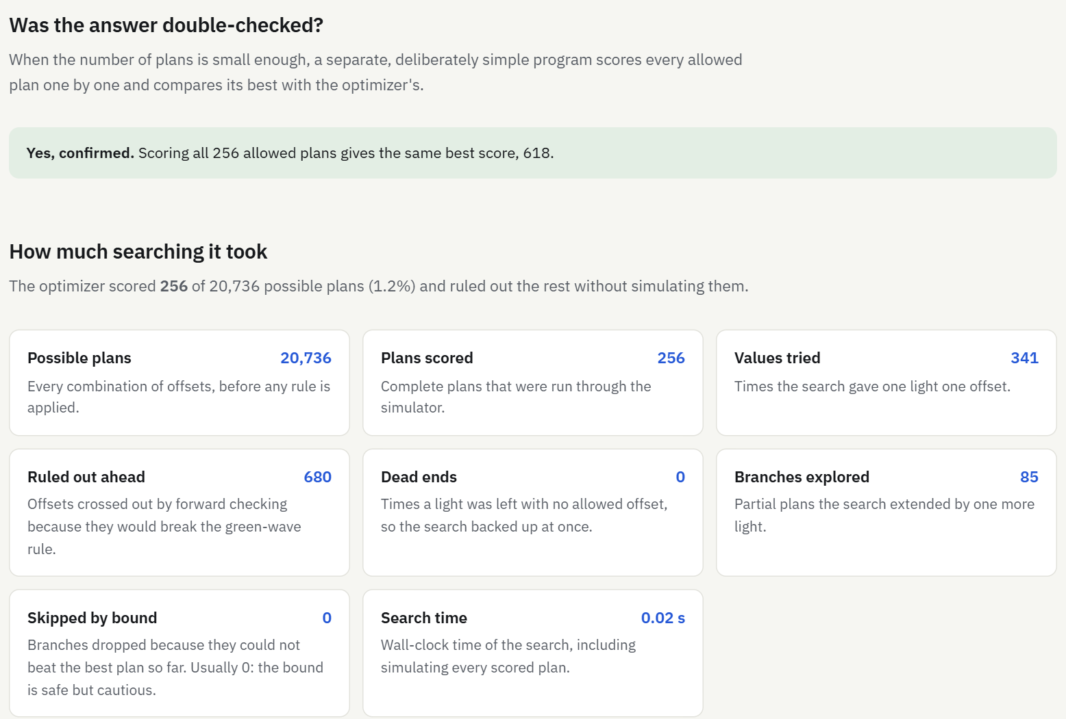
PART 4 · INTEGRATION
On the website › Under the hood › Was the answer double-checked?
Is it really the best? Double-checking the answer
Two kinds of proof
Proven by the search: the search finished, so every allowed plan was scored or safely ruled out.
Checked by brute force: a separate, deliberately simple program scores every allowed plan one by one and must agree.
Default road: brute force over 256 plans gives the same best score, 618.
If the search hits its 30 s limit, the website says “best found in time (not proven best)”.
Classical AI traffic signal coordination
24
Notes:
We never just claim the answer is the best. The search itself proves it when it finishes, and an independently written brute-force verifier double-checks it whenever the number of plans is small enough (up to 250,000). In the benchmarks it agreed on 12 of 14 roads; the other 2 were too large and are reported as skipped, not as verified.

Slide 25
5
Results
What the AI achieved, on the default road and across test roads.
Notes:
Part 5 shows the results with screenshots from the live website.

Slide 26
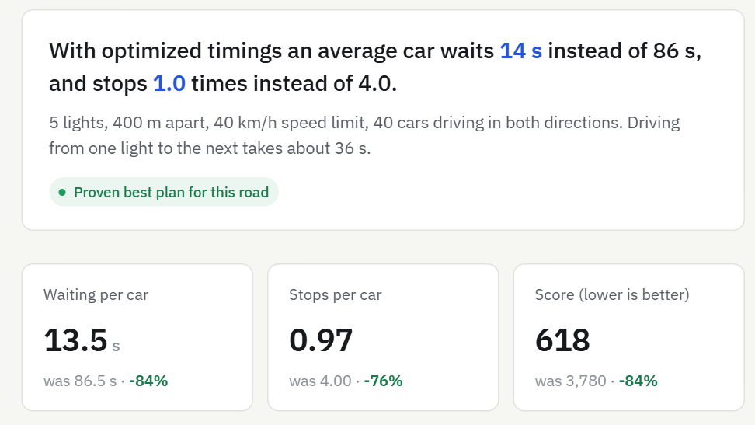
PART 5 · RESULTS
On the website › Try it › headline and stats
The default road: 84% less waiting
 | None | Optimized | Change
Waiting per car | 86.5 s | 13.5 s | −84%
Stops per car | 4.00 | 0.97 | −76%
Score | 3,780 | 618 | −84%
Badge: Proven best plan for this road.
Try changing the road on the website: 7 lights, heavy traffic, one way. The headline updates and the search re-runs in seconds.
Classical AI traffic signal coordination
26
Notes:
This is the Try it page on the default road. An average car now waits 13.5 s instead of 86.5 s and stops about once instead of four times. The green badge means the search finished and proved the plan is the best under the rules.

Slide 27
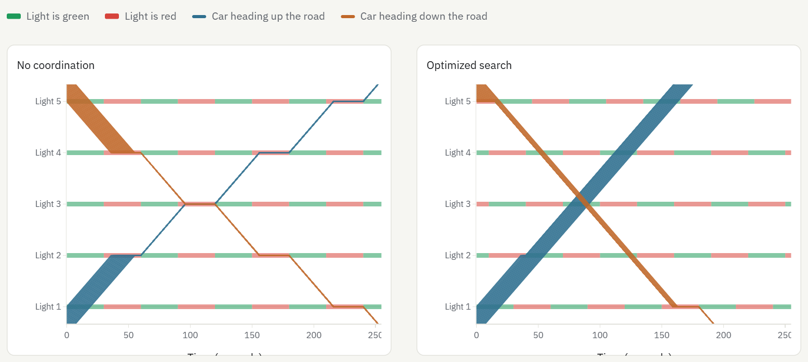
PART 5 · RESULTS
On the website › Try it › See the difference
Seeing the difference: time-space diagrams
How to read it
Time runs left to right; the road runs from Light 1 (bottom) to Light 5 (top).
Each band is a bunch of cars. Blue drives up, orange drives down.
A flat stretch on a red bar = cars waiting at a red light.
Left: flat steps at almost every light. Right: both bands slide through.
Classical AI traffic signal coordination
27
Notes:
Time-space diagrams are the traffic engineer's standard picture. A straight slope means cars are moving; a flat segment means they are stopped. Without coordination both bunches stop at nearly every light. With the optimized plan both directions pass almost without stopping.

Slide 28
PART 5 · RESULTS
On the website › Experiments › Five test roads
Across five test roads, the search always wins or ties
Road | What it tests | None | Green wave | Optimized | vs none | Checked by
A | 3 lights, light traffic | 762 | 140 | 140 | −82% | Brute force
B | 5 lights, moderate (default) | 3,780 | 830 | 618 | −84% | Brute force
C | 7 lights, ~3 million plans | 5,860 | 1,610 | 674 | −88% | Search proof
D | 5 lights, heavy traffic | 10,406 | 2,525 | 2,078 | −80% | Brute force
E | 5 lights, 1 s step | 3,780 | 850 | 605 | −84% | Search proof
Scores = waiting + 2 × stops, lower is better. Optimized is 80–88% lower than no coordination and up to 58% lower than the green wave (road C).
Live sweep on the website: varying the amount of traffic, the optimized plan cut waiting by 81% to 100%.
Classical AI traffic signal coordination
28
Notes:
These five roads were run ahead of time with the benchmark script (experiments/results). Each changes one thing from the default road. On road A the green wave is already optimal, so it ties. Roads C and E have too many plans for brute force, so their proof comes from the search running to completion with the green-wave rule on. The Experiments page also lets you run a live comparison.

Slide 29
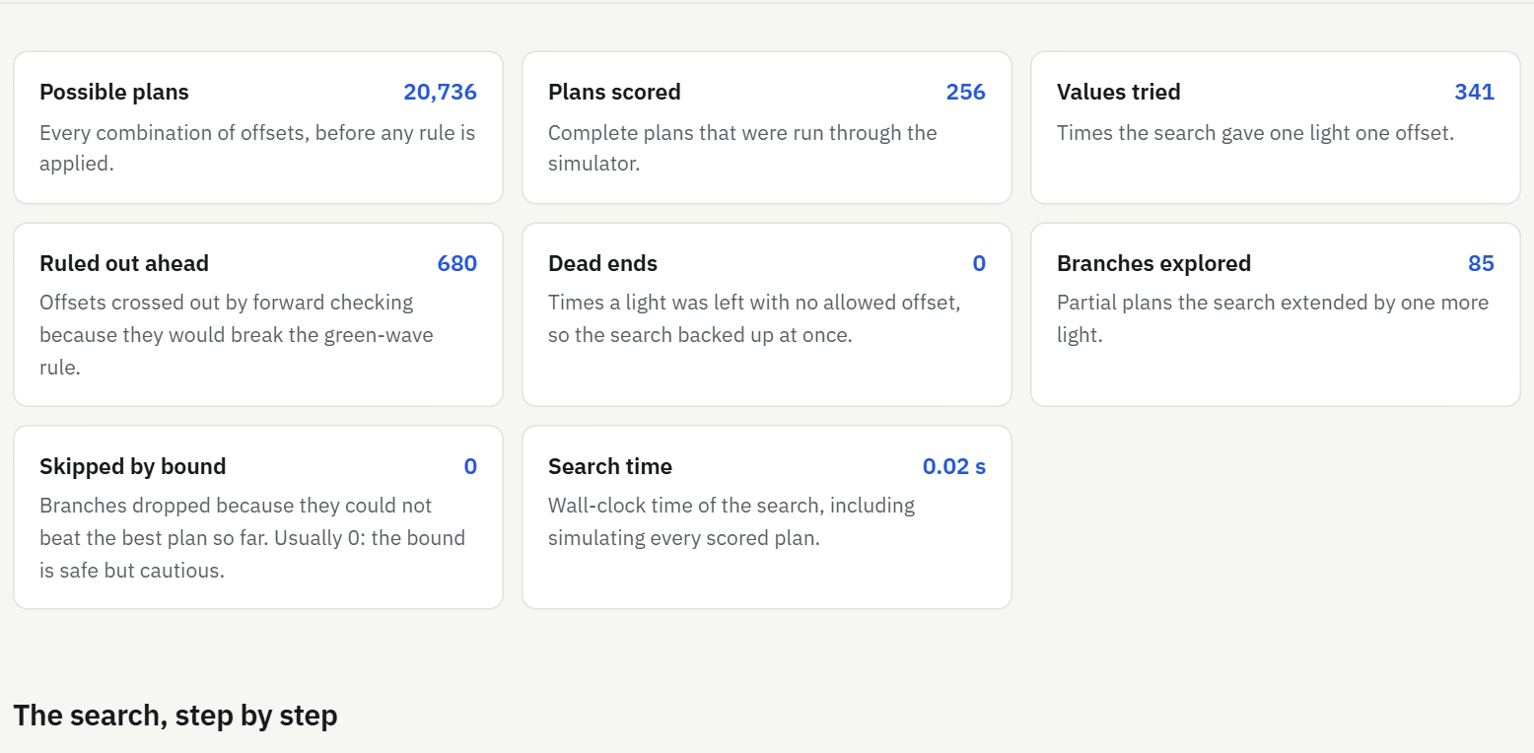
PART 5 · RESULTS
On the website › Under the hood › How much searching it took
How much searching it took
Default road, in numbers
20,736 possible plans; only 256 scored (1.2%).
341 values tried, 85 partial plans extended.
680 values ruled out ahead by forward checking.
0 skipped by bound, 0 dead ends.
Search time: about 0.02 s.
Bigger roads: road E scored 194,481 plans in about 12 s.
Classical AI traffic signal coordination
29
Notes:
Every counter on the Under the hood page maps to a vocabulary word from Part 3: values tried = assignments attempted, branches explored = nodes expanded, ruled out ahead = forward-checking eliminations, skipped by bound = branch-and-bound prunes.

Slide 30
6
Limits and recap
What the model leaves out, and the whole project in one minute.
Notes:
Part 6 closes with honest limitations and a summary you can say out loud.

Slide 31
PART 6 · LIMITS
What the model simplifies (said honestly)
No queues
Constant speed
One road, one phase
Cars never pile up behind each other; heavy traffic is gentler than in reality.
Every car drives exactly at the speed limit, no braking or accelerating.
No turning cars, pedestrians or side streets.
Synthetic traffic
Weak bound
Big roads
Cars are generated, not measured from a real road.
h = 0 never prunes; a sharper admissible bound is future work.
7+ lights need the green-wave rule to stay fast; proof is within that rule.
Future work: a sharper bound · queues in the simulator · local search for very large roads · turning phases · testing on a real road layout.
Classical AI traffic signal coordination
31
Notes:
Say these before you are asked. The numbers are simulated under simplifications, so they compare plans fairly but are not field predictions. The project is a demonstration of classical AI search, not a traffic-engineering tool.

Slide 32
PART 6 · RECAP
The whole project in one minute
Problem
Uncoordinated traffic lights make cars stop at almost every light: 86.5 s waiting and 4 stops per car on our default road.
AI technique
Model the offsets as a constraint satisfaction problem and solve it with backtracking, forward checking and branch and bound.
Integration
One deterministic simulator scores every plan; a brute-force verifier double-checks the answer; a four-page website explains it all.
Result
13.5 s waiting and 0.97 stops per car (−84%); 80–88% lower scores on every test road; optimality proven or brute-force checked.
Classical AI traffic signal coordination
32
Notes:
If you only remember one slide, remember this one. Problem: wasted waiting at uncoordinated lights. Technique: a CSP solved by backtracking with forward checking and branch and bound. Integration: a shared simulator, an independent verifier and the website. Result: 84% less waiting on the default road, proven optimal.

Slide 33
PART 6 · RECAP
Questions you will probably be asked
Where is the AI?
Why not try every plan?
The CSP search that picks the offsets: backtracking + forward checking + branch and bound.
It grows ×12 per light (3 million at 7 lights). Pruning keeps it to 256 plans on the default road.
How do you know it is the best?
Why does branch and bound prune 0?
The search is complete, and brute force agrees wherever the space is small enough.
Our bound h = 0 is admissible but weak; we report the true count.
Why not machine learning?
Is it realistic?
The rules are known exactly and there is no data; search gives a proven-best answer.
It is a simplified simulator: fair for comparing plans, not a field prediction.
More answers: docs/viva_questions.md (42 questions).
Classical AI traffic signal coordination
33
Notes:
Short answers to the most likely viva questions. The full list is in docs/viva_questions.md.

