Slide 1
Cybersecurity Intrusion Detection Using Machine Learning
ECSCI24302 - [Course title as per syllabus] | UNSW-NB15 | [Team member names] | [Allotted date]

Slide 2
Problem and scope
Detect malicious network flows without leakage (UNSW-NB15)
175,341 raw training rows (dedup -> 107,740); 82,332 untouched test rows
Baseline + 4 ML models, identical leak-free pipelines
Single test pass at the very end

Slide 3
Dataset verification
Row-count variance: 175,341 train / 82,332 test, 45 columns verified
Access page https://www.kaggle.com/datasets/mrwellsdavid/unsw-nb15
Credentials-free verified mirror https://huggingface.co/datasets/Mireu-Lab/UNSW-NB15
Accessed 2026-10-26

Slide 4
Data-quality findings
67,601 exact duplicates in training - removed
26,387 in testing - kept (deployment realism)
0 missing cells; 0 label mismatches
Constant features dropped via audit

Slide 5
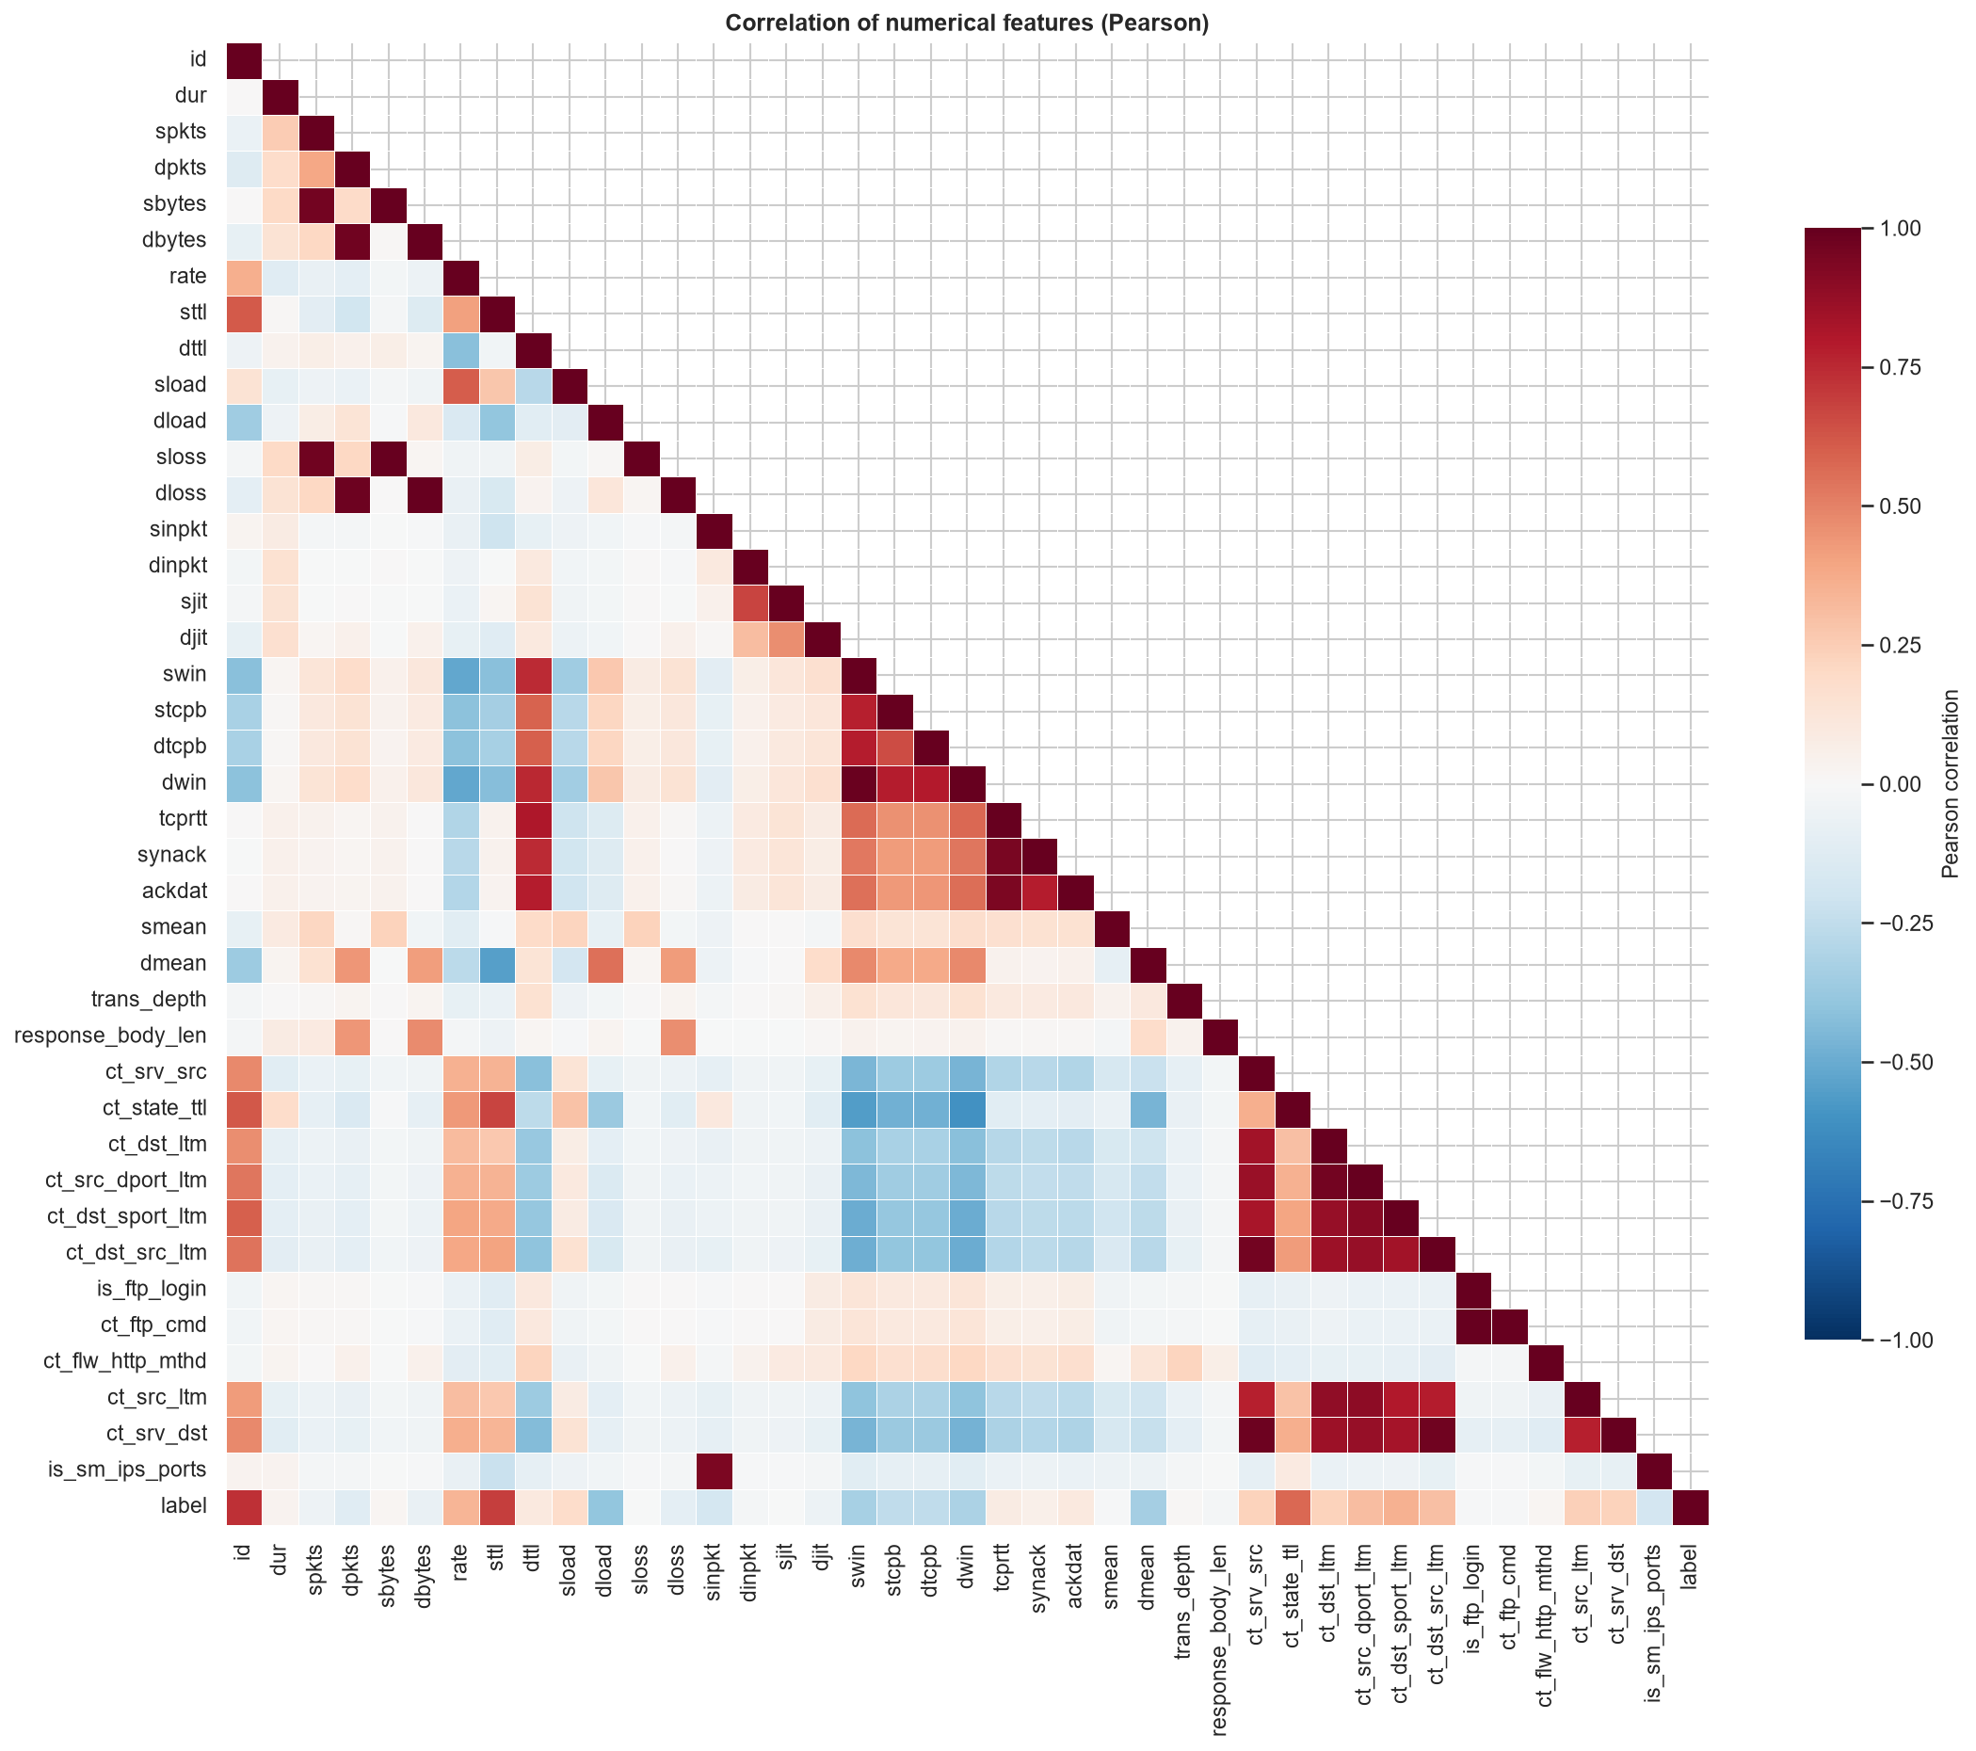
Exploratory data analysis
- sttl's correlation with 'malicious' 0.693 - strongest
- Medians separate classes: dur 0.0386 vs 9e-06, sbytes 1470 vs 200, dbytes 1110 vs 0
- Descriptive only - prediction test comes next

Slide 6
Pipelines (identical shape)
FeatureEngineer (16 engineered features)
Median imputer, scaler only for linear model
OneHotEncoder(handle_unknown='infrequent_if_exist', min_frequency=25)
id / label / attack_cat excluded from model inputs

Slide 7
Model zoo
Dummy (most_frequent) baseline
LogisticRegression (balanced, scaled)
DecisionTree (depth 12, balanced)
RandomForest (200 estimators, balanced_subsample)
HistGradientBoosting (250 iterations)

Slide 8
Tuning protocol (train partition only)
cv=3, scoring F1, 60k stratified subsample
GridSearchCV for LogisticRegression and DecisionTree
RandomizedSearchCV for RandomForest and HistGradientBoosting
Search spaces fixed a priori (documented in results/tuning_*.json)

Slide 9
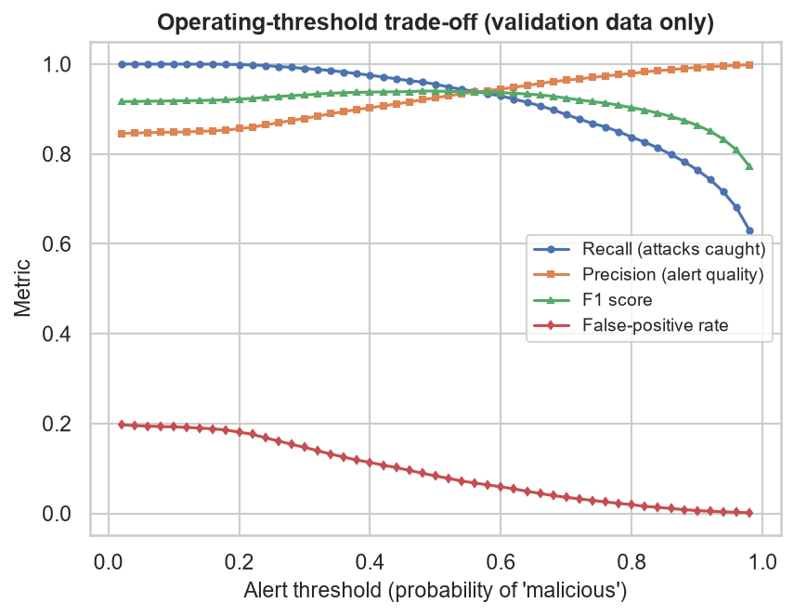
Threshold trade-off (validation)
- Rule fixed a priori: max F1 on a 20% validation slice
- Threshold = 0.480
- Test set untouched at this point

Slide 10
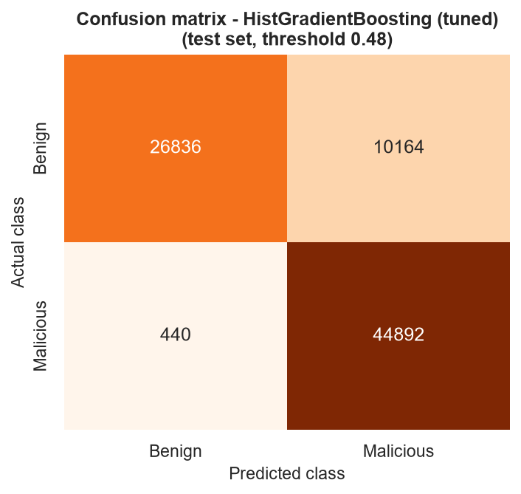
Single test pass - confusion matrix
- accuracy 0.8712 / precision 0.8154 / recall 0.9903 / F1 0.8944
- ROC-AUC 0.9868 / AP 0.9903
- tn=26,836 fp=10,164 fn=440 tp=44,892

Slide 11
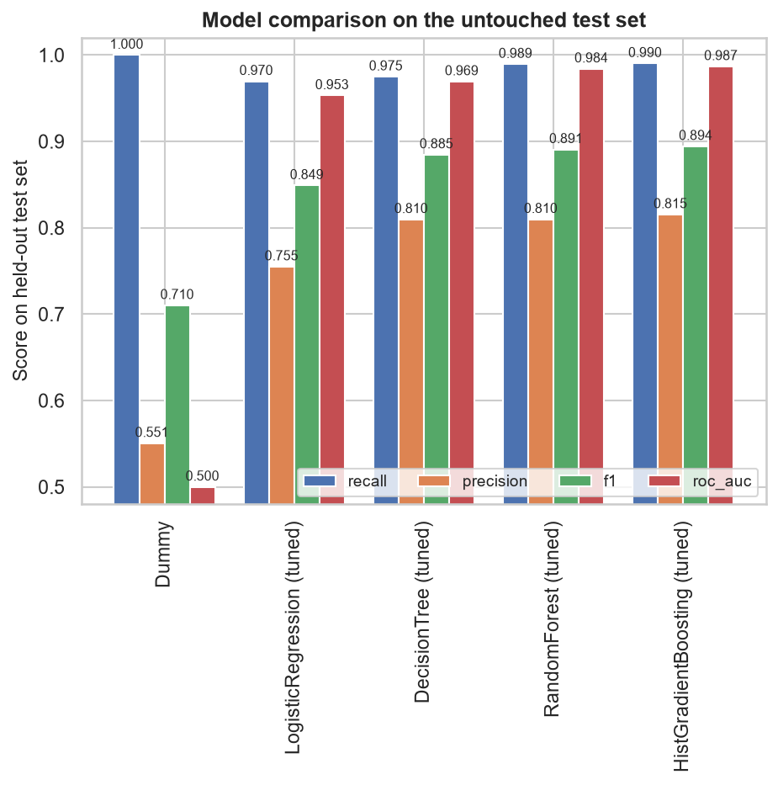
Model comparison
- Same pipelines; identical test pass
- HistGradientBoosting (tuned) leads on every reported metric

Slide 12
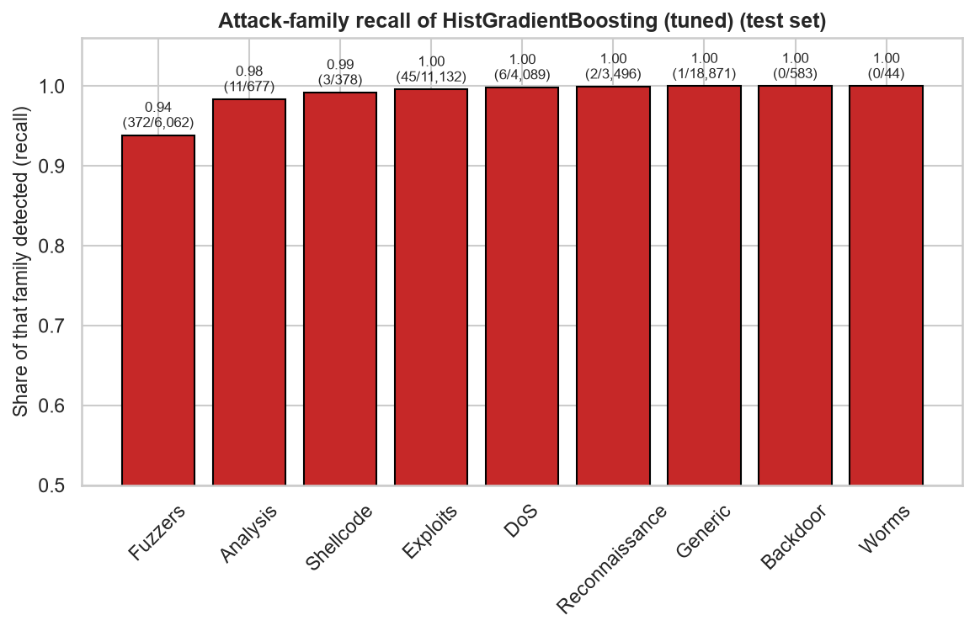
Error analysis
- Fuzzers hardest: 372 of 6,062 missed (6.14%)
- Backdoor easiest: 0 missed
- FP medians: sttl 254 vs 31 for correct benign; dur 0.68 vs 0.06

Slide 13
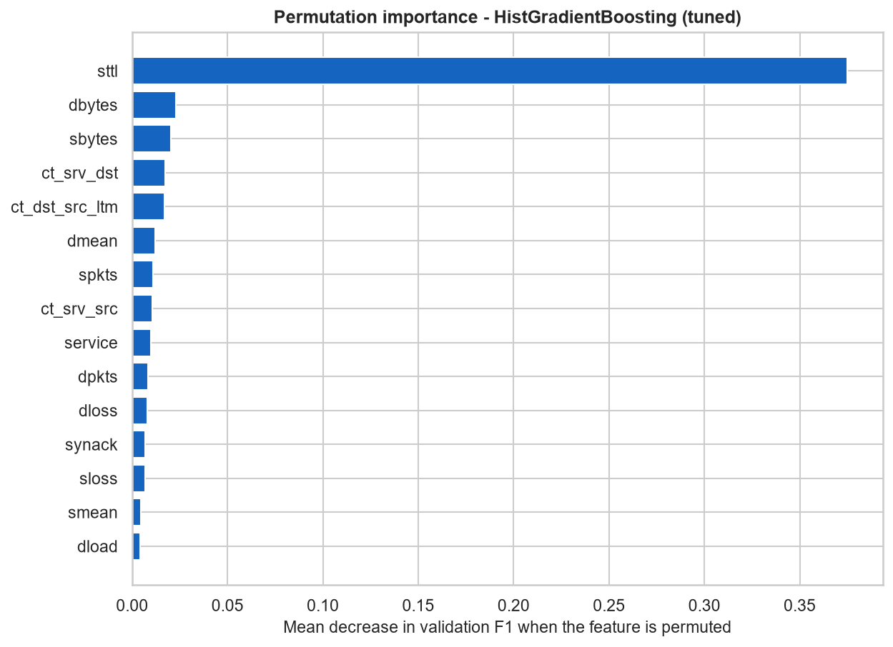
Interpretation
- sttl dominates (0.3748) - synthetic-capture schema artifact
- Importance is statistical, not causal

Slide 14
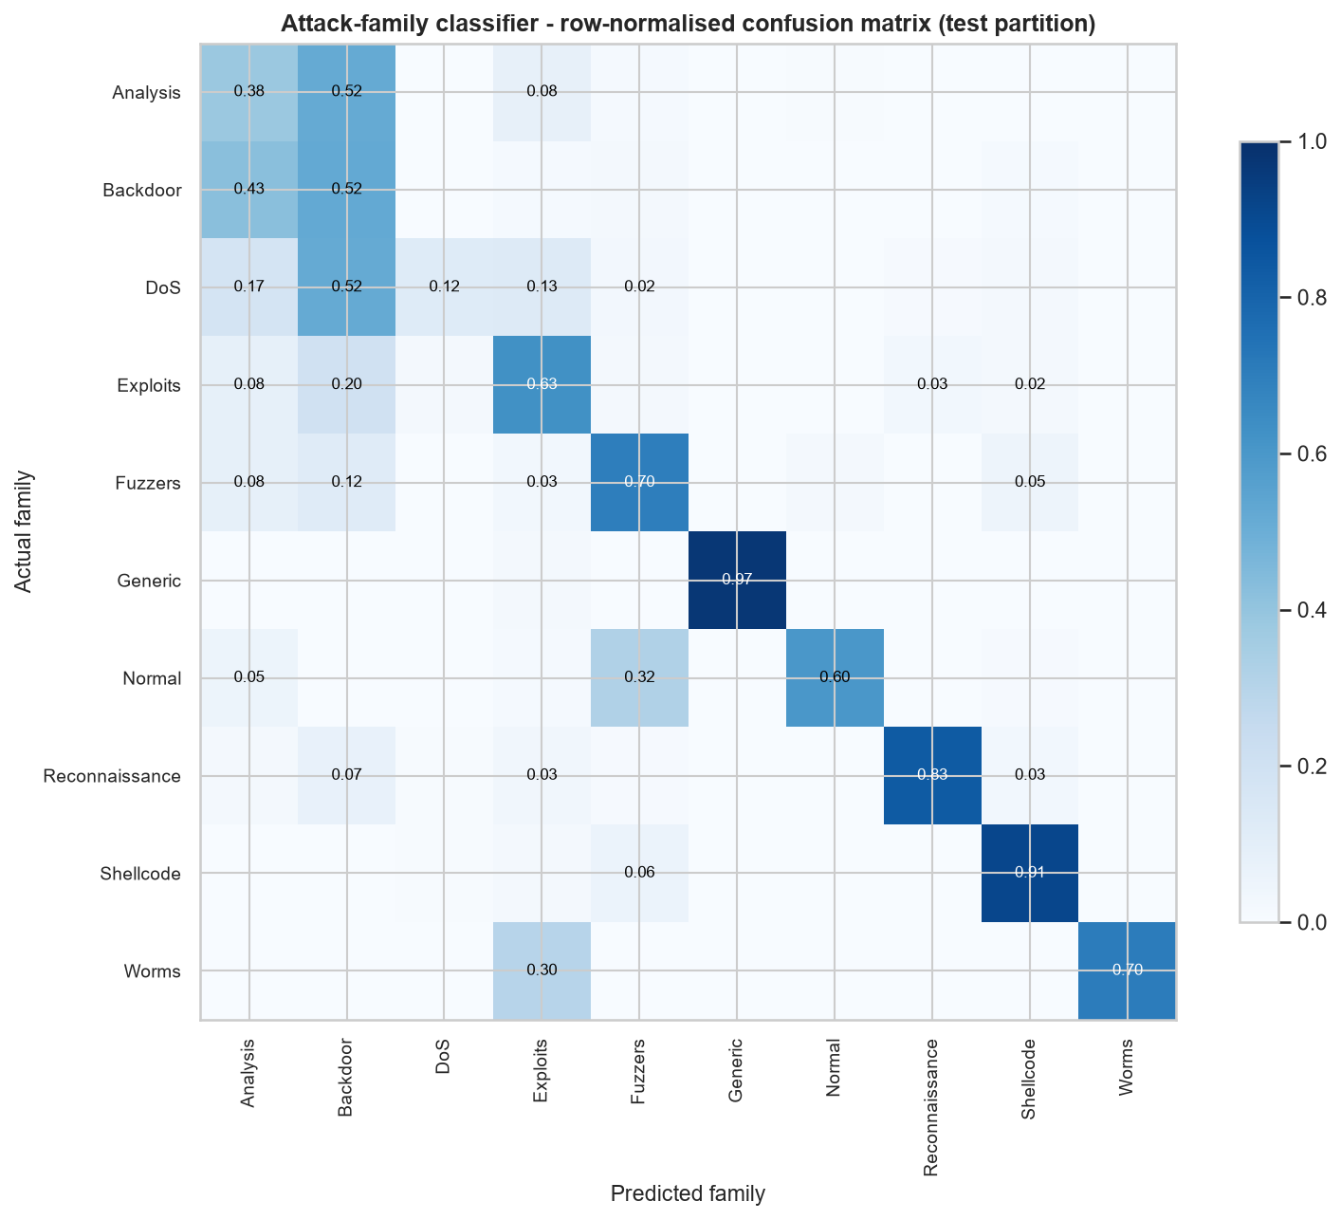
Optional multi-class extension
- 10 families; accuracy 0.6814; macro-F1 0.5129
- Analysis (38.26%) and DoS (12.40%) recall genuinely hard

Slide 15
Limitations (honest)
FPR 27.47% - train/test shift; disclosed, not hidden
sttl importance: schema artifact (does not generalise)
Demo accuracy 80% on 10 records = sanity check only

Slide 16
Conclusion and reproducibility
Test F1 0.8944 under one strict leakage regime
All numbers come from findings.md (single source of truth)
python -m src.download_data / src.train / app.py / pytest
random_state=42 end-to-end

