Slide 1
Containerization of a polyglot microservice application using Docker and Kubernetes
Submitted By – Team #5
Vamsi Krishna Yepuri
Venkata Kalyan Polamarasetty
Shivani Donthi
Ajay Kumar Reddy Gondi

Slide 2
Problem Statement
Monolithic applications : Drawbacks
complex and difficult to manage as a single unit
achieving agility is challenging
Microservices
simplifies monolithic applications
flexible, agile, easy to maintain
Microservices Deployment on Virtual Machines: Drawbacks
conflicting libraries and components
Efforts : provisioning, scaling, service discovery, load balancing

Slide 3
Abstract
Project Development
polyglot microservice application (Java, Python, and JavaScript)
containerized with Docker
deployed on Kubernetes
Study
benefits of containerization
Benefits : portability, deployment, resource utilization, startup times, scalability , flexibility
Performance Evaluation
Performance metrics : virtual machines vs containers

Slide 4
Literature Review
Papers | Microservices | Stateless | Container | Kubernetes | Polyglot
1 | ✓ | ✗ | ✓ | ✓ | ✗
2 | ✗ | ✗ | ✓ | ✓ | ✗
3 | ✗ | ✗ | ✓ | ✗ | ✗
4 | ✓ | ✗ | ✓ | ✗ | ✗
5 | ✓ | ✗ | ✓ | ✗ | ✓
Ours | ✓ | ✓ | ✓ | ✓ | ✓

Slide 5
Related Work
[1] explains the significance of using a microservices-based architecture to implement high availability for stateful applications in Kubernetes.
In [2], emphasized the enhanced portability, scalability, and flexibility of a web application made up of several microservices that each execute in their own container.
The methods for achieving consistent distributed transactions across polyglot microservices that use several databases were covered in [3], that also addressed the challenges of distributed transactions in a polyglot environment.
[4] proposes a validated performance model for Kubernetes clusters that utilizes queueing theory and stochastic processes to optimize resource allocation and enhance cluster efficiency.
[5] compares monolithic and microservices-based applications' performance using Docker containers. The experiments measure response time and throughput under different workloads.

Slide 6
Milestones
Milestone 1 : Development of polyglot microservices and containerizing then with Docker
Milestone 2 : Setting up Kubernetes on cloud
Milestone 3 : Deployment, scaling and load balancing of microservices on K8s
Milestone 4 : Performance comparison of application on VM and containers

Slide 7
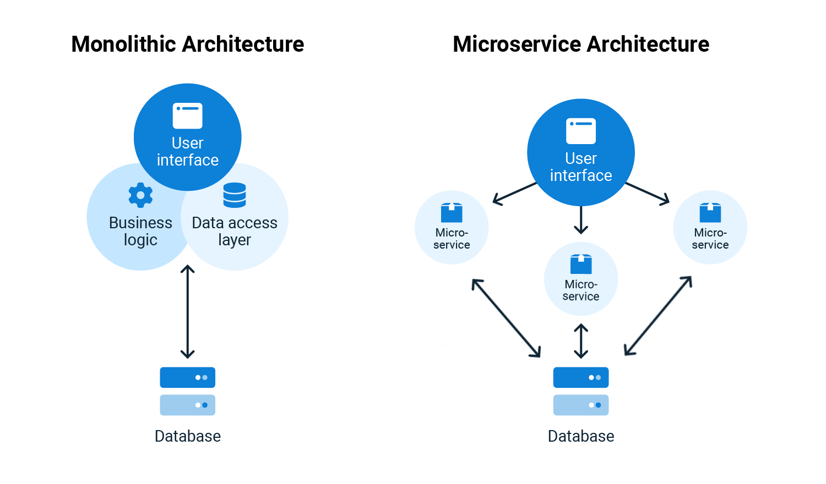
Project Background – Key Concepts
Monolithic and Microservices

Slide 8
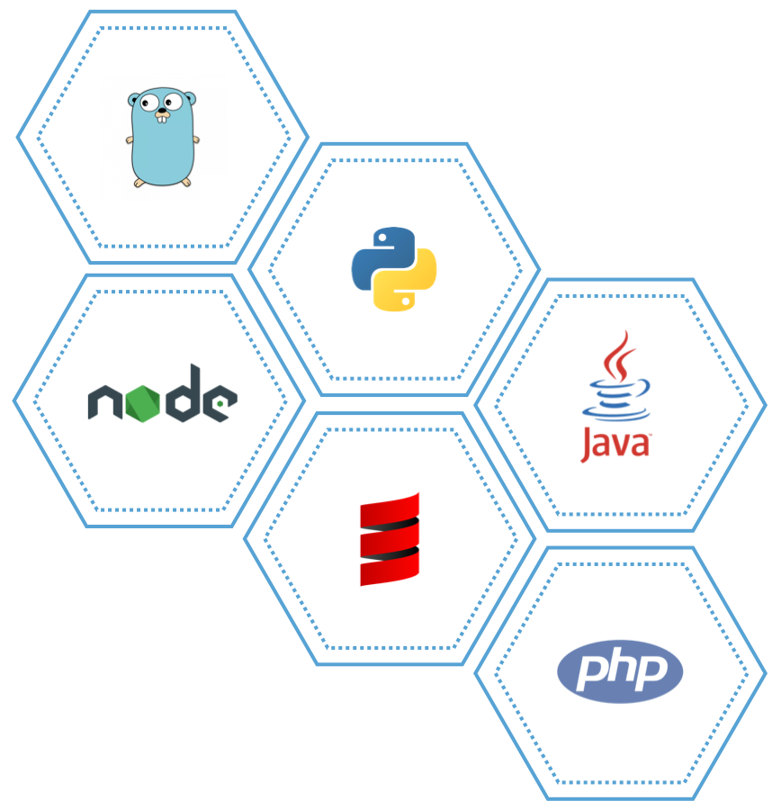
Project Background – Key Concepts
Polyglot Microservices : Developed in multiple programming languages

Slide 9
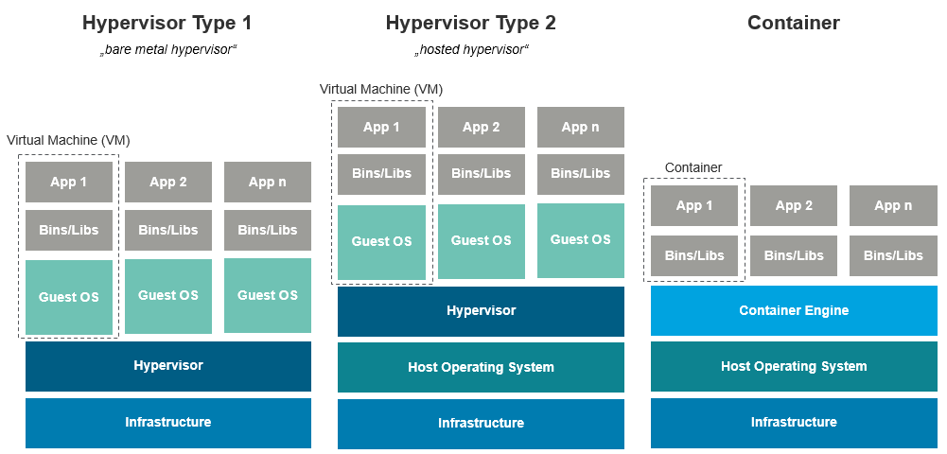
Project Background – Key Concepts
Container : unit of software that packages application and its dependencies
Virtual Machine vs Container

Slide 10

Project Background – Key Concepts
Docker : Tool for container engine
Kubernetes: Tool for container orchestration
App 1
Container
App 2
Container
App 3
Container
App 1
Container
App 2
Container
App 3
Container
Docker
Docker
Host Operating System
Host Operating System
Infrastructure
Infrastructure

Slide 11
Infrastructure
Infrastructure required
physical or virtual machines
storage systems
networking components
Cloud Provider
Google Cloud Platform (GCP)
GCP Services
VPC networks – Virtual Private Cloud Network
Compute Engine – CPU, Memory, Storage for VMs

Slide 12
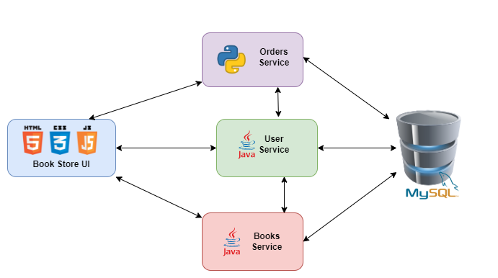
System Architecture
Book Store Application – Microservice architecture

Slide 13
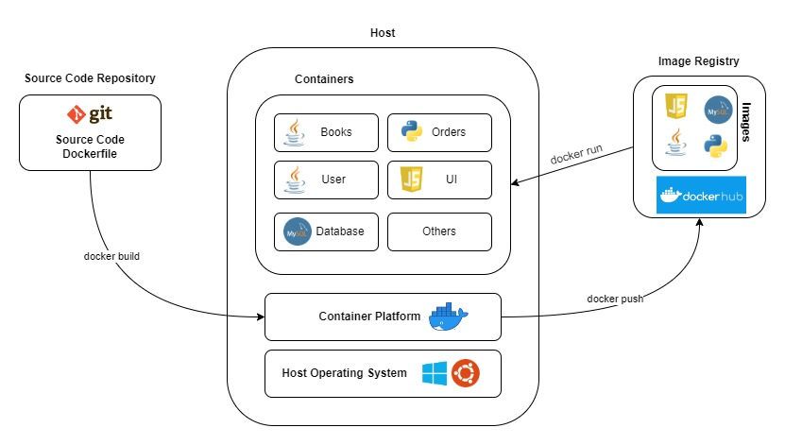
System Architecture
Book Store Application – Docker architecture (on single host)

Slide 14
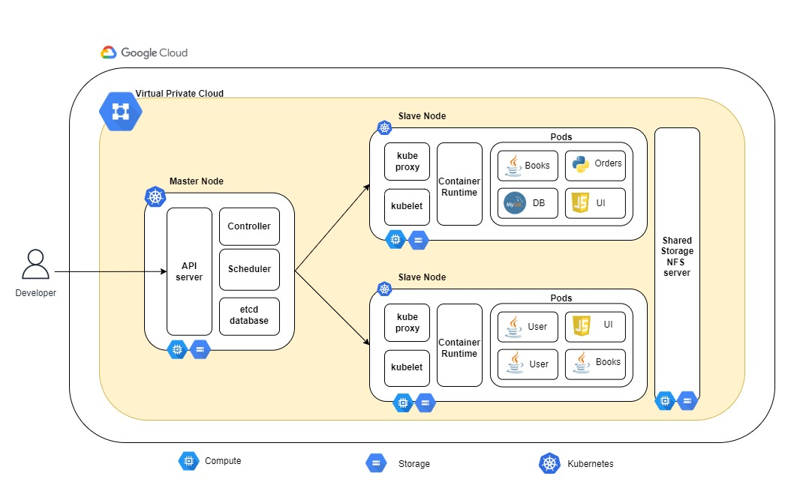
System Architecture
Book Store Application – Kubernetes architecture

Slide 15
Milestones
Milestone 1 : Development of polyglot microservices and containerizing then with Docker
Milestone 2 : Setting up Kubernetes on cloud
Milestone 3 : Deployment, autoscaling and load balancing of microservices on K8s
Milestone 4 : Performance comparison of application on VM and containers

Slide 16
References
[1] Leila Abdollahi Vayghan, Mohamed Aymen Saied, Maria Toeroe, and Ferhat Khendek. Microservice based architecture: Towards high- availability for stateful applications with kubernetes. In 2019 IEEE 19th international conference on software quality, reliability and security (QRS), pages 176–185. IEEE, 2019.Achieving agility in the development of monolithic applications is challenging.
[2] Vivek Sharma, Harsh Kumar Saxena, and Akhilesh Kumar Singh. Docker for multi-containers web application. In 2020 2nd International Conference on Innovative Mechanisms for Industry Applications (ICIMIA), pages 589–592. IEEE, 2020.Microservices are often set up in traditional virtual machines, leading to issues with conflicting libraries and components.
[3] Guogen Zhang, Kun Ren, Jung-Sang Ahn, and Sami Ben-Romdhane. Grit: consistent distributed transactions across polyglot microservices with multiple databases. In 2019 IEEE 35th International Conference on Data Engineering (ICDE), pages 2024–2027. IEEE, 2019.
[4] Victor Medel, Omer Rana, Jos ́e ́Angel Ba ̃nares, and Unai Arronategui. Modelling performance & resource management in kubernetes. In Proceedings of the 9th International Conference on Utility and Cloud Computing, pages 257–262, 2016.
[5] Marcelo Amaral, Jorda Polo, David Carrera, Iqbal Mohomed, Merve Unuvar, and Malgorzata Steinder. Performance evaluation of microservices architectures using containers. In 2015 ieee 14th international symposium on network computing and applications, pages 27–34. IEEE, 2015.

Slide 17
Demo – Milestone 2

Slide 18
Containerization of a polyglot microservice application using Docker and Kubernetes
Submitted By – Team #5
Vamsi Krishna Yepuri
Venkata Kalyan Polamarasetty
Shivani Donthi
Ajay Kumar Reddy Gondi

Slide 19
Milestones
Milestone 1 : Development of polyglot microservices and containerizing then with Docker
Milestone 2 : Setting up Kubernetes on cloud
Milestone 3 : Deployment, autoscaling and load balancing of microservices on K8s
Milestone 4 : Performance comparison of application on VM and containers

Slide 20
System Architecture
Book Store Application – Kubernetes architecture

Slide 21
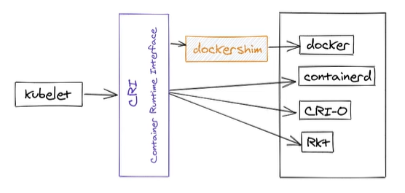
Container - Runtime
Container Runtimes
Containerd

Slide 22
Demo – Milestone 3

Slide 23
Containerization of a polyglot microservice application using Docker and Kubernetes
Submitted By – Team #5
Vamsi Krishna Yepuri
Venkata Kalyan Polamarasetty
Shivani Donthi
Ajay Kumar Reddy Gondi

Slide 24
Milestones
Milestone 1 : Development of polyglot microservices and containerizing then with Docker
Milestone 2 : Setting up Kubernetes on cloud
Milestone 3 : Deployment, scaling and load balancing of microservices on K8s
Milestone 4 : Performance comparison of application on VM and containers

Slide 25
System Architecture
Book Store Application – Microservice architecture

Slide 26
System Architecture
Book Store Application – Kubernetes architecture

Slide 27
Load Balancing Strategies in K8S service
Round Robin
Least Connection
Destination Hashing
Source Hashing
Shortest expected delay
Never queue
https://technekey.com/changing-the-traffic-distribution-of-a-kubernetes-service/

Slide 28
Thank You

