Slide 1
Containerization of a polyglot microservice application using Docker and Kubernetes
Submitted By – Team #5
Vamsi Krishna Yepuri
Venkata Kalyan Polamarasetty
Shivani Donthi
Ajay Kumar Reddy Gondi

Slide 2
Problem Statement
Monolithic applications : Drawbacks
complex and difficult to manage as a single unit
achieving agility is challenging
Microservices
simplifies monolithic applications
flexible, agile, easy to maintain
Microservices Deployment on Virtual Machines: Drawbacks
conflicting libraries and components
Efforts : provisioning, scaling, service discovery, load balancing

Slide 3
Abstract
Project Development
polyglot microservice application (Java, Python, and JavaScript)
containerized with Docker
deployed on Kubernetes
Study
benefits of containerization
Benefits : portability, deployment, resource utilization, startup times, scalability , flexibility
Performance Evaluation
Performance metrics : virtual machines vs containers

Slide 4
Literature Review
Papers | Microservices | Stateless | Container | Kubernetes | Polyglot
1 | ✓ | ✗ | ✓ | ✓ | ✗
2 | ✗ | ✗ | ✓ | ✓ | ✗
3 | ✗ | ✗ | ✓ | ✗ | ✗
4 | ✓ | ✗ | ✓ | ✗ | ✗
5 | ✓ | ✗ | ✓ | ✗ | ✓
Ours | ✓ | ✓ | ✓ | ✓ | ✓

Slide 5
Related Work
The importance of adopting a microservice-based architecture to achieve high availability for stateful applications in Kubernetes is being explained in [1].
In [2] , presented a case study of a web application that consists of several microservices, each running in a separate container and highlighted the improved portability, scalability, and flexibility..
[3] discussed the approaches for achieving consistent distributed transactions across polyglot microservices that use multiple databases addressed the challenges in distributed transactions in a polyglot environment.
[4] proposes a performance model to analyze the resource management in Kubernetes clusters. The model uses queueing theory and stochastic processes to represent the resource utilization of nodes and pods. The proposed model is validated through experiments that compare its accuracy against the real system performance. The paper highlights the importance of having an accurate performance model to optimize resource allocation and improve the overall efficiency of Kubernetes clusters.
In [5] the evaluation of the performance of microservices architectures using containers, specifically Docker. The authors conduct experiments to compare the performance of a monolithic application with a microservices-based application, both deployed on Docker. The experiments involve measuring the response time and throughput of the applications under various workloads.

Slide 6
Milestones
Milestone 1 : Development of polyglot microservices
Milestone 2 : Containerizing microservices with Docker
Milestone 3 : Setting up Kubernetes on cloud
Milestone 4 : Deployment, autoscaling and load balancing of microservices on K8s
Milestone 5 : Performance comparison of application on VM and containers

Slide 7
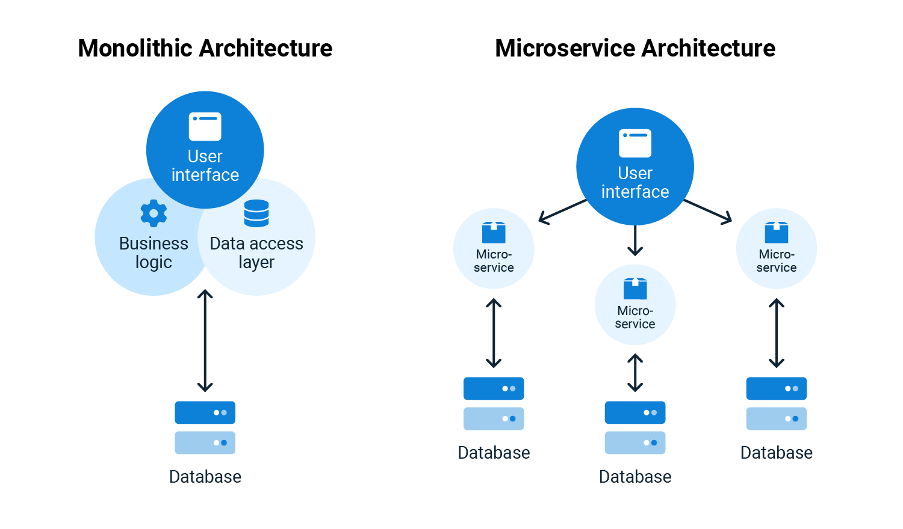
Project Background – Key Concepts
Monolithic and Microservices

Slide 8
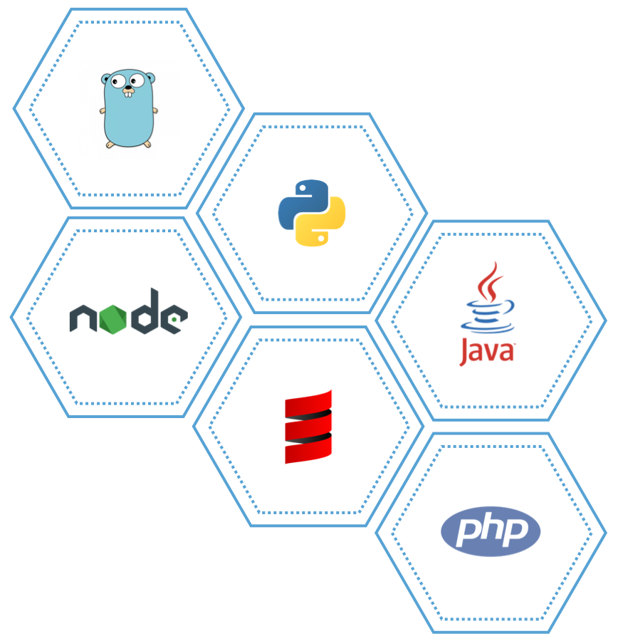
Project Background – Key Concepts
Polyglot Microservices : Developed in multiple programming languages

Slide 9
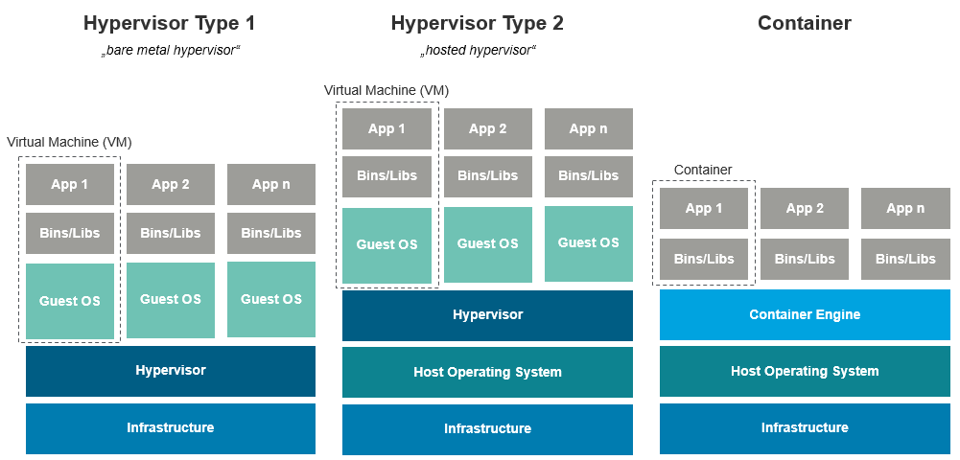
Project Background – Key Concepts
Container : unit of software that packages application and its dependencies
Virtual Machine vs Container

Slide 10

Project Background – Key Concepts
Docker : Tool for container engine
Kubernetes: Tool for container orchestration
App 1
Container
App 2
Container
App 3
Container
App 1
Container
App 2
Container
App 3
Container
Docker
Docker
Host Operating System
Host Operating System
Infrastructure
Infrastructure

Slide 11
Infrastructure
Infrastructure required
physical or virtual machines
storage systems
networking components
Cloud Provider
Google Cloud Platform (GCP)
GCP Services
VPC networks – Virutal Private Cloud Network
Compute Engine – CPU, Memory, Storage for VMs

Slide 12
References
[1] Leila Abdollahi Vayghan, Mohamed Aymen Saied, Maria Toeroe, and Ferhat Khendek. Microservice based architecture: Towards high- availability for stateful applications with kubernetes. In 2019 IEEE 19th international conference on software quality, reliability and security (QRS), pages 176–185. IEEE, 2019.Achieving agility in the development of monolithic applications is challenging.
[2] Vivek Sharma, Harsh Kumar Saxena, and Akhilesh Kumar Singh. Docker for multi-containers web application. In 2020 2nd International Conference on Innovative Mechanisms for Industry Applications (ICIMIA), pages 589–592. IEEE, 2020.Microservices are often set up in traditional virtual machines, leading to issues with conflicting libraries and components.
[3] Guogen Zhang, Kun Ren, Jung-Sang Ahn, and Sami Ben-Romdhane. Grit: consistent distributed transactions across polyglot microservices with multiple databases. In 2019 IEEE 35th International Conference on Data Engineering (ICDE), pages 2024–2027. IEEE, 2019.
[4] Victor Medel, Omer Rana, Jos ́e ́Angel Ba ̃nares, and Unai Arronategui. Modelling performance & resource management in kubernetes. In Proceedings of the 9th International Conference on Utility and Cloud Computing, pages 257–262, 2016.
[5] Marcelo Amaral, Jorda Polo, David Carrera, Iqbal Mohomed, Merve Unuvar, and Malgorzata Steinder. Performance evaluation of microservices architectures using containers. In 2015 ieee 14th international symposium on network computing and applications, pages 27–34. IEEE, 2015.

Slide 13
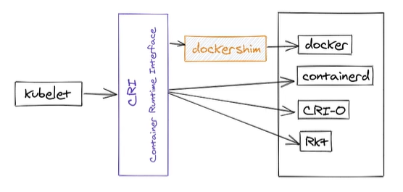
Appendix

