Slide 1
Pirean UI Candidate Assessment Task
January 2015

Slide 2
Introduction
This document provides a guide visual for the UI developer applicant assessment task.
For the purposes of the task, the information in this document should be followed as closely as possible.

Slide 3
Guides
Concept, font sizes, colours.
Please note, the visual provided is for a large device (eg, Desktop). Please also consider how the design will adapt for smaller devices.

Slide 4
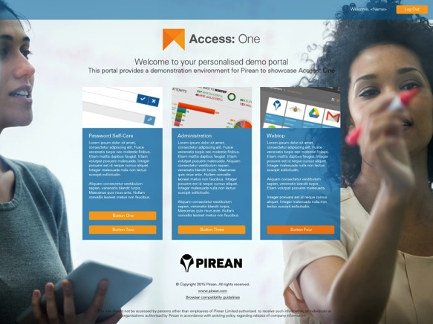
Concept

Slide 5

Fonts (please also set fallbacks)
Helvetica Neue (Regular) 16px, #ffffff
Helvetica Neue (Light) 16px, #ffffff
Helvetica Neue (Regular) 30px, #000000
(70% transparent)
Helvetica Neue (Regular) 24px, #000000
(70% transparent)
Helvetica Neue (Light) 18px, #ffffff
Helvetica Neue (Regular) 14px, #ffffff
Helvetica Neue (Light) 16px, #ffffff
Helvetica Neue (Regular) 14px, #000000
(70% transparent)

Slide 6
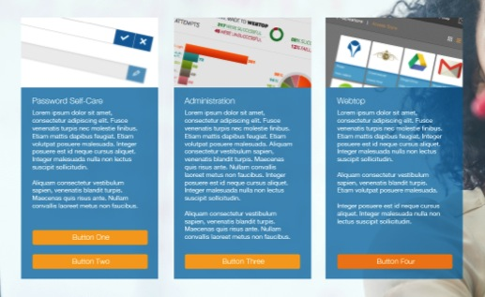
Measurements (content panels)
150px
300px
30px

Slide 7
Measurements (top bar)
75px
(Note: Top bar would be fixed during scroll)

Slide 8
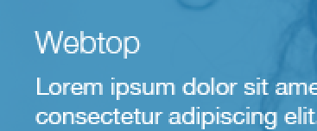
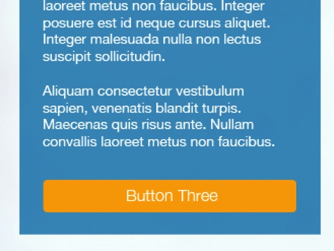
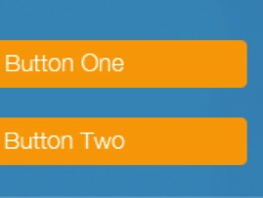
Measurements (inside panels)
15px
25px
25px
20px
25px

Slide 9
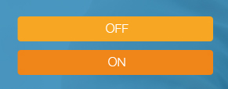
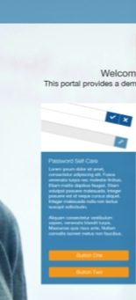

Colours
#086ba3
(50% transparent)
#f7a623
#ff08518
#000000
(70% transparent)
#086ba3
(70% transparent)
#086ba3
(70% transparent)

Slide 10
Images
A1_Logo_Transparent.png
PasswordSelfCare.png
Administration.png
Webtop.png
Pirean_Logo.png
Background.jpg

