Slide 1
Smartphone Bluetooth – Raspberry pi Interface
Vy. N – C0776242 – Group 1

Slide 2
Table of Contents
Summary of the project
Bluetooth 5
Raspberry Pi
Blynk

Slide 3
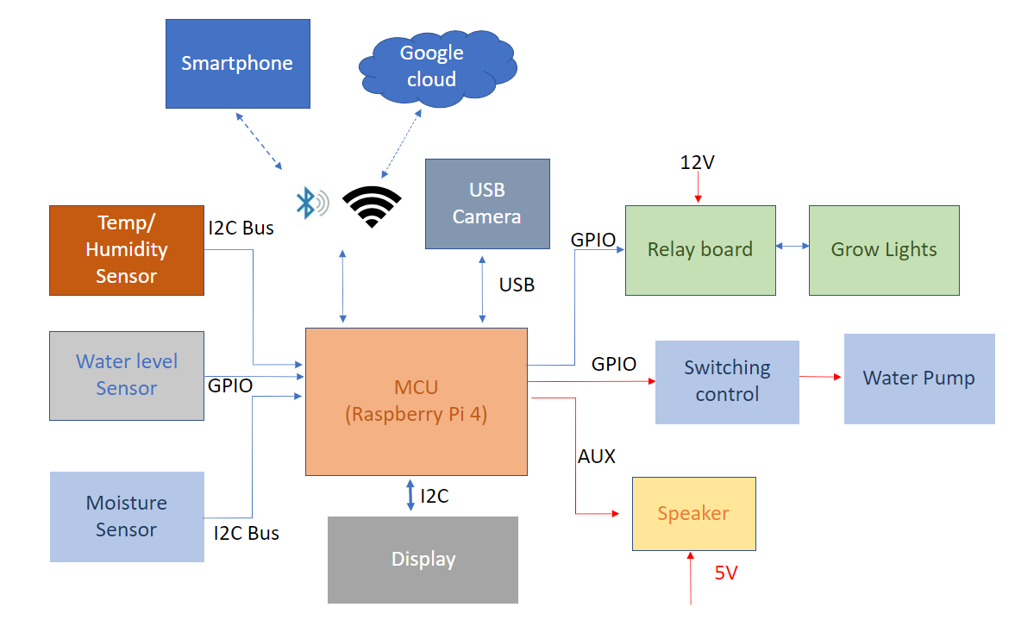
Project summary – Block diagram

Slide 4
Project Summary – Key features
Smartphone control: the device can be monitored and controlled via the BLE system or by smartphone via Wifi and Google Cloud.
Auto-adjusting temperature: with an optional enclosed space, the temperature in each slot of the device can be adjusted to a suitable level for any particular plant.
Auto-adjusting humidity: some plants may enjoy their habitat in a humid environment; our device can replicate the humidifier system’s moist air humidifier system’s moist air-control.
Auto-watering: the plants will never be dried out again with this feature; the device will detect the soil’s humidity and automatically water your plants whenever they need.
Auto-disease-detect: the device will have a camera system that scans the leaves of your plants, then detects any disease happening to the plants, and recommends proper treatment.
Light system: with the LEDs system, the device can save up to 70% of power consumption.
Music player: yes, our device will also have a music function. You wonder why? According to a study, music increases plants’ productivity, and it improves their health and “mood.” (Mazlan, 2020).
Friendly control interface: With a LCD built on, you can easily control your whole garden within a few steps.

Slide 5
Bluetooth Low Energy
Bluetooth Low Energy
What is Bluetooth Low Energy?
Bluetooth Low Energy (BLE) is a low power wireless communication technology that can be used over a short distance to enable smart devices to communicate. Some of the devices you interact with every day such as your smart phone, smart watch, fitness tracker, wireless headphones and computer are using BLE to create a seamless experience between your devices.

Slide 6
Bluetooth Low Energy - Introduction
Introduction
BLE is a relatively new Bluetooth standard defined by the Bluetooth Special Interest Group (SIG) with a focus on low energy. It has enabled device manufacturers to add a low power communications interface on existing solutions. It has also been used to create new low power devices such as beacons that can be powered by a small coin cell battery for months or even years.
BLE has a wide range of possibilities and is implemented in a broad set of fields such as health, fitness, security, home automation, home entertainment, smart industry and IoT (Internet of Things). It's also close at hand in the smartphones and laptops that we use every day.

Slide 7
Bluetooth Low Energy – Devices roles
In order to understand how BLE works, we need to define some of the terms and concepts at play. A BLE device is acting in either a central or peripheral role and is sometimes also referred to as a client or server.
Central (Client)
A device that initiates commands and requests, and accepts responses.
Examples: computer, smartphone
Peripheral (Server)
A device that receives commands and requests, and returns responses
Examples: a temperature sensor, heart rate monitor

Slide 8
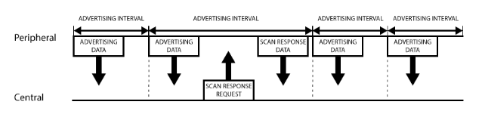
Bluetooth Low Energy – Advertising
The advertising process is mainly about two 31 bytes packets:
1. Advertising packet 2. Scan response (Optional)
A peripheral will set a specific advertising interval, and every time this interval passes, it will retransmit its main advertising packet. A longer delay saves power but feels less responsive if the device only advertises itself once every 2 seconds instead of every 20ms.
If a listening device is interested in the scan response payload (and it is available on the peripheral) it can optionally request the scan response payload, and the peripheral will respond with the additional data.

Slide 9
Bluetooth Low Energy – Communication
BLE uses a hierarchical data structure to define the information exchange structure.
A BLE device acting as a peripheral will advertise services and characteristics that can be used for communication with the device.
These attributes are defined using a GATT (Generic Attributes) profile.
Characteristics expose values as small packets of information that can change over time. Characteristics are grouped together with similar types into services.

Slide 10
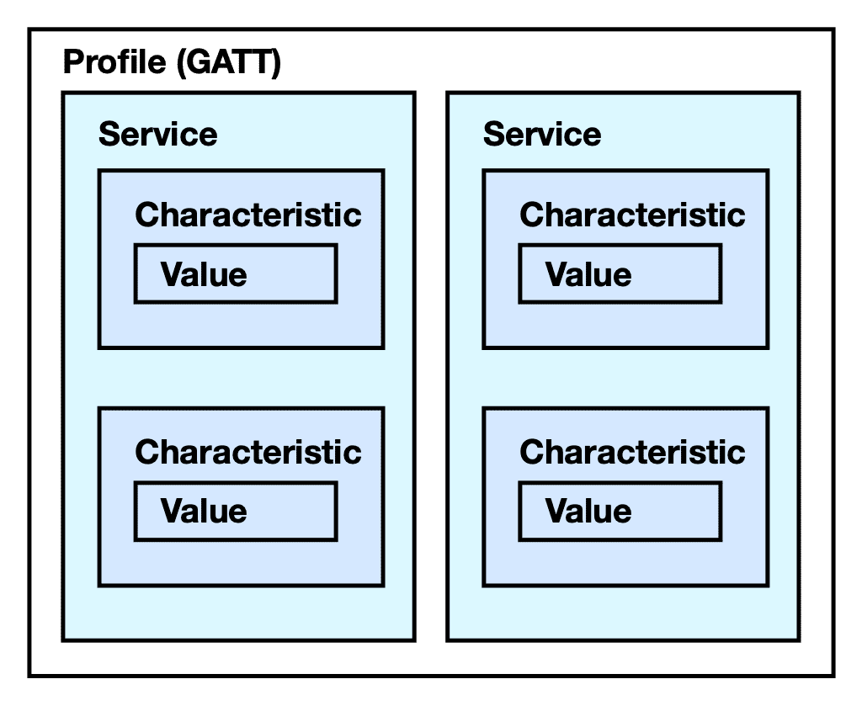
Bluetooth Low Energy – Communication (cont.)

Slide 11
Services
Services are used to break data up into logic entities and contain specific chunks of data called characteristics. A service can have one or more characteristics, and each service distinguishes itself from other services by means of a unique numeric ID called a UUID, which can be either 16-bit (for officially adopted BLE Services) or 128-bit (for custom services).
Characteristics can be defined to contain read or write type values.
Peripherals providing read type characteristics are generally publishing information for the central to consume.
Peripherals providing write type characteristics are generally providing an interface to receive data from a central - for example a configuration value that changes something on the peripheral.
Bluetooth Low Energy – Communication (cont.)

Slide 12
Bluetooth Low Energy – Communication(cont.)
The characteristics and services defined for a GATT profile each have a UUID unique identifier. There are some standard types of characteristics that the Bluetooth SIG defines as reserved, but BLE peripherals are expected to uniquely identify their characteristics
A common interaction pattern from a central device is as follows:
Scan for peripherals advertising defined BLE service types by UUID
Connect to a selected peripheral
Discover services on the connected peripheral
Discover characteristics on the services of interest on the peripheral
Read or write values to the characteristics of interest
Disconnect when connection no longer needed.

Slide 13
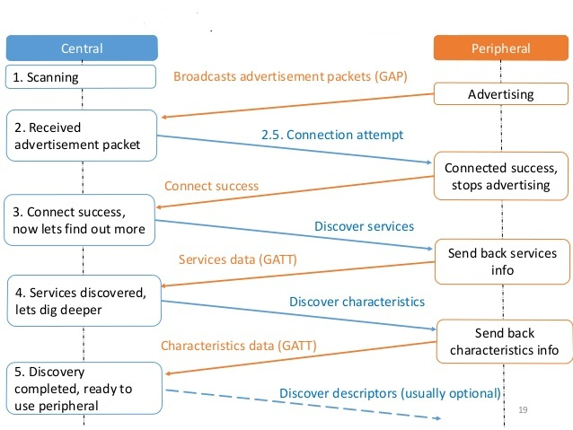
Bluetooth Low Energy – Connection

Slide 14
Bluetooth Low Energy – Bluetooth classic comparison
 | Bluetooth Low Energy (LE) | Bluetooth Classic
Frequency Band | 2.4GHz ISM Band (2.402 – 2.480 GHz Utilized) | 2.4GHz ISM Band (2.402 – 2.480 GHz Utilized)
Channels | 40 channels with 2 MHz spacing (3 advertising channels/37 data channels) | 79 channels with 1 MHz spacing
Channel Usage | Frequency-Hopping Spread Spectrum (FHSS) | Frequency-Hopping Spread Spectrum (FHSS)
Modulation | GFSK | GFSK, π/4 DQPSK, 8DPSK
Data Rate | LE 2M PHY: 2 Mb/s LE 1M PHY: 1 Mb/s LE Coded PHY (S=2): 500 Kb/s LE Coded PHY (S=8): 125 Kb/s | EDR PHY (8DPSK): 3 Mb/s EDR PHY (π/4 DQPSK): 2 Mb/s BR PHY (GFSK): 1 Mb/s
Tx Power* | ≤ 100 mW (+20 dBm) | ≤ 100 mW (+20 dBm)
Rx Sensitivity | LE 2M PHY: ≤-70 dBm LE 1M PHY: ≤-70 dBm LE Coded PHY (S=2): ≤-75 dBm LE Coded PHY (S=8): ≤-82 dBm | ≤-70 dBm

Slide 15
Bluetooth Low Energy – Bluetooth Classic Comparison
 | Bluetooth Low Energy (LE) | Bluetooth Classic
Data Transports | Asynchronous Connection-oriented Isochronous Connection-oriented Asynchronous Connectionless Synchronous Connectionless Isochronous Connectionless | Asynchronous Connection-oriented Synchronous Connection-oriented
Communication Topologies | Point-to-Point (including piconet) Broadcast Mesh | Point-to-Point (including piconet)
Positioning Features | Presence (Advertising) Proximity (RSSI) Direction (AoA/AoD) Distance (Coming) | None

Slide 16
Raspberry Pi 4 Specs
Broadcom BCM2711, Quad core Cortex-A72 (ARM v8) 64-bit SoC @ 1.5GHz
2GB, 4GB or 8GB LPDDR4-3200 SDRAM (depending on model)
2.4 GHz and 5.0 GHz IEEE 802.11ac wireless, Bluetooth 5.0, BLE
Gigabit Ethernet
2 USB 3.0 ports; 2 USB 2.0 ports.
Raspberry Pi standard 40 pin GPIO header (fully backwards compatible with previous boards)
2 × micro-HDMI ports (up to 4kp60 supported)
2-lane MIPI DSI display port

Slide 17
Raspberry Pi 4 Specs(cont.)
2-lane MIPI CSI camera port
4-pole stereo audio and composite video port
H.265 (4kp60 decode), H264 (1080p60 decode, 1080p30 encode)
OpenGL ES 3.1, Vulkan 1.0
Micro-SD card slot for loading operating system and data storage
5V DC via USB-C connector (minimum 3A*)
5V DC via GPIO header (minimum 3A*)
Power over Ethernet (PoE) enabled (requires separate PoE HAT)
Operating temperature: 0 – 50 degrees C ambient
* A good quality 2.5A power supply can be used if downstream USB peripherals consume less than 500mA in total.

Slide 18
Blynk
What is Blynk?
Blynk was designed for the Internet of Things. It can control hardware remotely, it can display sensor data, it can store data, vizualize it and do many other cool things.

Slide 19
Blynk - Components
There are three major components in the platform:
Blynk App - allows to you create amazing interfaces for your projects using various widgets we provide.
Blynk Server - responsible for all the communications between the smartphone and hardware. We can use the Blynk Cloud or run a private Blynk server locally. It’s open-source, could easily handle thousands of devices and can even be launched on a Raspberry Pi.
Blynk Libraries - for all the popular hardware platforms - enable communication with the server and process all the incoming and outcoming commands.

Slide 20
Blynk - Features
Similar API & UI for all supported hardware & devices
Connection to the cloud using:
WiFi
Bluetooth and BLE
Ethernet
USB (Serial)
GSM
Set of easy-to-use Widgets
Direct pin manipulation with no code writing
Easy to integrate and add new functionality using virtual pins
History data monitoring via SuperChart widget
Device-to-Device communication using Bridge Widget
Sending emails, tweets, push notifications, etc.
… new features are constantly added!

Slide 21
Blynk – How does it work?
The Blynk system is rather clever in the sense that it takes all of the complicated parts of building a slick user interface on a phone out of the equation. It also handles the entire Internet portion of your Internet of Things device, meaning you don’t need to figure out any networking or communications stuff.
So how does it work? Well, in the most basic sense, the Blynk project you design on your phone has a unique identifier assigned to it. When you start your internet connected device (the Raspberry Pi in this case) the Blynk program running on the device connects to the Blynk server using that same unique identifier. The server then lets the app on your phone know it is connected, and creates the connection.
To perform the most basic operations (like turn a GPIO pin on or off) you don’t actually need to do any programming at all. However, sending data from the Pi back to your Phone does require a little bit of coding.

Slide 22
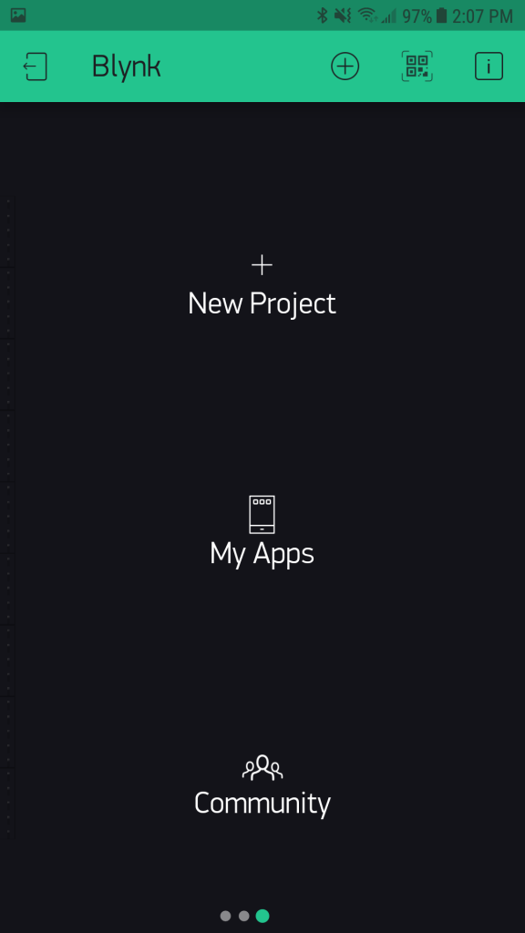
Blynk – Set up
Step 1: Get Everything Prepare
Download the Blynk app, available on Android or iOS store.
Step 2: Installing Blynk library on raspberry pi
First we have to install git on the raspberry pi.
Next we are going to use Git to clone the Blynk project to the Pi
git clone https://github.com/blynkkk/blynk-library.git

Slide 23
Blynk – Set up (cont.)
Step 3: Navigate to the newly created Blynk folder:
cd blynk-library/linux
You can list the contents of the folder to make sure everything is there using the command:
ls
Step 4 – Make Clean:
Now we use the make clean command to set it up for the Raspberry Pi:
Step 5: Build
We will now build our program so that it can be run.
make clean all target=raspberry
./build.sh raspberry

Slide 24
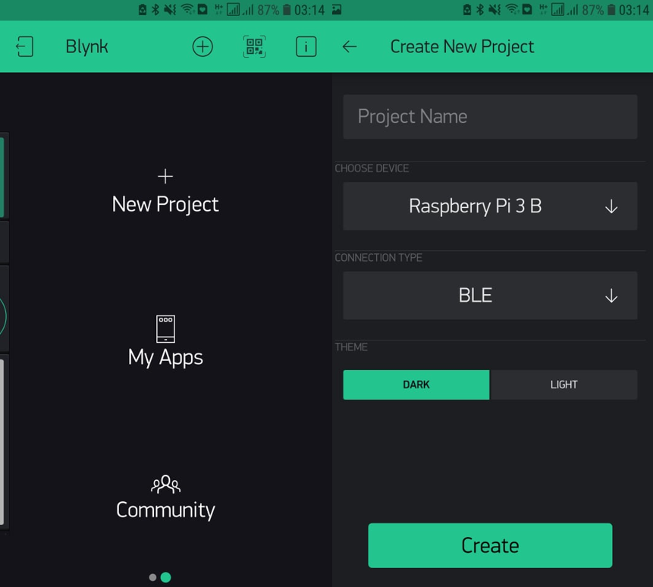
Blynk – Set up (cont.)
Step 6: Create a Blynk project:
Within the Blynk app, click “New Project” and select “Raspberry Pi 3 B” from the list and select your method of internet connection. Once you create the project, an email will be sent with the authorization token for your project. This is the key that allows your phone to communicate with your Raspberry Pi by way of the Blynk server so keep that handy.

Slide 25
Blynk – Set up (cont.)
Step 7: Test the connection:
Hit the Play button in the top right corner of the App. Don’t worry if you have no controls added. You should see a little device icon in the top bar, with a notice saying it isn’t connecting.
Jump over to the Raspberry Pi and type the following into the terminal
sudo ./blynk --token=2432a5113a448fcb45e664a1934215
Step 8 Design Your App
As an example, we will be turning on an LED and reading a Pushbutton connected to the Raspberry Pi.
On your phone app: Click the “Stop” button in the top right corner of the app. Now click anywhere in the workspace. This will show the “Widget Box” full of all the interesting bits that are available for your App.

Slide 26
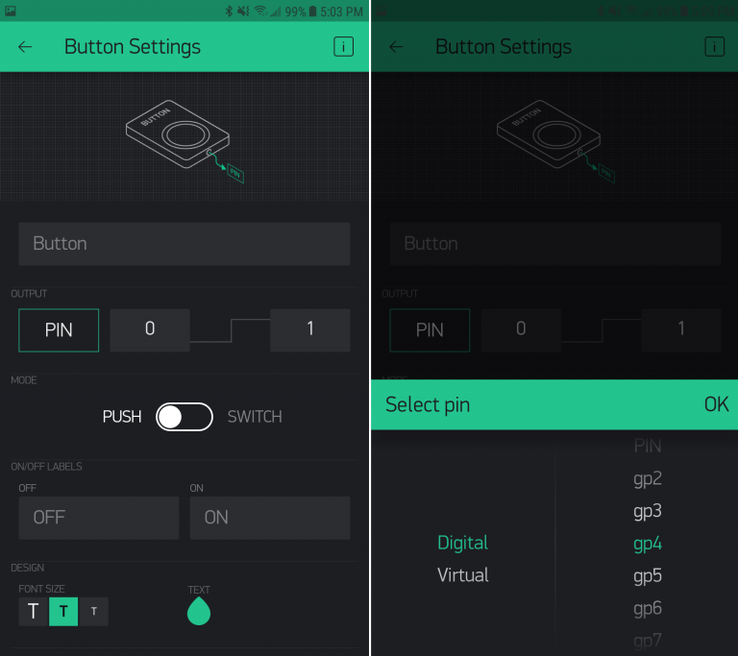
Blynk – Set up (cont.)
Step 9: Configure App Controls
Click on the button we have just added – this will open a configuration window for that specific button. We need to tell it what to do on the Raspberry Pi; so in this case we are going to trigger Raspberry Pi digital pin GPIO04. To do this we are going to change the “Pin” setting. Click “PIN” and use the boxes to select “Digital” and “gp4”; click OK when you are finished . You can change the type of button from “Momentary” to “On/Off” depending on your preference. Hit the back button on your device to return to the workspace.

Slide 27
Blynk – Set up (cont.)
Step 10:Wire It Up
The LED should be connected to GPIO04 on the Pi as shown using a 330 ohm resistor. The button should be connected to pin GPIO17. Once it matches the attached image, boot the Pi up again.
Step 11: Try Lighting The LED
With everything wired up, we can now start the program on the Pi once again to remotely switch our breadboard LED on and off.
Start by navigating back to the Blynk project folder in the terminal:
and then start Blynk:
cd blynk-library/linux
sudo ./blynk --token=qlxUAUH_0vIwxvcb2W06yIsTKeE5c281

Slide 28
Blynk – Set up (cont.)
Step 12: Sending Back Data From The Pi
The basic “sketch” is already running whenever we run Blynk – so any changes require us to shutdown Blynk, modify the main.cpp file, and build it again.

Slide 29
Blynk – Custom coding
Step 13: Adding custom coding
This one we are trying to use the ultrasonic sensor to send back data to the app
#define BLYNK_PRINT stdout
#ifdef RASPBERRY
#include <BlynkApiWiringPi.h>
#else
#include <BlynkApiLinux.h>
#endif
#include <BlynkSocket.h>
#include <BlynkOptionsParser.h>
static BlynkTransportSocket _blynkTransport;
BlynkSocket Blynk(_blynkTransport);
static const char *auth, *serv;
static uint16_t port;
#include <BlynkWidgets.h>
//#include <WiringPi.h>
#include <sys/time.h>

Slide 30
Blynk – Custom coding (cont.)
BLYNK_READ(V5)
{
// Define GPIO to use on Pi ( wiringPI numbers )
int GPIO_TRIGGER=4 ;
int GPIO_ECHO=5 ;
//Compensate distance from edge to sensor
int COMP_SENSOR=0 ;
//Variables used by gettimeofday
struct timeval start, stop ;
// Set pins as output and input
wiringPiSetup() ;
pinMode(GPIO_TRIGGER, OUTPUT) ;
pinMode(GPIO_ECHO, INPUT) ;
//Set trigger to False (Low)
digitalWrite (GPIO_TRIGGER, 0) ;
//200 ms delay to start
delay (200) ;
//Send 10us pulse to trigger
digitalWrite (GPIO_TRIGGER, 1) ;
delayMicroseconds (10) ;
digitalWrite (GPIO_TRIGGER, 0) ;
gettimeofday(&start, NULL) ;

Slide 31
Blynk – Custom coding (cont.)
while (digitalRead (GPIO_ECHO)==0)
{
gettimeofday(&start, NULL) ;
}
while (digitalRead (GPIO_ECHO)==1)
{
gettimeofday(&stop, NULL) ;
}
// Calculate pulse length
float TIME_DELTA, DISTANCE ;
TIME_DELTA=(stop.tv_sec-start.tv_sec) + (stop.tv_usec-start.tv_usec) ; // Distance pulse travelled in that time is time multiplied by the speed of sound (cm/s)
DISTANCE=TIME_DELTA * 34000 ; // That was the distance there and back so halve the value
DISTANCE=DISTANCE / 2 ; // Add compensation
DISTANCE=DISTANCE + COMP_SENSOR ; // This command writes result to Virtual Pin (10) and convert usec to sec
Blynk.virtualWrite(5, DISTANCE / 1000000) ; }

Slide 32
Blynk – Custom coding (cont.)
void setup()
{
Blynk.begin(auth, serv, port);
}
void loop()
{
Blynk.run();
}
int main(int argc, char* argv[])
{
parse_options(argc, argv, auth, serv, port);
setup();
while(true)
{
loop();
}
return 0;
}

Slide 33
References
Getting started with blynk on the raspberry pi 3+. BC Robotics. (n.d.). https://bc-robotics.com/tutorials/getting-started-blynk-raspberry-pi-3/.
Murphy, M. (2021, January 8). What is BLUETOOTH technology? Bluetooth 5.0 Vs Bluetooth 4.1 and 4.2. Medium. https://sharmin3086.medium.com/what-is-bluetooth-technology-bluetooth-5-0-vs-bluetooth-4-1-and-4-2-a2d09aa0cdce.
Ray, B. (n.d.). Bluetooth vs. Bluetooth low Energy (LE): What's the difference? Bluetooth Vs. Bluetooth Low Energy (LE): What's The Difference? https://www.link-labs.com/blog/bluetooth-vs-bluetooth-low-energy.
Sgerevini, Pavel, & Minc. (2015, July 15). HC-SR04 ultrassonic sensor on raspberry pi + BLYNK. Blynk Community. https://community.blynk.cc/t/hc-sr04-ultrassonic-sensor-on-raspberry-pi-blynk/1034.

