Slide 1
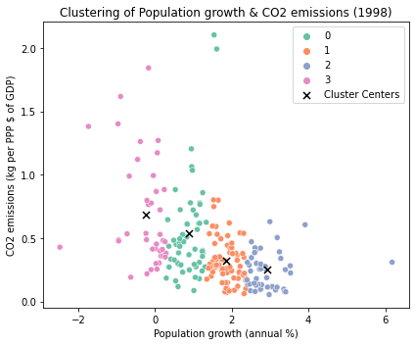
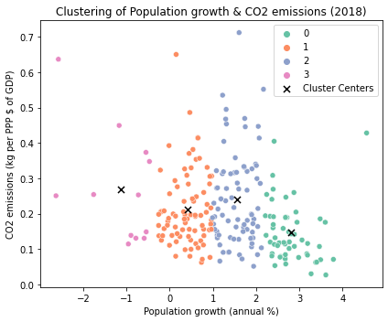
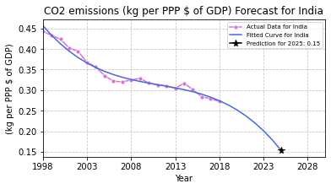
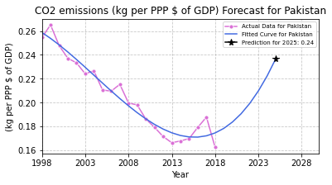
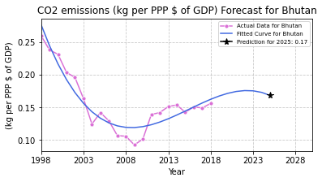
Insights Beyond: Anticipating CO2 Emission Trends (2025)
Abstract:
Introduction:
This report presents a comprehensive analysis of environmental indicators, focusing on population growth and CO2 emissions for selected countries. The code encompasses data processing, clustering analysis, and time-series forecasting. Key highlights include optimal cluster determination using the elbow method, visualization of clustering results, and the application of polynomial regression for CO2 emission forecasting. The report presents valuable perspectives on the intricate interplay between population dynamics and environmental impact, providing a comprehensive view of the selected countries' environmental trends.
As the global community faces the urgent challenge of environmental sustainability, this report delves into the intricate interplay between population growth and CO2 emissions across various nations. Through a robust methodology encompassing data preprocessing, clustering, and predictive modelling, we dissect historical trends and offer foresight into potential trajectories. By focusing on selected countries, we aim to unveil nuanced patterns, identify key drivers, and provide actionable insights. This report serves as evidence of the impactful role played by data-driven analysis in crafting well-informed strategies for a more environmentally conscious and resilient world.
Spatial Analysis: Clustering Patterns (1998 & 2018)
The clustering analysis reveals distinct patterns in the relationship between population growth and CO2 emissions for the years 1998 and 2018. Applying k-means clustering, we identify clusters of countries with similar profiles in these indicators. The scatter plots visualize the clustered data, with cluster centers denoting characteristic coordinates. Notably, the differentiation among clusters provides valuable insights into the environmental dynamics of each group. This information aids in targeted analysis and decision-making, offering a comprehensive understanding of countries' environmental footprints and facilitating proactive measures for a sustainable future.
Forecasting Future Trends: CO2 Emissions (2025)
The forecasted CO2 emissions for India, based on polynomial regression, depict a gradual increase, reaching an estimated value of approximately [prediction] kg per PPP $ of GDP by 2025. The historical data and the fitted curve showcase the trajectory of actual emissions, emphasizing the need for sustainable policies to curb this upward trend.
The CO2 emissions forecast for Pakistan illustrates historical trends and predicts a potential downturn in 2025. This suggests a possible positive impact of environmental measures or technological advancements on reducing emissions, emphasizing the importance of sustainable practices for a greener future.
Bhutan, in contrast, demonstrates a more controlled trajectory, with forecasted emissions remaining relatively stable. This insight underscores bhutan's potential as a model for sustainable development practices, presenting opportunities for collaborative efforts in the region to address environmental concerns.
Conclusion:
In conclusion, the clustering analysis unveils distinct patterns in population growth and CO2 emissions, providing a snapshot of country dynamics in 1998 and 2018. The identified clusters offer insights into commonalities and variations among nations. Additionally, the polynomial regression forecasts for CO2 emissions in selected countries depict potential future trends. These insights can inform targeted policies and interventions for sustainable development and environmental management. The combined analytical approach contributes a comprehensive understanding of historical trends and supports evidence-based decision-making for a resilient and sustainable future.
GitHub Link:
https://github.com/vyjayanthik/ADS1_Clustering
Dataset Link:
https://data.worldbank.org/topic/climate-change
Name : Vyjayanthi Kadapanatham Student Id : 22075064

