Slide 1

VISA APPROVAL PREDICTION USING MACHINE LEARNING
Presented by :
Team no:CSE-041
18UK1A0567-CH.SRICHANDHANA
18UK1A0578-K.DHEERAJ
18UK1A05C0-V.VAMSHI
18UK1A05A9-A.SOWMYA

Slide 2
OUTLINE
INTRODUCTION
OBJECTIVE
DATA
MACHINE LEARNING APPROACHES
VISUALIZATION OF GRAPHS
SOFTWARE REQUIREMENTS
CONCLUSION

Slide 3
INTRODUCTION
In our project, we aim to predict the outcome of H-1B visa applications that are filed by many high-skilled foreign nationals every year. We framed the problem as a classification problem and applied Naive Bayes, SVM in order to output a predicted case status of the application. The input to our algorithm is the attributes of the applicant which will be further explained in the following parts.
H-1B is a type of non-immigrant visa in the United States that allows foreign nationals to work in occupations that require specialized knowledge and a bachelor’s degree or higher in the specific specialty [1]. This visa requires the applicant to have a job offer from an employer in the US before they can file an application to the US immigration service (USCIS). USCIS grants 85,000 H-1B visas every year, even though the number of applicants far exceed that number [2].
The selection process is claimed to be based on a lottery, hence how the attributes of the applicants affect the final outcome is unclear. We believe that this prediction algorithm could be a useful resource both for the future H-1B visa applicants and the employers who are considering to sponsor them. a. Overview To predict the outcome of H-1B visa applications based on the attributes of the applicant ,several machine learning models like SVM, Naive Bayes can be used. Finally, this can be integrated to a web appliction. 1.2 Purpose Our aim from the project is to make use of pandas, matplotlib , & seaborn libraries from python to extract the libraries for machine learning for the Visa prediction.
Secondly, to learn how to hyper tune the parameters using grid search cross validation for the NaiveBayes machine learning algorithm. And in the end, to predict whether the Visa applicant can replay the Visa or not using voting ensemble techniques of combining the predictions from multiple machine learning algorithms and withdrawing the conclusions.

Slide 4
OBJECTIVE
Many applications are filed for h1b visa every year.The USCIS-US immigration service weighs certain aspects to approve the visa.
The objective is to explore what kind of data is provided and to determine the most important factors that contribute to an applicants visa approval.
And to select the appropriate model to predict the probability of visa approval.

Slide 5
DATA
H1b visa petitions from 2011 to 2016 dataset for predicting visa approval.3002458 rows with 11 columns.
CASE_STATUS,
EMPLOYER_NAME,
SOC_NAME'
JOB_TITLE,
FULL_TIME_POSITION,
PREVAILING_WAGE,
YEAR,
WORKSITE,
lon,
lat.
Data source:Internet

Slide 6
DATA VISUALIZATION
Data visualization is where a given dataset is presented in a graphical format. It helps the detection of patterns, trends and correlations that might go undetected in text-based data. Understanding your data and the relationship present within it is just as important as any algorithm used to train your machine learning model. Machine learning models will perform poorly on data that wasn’t visualized and understood properly.
To visualize the dataset we need libraries called Matplotlib and Seaborn. The Matplotlib library is a Python 2D plotting library that allows you to generate plots, scatter plots, histograms, bar charts etc.

Slide 7
MODEL BUILDING
There are several Machine learning algorithms to be used depending on the data you are going to process such as images, sound, text, and numerical values. The algorithms that you can choose according to the objective that you might have it may be Classification algorithms are Regression algorithms.
Example:
1.Linear Regression
2.Logistic Regression
3. Random Forest Regression / Classification.
4. Decision Tree Regression / Classification.
You will need to train the datasets to run smoothly and see an incremental improvement in the prediction rate.
On our Dataset , we have applied Logistic and Random Forest Regression to predict the Accuracy.

Slide 8
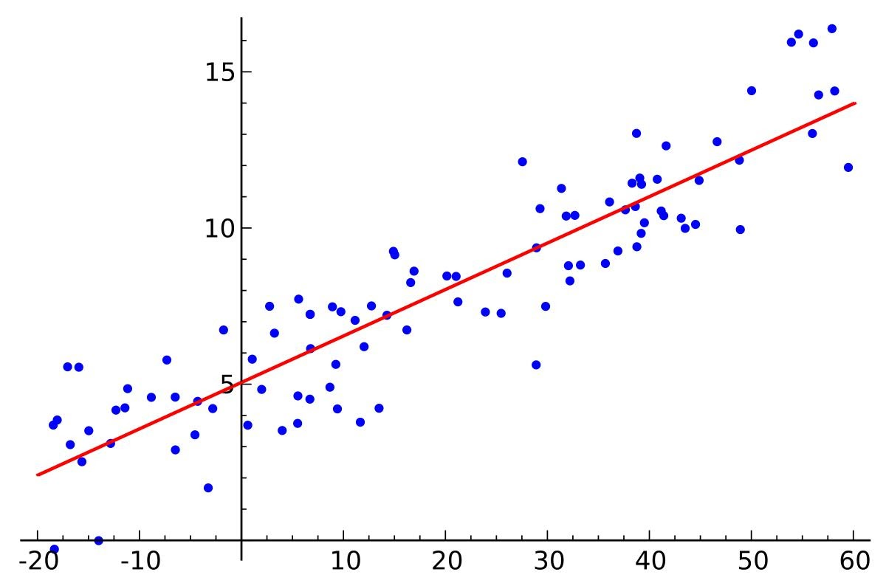
MACHINE LEARNING ALGORITHMS:
Random Forest :
A random forest is a machine learning technique that’s used to solve regression and classification problems. It utilizes ensemble learning, which is a technique that combines many classifiers to provide solutions to complex problem
LOGISTIC REGRESSION :
Logistic regression is a supervised learning classification algorithm used to predict the probability of a target variable. The nature of target or dependent variable is dichotomous, which means there would be only two possible classes. ... Mathematically, a logistic regression model predicts P(Y=1) as a function of X.
Logistic Regression is used when the dependent variable (target) is categorical.
For example To predict whether an email is a spam (1) or (0)
Whether the tumor is malignant (1) or not (0)
Out of all the algorithms Logistic Regression got the highest accuracy .
So, We build a model with Logistic regression.

Slide 9
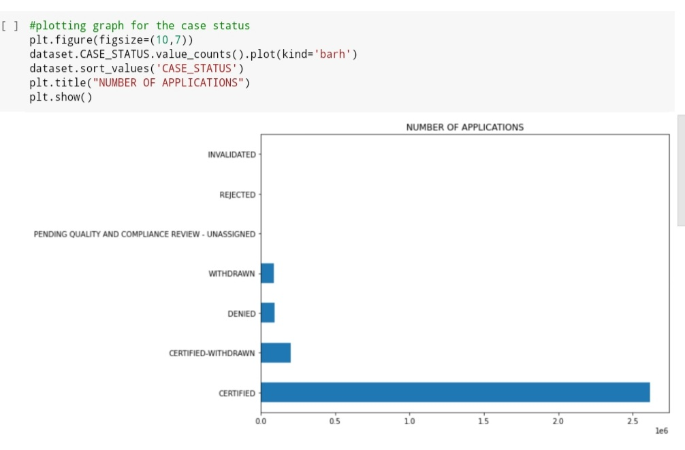
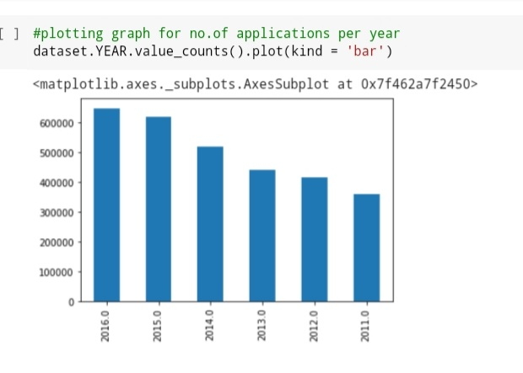
VISUALIZATION OF GRAPHS
It is the way of representing the data in 2-D form.It gives colorred visual summary of the data

Slide 10
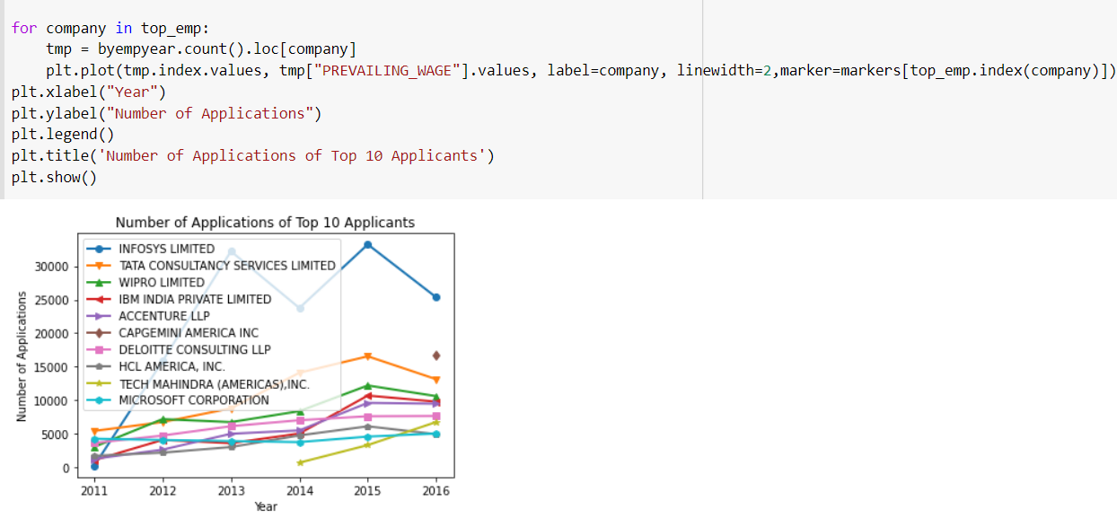

Slide 11
SOFTWARE REQURIMENTS:
Google colab
Anaconda navigator
Jupyter notebook
Machine learning tools: pandas,
numpy,
matplotlib,
scikitlearn,
seaborn

Slide 12

CONCLUSION:
In this project we have presented the prediction for visa approval Prediction using machine learning
For the better results we used logistics regression algorithm and proved with 87% accuracy

