Slide 1
Detecting Variable Length Anomaly Patterns in Time Series Data
GVHD: PGS.TS Dương Tuấn Anh
HV: Ngô Duy Khánh Vy (13073042)
Notes:
Bảng tóm tắt dữ liệu, trinh bay day du phan doan + them phan so sanh voi Leng
+ so sanh voi DTW truoc
Dinh nghia so nguyen duong
Chieu dai trung bình
Thoi gian thuc thi giam
+
-------------
+hinh thuc:

Slide 2
Content
Introduction
Proposed Algorithm
Experimental Evaluation
Conclusion
Q&A

Slide 3
Introduction
A time series is a sequence of data points made over a continuous time interval
Anomaly Patterns are subsequences that do not conform to a well deﬁned notion of normal behavior
Application areas that explore such time series anomalies include fault diagnostics, intrusion detection, fraud detection, auditing and data cleansing

Slide 4
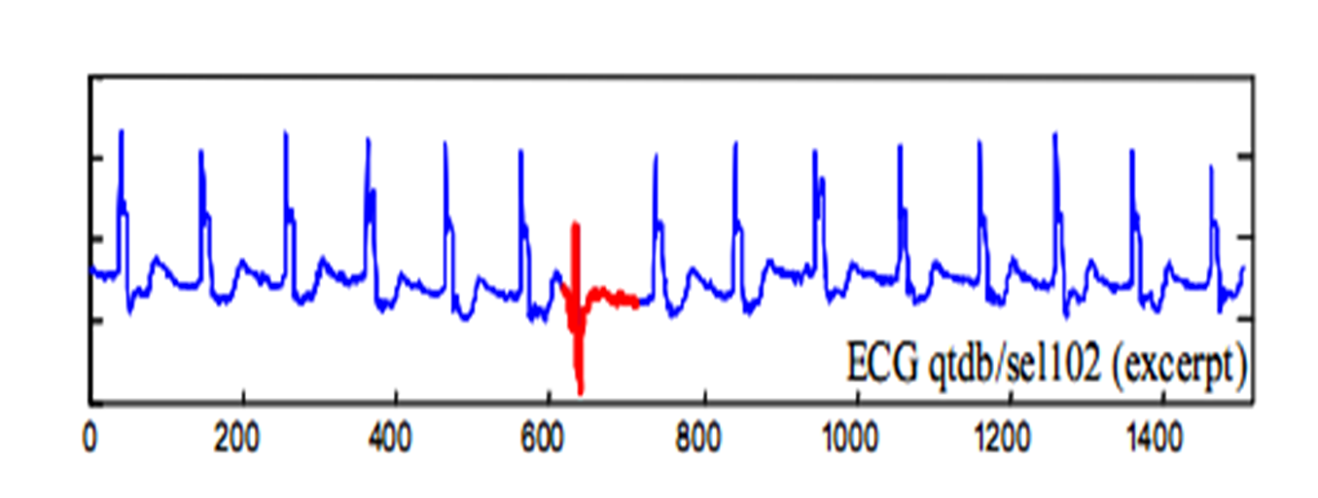
Introduction
unusual subsequence in time series data

Slide 5
Introduction
The problem to find anomaly subsequences in time series data is challenging.
There are many algorithms developed to find anomaly patterns such as HOT SAX, WAT,…But they require the user to specify the length of anomaly as an input parameter.
The exact lengths of the unusual subsequence are vary and are often unknown.

Slide 6
HOT SAX
Find discord of length n.
A discord is a subsequence which have largest nearest neighbor distance.
Use heuristic to improve brute-force.
Distance function: Euclid distance.
Notes:
J. Lin, E Keogh, S. Lonardi, B. Chiu. A Symbolic Representation of Time Series, with Implications for Streaming Algorithms. Proceedings of the 8th ACM SIGMOD, pp. 2-11, 2003.

Slide 7
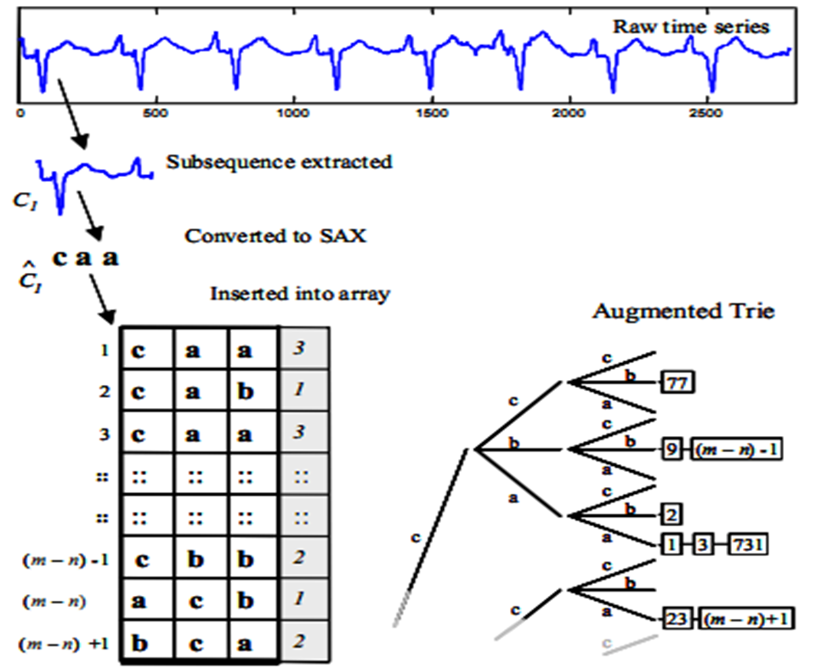
HOT SAX

Slide 8
Algorithm of Leng et al
In 2008, Leng et al proposed an algorithm to find variable length anomaly patterns without knowing in advance the lengths of them.
The method includes 2 phase:
Phase 1: use quadratic regression model to segment time series. Regression function is defined as quadratic polynomial f(t) = β₀ + β₁t + β₂t²,
Phase 2: Calculate anomaly factors for the subsequences base on DTW distance and show abnormal patterns.
Time consuming because of DTW distance.

Slide 9
Definitions
k-distance of a pattern: Given a positive integer k, a pattern set D and a pattern P ∈ D, the k-distance of P, denoted as k-dist(P), is defined as the distance between P and a pattern Q ∈ D such that.
i) For at least k patterns Q₁ ∈ D it holds that Dist(P, Q₁) ≤ Dist(P, Q).
ii) For at most k-1 patterns Q₁ ∈ D \{Q} it holds that Dist(P, Q₁) < Dist(P, Q).
Anomaly factor: For any pattern set D and a pattern P ∈ D, K-dist(D) denotes all k-dist of patterns, anomaly factor of pattern P defined as the ratio of k-dist(P) to median(K-dist(D)).

Slide 10
Proposed Algorithm
Based on method proposed by Leng et al
Use Homothetic Transformation + Modified Euclidean Distance instead of DTW
The Algorithm have 2 phase:
+ Phase 1: Segment the time series into variable length subsequences.
+ Phase 2: Calculate anomaly factor for each subsequence to extract anomaly patterns and then merge anomaly patterns which overlap each other

Slide 11
Phase 1: Segmentation
Quadratic regression (proposed by Leng et al),
Segmentation base on important extreme points.

Slide 12
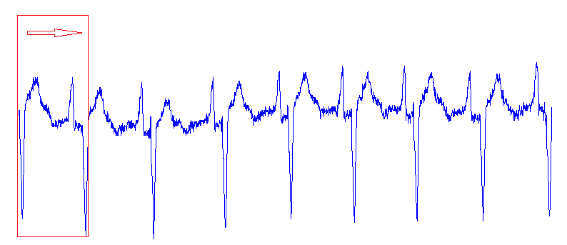
Quadratic regression
Two parameters: e₁ and e₂

Slide 13
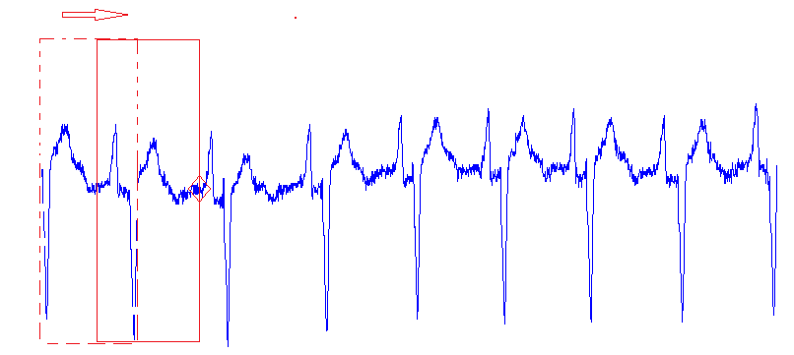
Quadratic regression

Slide 14
Extreme points
Based on the concepts of Important Extreme Points, proposed by Pratt and Fink (2002)
Parameter:
- Compression rate: R > 1
- Lower bound for the distance two extracted extreme points: min_length.

Slide 15
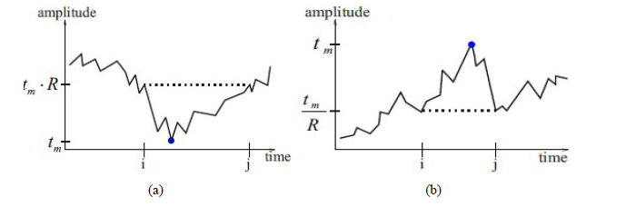
Extreme points

Slide 16
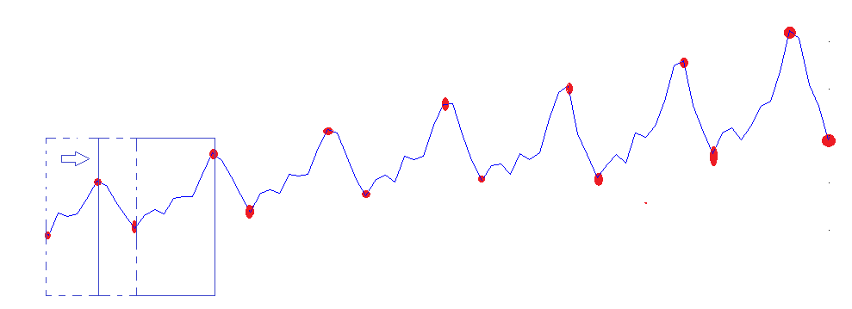
Extreme points

Slide 17
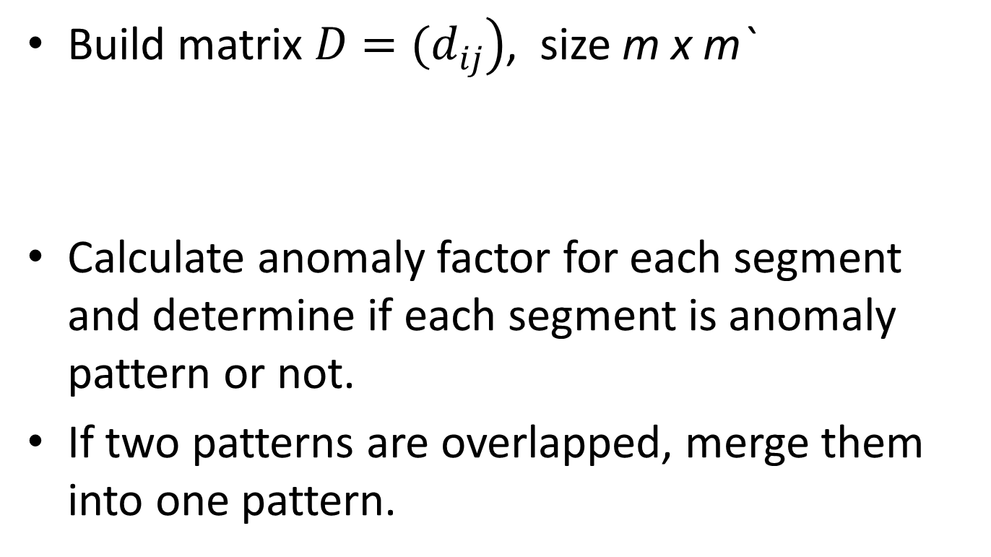
Phase 2: Find anomaly patterns
Build matrix $\left.D=(d_{ij}\right)$, size m x m`
Calculate anomaly factor for each segment and determine if each segment is anomaly pattern or not.
If two patterns are overlapped, merge them into one pattern.

Slide 18
Find l_{upper} and l_{lower}
Propose parameter r (small value in 0.1..0.3)
l_{upper} = ⎣l_{avg}(1+ r)⎦
l_{lower} = ⎡l_{avg}(1- r)⎤
l_{avg} is mean length of the subsequences.
L_{upper} = (l_{upper} ≤ l_{max} )? l_{upper} : l_{max}
L_{lower} = (l_{lower} ≥ l_{min})? l_{lower} : l_{min}
Leng et al chose l_{upper} = l_{max} and l_{lower} = l_{min}

Slide 19
Calculate the similar between two subsequence
To reduce computation time for Dist function
Use Homothetic Transformation + Modified Euclidean Distance instead of DTW

Slide 20

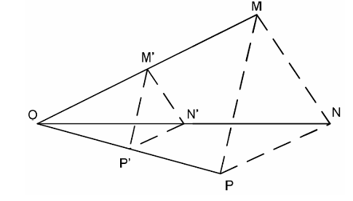
Homothetic Transformation
A Homothetic Transformation with center O and ratio k transforms the point M to the point M’ such that
Notes:
Chuoi thoi gian

Slide 21
Homothetic Transformation
Apply to time series, a homothetic transformation transforms a time series T of length n (T = {y1, y2, …, yn}) to time series T’ of length n’ by performing the following steps.
First, compute Y_MAX = MAX (y1, …, yn), Y_MIN = MIN(y1, …,yn ).
Second, set the center I of homothetic transformation with the coordinates X_C = n/2, Y_C = (Y_MAX + Y_MIN)/2. Next, perform the homothetic transformation with the center I and the ratio n’/n

Slide 22
Modified Euclidean Distance
Minimum Euclidean Distance between
T’ = {T’₁, T’₂,…, T’_{N}} and Q’ = {Q’₁, Q’₂,…, Q’_{N}}
Time Complexity: O(n)

Slide 23
Experimental Evaluation
VL_QR| HT: The proposed algorithm with quadratic regression
VL_EP| HT: The proposed algorithm with important extreme points.
Compare results and running time among VL_QR| HT, VL_EP| HT and HOT SAX
Compare running time between VL_QR| HT with the original algorithm proposed by Leng et al.

Slide 24
Data
In diverse domains from the UCR Time Series Data Mining Archive for discord discovery
Data | Length
ECG 108 | 17500
ECG 308 | 1300
ERP | 5000
Memory | 6875
Power Demand In Italy | 7000
Dutch Power Demand | 9000
Stock20 | 5000
TEK16 | 5000

Slide 25
Compare VL_QR| HT, VL_EP| HT and HOT SAX
To compute location difference of anomaly subsequences use:
d = |p – q|/l × 100
where p is the start position of the anomaly pattern found by proposed algorithm and q is the start position of the anomaly pattern found by HOT SAX and l is it’s length

Slide 26
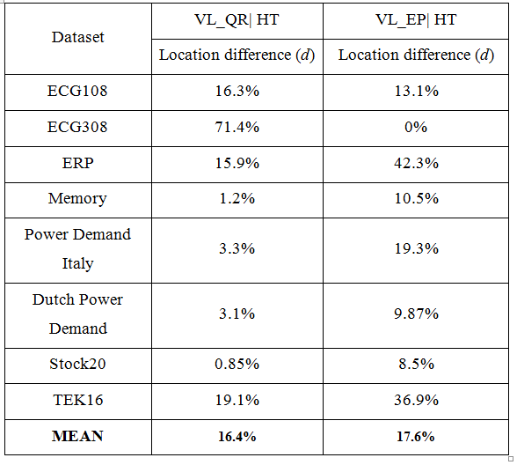
Positions of anomaly patterns detected by VL_QR|HT and VL_EP|HT and HOT SAX

Slide 27
Positions of anomaly patterns detected by VL_QR|HT and VL_EP|HT

Slide 28
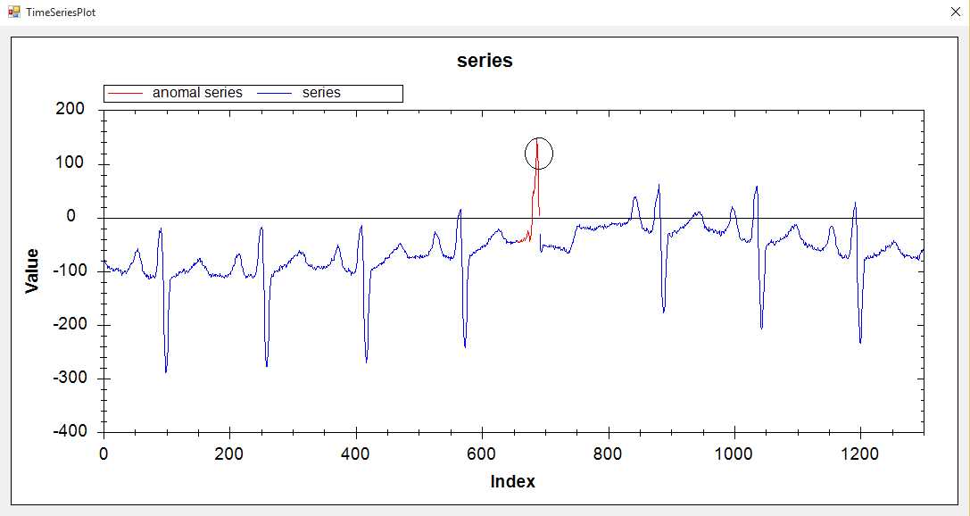
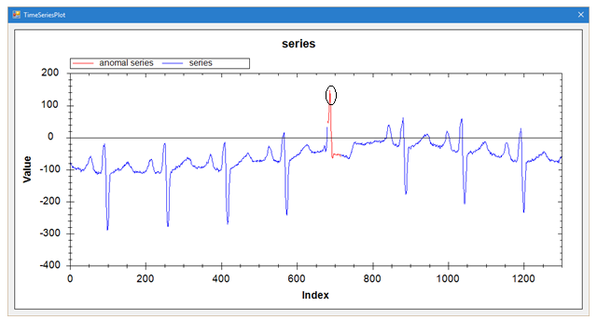
ECG 308: VL_QR|HT vs HOT SAX(35)

Slide 29
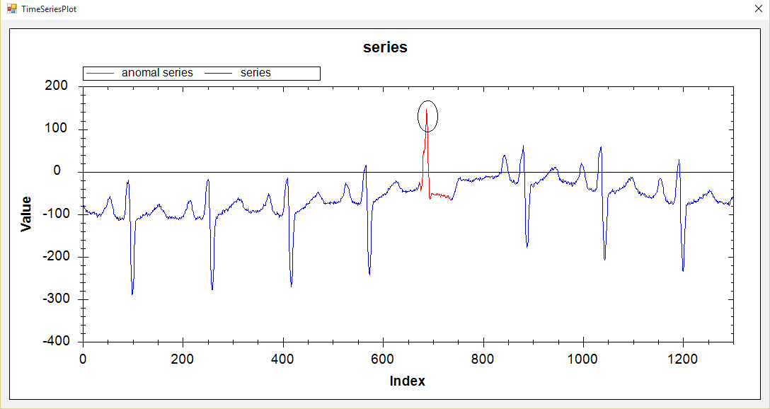
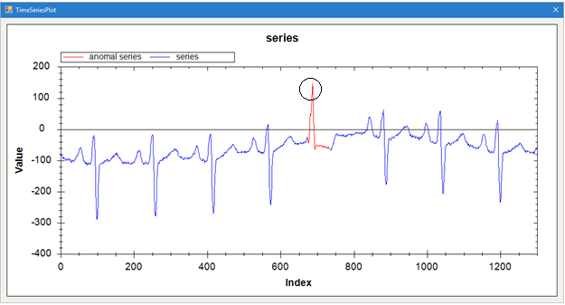
ECG 308: VL_EP|HT vs HOT SAX(62)

Slide 30
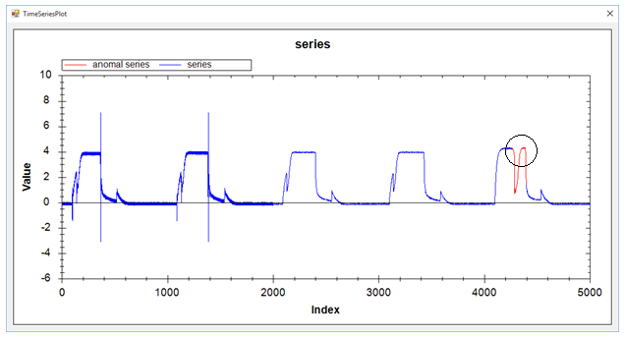
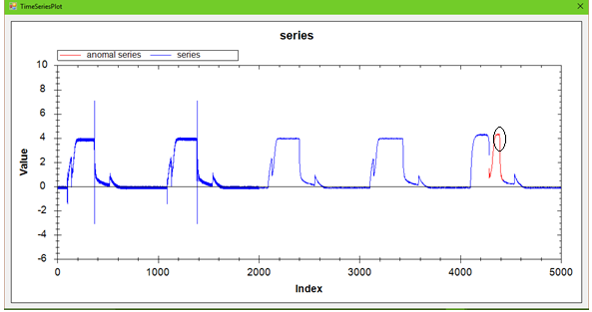
TEK16: VL_QR|HT vs HOT SAX(136)

Slide 31
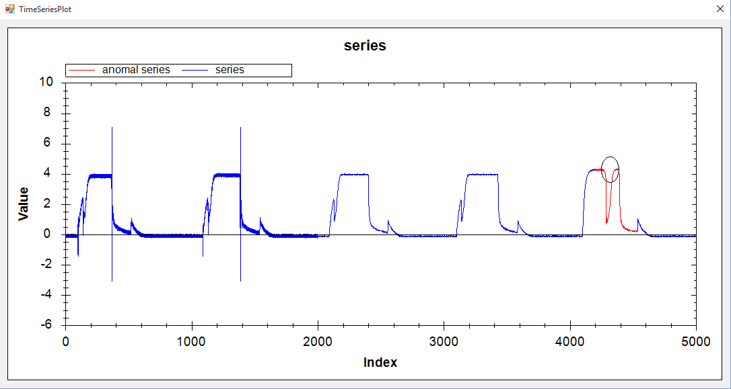
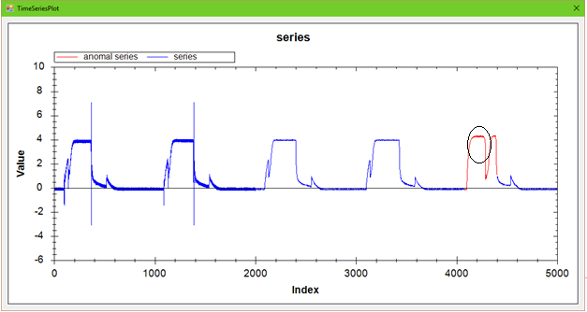
TEK16: VL_EP|HT vs HOT SAX(328)

Slide 32
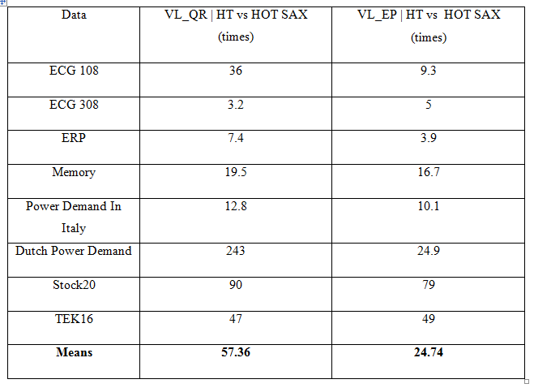
Running time among VL_QR|HT, VL_EP|HT and HOT SAX

Slide 33
Running time between VL_QR|HT and Original Algorithm

Slide 34
Conclusion
VL_QR|HT and VL_EP|HT bring out a remarkable improvement for the original algorithm in time efficiency without compromising anomaly detection accuracy.
Experimental results on eight datasets demonstrate these algorithms outperform the VL_QR|DTW in time efficiency.
Not easy to estimate the regression error threshold ε₁ and the non-self match threshold ε₂ in the segmentation phase of VL_QR|HT.
Not easy to find the R in VL_EP|HT.
Future work: apply some more advanced method of time series segmentation which is easy to find suitable parameters

Slide 35
References
E. Keogh, J. Lin, and A. Fu, “HOT SAX: efficiently finding the most unusual time series subsequence”, Proc. of 5th ICDM, Houston, Texas, pp. 226–233, 2005.
E. Keogh, www.cs.ucr.edu/~eamonn/discords/ (accessed on January 24 - 2015).
M. Leng, X. Chen and L. Li, “Variable length methods for detecting anomaly patterns in time series”, Proc. of Int. Symposium on. Computational Intelligence and Design (ISCID'08), Vol. 2, 2008.
K. B. Pratt and E. Fink, “Search for patterns in compressed time series”, International Journal of Image and Graphics , vol. 2, no. 1, pp. 89-106, 2002.
H. Sakoe and S. Chiba, “Dynamic programming algorithm optimization for spoken word recognition”, IEEE Trans. Acoustics, Speech, and Signal Proc., vol. ASSP-26, pp. 43-49, 1978.
C. D. Truong, H. N. Tin, D. T. Anh, “ Combining motif information and neural network for time series prediction”, Int. Journal of Business Intelligence and Data Mining, vol. 7, no. 4, pp. 318-339, 2012.

Slide 36
Q & A
Thank you!

Slide 39
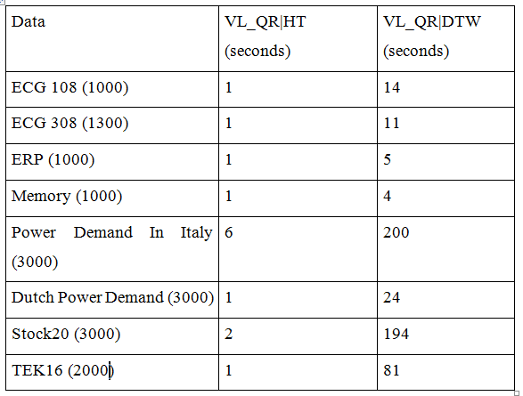
Running time between VL_QR|HT and Original Algorithm

Slide 40
Parameters between VL_QR|HT and VL_EP|HT

Slide 41
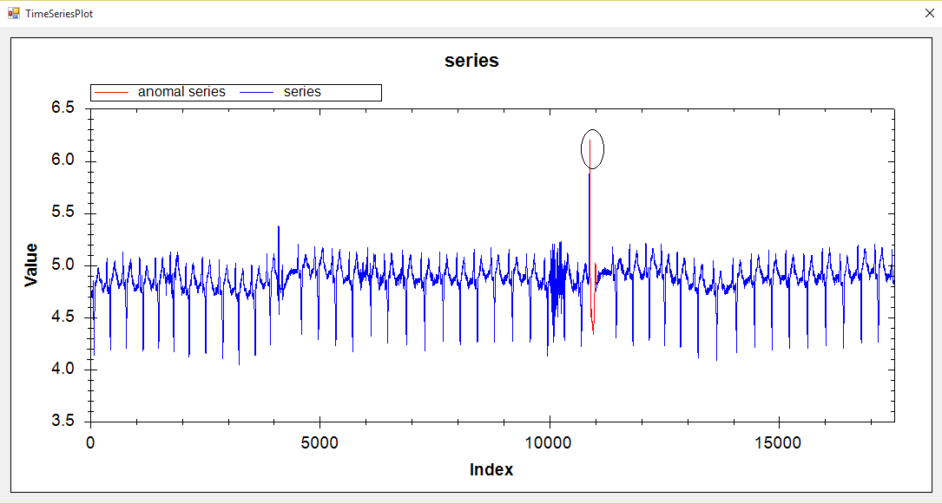
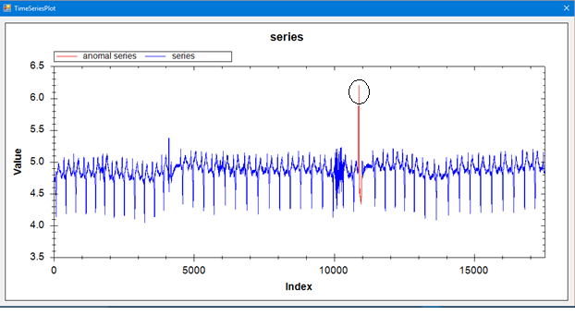
ECG 108: VL_QR|HT vs HOT SAX(135)

Slide 42
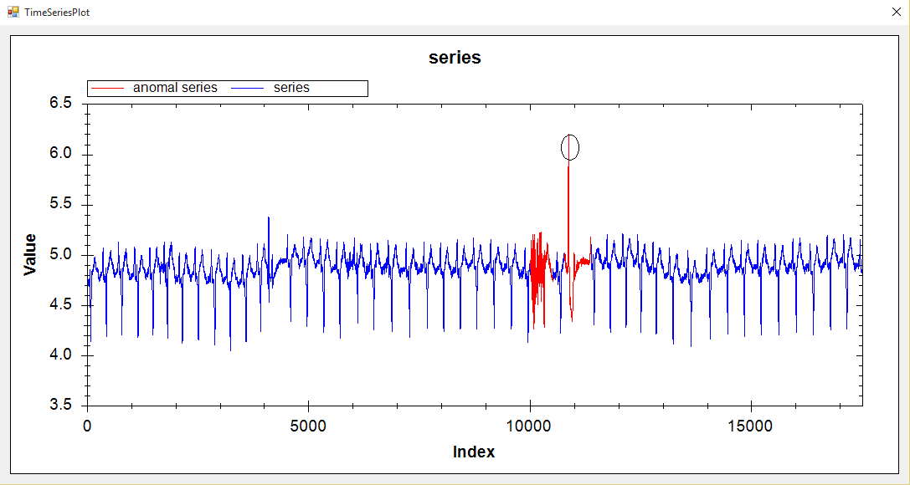
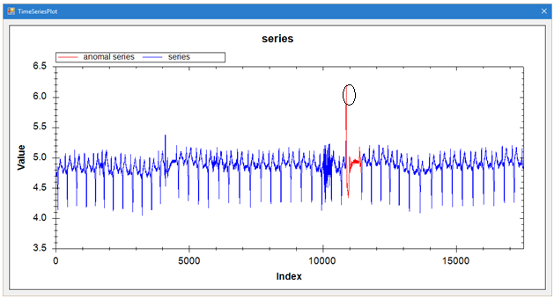
ECG 108: VL_EP|HT vs HOT SAX(588)

Slide 43
ECG 308: VL_QR|HT vs HOT SAX(35)

Slide 44
ECG 308: VL_EP|HT vs HOT SAX(62)

Slide 45
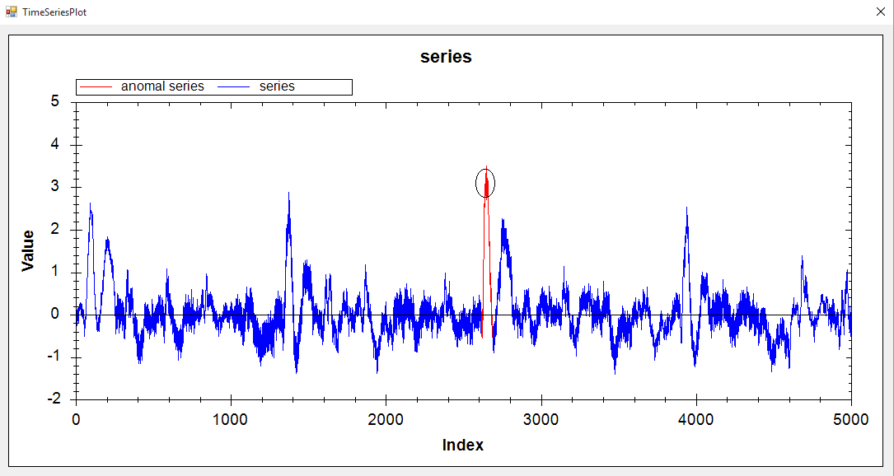
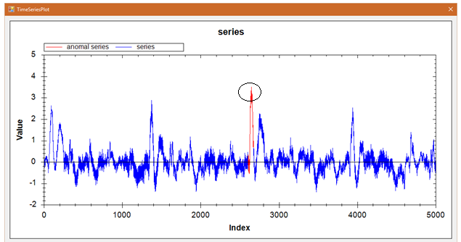
ERP: VL_QR|HT vs HOT SAX(69)

Slide 46
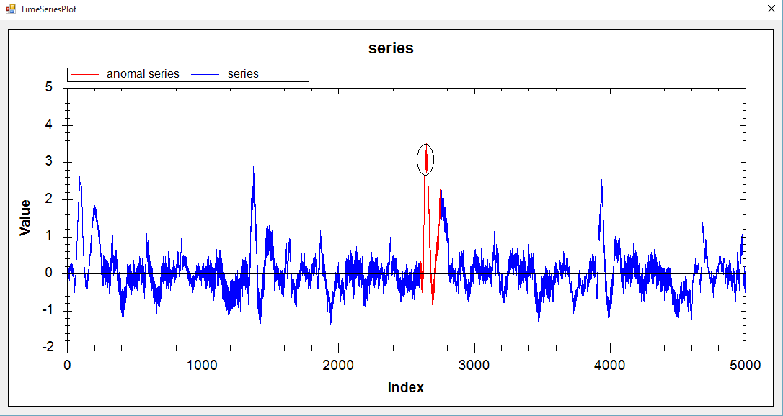
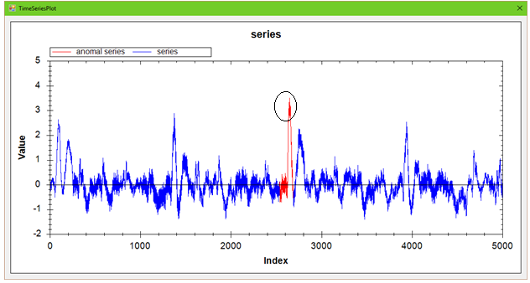
ERP: VL_EP|HT vs HOT SAX(149)

Slide 47
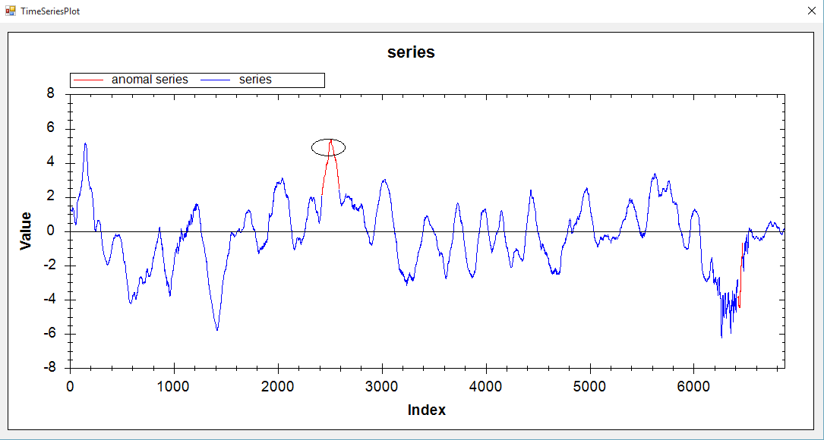
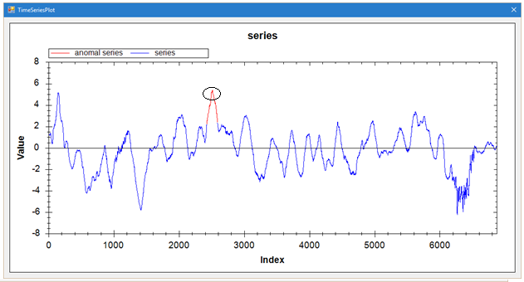
Memory: VL_QR|HT vs HOT SAX(165)

Slide 48
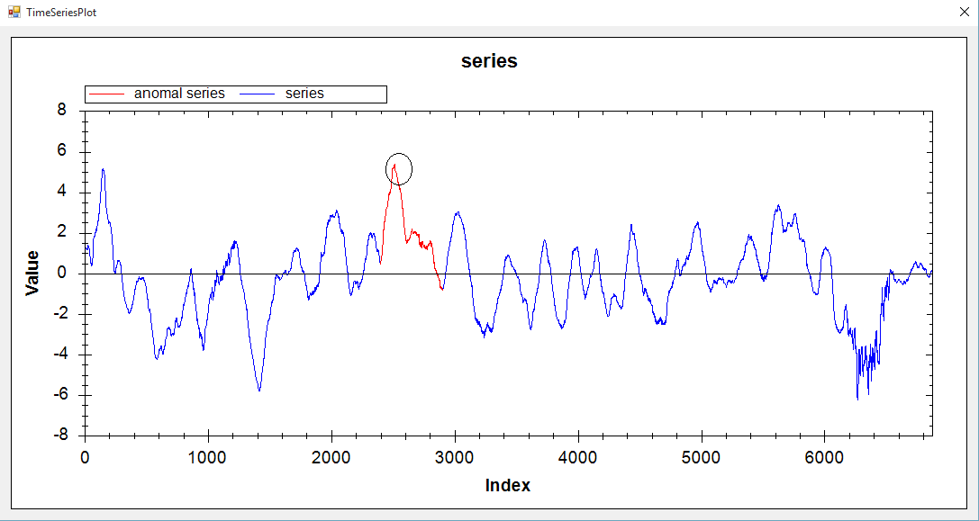
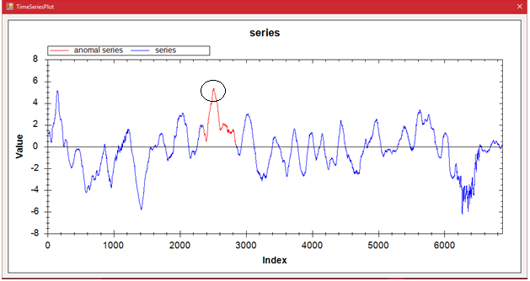
Memory: VL_EP|HT vs HOT SAX(504)

Slide 49
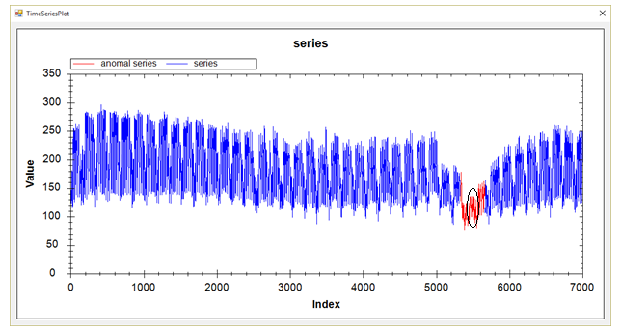
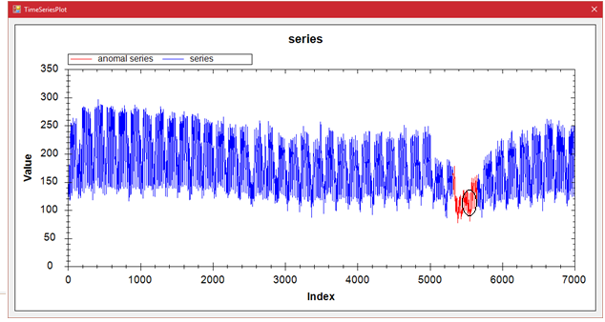
PDItalia: VL_QR|HT vs HOT SAX(332)

Slide 50
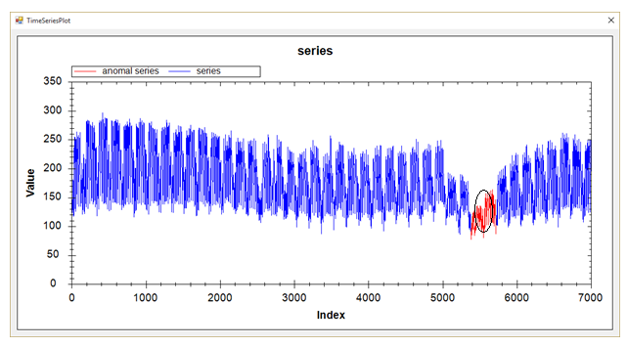
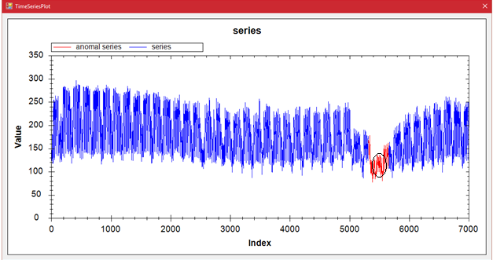
PDItalia: VL_EP|HT vs HOT SAX(336)

Slide 51
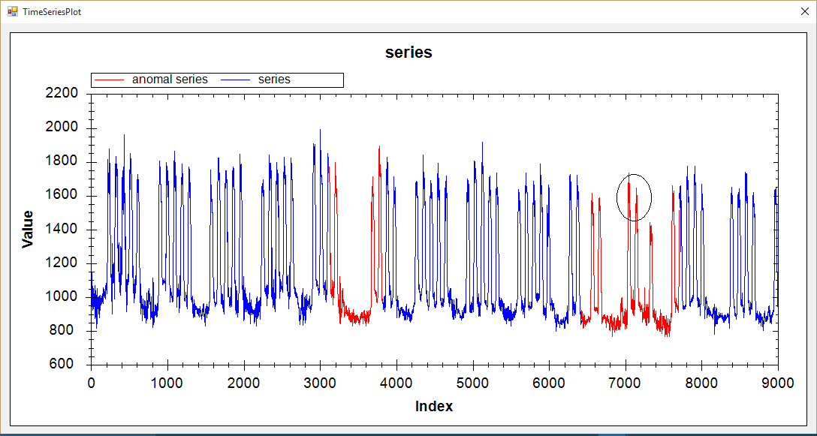
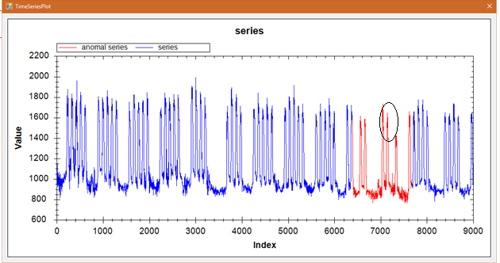
DPDem: VL_QR|HT vs HOT SAX(1285)

Slide 52
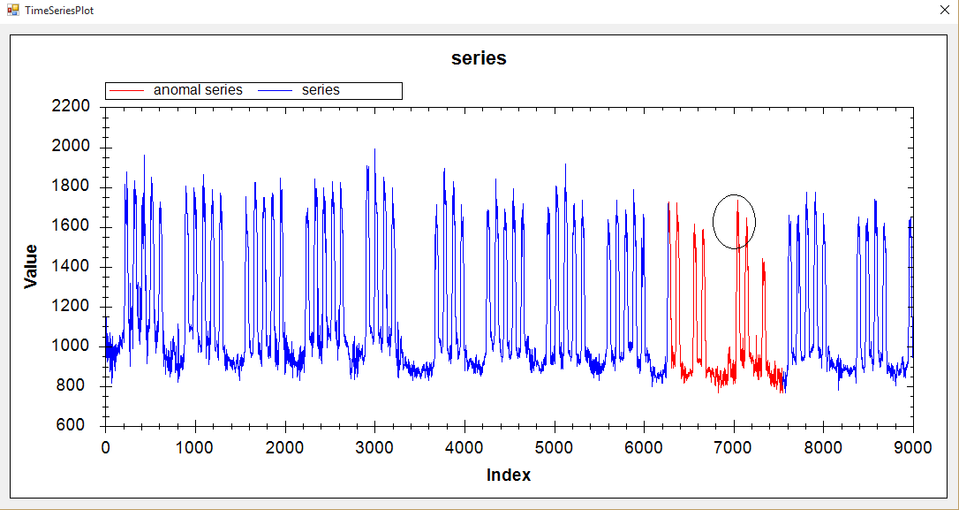
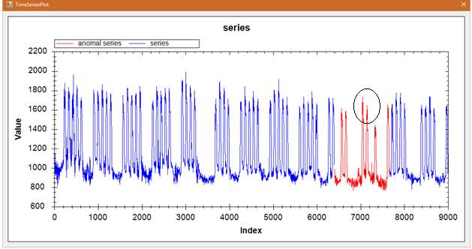
DPDem: VL_EP|HT vs HOT SAX(1267)

Slide 53
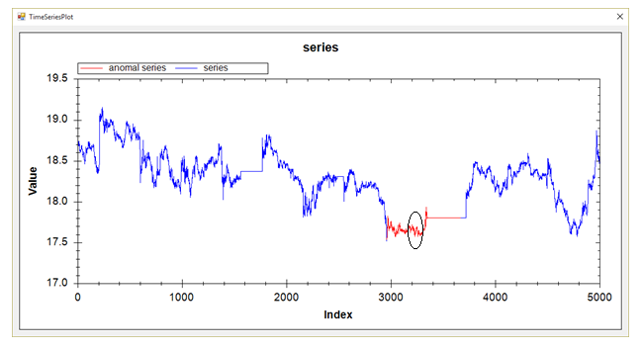
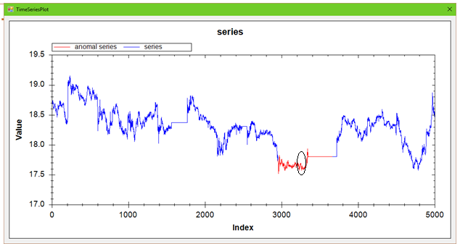
Stock20: VL_QR|HT vs HOT SAX(706)

Slide 54
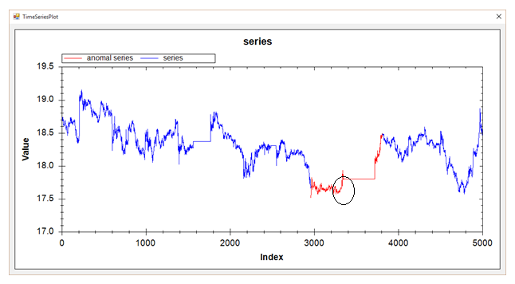
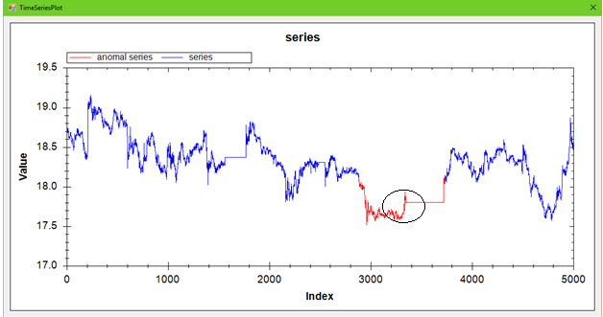
Stock20: VL_EP|HT vs HOT SAX(849)

Slide 55
TEK16: VL_QR|HT vs HOT SAX(136)

Slide 56
TEK16: VL_QR|HT vs HOT SAX(328)

Slide 57
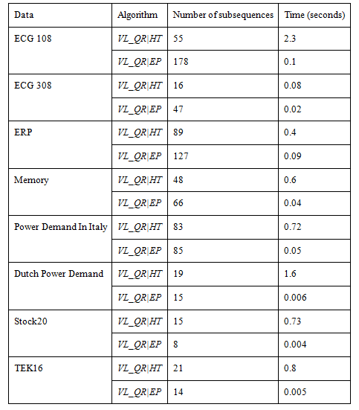
Segmentation

Slide 58
IEP
i = FIND-FIRST-TWO
if i < n and T[i] > T[1] then i = FIND-MIN(i)
while i < n do i = FIND-MAX(i); i = FIND-MIN(i)
---------------------------------------------------------------------------------
FIND-FIRST-TWO
iMin = 1; iMax = 1; i = 2
while i < n and T[i] / T[iMin] < R and T[iMax] / T[i] < R do
if T[i] < T[iMin] then iMin = i
if T[i] > T[iMax] then iMax = i
if iMin < iMax then output(T[iMin], iMin); output(T[iMax], iMax)
else output(T[iMax], iMax); output(T[iMin], iMin)
return i

Slide 59
IEP
FIND-MIN(i)
iMin = i
while i < n and T[i]/T[iMin] < R do
if T[i] < T[iMin] then iMin = i
i = i + 1; output(T[iMin], iMin)
return i
------------------------------------------------------------------------------------
FIND-MAX(i)
Finding the first significant maximum after the i-th point
iMax = i
while i < n and T[iMax] / T[i] < R do
if T[i] > T[iMax] then iMax = i
i = i + 1; output(T[iMax], iMax); return i

Slide 61
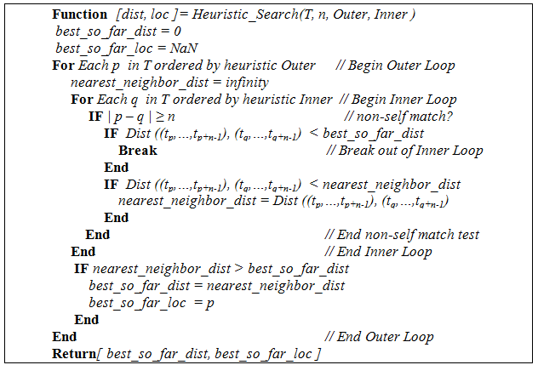
HOT SAX
Notes:
Phia sau

Slide 62
HOT SAX
Present subsequences of length n to SAX words.
Use PAA for Dimensionality reduction
Use an array and an augmented trie to embed all the SAX words

Slide 63
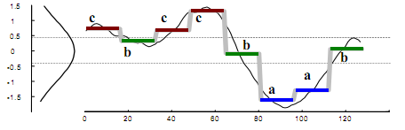
HOT SAX

Slide 64
Definitions
Time Series: A time series T = t₁, t₂, …, t_{m} is an ordered set of m real values measured at equal intervals.
Subsequence: Given a time series T of length m, a subsequence C is a sampling of length n < m of contiguous positions from T, i.e., C = t_{p}, t_{p+1}, …, t_{p+n-1}, for 1≤ p ≤ m-n+1. Sometimes, C is denoted as (s_{p}, e_{p+n-1}), where s_{p} = t_{p} and e_{p+n-1} = t_{p+n-1}.
Non-Self Match: Given a time series T, its two subsequences P of length n starting at position p and Q starting at position q, we say that Q is a non-self-match to P, if Dist(P, Q) ≥ e or |p - q| ≥ n, where e is a given value of distance threshold.

Slide 65
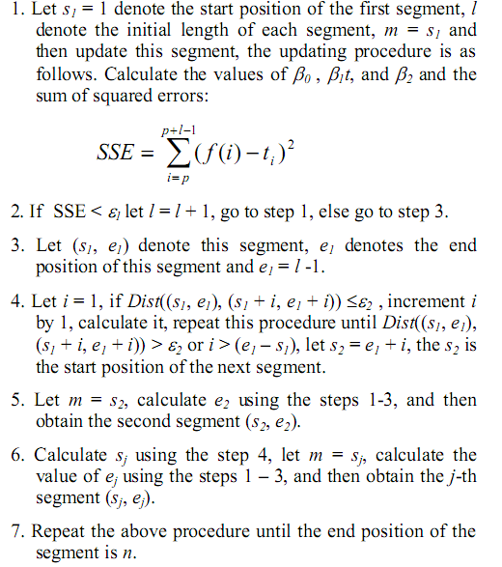
Quadratic regression

Slide 66
Extreme points
1. Extract all important extreme points of the time series T: EP = (ep₁, ep₂, …, ep_{l}) 2. For i in 1..(l-2) 2.1. Extract candidate pattern CPi(T) which is the subsequence of T that is bounded by extreme points ep_{i} and ep_{i+2}.

Slide 67
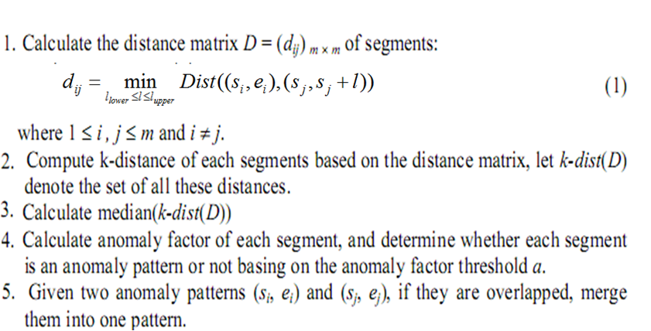
Phase 2: Find anomaly patterns

Slide 68
Experimental Evaluation
Experiments environment : Intel® Core™ 2 Duo 2.0GHz, Ram 3072MB PC
All algorithms are implemented in Microsoft Visual C# programing language

Slide 69
Homothetic Transformation

Slide 70
Homothetic Transformation

Slide 71
